Slide 1
Exercise 2 Local Binary Pattern(LBP)
負 責 人：Professor 陳朝烈
目前成員：Nat
報告日期：2023/03/29

Slide 2
Questions
Write a program
Framing out some two parts of the picture
and judge if they are similar

Slide 3
Requirements
Library
Cv2
Numpy
Matplotlib
Device spec:
Intel(R) Core(TM) i7-9700KF CPU @ 3.60GHz 3.60 GHz
Installed RAM: 64.0 GB
Python 3.9.13
Windows 10 Pro

Slide 4
Breakdown
Segmentation Algorithm
LBP (feature)
LBP feature comparison
Feature selection
ROI
Similarity measure

Slide 5
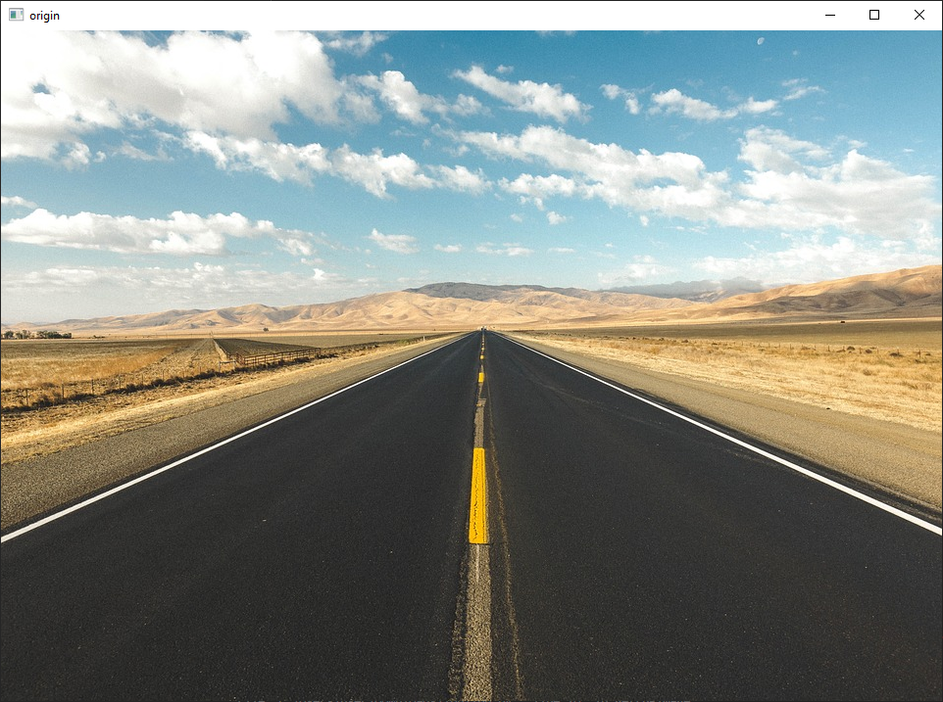
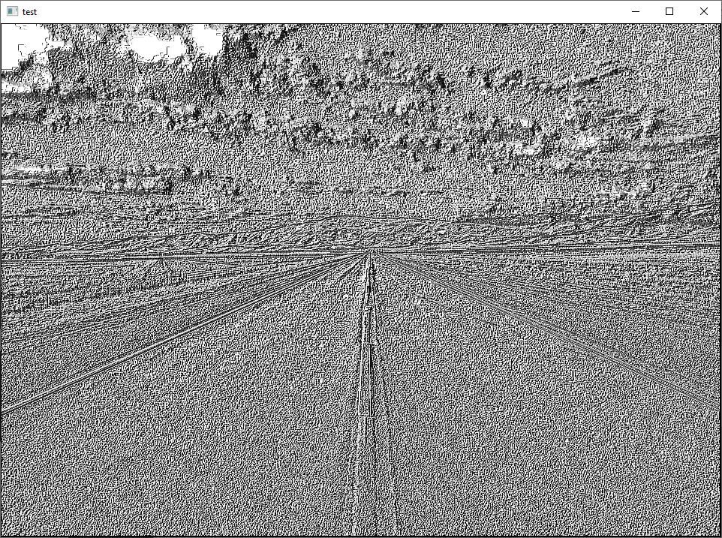
LBP (feature)

Slide 6
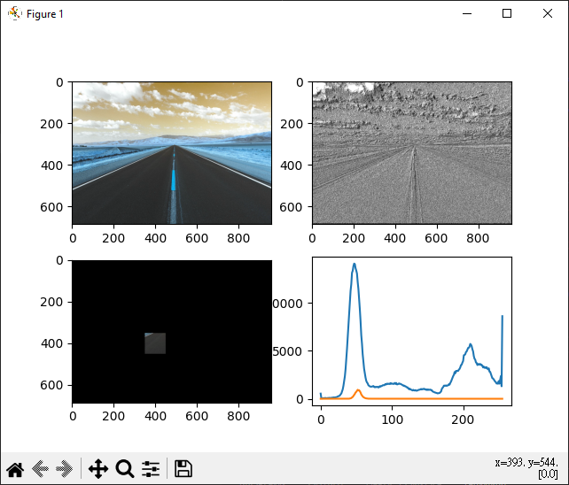

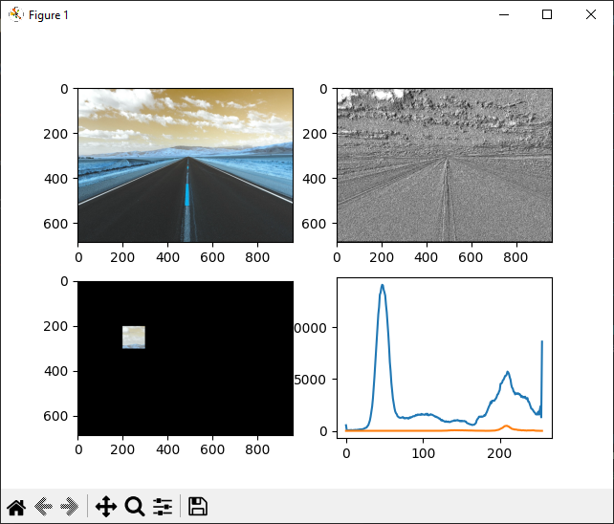
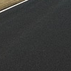
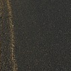

ROI
Histogram of ROI
Histogram of full img
1.
2.
3.

Slide 7
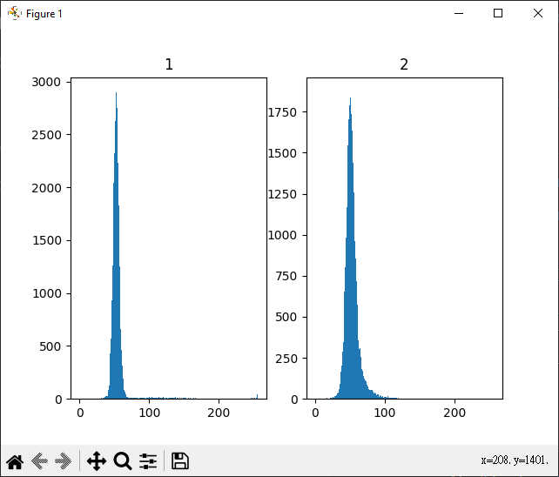
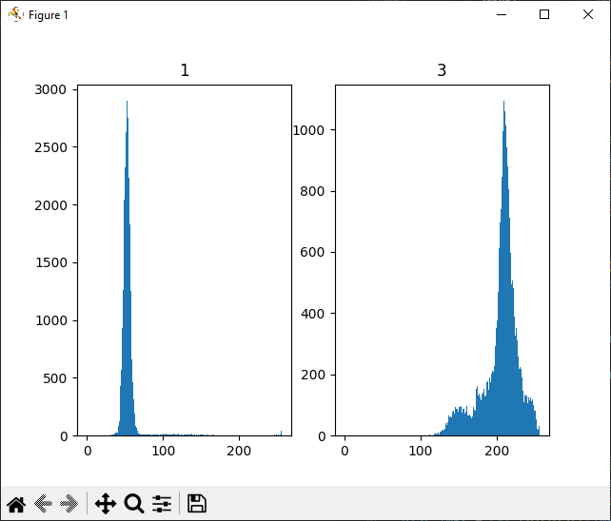
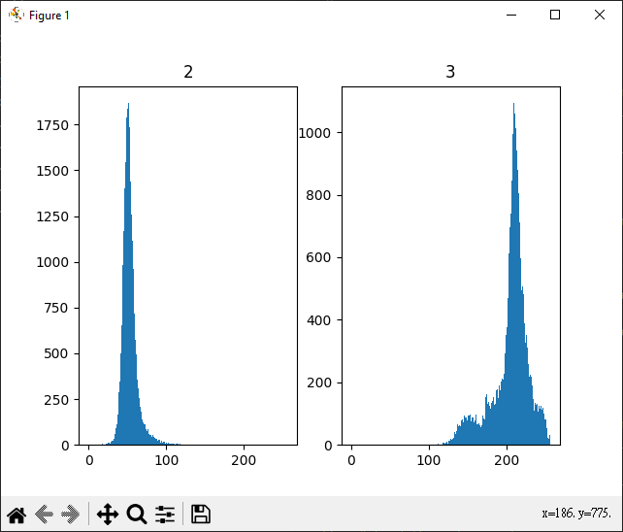



LBP feature comparison
1.
2.
3.

Slide 8
LBP feature comparison conclusion
Method/w metric value | 1 - 2 | 1 - 3 | 2 -3
Correlation Histogram Comparison | 0.009776623519029576 | -0.0028384672337355907 | -0.005903654839948933
Using Chi Square Histogram comparison | 1931.1948120421393 | 26.81437813215347 | 54.94505615765229
Using Intersection Histogram comparison | 0.33304274594411254 | 0.02087682718411088 | 0.0
Using Bhattacharyya Histogram Comparison | 0.9723298030517767 | 0.9993809182624551 | 1.0

Slide 9
Reference
1. LBP feature
arsho/local_binary_patterns: Local Binary Patterns implementation using Python3 and OpenCV (github.com)
Look at the Haralick histogram – AURlabCVsimulator
2. OpenCV: Histogram Comparison
3. The Simplest Classifier: Histogram Comparison (mpatacchiola.github.io)
(compare 2 parts similarity)

