Slide 1
Embedded Image Processing Hw1
Name: Nawisa M.
Student ID: F110112130
Instructor: Professor 陳朝烈

Slide 2
Questions
1. Example of running morphology using x86 computer
2. Compare different kernel sizes running speed (not using AVX)
3. Comparison of performance differences with or without AVX

Slide 3
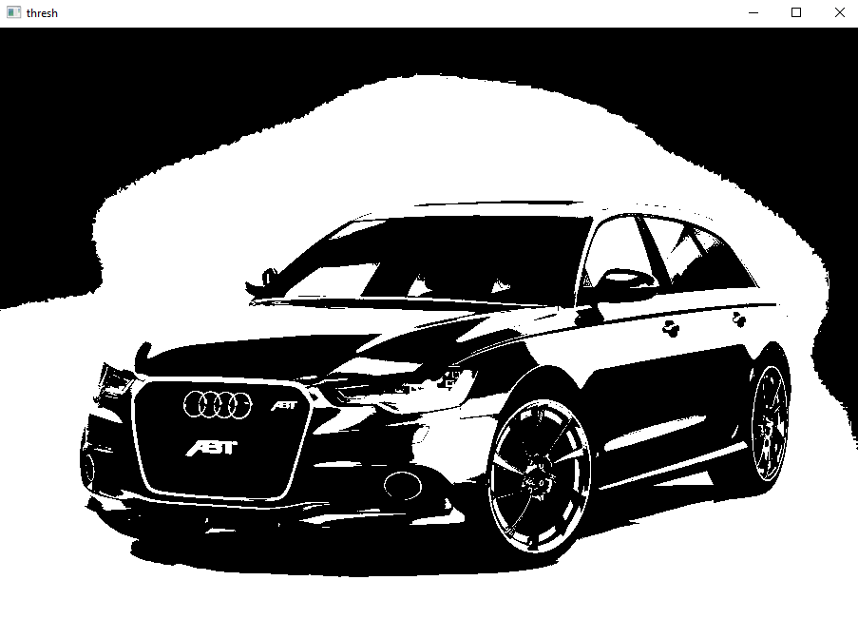
Question1
Threshold

Slide 4
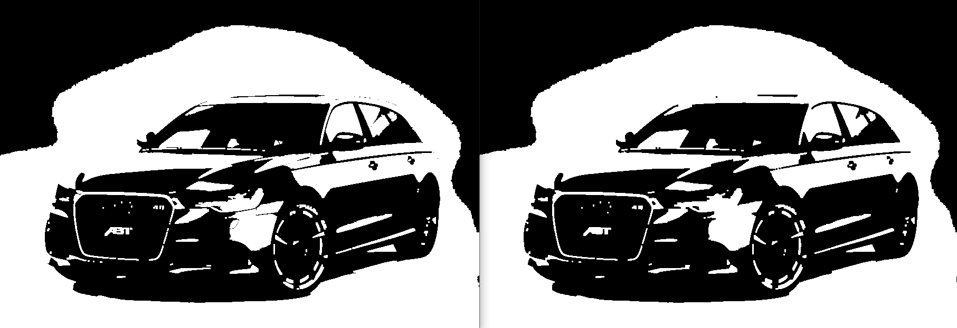



Question2
Open
Close
Kernel size | Running time (sec.)
3*3 | 0.000652
5*5 | 0.000724
7*7 | 0.000805
9*9 | 0.000918

Slide 5
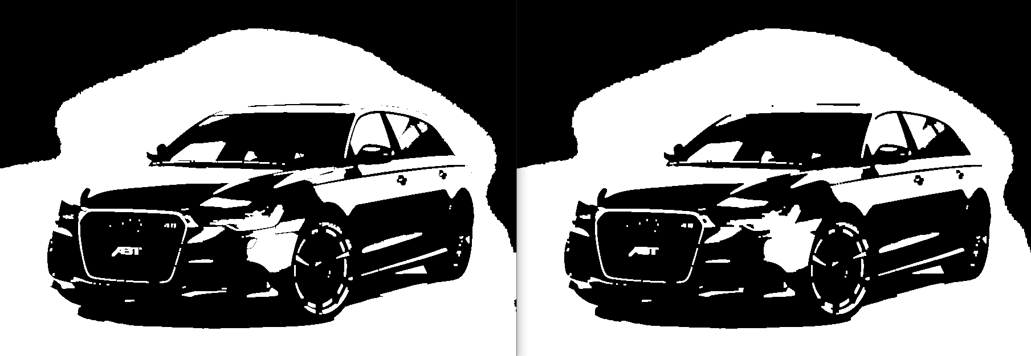

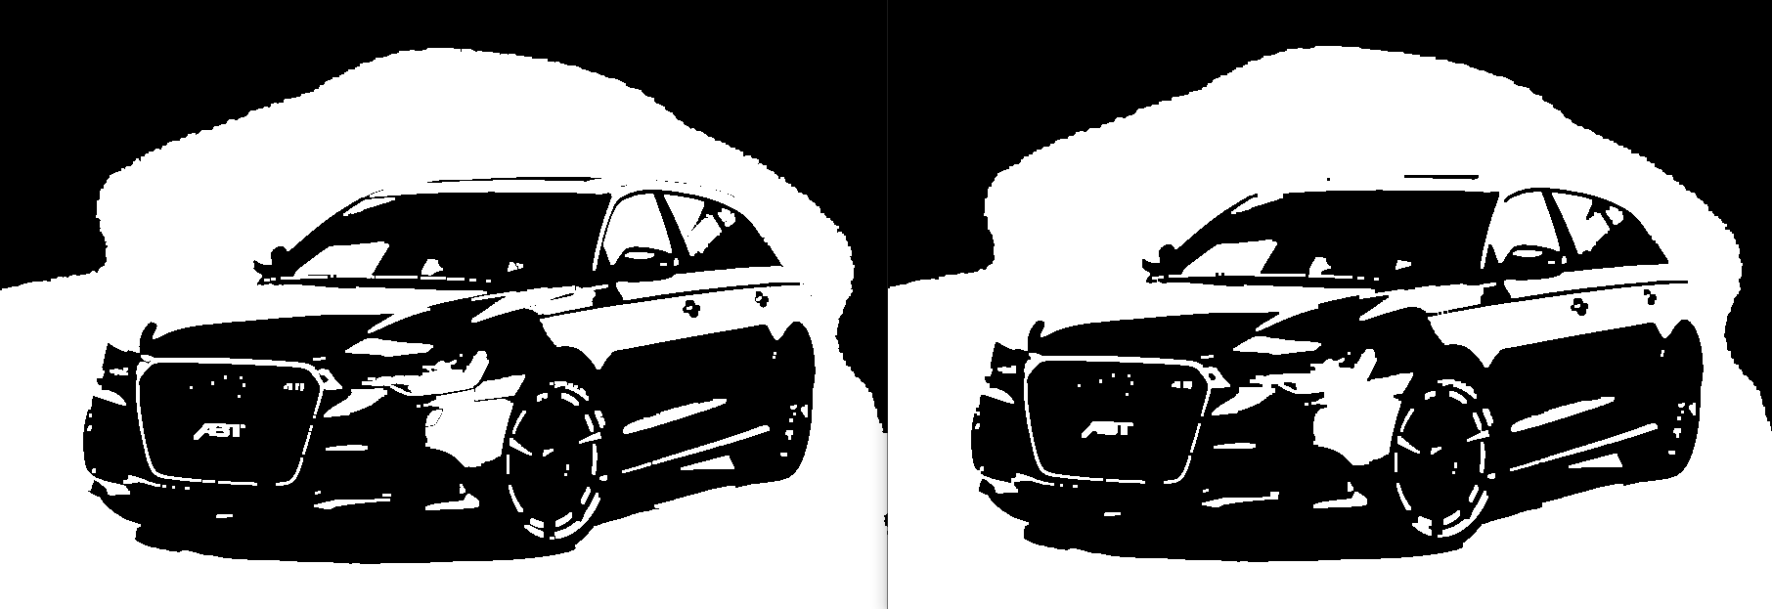

Question3
With AVX // Kernel: 3*3
With AVX // Kernel: 9*9
Open
Close
Open
Close
Without AVX // Kernel: 3*3
Without AVX // Kernel: 9*9
Open
Close
Open
Close

