Slide 1
LBP-Based Segmentation of Defocus Blur with Character Focused
Nawisa Matchacham
F110112130
6/21/2023

Slide 2
Outline
Requirement
Analysis
Results
API

Slide 3
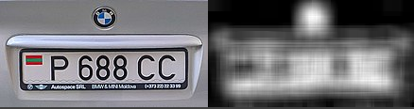
Requirement
Python 3.9.13
opencv-python 4.7.0.72
Pytesseract OCR 0.3.10
- Clear car plate image
Objective:
1. Use LBP-Based Segmentation of Defocus Blur for character segmentation .
2. Segment only the character on car plate and ignore the sharpness area that do not contain the car plate characters.
Notes:
Once we input the car plate in the system, we aim to detect only the character
The original system is focused only the deburr part, in this project we will use the help of this system
But will segment only the character out.

Slide 4
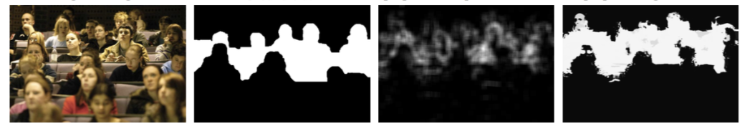
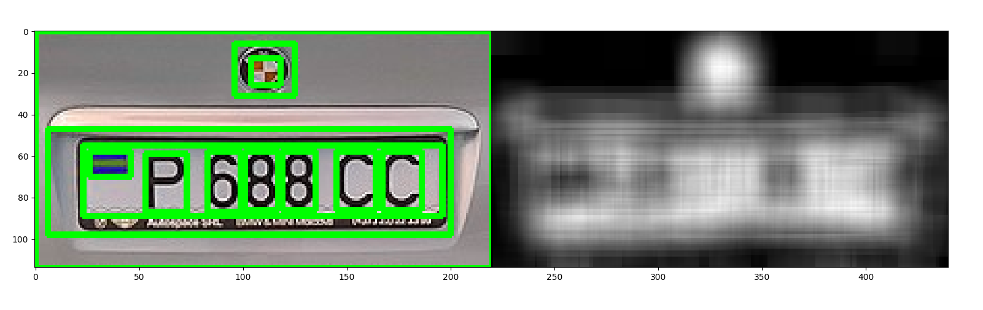
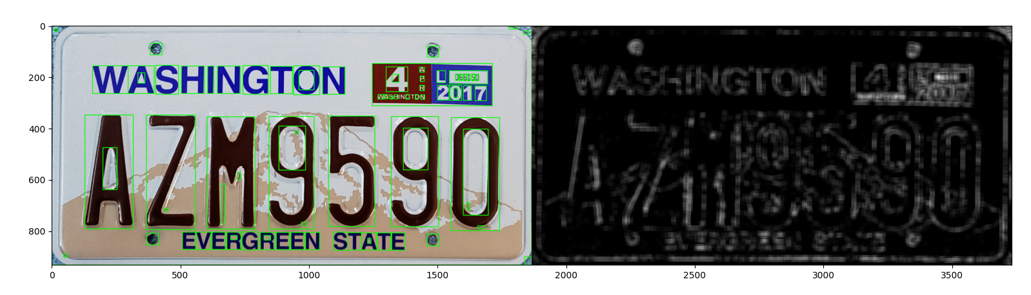
Analysis(4/26/2023)
Segment clear section of the object on the image

Slide 5
Breakdown (05/26/23)
Character detection
Morphology
Segmentation
Threshold
Sobel
ROI
Defocus on Blur
LBP focusing on sharpness

Slide 6
Breakdown (05/31/23)
Input image
Threshold
findContours
Extract and recognize characters
Morphology
ROI
Bounding Box
PyTesseract OCR
Bounding rectangle coordinates
Draw a rectangle around ROI
Calculate LBP sharpness
Normalise the sharpness map
Overlay the sharpness map of ROI
Characters output
Image output

Slide 7
Breakdown (06/07/23)
Character Segmentation
Threshold
findContours
Extract and recognize characters
Morphology
ROI
Bounding Box
PyTesseract OCR
Bounding box drawing
text
Calculate LBP sharpness
Normalise the sharpness map
Overlay the sharpness map of ROI
Characters output
Image output
Estimate Width, Height
Character Segmentation
Sharpness Character Segmentation
Notes:
The leave (final block) should show the output

Slide 8
Breakdown (06/14/23) Final
LBP-Based Segmentation of Defocus Blur with Character Focused
Character Recognition
Defocus Blur Segmentation
Contour Detection
Character Extraction and Recognition
Bounding rectangle
ROI
Datatype conversion
Thresholding operation
LBP performing
lbpSharpness
Text output
OCR
Output image
Notes:
The leave (final block) should show the output

Slide 9
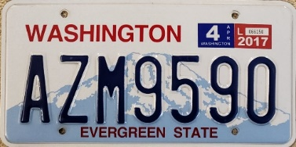
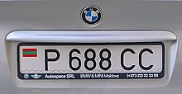
System Architecture(05/24/23)
How do character segmentation and lbp sharpness focusing combine?
(convert img to double-precision floating-point, to ensure that img data is within a consistent and standard range.
character detection and recognition
Convert image to double-precision
read the image in color format and converts to grayscale
Perform a threshold operation on input img
Input image
OpenCV
apply thresholding to convert the grayscale image into a binary image
THRESH_BINARY + THRESH_OTSU
Implement LBP
remove noise and fill gaps in the characters
Morphology
Contour detection
Compute sharpness
Find contour
Output
calculate the bounding for character region
Display ROI contour
Character extraction and recognition
w,h
ROI
Overlay the sharpness map to ROI
LBP sharpness calculation
Normalise the sharpness map
PyTesseract OCR
recognize the characters in the region
Display ROI character
calculate the LBP sharpness for each character region (roi)

Slide 10
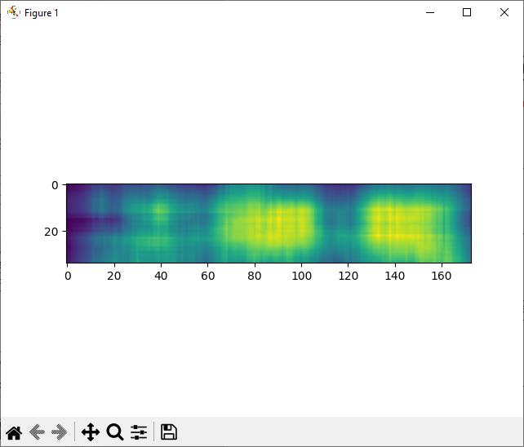
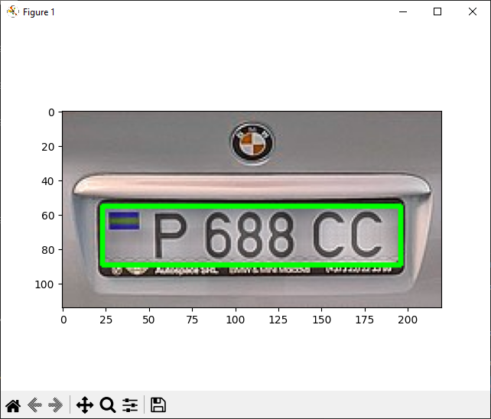
System Architecture (06/14/23)
Input image
Grayscale conversion
Morphological Opening
Find contours of license plate characters
Contour Detection
Character Extraction and Recognition
Grayscale image
Thresholding
ROI
Datatype conversion
Character Recognition using OCR
Datatype conversion
Perform LBP Sharpness
LBP-Based Sharpness Calculation
LBP performing
Recognition Character
Thresholding operation
Normalise Sharpness Map
Thresholding operation
Print Recognised Characters
Overlay the sharpness map onto the original image
Display Result image with Overlaid Sharpness Map
Notes:
Explain input and output in each block
The block name should be the same

Slide 11
System Architecture (06/21/23) Final
Input image
Grayscale conversion
Morphological Opening
Find contours of license plate characters
Contour Detection
Character Extraction and Recognition
Grayscale image
Thresholding
ROI
Datatype conversion
Character Recognition using OCR
Datatype conversion
Perform LBP Sharpness
LBP-Based Sharpness Calculation
LBP performing
Recognition Character
Thresholding operation
Normalise Sharpness Map
Thresholding operation
Print Recognised Characters
Overlay the sharpness map onto the original image
Display Result image with Overlaid Sharpness Map
Notes:
Explain input and output in each block
The block name should be the same

Slide 12
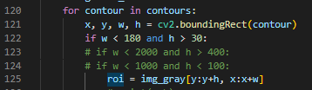
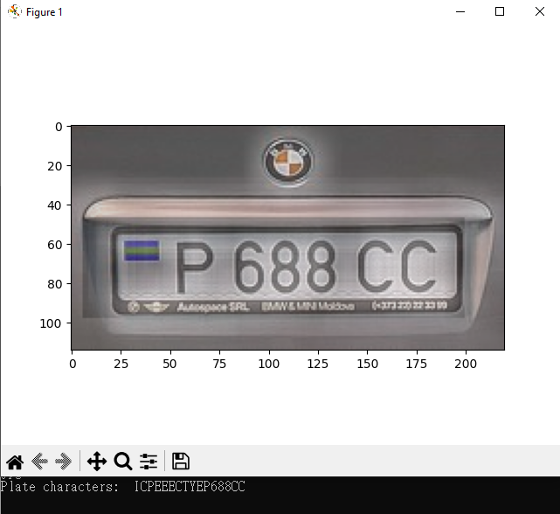
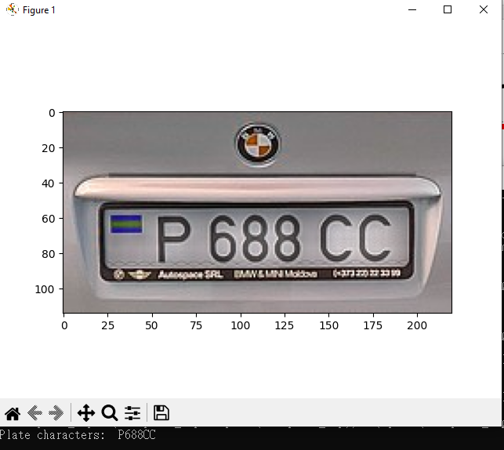
Result
The result is implemented by the range of height and width

Slide 13
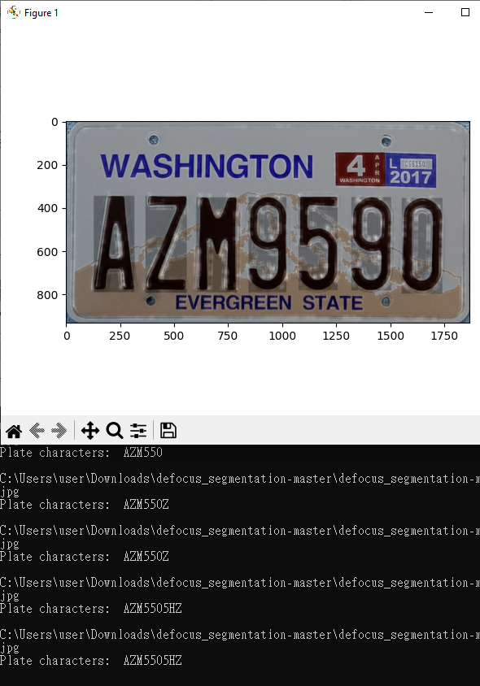
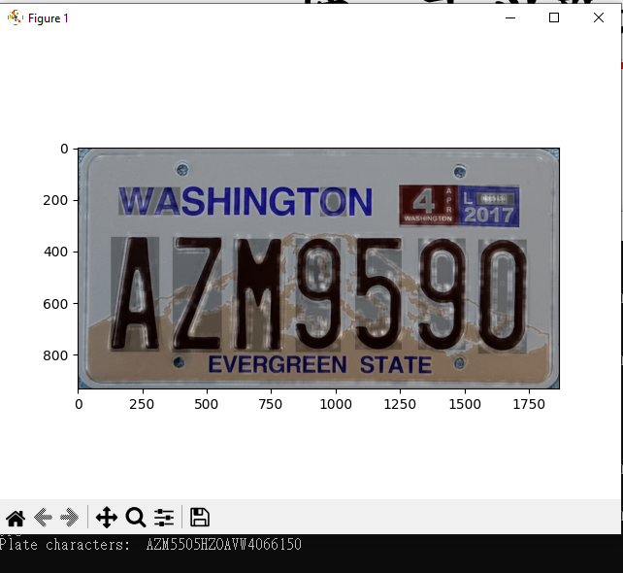
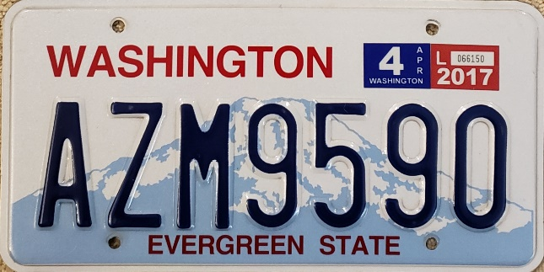
Result(Update)

Slide 14
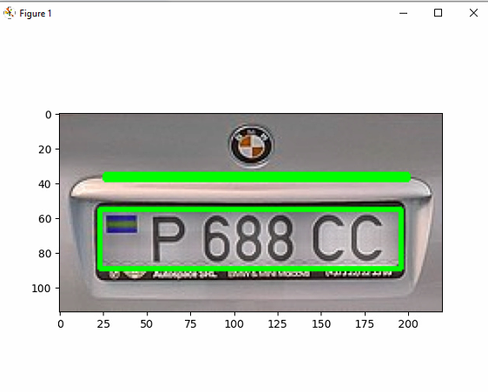
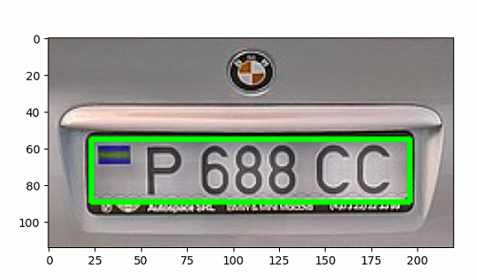




1.Result(21/06/23) Final
Use ground truth to compare and calculate the accuracy
Accuracy: 100%
Notes:
python lbpSharpness.py --input ./test_img/1.jpg

Slide 15
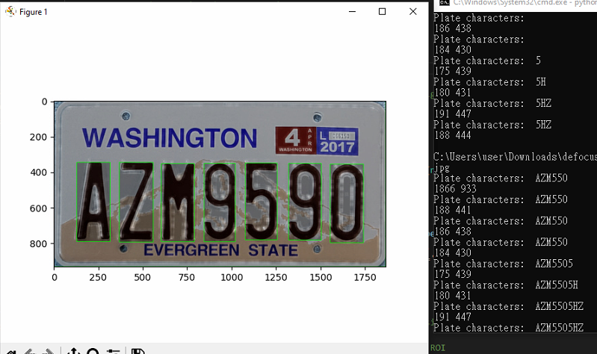


2.Result(21/06/23) Final
Use ground truth to compare and calculate the accuracy
Accuracy: 57.14%
Notes:
python lbpSharpness.py --input ./test_img/2.jpg

Slide 16
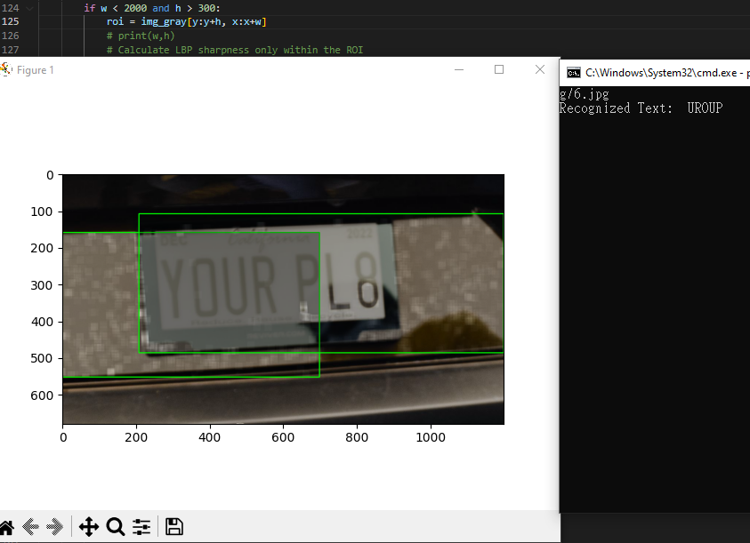
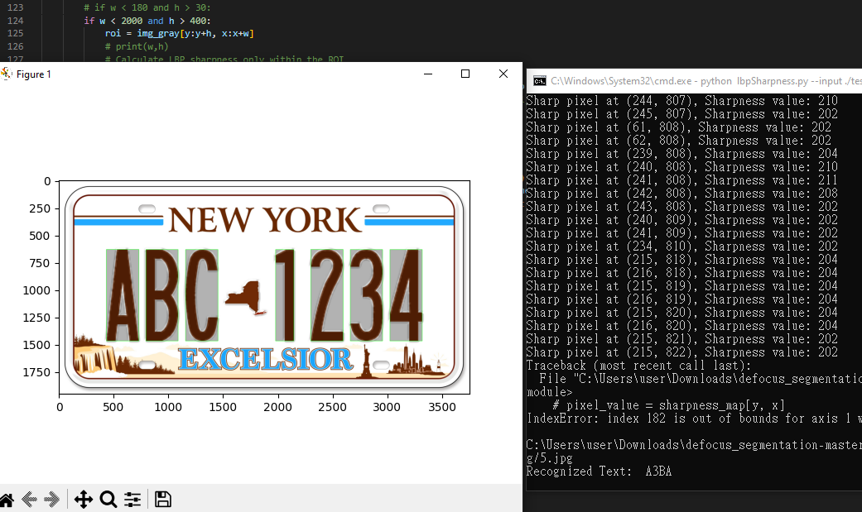
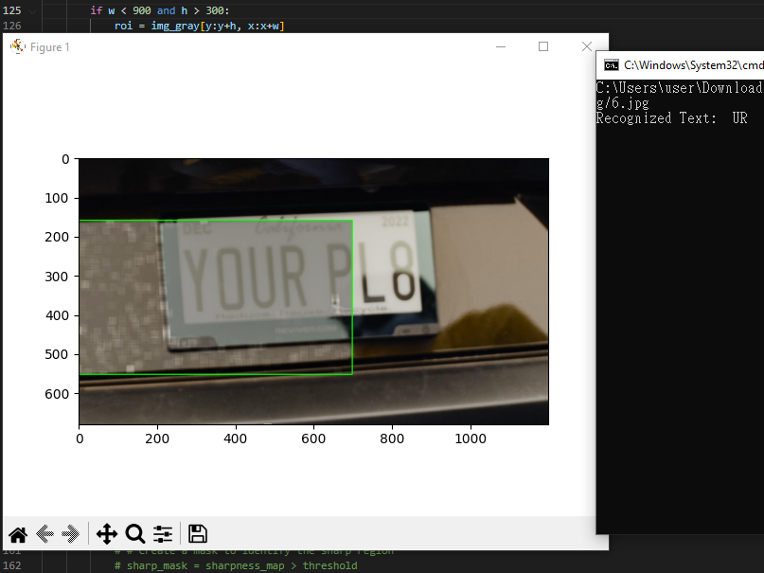
Result(21/06/23) Final
Use the same w,h with the second sample

Slide 17
Demo
https://drive.google.com/file/d/1O1PLjLfPlSZ6eOnjT4d2kRraHpPoADT9/view?usp=sharing
The file is too large to upload

Slide 18
API (06/14/23) Final
Function: | def im2double(im):
Input: | im: np.array
Output: | out: np.array
Parameters: | -
Method: | Normalisation np.min, np.max: np.array astype(): float
Description: | convert im to double-precision floating-point, to ensure that im data is within a consistent and standard range.

Slide 19
API (06/14/23) Final
Function: | def s(x): perform a thresholding operation
Input: | x: np.array(int)
Output: | temp: np.array(float)
Parameters: | -
Method: | astype(): convert Boolean array to float array

Slide 20
API (06/14/23) Final
Function: | def lbpCode(im_gray, threshold)
Input: | Im_gray: np.array(int)
Output: | The function that compute lbp
Parameters: | -
Method: | The function calculates the Local Binary Pattern (LBP) code for each pixel in a grayscale image.
Notes:
LBP operator is applied to each pixel in the input image by comparing its intensity value with the surrounding pixel values in a circular neighborhood of radius 1
The eight neighboring pixels are compared with the central pixel, and a binary code is generated based on whether each neighboring pixel is greater or less than the central pixel.
The LBP81riu2 feature is computed by thresholding the difference between the intensity values of the central pixel and its eight neighbors with the given threshold value.
The result of this thresholding is a binary value for each of the eight comparisons, which is then combined into an 8-bit binary number using bitwise operations.
The resulting LBP code is then transformed into a rotation-invariant uniform pattern (LBP81riu2) by comparing the absolute differences between each neighboring pair of binary values and thresholding the sum of these differences at a value of 2.
If the sum is less than or equal to 2, the pattern is considered uniform and assigned a binary value of 1, otherwise it is assigned a value of 0.

Slide 21
API (06/14/23) Final
Function: | def lbpSharpnesse(im_gray, s, threshold)
Input: | Im_gray: np.array(int)
Output: | Sharpness map: local sharpness value at each pixel location: np.array(floaing)
Parameters: | s: the local neighborhood size for calculating local sharpness: int Threshold: float
Method: | Local Binary Pattern (LBP) performing
Description: | Estimating the sharpness of an image based on its local binary pattern.
Notes:
The function first calls the lbpCode function to obtain the LBP code for each pixel in the image, using a given threshold value.
Then, it applies a sliding window of size s to the LBP map, centered on each pixel, and calculates the sum of LBP codes in the window.
The function then calculates the integral image of the sharpness map and computes the mean sharpness value in each window.
The resulting values are stored in the map array and returned as the output.

Slide 22
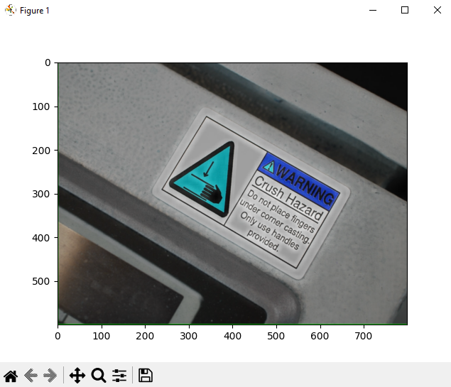

Limitation
It relies on character segmentation to recognize characters.
It assumes that the characters are already separated and can be individually processed.
If you would like to detect characters on a label or in a more complex scene where characters are not clearly segmented, additional conditions or techniques may be required.

Slide 23
Reference
OpenCV: Automatic License/Number Plate Recognition (ANPR) with Python – PyImageSearch
defocus_segmentation/lbpSharpness.py at master · xinario/defocus_segmentation (github.com)

