Slide 1
Exercise 3 Watershed Segmentation
負 責 人：Professor 陳朝烈
目前成員：Nat
報告日期：2023/04/05

Slide 2
Questions
Using tools like LBP and Watershed,
In different situations, such as: grassland stone road.....
Cut out the road
Complementary test environment
How to estimate the next point in 5 meters.

Slide 3
Requirements
Library
Cv2
Numpy
Matplotlib
Device spec:
Intel(R) Core(TM) i7-9700KF CPU @ 3.60GHz 3.60 GHz
Installed RAM: 64.0 GB
Python 3.9.13
Windows 10 Pro

Slide 4
System Architecture
Threshold image to binary using OTSU
find the background area
cv2.morphologyEx
Watershed Segmentation
Find the foreground area
cv2.cvtColor
Watershed:
Find unknow region
Mark the area using watershed
Segment the stone
Watershed:
cv2.dilate
Morphological operations to remove noise - opening
cv2.distanceTransform
cv2.threshold
Size: (700,500)
np.uint8
cv2.subtract
Set stone as 1, background as 0
Notes:
Watershed segmentation starts from user-defined seeds or markers, and it simulates the flooding of water from these markers to delineate regions of the image that correspond to catchment basins or valleys. These regions are then used as the final segmentation result.

Slide 5
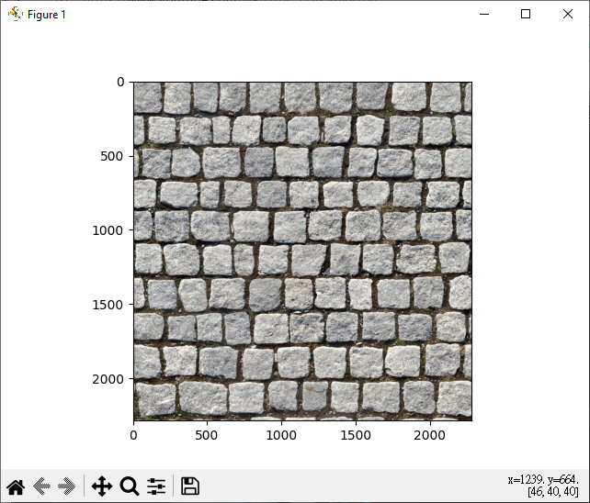
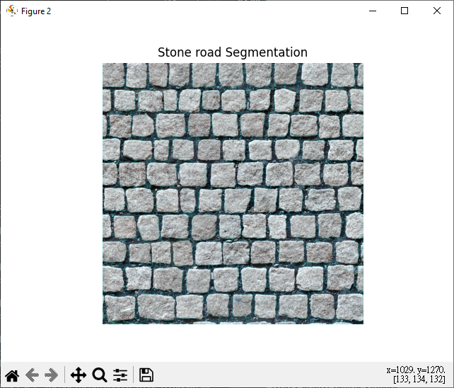
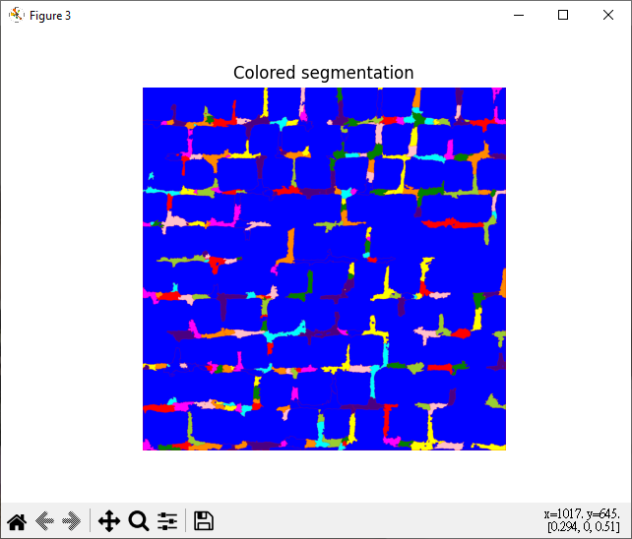
Watershed
Segment the stone from the background
Original image

Slide 6
System Architecture
By cv2.watershed algorithm
and colour segmentation
Create two black image
Set the number for markers
Create tuple colours
One colour for each single digits
Call back function (track markers and display on image
Copy image
Custom seeds
Watershed:
Store colour:
colours = []
end
Select the area
Size: (700,500)
RGB 10 colours
no_markers = 10
0-9 represents each colour
cv2.setMouseCallback
One screen will show the original image, another one will show the black image
Track the markers once we select the area and the area that we track in each colour will display on the black image. Black will change according to those colours.
Notes:
Watershed segmentation starts from user-defined seeds or markers, and it simulates the flooding of water from these markers to delineate regions of the image that correspond to catchment basins or valleys. These regions are then used as the final segmentation result.

Slide 7
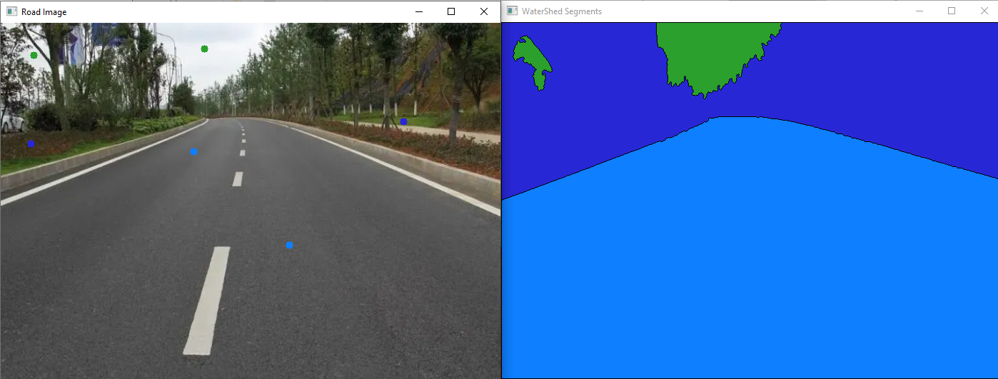
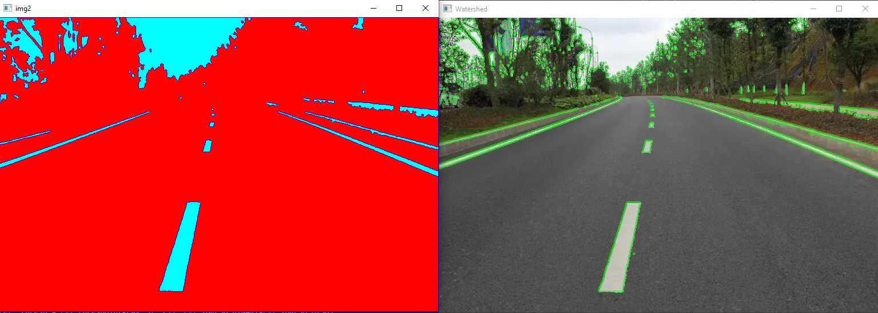
Watershed
Segment the different areas: sky, trees, road

Slide 8
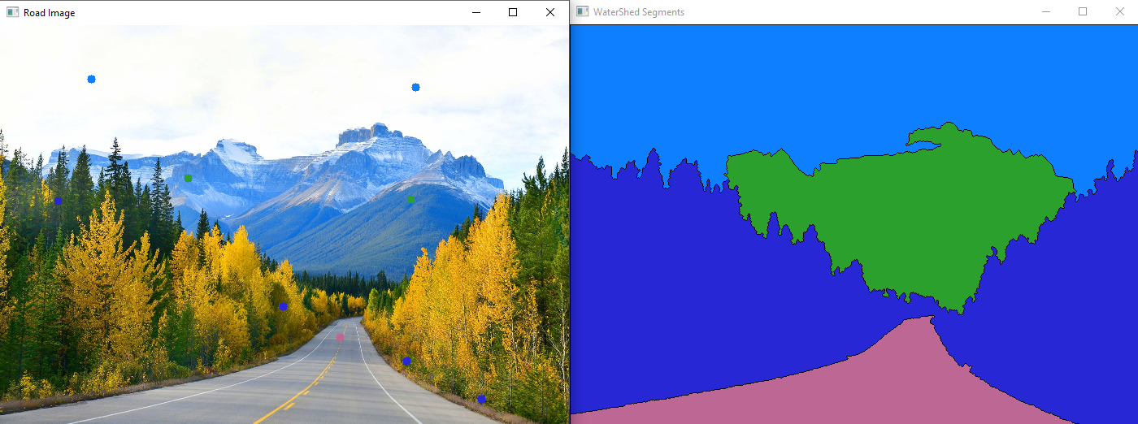
Watershed
Segment the different areas: sky, mountain, road

Slide 9
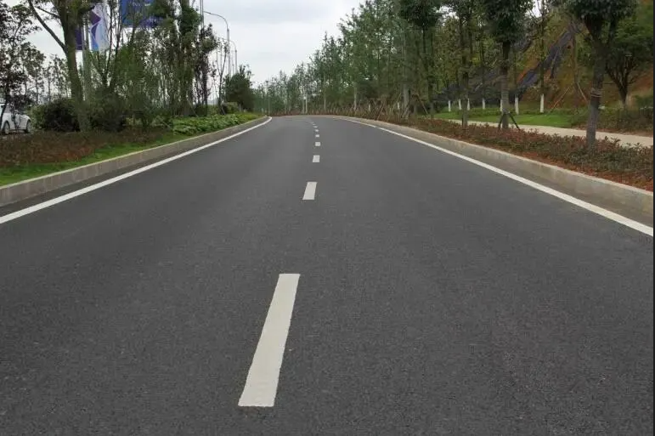
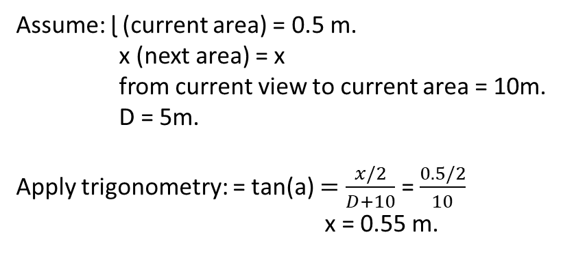
Estimate Different areas
How to estimate the current point of view and the next point of view.
Distance
x/2
x/2
Assume: ɭ (current area) = 0.5 m.
x (next area) = x
from current view to current area = 10m.
D = 5m.
Apply trigonometry: = tan(a) $=\frac{x/2}{D+10}$ = $\frac{0.5/2}{10}$
x = 0.55 m.
D
The next area
ɭ /2
ɭ /2
10 m
Visual angle
Current view

Slide 10
Reference
image processing - How to define the markers for Watershed in OpenCV? - Stack Overflow
object-detection-opencv/apply-watershed-algorithm.ipynb at master · neemiasbsilva/object-detection-opencv (github.com)
Segmentation Using Canny+Watershed in Opencv-python ~ Learn Delta X - Segmentation using canny+watershed in opencv-python
Watershed Segmentation — detect individual objects when heavily clustered | by Samuel Sung | CodeX | Medium
How to compute the aspect ratio of an object in an image using OpenCV Python (tutorialspoint.com) – calculate the ratio
snsharma1311/object-size: Measure size of an object (height and width) using a reference object (github.com)
(4) Is there a way to estimate the distance you are from an object if you know the object’s exact width and it’s apparent width (aka width of object according to the distance you are away from the object)? – Quora
Contour Detection with Custom Seeds using Python - OpenCV - GeeksforGeeks

