Slide 1
Project Report
Presenter : Nawisa
Present Date：2022.6.22
Start Date：2022.6.22
Finish Date：-

Slide 2
TO DO LIST
2022/6/22
Detect defective part of the mold.

Slide 3
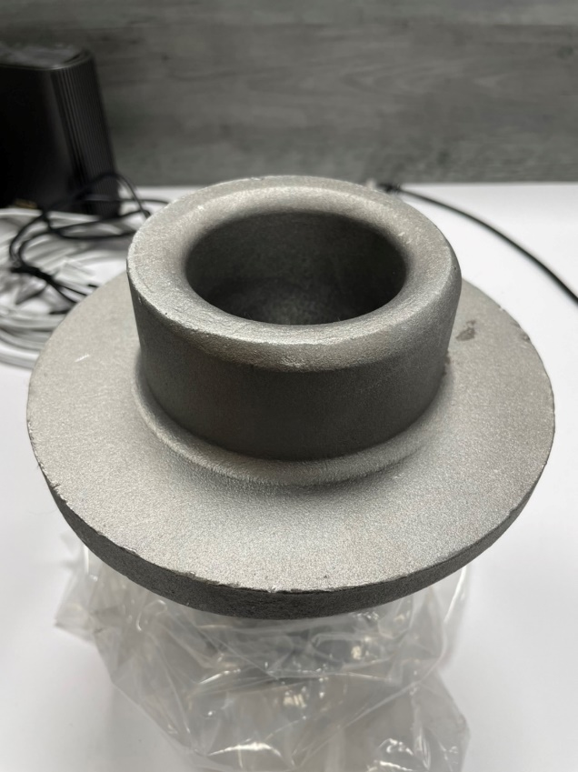
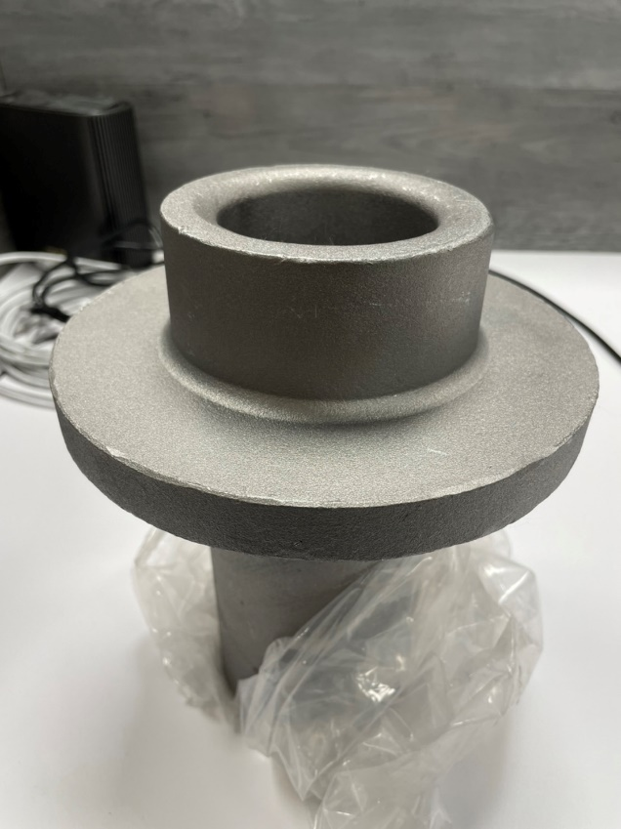
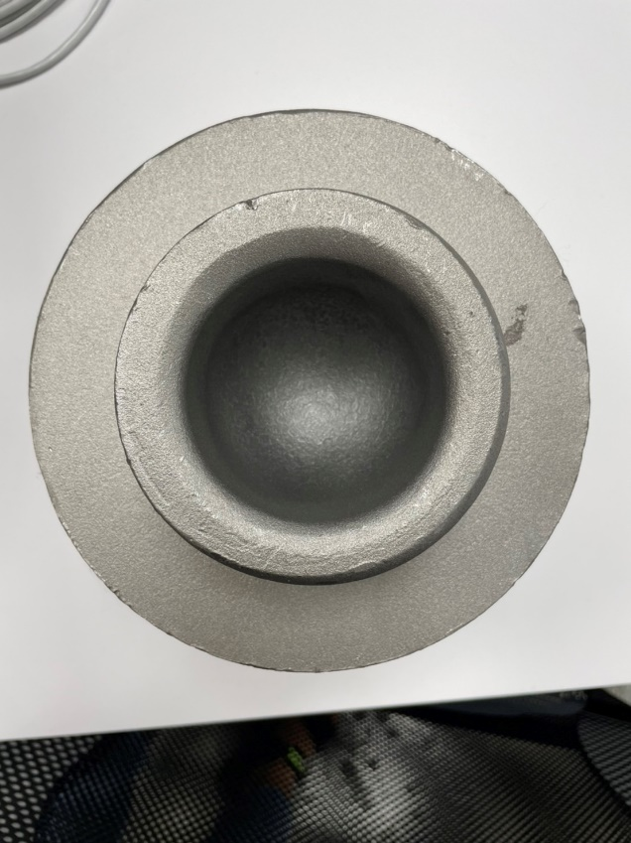
Detect defective parts of the mold
From the Fig 1., the box shows curve area where the angle was damaged and being unshaped.
Fig 2., inside the red box, shows the border of the mold with normal curve.
The top-view in Fig 3. shows defective part with small shadow.
Normal part
Defective part
Defective part
Fig 1. Side-view (1)
Fig 2. Side-view (2)
Fig 3. Top-view

Slide 4
2022/06/22 ~ present

Slide 5
1st
Objective
Find the tools
Do the experiment and record
- To learn and practice the programs, algorithms, tools, how to solve the problems, how to fix the bugs and errors.
- First experiment, I tried “Shadow detection” because from analysing, I saw the shadow on detective curve, so I firstly tried this method.

Slide 6
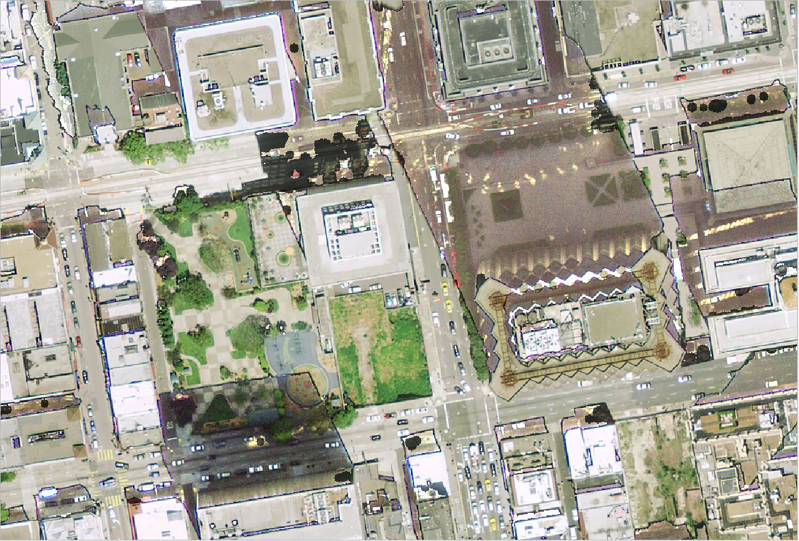
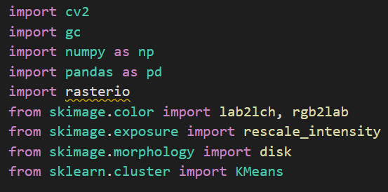
Experiment and record
- I tried open source code [1] on github, they use Shadow-Detection-Algorithm-for-Aerial-and-Satellite-Images.
The result is nice, they can detect the shadow of the houses from sky-views as in Fig 4.
Fig 5. These are the library they use.
Fig 4. The result (form open source code) of Shadow detection.
Notes:
[1] https://github.com/ThomasWangWeiHong/Shadow-Detection-Algorithm-for-Aerial-and-Satellite-Images

Slide 7
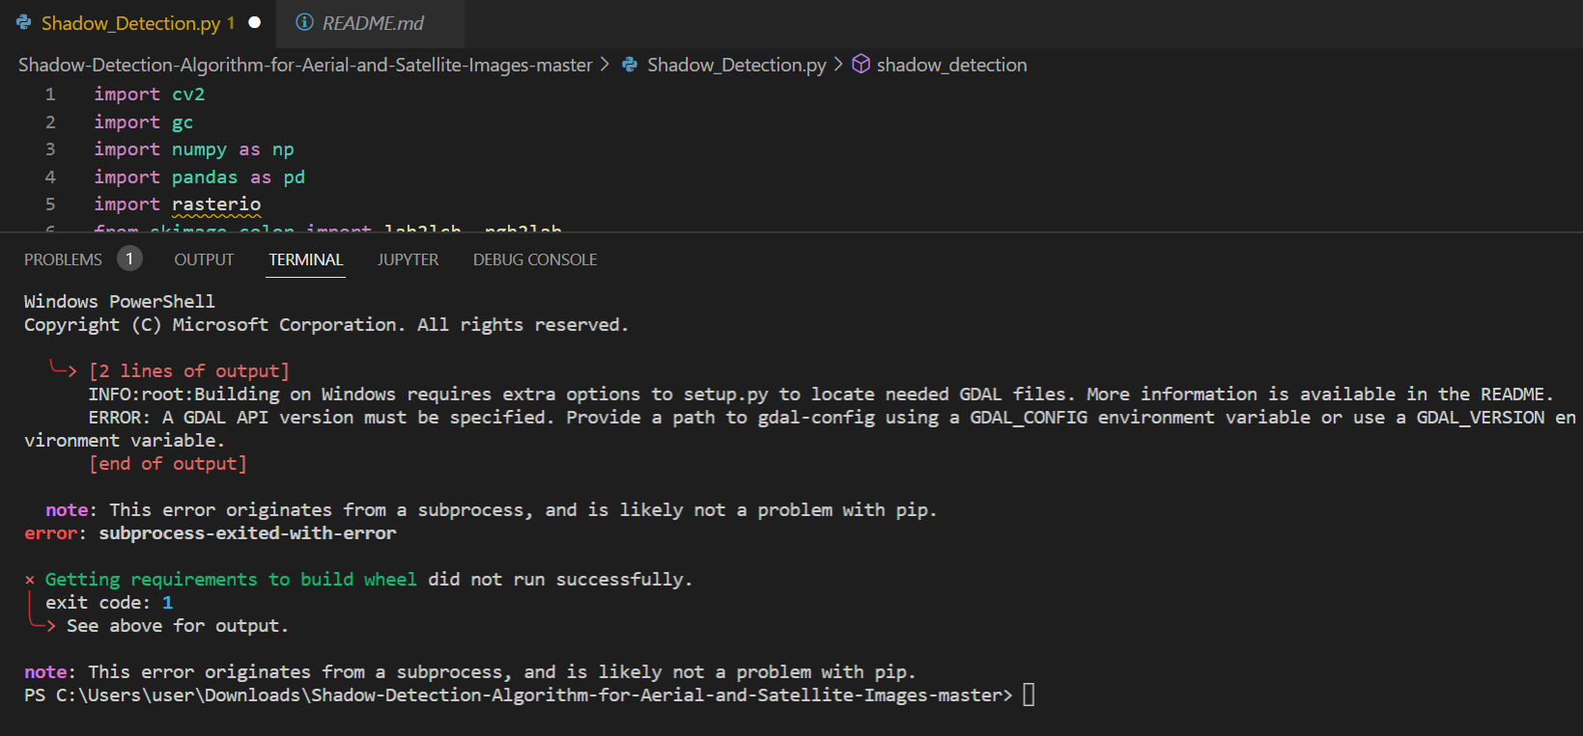
Problem record
As I used open source code, there is one library I could not install,“rasterio”.
I have done:
Install on anaconda
(succeeded to install on cmd but
Still cannot run on VScode)
Pip on VScode
(got the error as shown
on the Fig.6)
Fig 6. The error on VScode ( pip install rasterio

Slide 8
Next
There are the ways I’m going to do:
1. find the new tools.
2. fix the error but this might take time but I can learn how to solve this problem.
3. ask advisor for suggestion.

Slide 9
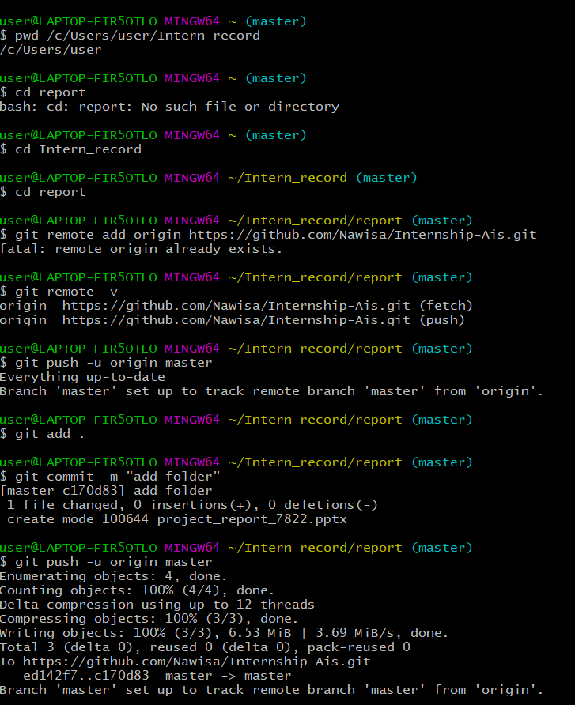
Reference

