Slide 1

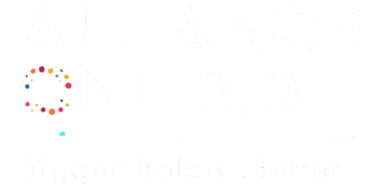

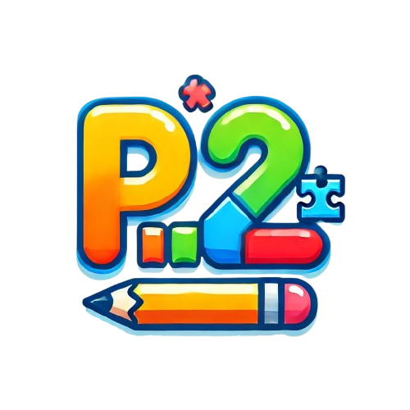
Gamified learning Platform for kids
Play2Learn

Slide 2
Gamified learning for kids
BIHAR ALLIANCE
LASYA PRIYA REDDY
KHYATI RAJ
NAWNEET RAJ
SHIVAM KUMAR

Slide 3
Problem Statement:
Traditional learning methods are boring for kids.
Attention spans are decreasing.
Parents and teachers need engaging tools to make learning interesting.
Solution:
A gamified learning app that makes education fun and interactive.
Learning + Gaming = Better Retention & Engagement.

Slide 4
Benefits of Gamified Learning
Higher Engagement
Better Retention
Self-paced Learning
Improves Problem-Solving Skills

Slide 5
Technology Stack
Front-end: React JS/HTML/CSS/JS
Back-end: Node.js
Database: MongoDB

Slide 6
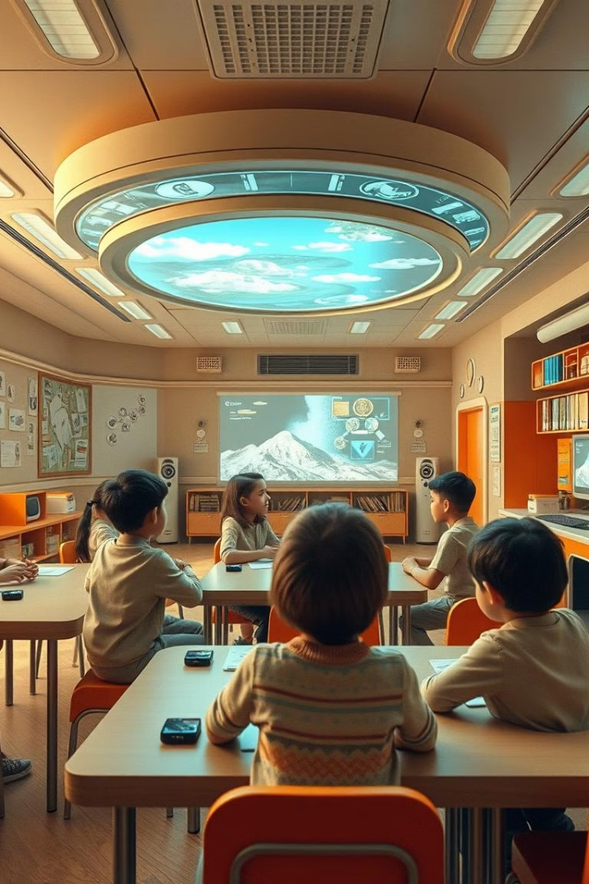
Conclusion and Future Development

