Slide 1

Design Defects and Restructuring
PROJECT: Locks Design Pattern
Group Members:
Nawshrvan Arshad (K19-0167)
Sharyar Khalid (K19-0187)
Sundar Ali (K19-1430)

Slide 2


What are Locks

Slide 3
Introduction
When multiple threads access a resource, they can cause (Race Condition).
Locks is a mechanism to enforce limits on a particular resource.
A lock is designed to enforce a mutual exclusion concurrency control policy.
Gives access of a critical resource to each thread but only if that resource is available.
Helps in synchronization of Threads.

Slide 4
Types of Synchronization
Mutex Locks
A locking Mechanism used to synchronize access to a resource.
Only one thread/task can have access to the resource.
Thread/process with the lock has the right to release the lock.

Slide 5
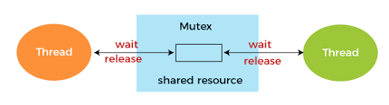

Slide 6
Types of Synchronization
Semaphores
A signaling mechanism.
Uses integers values shared between Threads.
Good in comparison to Mutex Lock and achieves synchronization in multi-process environment.

Slide 7
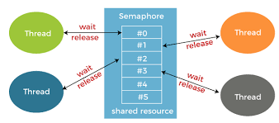

Slide 8
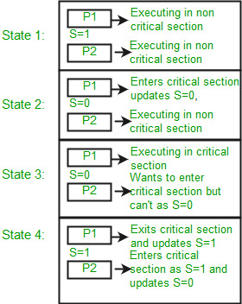
Example of Binary semaphore

Slide 9
How is it related to the course
Locks is not a standardized pattern.
It can be mapped to a practical implementation where Locks are a necessity to restrict concurrent access and maintain Data integrity.
Example practical implantation include Database Access, Banking transaction etc.

Slide 10
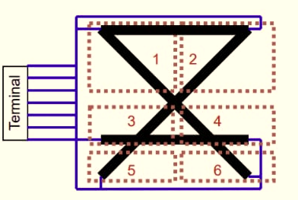
Flight Simulation on Runways using Locks
The Diagram above shows an airport terminal with multiple runways. In this terminal there are 2 types of runways: Large runways {(1,4 6), (2,3,5)} for large airplanes and small runways {(1,2), (3,4), (1,4), (2,3), (3,5), (4,6)} for small airplanes. The airplanes can travel in any direction example a large airplane can travel on (1,4,6) or (6,4,1).

Slide 11
In this simulation we will generate Threads for both Large airplanes and small airplanes which will use locks to acquire runways and the threads will signal their states to show the availability of the runways. The states of the planes which each Thread will signal are:
Ideal at the terminal: This state is basically a random sleep. Each plane begins at a random time at the terminal.
2. Awaiting Takeoff: Randomly chooses a set of runways which is available if not it will wait until the runway is available.
3. Taking off: Will print its position where and on which block numbered (1-6) of the runways the plane is available.
4. Flying: Is in the air meaning has left the terminal so that runway is now free for other threads to use.
5. Awaiting Landing: Similar to awaiting takeoff will check for runway randomly which is available and use that for landing.
6. Landing: Similar to Takeoff will print the blocks of the runways numbered(1-6) to show which runway it took and that it has landed.

Slide 12
Each plane/thread will be in one of the following states as mentioned in the previous slide In the order from Idle at terminal till Landing state. Once a plane has landed the threads job is done.
The above problem is achieved using semaphored and locks to signal threads of availability of runways which are available and acquire them. Each thread is running concurrently. Any number of threads can be used to simulate the runway pattern the flights use.

Slide 13

THANK YOU!

