Slide 1
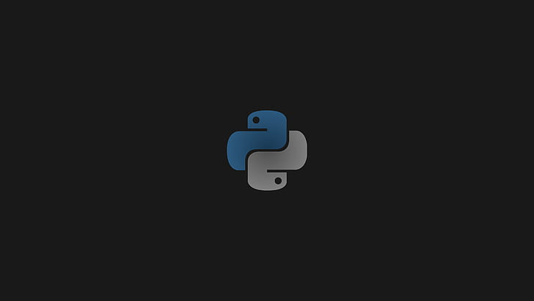
¿What is Pyhton?
Evidence l
Student: Isaac Reyna Uresti
Teacher: Eloy Hernández Frías
Group: 22

Slide 2
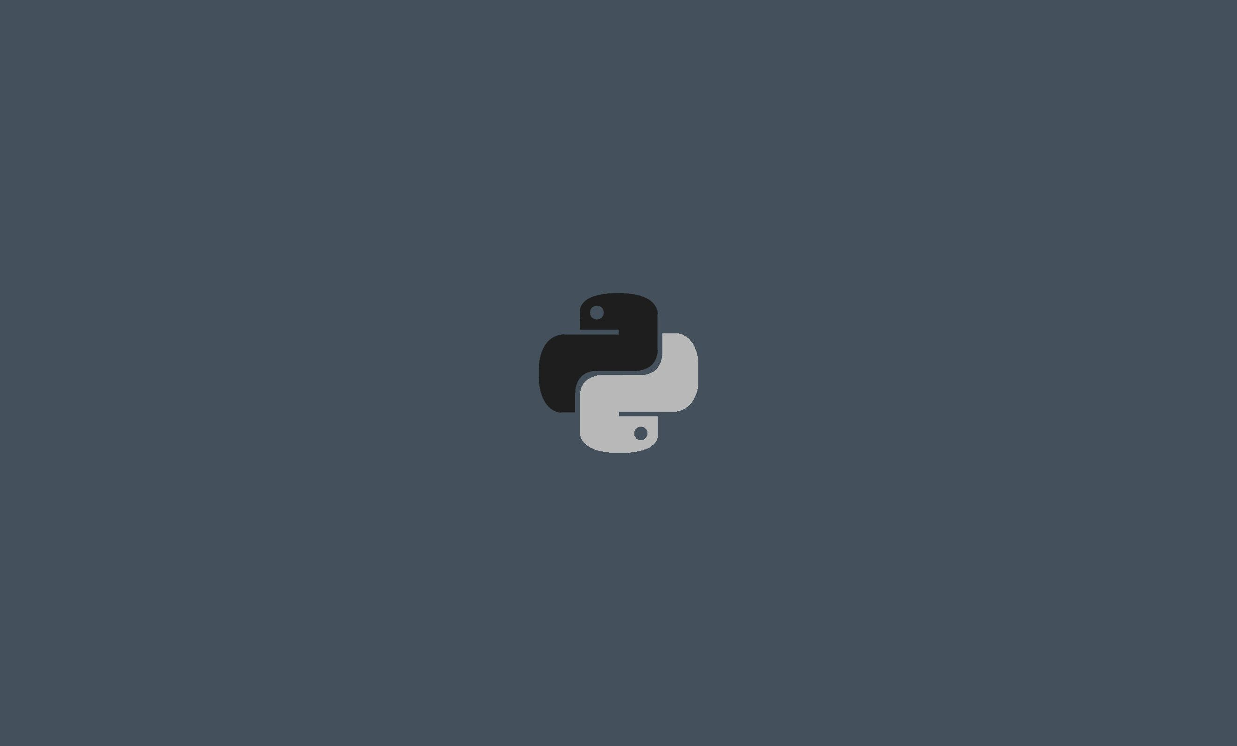
I decided to talk about Python because it is the programming language that I am currently learning, and it seems very good to start in the world of programming

Slide 3
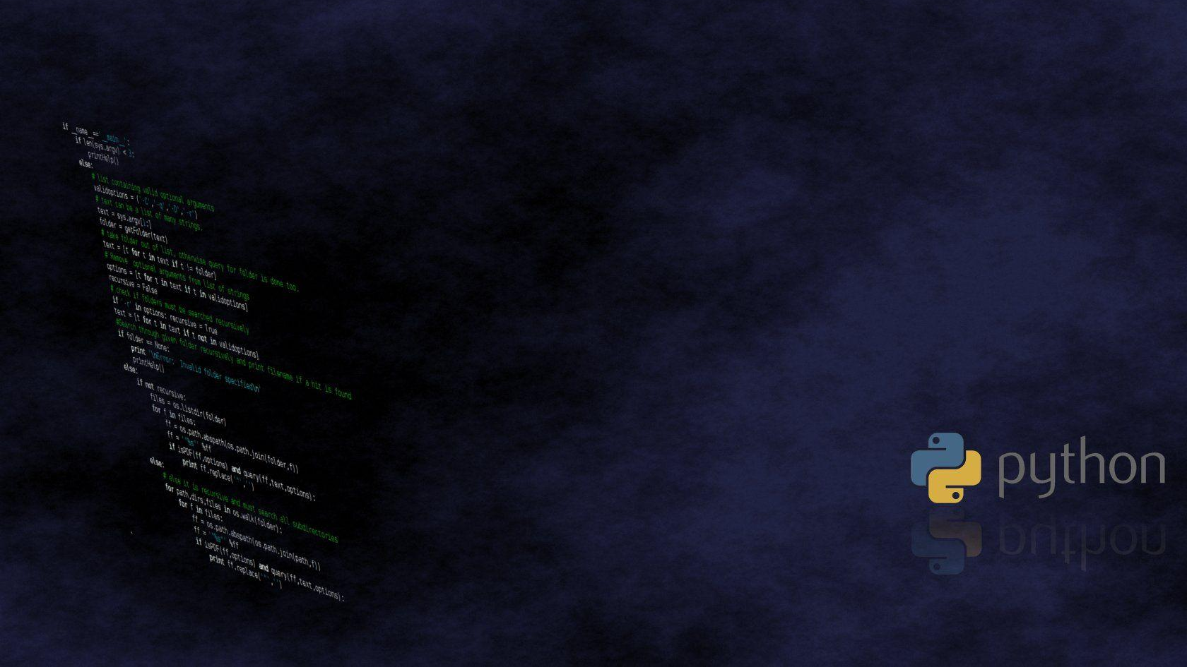
Python is
A dynamically-typed interpreted programming language whose philosophy emphasizes syntax that favors readable code. It is a multiparadigm programming language

Slide 4
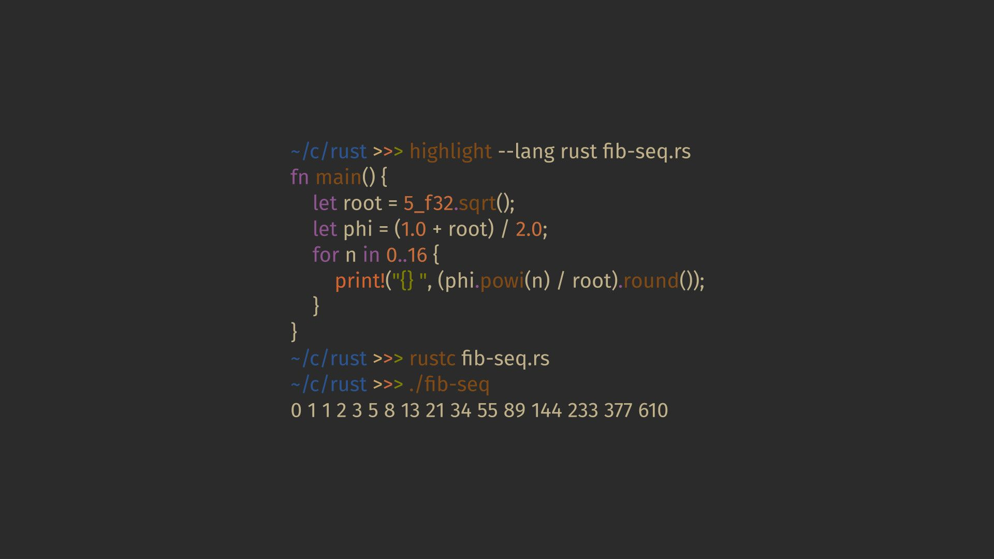
Where does Python come from?
The creator of the language is a European named Guido Van Rossum. He has been designing Python for more than a decade, helped and motivated by his experience in creating another language called ABC.

Slide 5
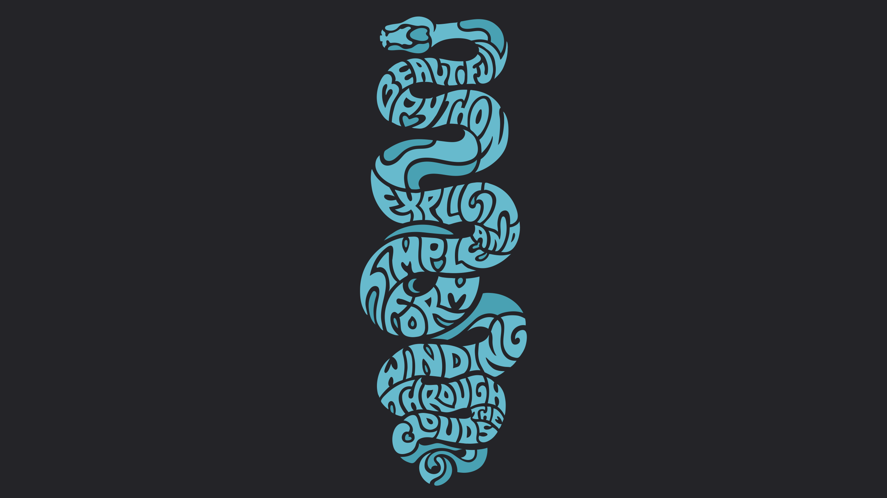
Why python is so popular?
The number of libraries it contains
The simplicity and speed with which programs are created.
The number of platforms we can develop on
Python is free

Slide 6
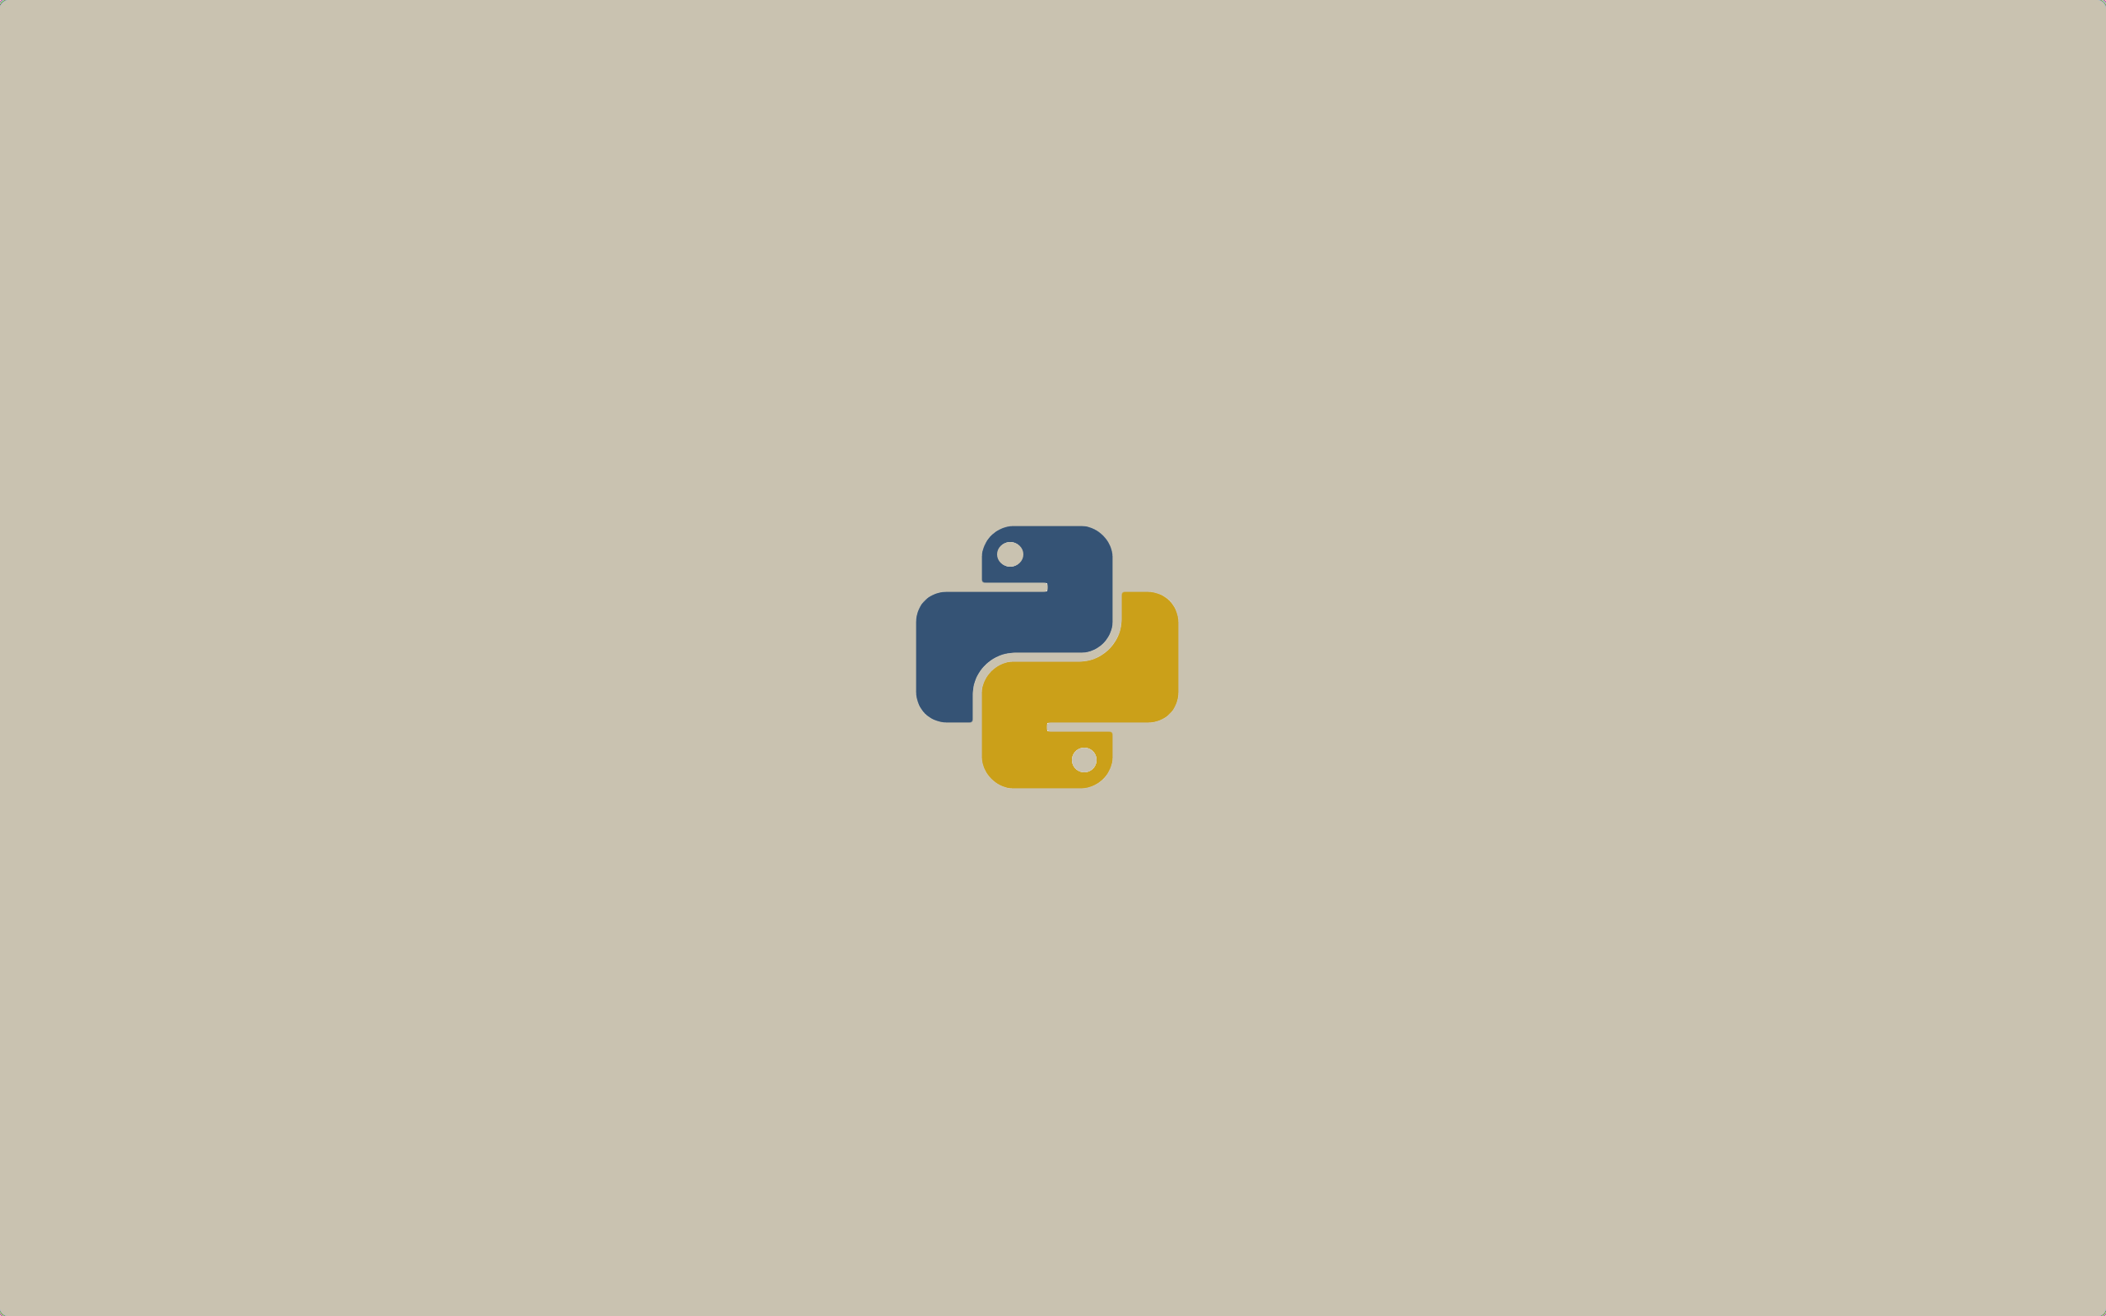
Python features
General purpose
Multi platform
Interpreted
Interactive
Object Oriented
Functions and libraries

Slide 7
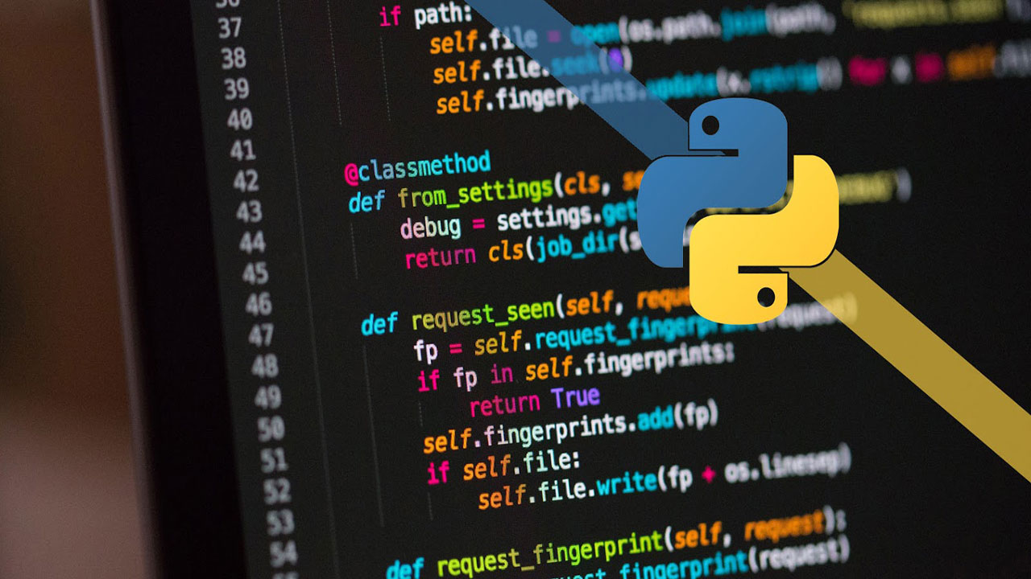
Python advantages
Simplified and fast: This language greatly simplifies programming, it is a great language for scripting.
Elegant and flexible: The language offers many facilities to the programmer as it is easily readable and interpretable.
Healthy and productive programming: It is easy to learn, with a moderate learning curve. It's very easy to get started with programming and encourages productivity.
Neat and clean: it is very readable and its modules are well organized.

Slide 8
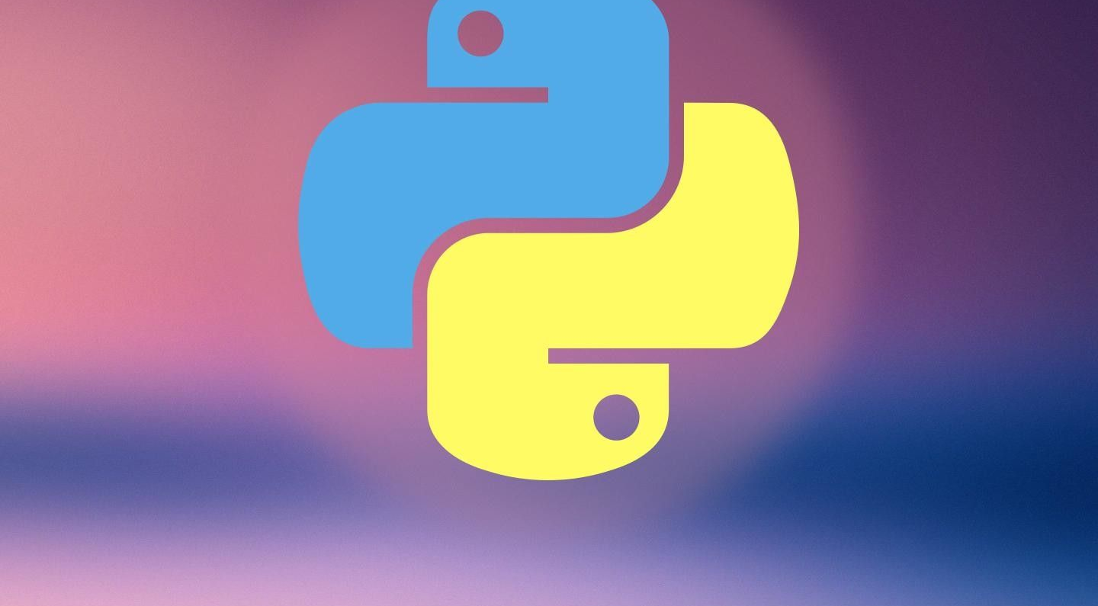
Conclusion
Python is a very interesting programming language, and it has many qualities which make it a very good option for all people who are just starting to program, its learning curve is quite fast and great things can be achieved with it.

Slide 9
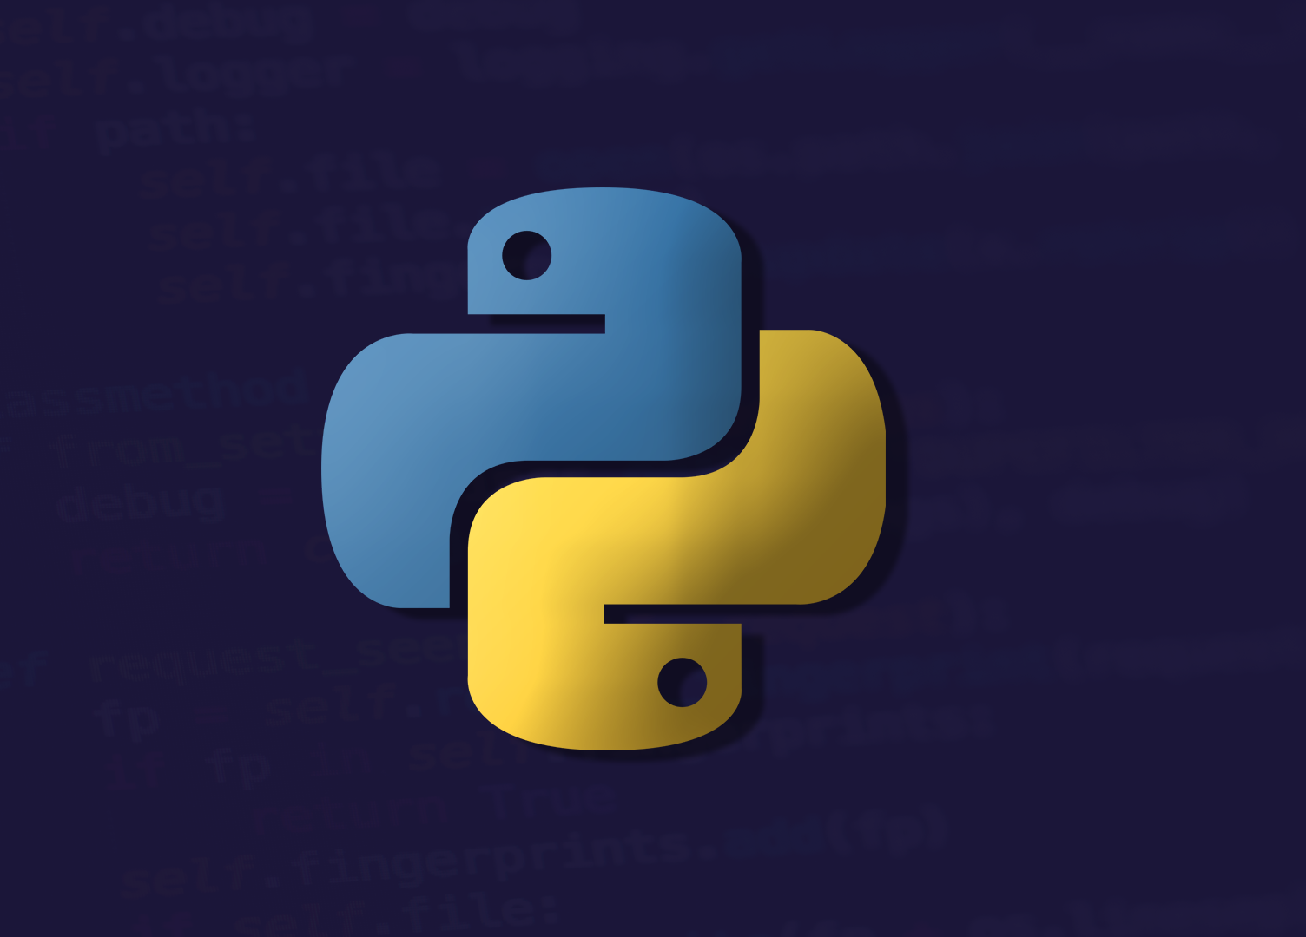
Bibliographic references
Canal Develoteca. (8 de diciembre de 2019). ¿Qué es PYTHON y para qué SIRVE? [Archivo de Vídeo]. Youtube. https://www.youtube.com/watch?v=lc5JJTQa4r8
Alvarez, M. (19 de noviembre de 2013). ¿Qué es Python?. desarrolloweb.com. https://desarrolloweb.com/articulos/1325.php
Robledano, Á. (23 de septiembre de 2019). Qué es Python: Características, evolución y futuro. Openwebinars.net. https://openwebinars.net/blog/que-es-python/

