Slide 1
Betting System

Slide 2
Purpose
The purpose of this project is to create a smart betting solution, that enables its users to easily place bets, review match scores and see their betting history.

Slide 3
Requirements
I. User can place bets on multiple events
II. User is able to retrieve his/her bets on demand
III. User can see a daily offer of matches with a detailed description
IV. User can filter events based on their types and a time frame
V. Administrator can insert or edit matches
VI. Administrator is able to set results for a selected match

Slide 4
Requirements
VII. Winnings are distributed according to match results
VIII. Users have to log in in the system with their password
IX. User is able to create a new account with a permanent username
X. User can edit his/her profile

Slide 6
Non-functional requirements
I. System must work over a network
II. System must use RMI or socket programming
III. The backend of the system must be database based
IV. Functional dependency of the database
V. System must implement design patterns
VI. System must be scalable
VII. System must be capable of updating the contents aimed at the users
VIII. System must implement authentication as a form of security

Slide 7
Work process

Slide 8
Sprint 1

Slide 10
Design patterns
1. Singleton
2. Observer
3. MVC

Slide 11
Singleton

Slide 12
Implementation

Slide 13
Observer

Slide 14
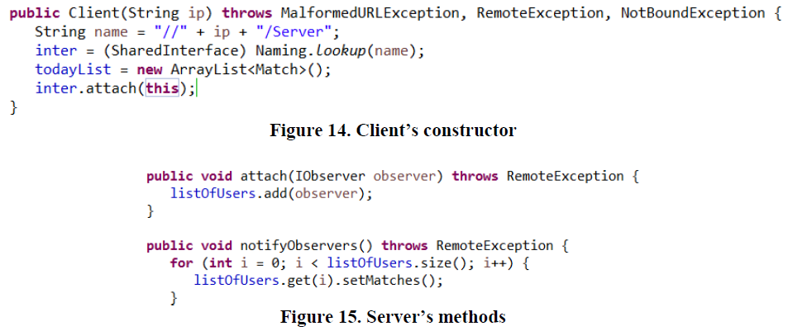
Implementation

Slide 15
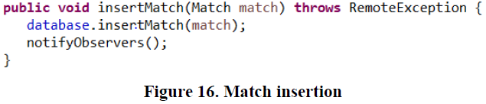
Implementation

Slide 16
MVC

Slide 17
Database connection

Slide 18
Prepared statement

Slide 19
RMI

Slide 20
Client

Slide 21
Server

Slide 22
Live Demo
As a User
-log in/register
-see available events
-place a bet
-see betting history
-edit user’s personal information
As an admin
-filtering events
-add events
-edit events

