Slide 1
IMAGE CLASSIFICATION – FASHION ITEM
Statistical Deep Learning – Midterm Project
Nayaeun Kwon

Slide 2
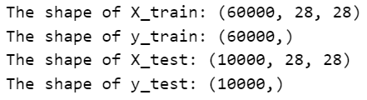
Dataset Description
The objective of this project is to leverage the Fashion MNIST dataset to explore, develop, and evaluate deep learning models, especially Convolutional Neural Network, for image classification tasks, with a specific focus on classifying fashion items.
The Fashion MNIST dataset is a widely-used in the field of deep learning. It serves as an alternative to the traditional MNIST dataset, focusing on fashion items and clothing accessories.
Load the Fashion MNIST dataset using keras. Also, dataset is publicly available on kaggle and Zalando Fashion MNIST repository on Github.
Notes:
The object of this project is to explore, develop, and evaluate deep learning models for image classification. As you can see the copy of console, the dataset consists of total 70,000 grayscale images of size 28 * 28 pixels. It is divided by 60,000 for train data and 10,000 for test data.

Slide 3
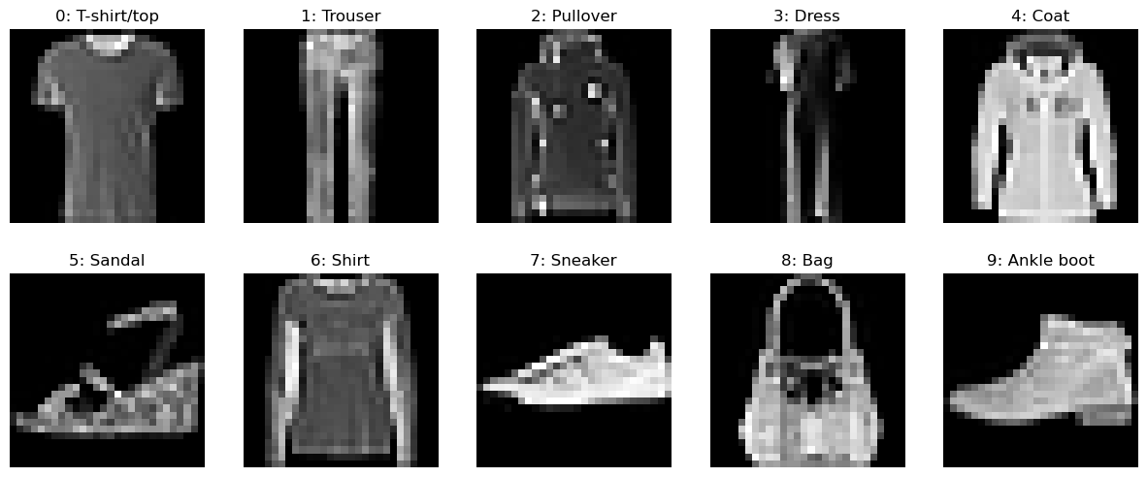
Dataset Description
0: T-shirt/top
1: Trouser
2: Pullover
3: Dress
4: Coat
5: Sandal
6: Shirt
7: Sneaker
8: Bag
9: Ankle boot
Notes:
There are 10 distinct fashion labels from 0 to 9 mapping from T-shirt or Top to Ankle boots.

Slide 4
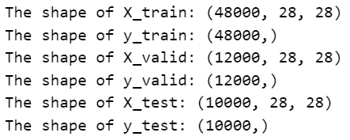
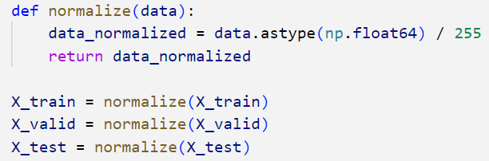
Data Preprocessing
Training dataset was divided into a training set and a validation set. Approximately 20% of the training data was allocated to the validation set
Normalize pixel values to a range of 0 to 1
Notes:
Before building model, common preprocessing steps applied to dataset such as data splitting into training, validation, and test sets, and pixel normalization to drop a range between 0 to 1.

Slide 5
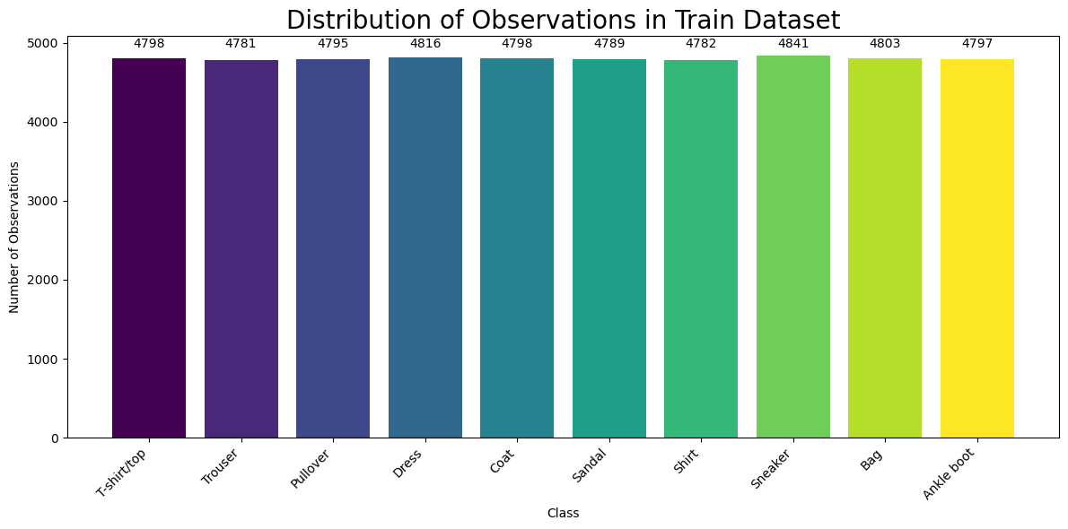
Data Preprocessing
Notes:
Also, I checked whether the dataset is balanced in terms of class labels.

Slide 6
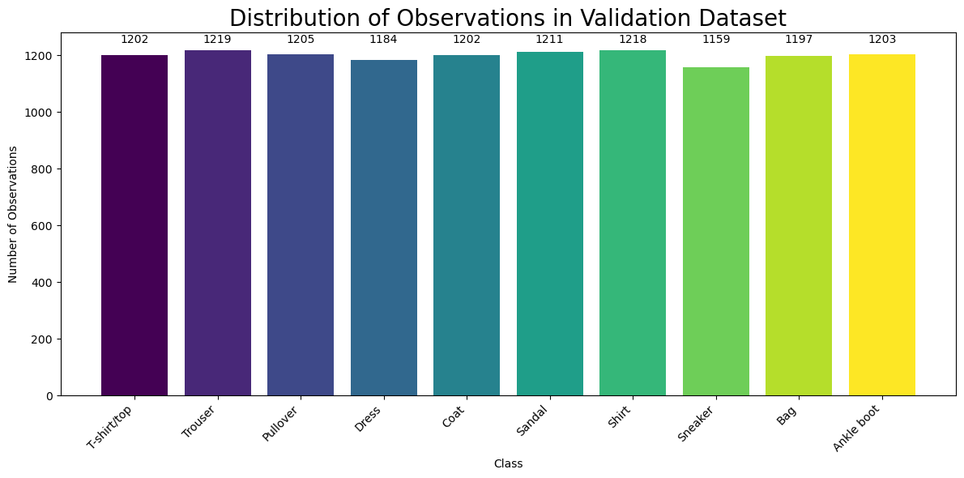
Data Preprocessing

Slide 7

Data Preprocessing
Notes:
It’s all evenly distributed

Slide 8
Modeling
For building a model for image classification, I used convolutional neural networks (CNNs).
My approach involves building a series of CNNs with varying depths and complexity, starting from a basic 2-layer CNN and progressively increasing the number of layers and units.
This gradual expansion allows me to find the optimal configuration that achieves the highest validation performance while addressing the challenge of overfitting.
Notes:
I used CNNs and My approach involves building a series of CNNs with varying depths and complexity, starting from a basic 2-layer CNN and progressively increasing the number of layers and units.

Slide 9
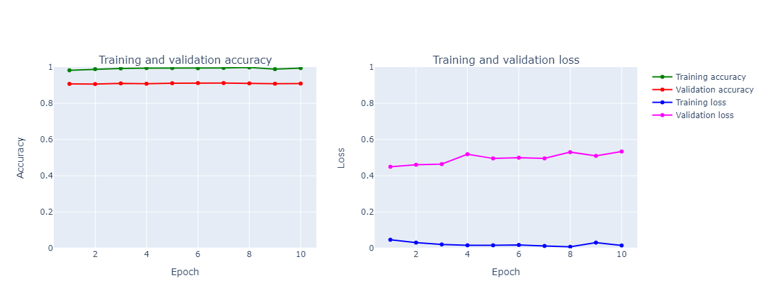

Modeling - Basic 2-layer CNN
Validation Accuracy:
Fold 1: 90.27%
Fold 2: 93.11%
Fold 3: 94.86%
Fold 4: 97.52%
Fold 5: 98.26%
Mean: 94.81%
Test Accuracy:
Notes:
I started with a basic 2-layer CNN. To ensure model robustness, a 5-fold cross-validation strategy was implemented. The result is as shown you guys, and the mean of 5 folds accuracy is 94.81%. But the plots shows that this model should be paid to potential overfitting, as the training accuracy exceeds the validation accuracy. Further regularization techniques can be explored to strike a balance between enhanced performance and generalization.
The architecture consists of
* Convolutional layers with 32 and 64 filters of size (3, 3) and ReLU activation functions.
* Max-pooling layers with (2, 2) pooling windows.
* Flattening layer to transform the 2D feature maps into a 1D vector.
* Two fully connected (Dense) layers with 128 units and ReLU activation, and an output layer with 10 units and softmax activation for classification.
But the plots shows that this model should be paid to potential overfitting, as the training accuracy exceeds the validation accuracy. Further regularization techniques can be explored to strike a balance between enhanced performance and generalization.

Slide 10
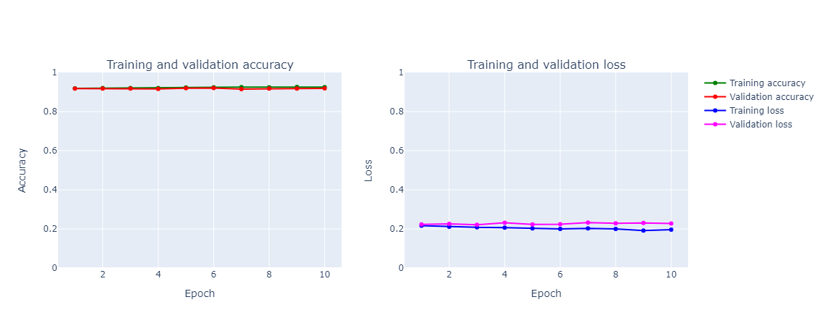

Modeling - Basic 2-layer CNN with Dropout
Validation Accuracy:
Fold 1: 90.02%
Fold 2: 92.05%
Fold 3: 92.84%
Fold 4: 93.97%
Fold 5: 94.52%
Mean: 92.68%
Test Accuracy:
Notes:
To get better classification performance while mitigating the risk of overfitting, the initial model, a 2-layer CNN, was further refined. The refined model includes the addition of dropout layers, which play a crucial role in regularization.As you can see, this model, with the inclusion of dropout layers, effectively addressed the overfitting issue. It achieved higher validation accuracy and lower validation loss. Also improved from 90.51% to 91.4% in test accuracy.
The architecture is all same with the first CNN model, but added Dropout Layer rate 0.25 after the max-pooling layers and add a dropout layer with a rate of 0.5 is positioned before the final classification layer.

Slide 11
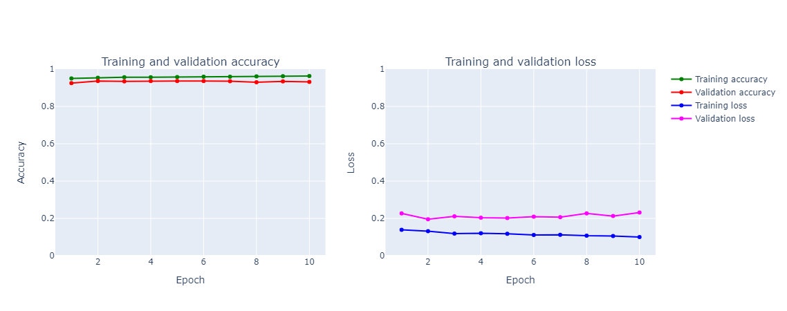

Modeling - 4-layer CNN
Validation Accuracy:
Fold 1: 90.86%
Fold 2: 93.17%
Fold 3: 94.96%
Fold 4: 95.86%
Fold 5: 96.57%
Mean: 94.28%
Test Accuracy:
Notes:
In the pursuit of achieving the better classification performance, the second model introduces additional layers with dropout and batch normalization to further enhance performance and combat overfitting. As you can see, test accuracy 92.89% is slightly higher than the previous one 91.4.
Until now, the second model focuses on addressing overfitting through strategically placed dropout layers within the existing architecture. In contrast, the this model takes a more extensive approach by adding extra convolutional and dense layers, along with batch normalization, to improve feature extraction and representational power. The third model's architectural enhancements contribute to a higher validation accuracy, demonstrating its ability to capture more intricate patterns and achieve improved classification performance.
It extends the architecture like:
- Two more convolutional layers with ReLU activation and batch normalization are added.
- A max-pooling layer with a dropout rate of 0.25 is included after the third convolutional layer.
- A final convolutional layer with batch normalization and a dropout rate of 0.25 is added.
- The fully connected layers are expanded, including a dense layer with 512 units, ReLU activation, batch normalization, and a dropout rate of 0.5.
- A subsequent dense layer with 128 units, ReLU activation, batch normalization, and a dropout rate of 0.5 is added.

Slide 12
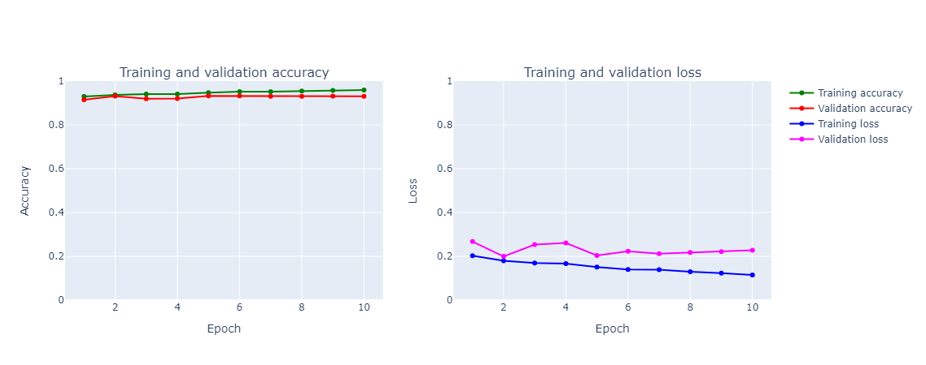

Modeling - 5-layer CNN
Validation Accuracy:
Fold 1: 92.10%
Fold 2: 93.30%
Fold 3: 94.68%
Mean: 93.36%
Test Accuracy:
Notes:
The new model represents a more complex and deeper neural network compared to the third model, which is 4-layer CNN. Total 5 layers with dropout, batch normalization, and large number in the fully connected layers compmared to the third model. Based on the plots, the 5-layer CNN displays a higher susceptibility to overfitting compared to the 4-layer CNN. This is evident from the training and validation accuracy plots where both lines exhibit similar trends, and the training and validation loss plots where the validation loss closely tracks the training loss in the 5-layer model.
Also, test accuracy 93.08% is slightly higher than 4-layer validation 92.89.
- Includes 5 convolutional layers, which increases the depth of the network.
- Utilizes dropout, batch normalization, and max-pooling at various points in the architecture to manage overfitting and improve training performance.
- Has a larger number of neurons in the fully connected layers (Dense layers) compared to the third model.
The key is to strike a balance between model complexity and overfitting.

Slide 13
Model Select
Classifier | Accuracy
2-layer CNN | 90.51%
2-layer CNN with Dropout | 91.40%
4-layer w/ Dropout & Batch Normalization | 92.89%
5-layer w/ Dropout & Batch Normalization | 93.08%
Notes:
As a result, with the highest test accuracy of the model, I can choose the last model which is 5-layer with several features as the final model for fashion MNIST dataset

Slide 14
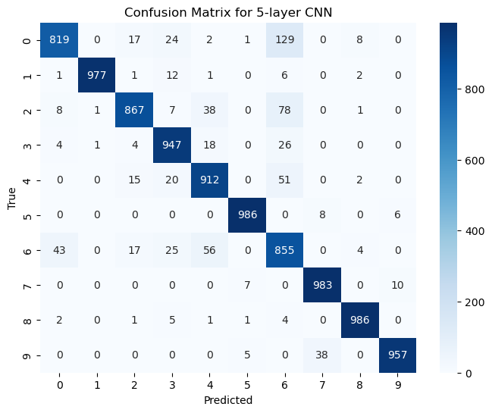
Model Select - Confusion Matrix
I can observe misclassification for some items such as 0: T-shirt/top, 2: Pullover, 3: Dress, 4: Coat, and mainly 6: Shirts
Notes:
To plot confusion matrix of the final model, I can observe misclassification for some items such as 0: T-shirt/top, 2: Pullover, 3: Dress, 4: Coat, and mainly 6: Shirts

Slide 15
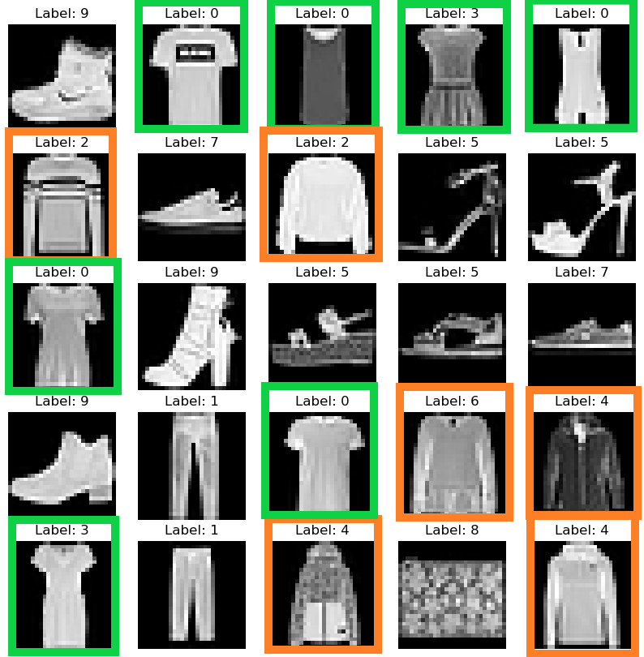
Conclusion
Notes:
This was the challenge about similarity between labels. T-shirts(0), Dress(2) has similarity and Pullover(2), shirts(6), Coat(4) too. To further improve the classifier performance, more samples should be collected and give more images from these 4 classes to the model so the classifier can learn more features or patterns even better.

Slide 16
THANK YOU !

