Slide 1


Bala Sangama 2019 Kids Quiz

Slide 2
Instructions
Rounds
Remembering our Heroes - 6Q - 10 Points/question
Riddles - 6Q - 5 Points/question
Why do We - 6Q - 10 Points/question
Kaala Ganana - 6Q - 5 Points/question
Theme article and Seasonal Food/Health - 6Q - 5 Points/question

Slide 3
Instructions
Time to be strictly adhered, 30 seconds per question
No Negative marks for wrong answers
While all kids of each center can discuss among each other, One kid from each Balabharathi center should be nominated for the Final answer of the question
No Pass question
Designed for 6 teams per cluster, in-case of tie, please additional questions in each category.

Slide 4
Remembering our Heroes
(10 points per question, Identification – 5 points
Fact – 5 points)

Slide 5
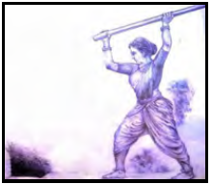
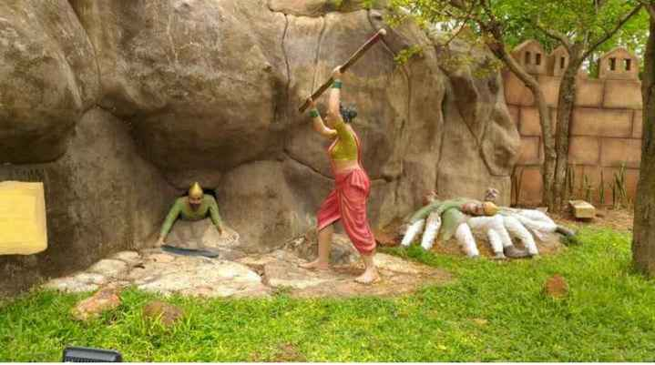
ROH - 1
Identify this great personality (5 Points) and mention 1 fact (5 Points)

Slide 6
ROH - 1 - Answer
She is Onake Obavva
Onake Obavva of chitradurga was one of the fiercest women patriots and warriors of Karnataka.
She single handedly fought with the army of Hyder Ali.
She just used a wooden pestle called Onake (in Kannada) as her weapon.
Her husband, Kalanayak was a guard of one of the secret entrance in the fort of Chitradurga.

Slide 7
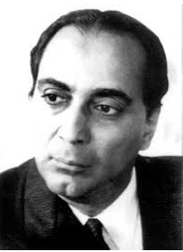
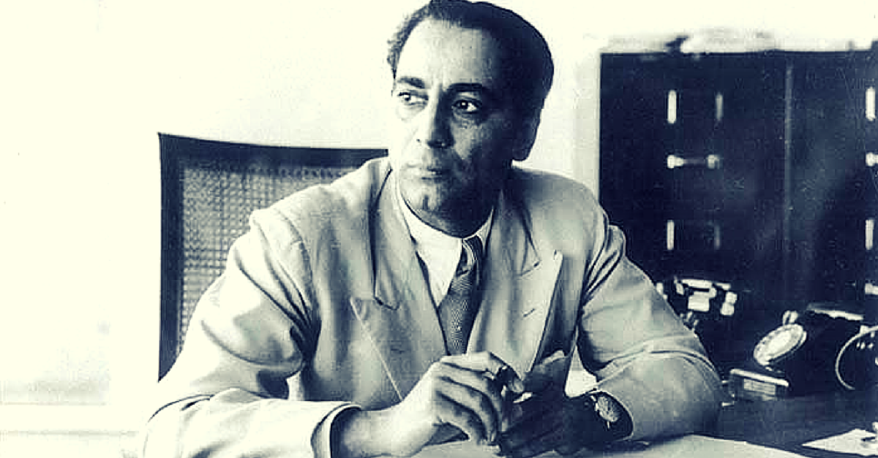
ROH - 2
Identify this great personality (5 Points) and mention 1 fact (5 Points)

Slide 8
ROH - 2 - Answer
He is Homi Jehangir Bhabha
Bhabha is the architect of nuclear science in Bharat.
He took up the phenomenal task of establishing atomic power plants in Tarapur in Maharashtra, Rana Pratap Sagar in Rajasthan and Kalpakkam in TamilNadu.
Bhabha became the director Tata Institute of Fundamental Research in 1945

Slide 9
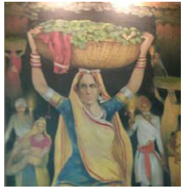
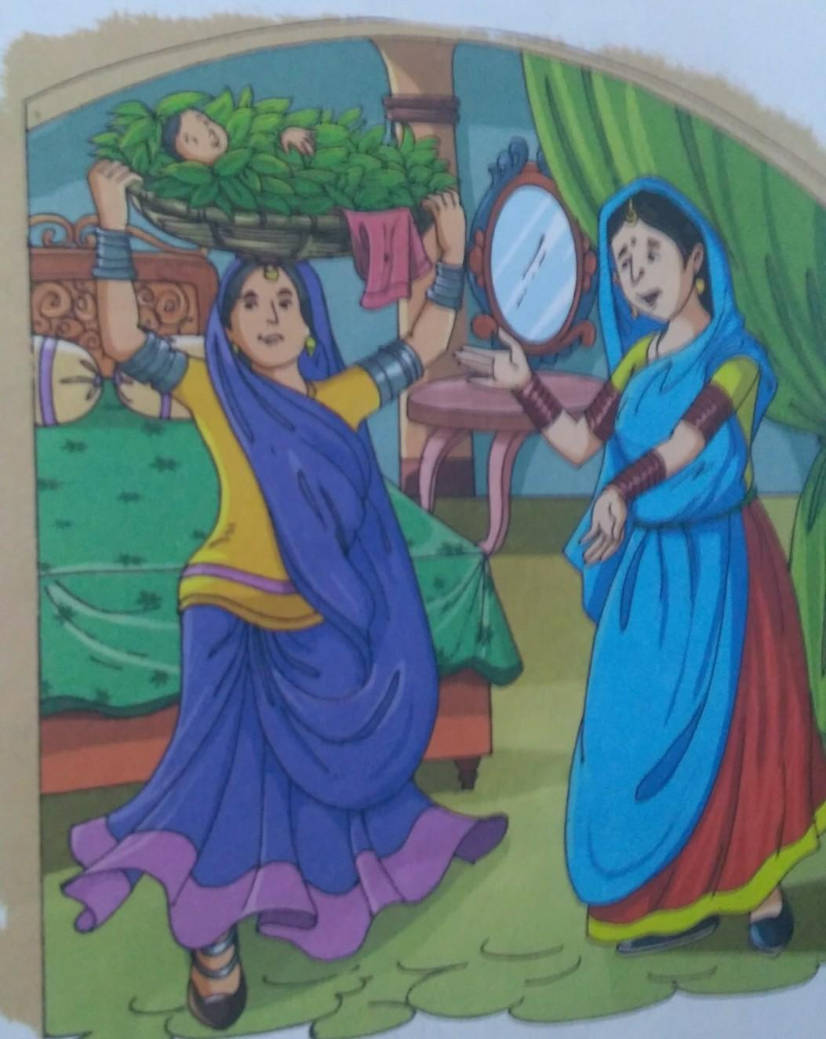
ROH - 3
Identify this great personality (5 Points) and mention 1 fact (5 Points)

Slide 10
ROH - 3 - Answer
She is Panna Dai
Panna Dai was a 16 century nursemaid appointed by Rani Karnavati (wife of Maharana Sangram Singh)
She sacrificed her son Chandan to save young king Uday Singh at age of 14, from the rivalry of a relative named Banvir
Great king Maharana Pratap was the son of King Uday Singh
Panna means ‘emerald’ and Dai means ‘caretaker’

Slide 11
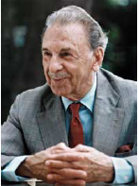
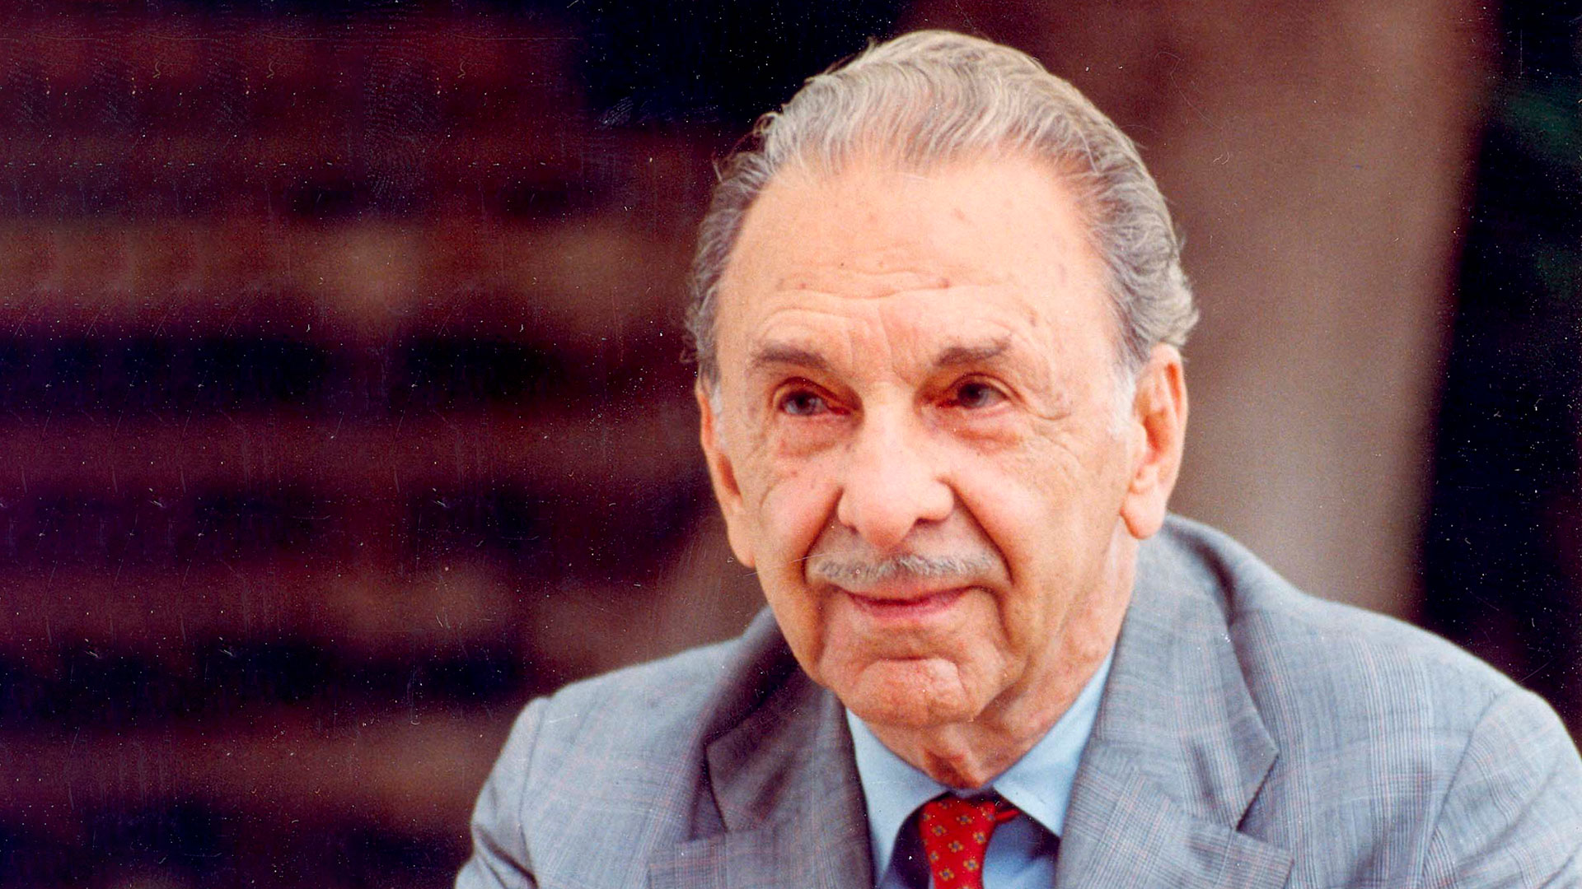
ROH - 4
Identify this great personality (5 Points) and mention 1 fact (5 Points)

Slide 12
ROH - 4 - Answer
He is JRD Tata
One of the greatest Industrialist of India, under whose leadership, Tata group grew exponentially
He became India’s first licensed pilot & also founded India’s first commercial airline in 1932, Tata Airlines now known as Air India
He was hailed as the Father of the aviation Industry
He received two of India's highest civilian awards the Padma Vibhushan and the Bharat Ratna

Slide 13
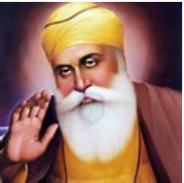
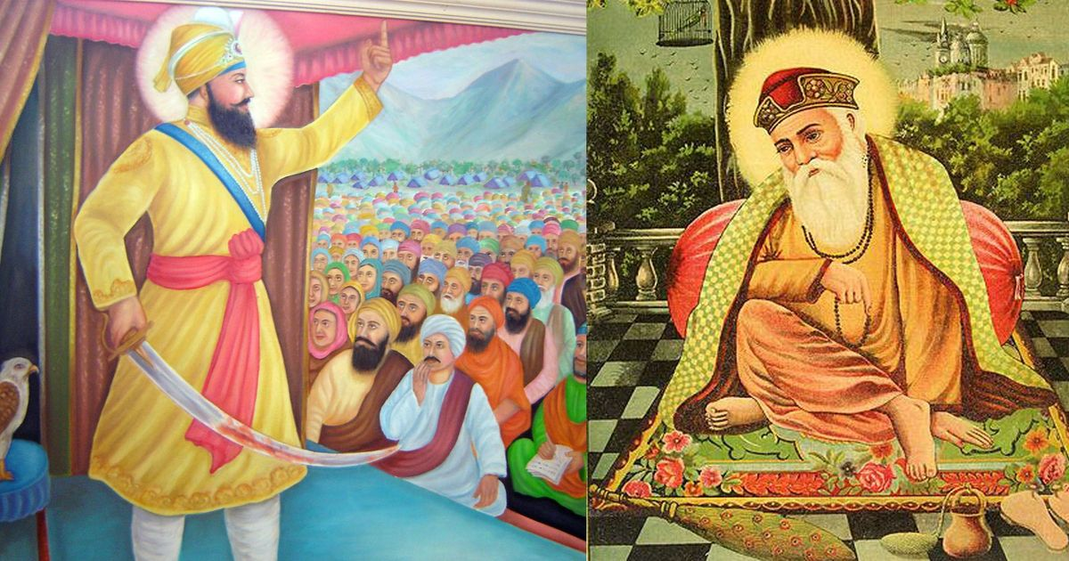
ROH - 5
Identify this great personality (5 Points) and mention 1 fact (5 Points)

Slide 14
ROH - 5 - Answer
He is Guru Nanak
His teachings were organized into 974 hymns(phrases), which became the Guru Granth Sahib, the holy text of the Sikhs
Even today in Gurudwaras, langars (free meals) are served
Nanak ji's resting place is in Kartarpur which is in present day Pakistan.

Slide 15
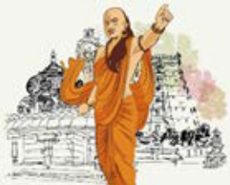
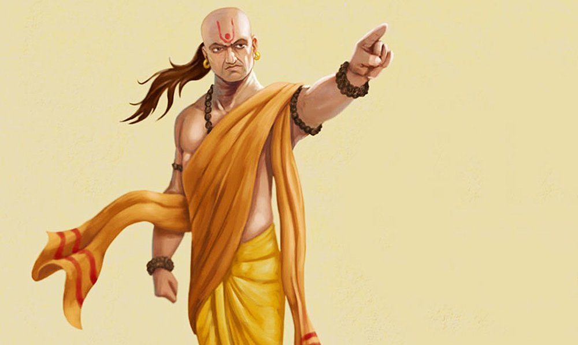
ROH - 6
Identify this great personality (5 Points) and mention 1 fact (5 Points)

Slide 16
ROH - 6 - Answer
He is Chanakya
Chanakya was the minister in the kingdom of Chandragupta Maurya during 317 – 293 BC
He completed his education at Takshasila University and became an Acharya at the university
He was known as a master statesman who authored the incredible Arthashastra, a treatise on statecraft that scholars study even today

Slide 17
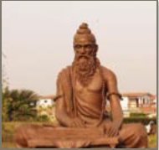
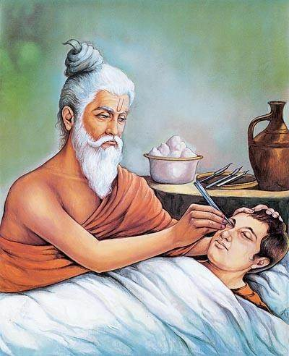
ROH - 7
Identify this great personality (5 Points) and mention 1 fact (5 Points)

Slide 18
ROH - 7 - Answer
He is Maharshi Sushrutha
He is known as ‘ Father of plastic surgery’ for inventing and developing surgical procedures
Sushruta Samhita (written in Sanskrit) is one of the oldest book on medicine and plastic surgery. It is considered as foundational text of Ayurveda
He had described around eight special operations of surgery, such as cutting, piercing, opening, scratching, inserting and stitching

Slide 19
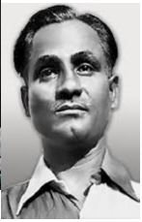
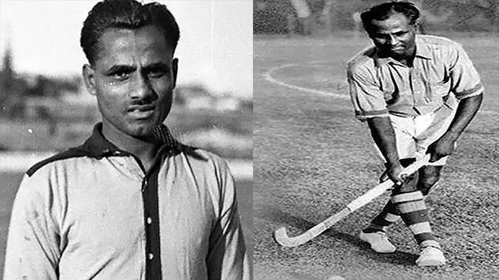
ROH - 8
Identify this great personality (5 Points) and mention 1 fact (5 Points)

Slide 20
ROH - 8 - Answer
He is Dhyan Chand
He is called 'the wizard of hockey’, 'the typhoon out of the east' and Dhyan Chand as he used to practice hockey under the moon light after his soldierly works
He brought victories to Team India in Hockey by winning gold medals for three consecutive years at the Olympics
His birthday, 29th August is celebrated as National Sports Day
Dhyan Chand award is given for life time achievement in sports

Slide 21
Riddle (5 Points per question)

Slide 22
R - 1
Standing tall
Snow overall,
Protecting our nation,
Which is this nature's creation?
Ans : _____________________

Slide 23
R - 1 - Answer
Himalayas

Slide 24
R - 2
Where three rivers met
The name Triveni we kept
The king of pilgrimage
Guess, which is that place?
Hint-Where did Kumbh happen this year?
Ans : _____________________

Slide 25
R - 2 - Answer
Prayagraj

Slide 26
R - 3
Belongs to Kittur in South
Whose Bravery we can vouch
Who fought against East India Company
Guess the name of that brave lady.
Hint-There was one queen with same name belonging to Keladi
Ans : _____________________

Slide 27
R - 3 - Answer
Kittur Rani Chennamma

Slide 28
R - 4
Born in a foreign land,
Disciple of Swami Vivekananda
Serviced our Motherland
Who was that? Did you Understand?
Hint- She was an Irish teacher?
Ans : _____________________

Slide 29
R - 4 - Answer
Sister Nivedita

Slide 30
R - 5
He talked about Dharma,
in the great battle of Karma.
Who liked both music and dance,
All followed him like in a trance.
Hint-He was fondly called Makhan-chor.
Ans : _____________________

Slide 31
R - 5 - Answer
Krishna

Slide 32
R - 6
Who sits on a swan,
And is the Goddess of music & gyaan,
Who always wears white,
And carries instrument by her side.
Hint- Her other name is Vagdevi.
Ans : _____________________

Slide 33
R - 6 - Answer
Saraswati

Slide 34
R - 7
Holy place associated with Origin of Ganga
Stands the temple of Bhagirath opening its gates,
Where the river flows with a fast pace,
Can you guess the name of that place?
Ans : _____________________

Slide 35
R - 7 - Answer
Gangotri

Slide 36
R - 8
A Vaishnav temple revered by sages,
Worshipped by one & all since ages,
On the banks of Alaknanda it lays,
Can you guess the name of this place?
Hint-Where the ákhand jyoti burns?
Ans : _____________________

Slide 37
R - 8 - Answer
Vaishnodevi

Slide 38
R - 9
You can find me,
in a lake or in a stream
When I am frozen,I turn into ice
When I am boiled I turn into steam
Hint- It satisfies our thirst.
Ans : _____________________

Slide 39
R - 9 - Answer
Water

Slide 40
R - 10
Doing it daily keeps you fit,
Playing outside is also a part of it,
'Beause a healthy mind
resides in a healthy body.
Hint - Khel khiladi khel....
Ans : _____________________

Slide 41
R - 10 - Answer
Games

Slide 42
R - 11
As small as a dwarf was He,
Came to answer the Deva's plea,
Requested for three steps of land,
Pushed the great king into Paataal loka's sand.
Hint- Relates to king Bali.
Ans : _____________________

Slide 43
R - 11 - Answer
Vamana Avataar

Slide 44
R - 12
This avatar of the Lord was half human,
He was born to kill a demon,
By appearing from a pillar in a spree,
He saved the life of his devotee.
Hint-Relates to Bhakt Prahlad
Ans : _____________________

Slide 45
R - 12 - Answer
Narasimha Avataar

Slide 46
R - 13
Tamil was his mother tongue,
He died very young,
Who was a mathematical genius,
Still living in the mind of ours.
Hint-He created a magic square.
Ans : _____________________

Slide 47
R - 13 - Answer
Sreenivasa Ramanujam

Slide 48
R - 14
Celebrated in the Telegu land,
Like a temple Gopuram the flowers stand,
The festival means' Mother Goddess comes alive'
Participation by men and women alike.
Hint- Celebrated in Andhra & Telangana
Ans : _____________________

Slide 49
R - 14 - Answer
Bathukamma

Slide 50
Why do we
(10 Points per question, Mention at least 2 facts, 5 points for each fact)

Slide 51
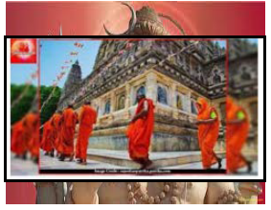
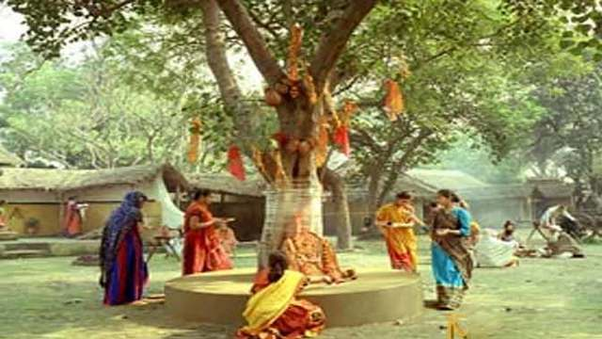
WD - 1
Why do we do ‘Parikrama/Pradakshina’? Mention at least 2 facts

Slide 52
WD - 1 - Answer
Why do we do ‘Parikrama/Pradakshina’?
Pradaskhina or Parikrama is done at the end of every traditional Hindu worship.
The Sanskrit word Pradakshina is combination of two Sanskrit words; “Pra” means Towards, “Daskhina” means South or Right.
In our tradition Pradaskhina is performed around holy trees, cows, and temples.
In temples Pradaskhina is performed in clock wise direction to the right for odd number of times.
Pradakshina in clockwise signifies: straightforward, honest, impartial, submissive gesture in praying to God.
Pradaskhina signifies that we must always lead a righteous life, in the right path called Dharma.

Slide 53
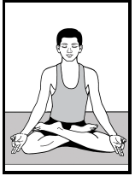
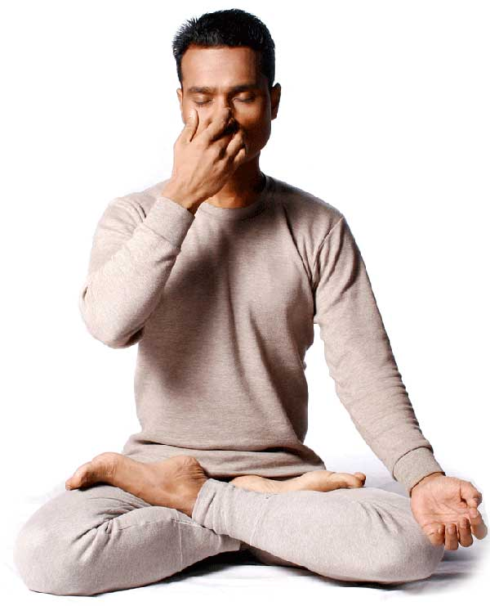
WD - 2
Why do we do ‘Pranayama’? Mention at least 2 facts

Slide 54
WD - 2 - Answer
Why do we do ‘Pranayama’?
Pranayama is the conscious expansion of inhalation and exhalation in a specific manner.
It is a scientific process of internal purification, draws the mind inwards and connects to deeper levels of consciousness.
Pranayama refreshes and energizes the brain, calms the mind, removes stress, negativity and make all the systems function well.

Slide 55
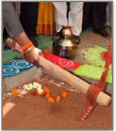
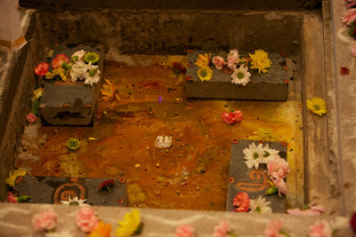
WD - 3
Why do we do ‘Bhoomi Puja’? Mention at least 2 facts

Slide 56
WD - 3 - Answer
Why do we do ‘Bhoomi Puja’?
Bhoomi simply means "the one who holds everything". We consider Earth as Mother and believe that it is our dharma to protect her as she is Vishwa Daani- the giver of all
Bhoomi puja is worshipping of Mother earth, giving honor, respect and also seeking her blessing.
Bhoomi puja is typically done before any type of construction, agricultural activities or any work on land on an auspicious day
Whenever we build or do something with right principles, it creates stability between the cosmos, nature and the artificial structure built.

Slide 57
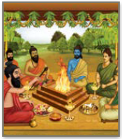
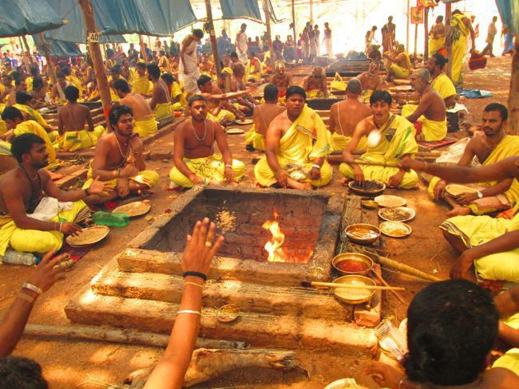
WD - 4
Why do we perform ‘Havana/Yagna’? Mention at least 2 facts

Slide 58
WD - 4 - Answer
Why do we perform ‘Havana/Yagna’?
‘Havana/Yajna’ is a Sanskrit word for ritual wherein offerings such as grains and ghee are made into a consecrated fire, which is held on the occasion of child birth, marriages, and other special occasions.
The mantra during Yajna is in the plural form, since it’s purpose is not only for an individual benefit but welfare for all by bestowing gifts of intelligence, cattle, crops, vitality energy and wealth.
Mantra ends with “Idam Na Mama” translates into - It’s not for me or belongs to me but it’s dedicated to God for the benefit of all.

Slide 59
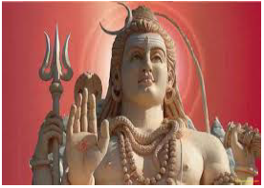
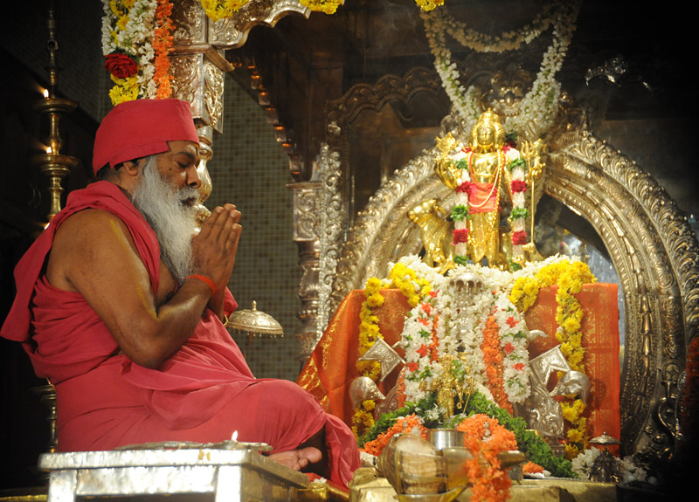
WD - 5
Why do we do ‘Murti Puja’? Mention at least 2 facts

Slide 60
WD - 5 - Answer
Why do we do ‘Murti Puja’?
Murti / Vigraha is one of the tools in the spiritual tool box through which we are able to connect with God.
Murtis are established in temples or even in our homes after a specific ritual called Prana prathishta
Murti puja is a simple way of expressing our faith, love and devotion to God. By admiring the qualities of the Devatha we tend to develop the same qualities in us also. Idols should lead us to the "Ideal".

Slide 61
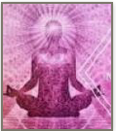
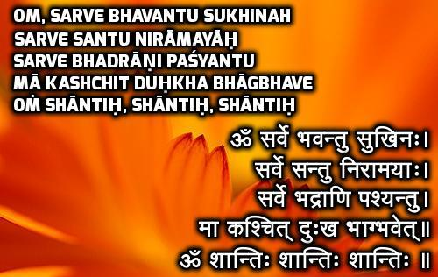
WD - 6
Why do we chant ‘Shanti Mantra’? Mention at least 2 facts

Slide 62
WD - 6 - Answer
Why do we chant ‘Shanti Mantra’?
Shanti Mantra is one of such Mantras chanted for peace before and after any rituals in our country. Shanti mantras are found in Upanishads
The first Shanti is to overcome obstacles from the external world, such as animals, people, natural calamities and attain peace.
Second Shanti mantra is to overcome effects from spirits and demons ( basically this can mean extra sensory causes we cannot see with, but can cause disturbance to us ).
The third Shanti to overcome obstacles from one's own body and mind, such as pain, diseases, laziness, absent-mindedness etc. Shanti Mantra calms

Slide 63
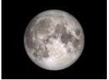
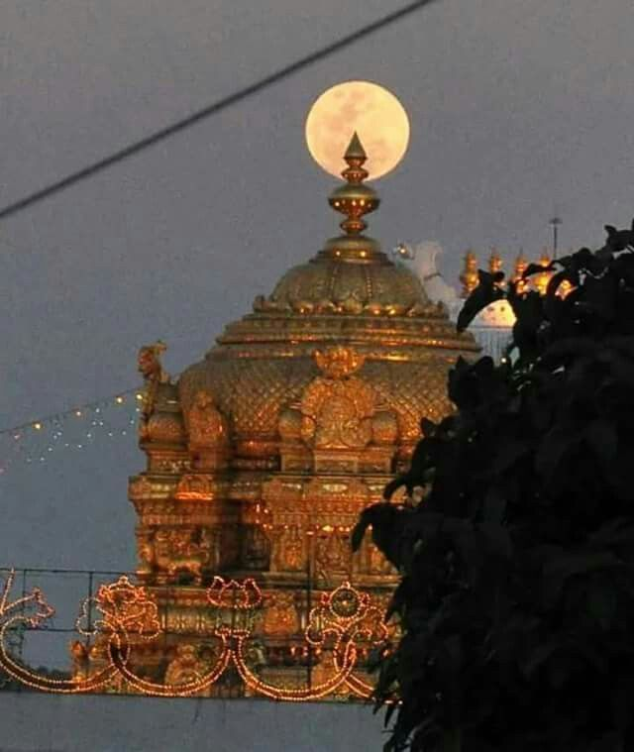
WD - 7
Why do we worship ‘Moon’? Mention at least 2 facts

Slide 64
WD - 7 - Answer
Why do we worship ‘Moon’?
The moon (Chandra) - the only natural source of light in the night
Many of our festivals fall on Poornima day such as Sharad Purnima, Holi, etc.
The moon helps us in measuring the period of one month through its revolution around the earth.

Slide 65
Kaalaganana (5 points per question)

Slide 66
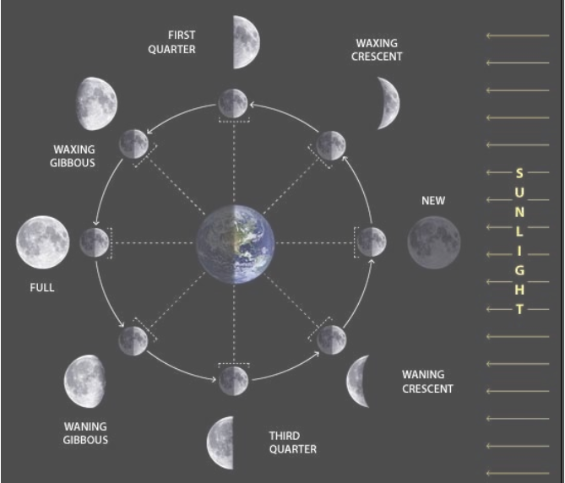
KG - 1
New moon is called as what as per Hindu Kaala Ganana
Options
Amavasya
Poornima
Saptami
Dashami

Slide 67
KG - 1 - Answer
A. Amavasya

Slide 68
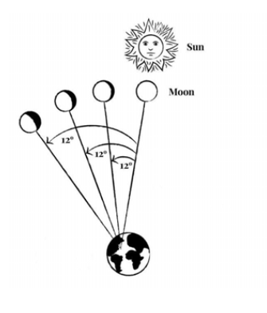
KG - 2
Each Paksha has how many Thithis
Options
12
13
14
15

Slide 69
KG - 2 - Answer
D. 15

Slide 70
KG - 3
Each Maasa has how many Pakshas
Options
1
2
3
4

Slide 71
KG - 3 - Answer
B. 2

Slide 72
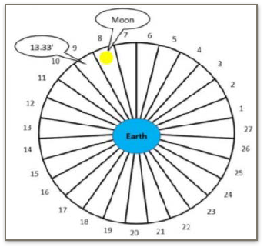
KG - 4
How many Nakshatras are there as per Hindu Calendar or Panchanga
Options
9
18
27
30

Slide 73
KG - 4 - Answer
C. 27

Slide 74
KG - 5
Guruvaara, is named after which planet
Options
Mars
Mercury
Saturn
Jupiter

Slide 75
KG - 5 - Answer
D. Jupiter

Slide 76
KG - 6
Shanivaara, is named after which planet
Options
Saturn
Venus
Jupiter
Mars

Slide 77
KG - 6 - Answer
A. Saturn

Slide 78
KG - 7
What is the phase called in which moon becomes bigger and bigger

Slide 79
KG - 7 - Answer
Shukla Paksha

Slide 80
Theme Article, Seasonal Food and Health (5 points per question)

Slide 81
TA - 1
Maha Kumbh is celebrated once in how many years?
Options
144
6
24
12

Slide 82
TA - 1 - Answer
A. 144

Slide 83
TA - 2
Find the missing piligrimage among the Chardhams –
Kedarnath, _________, Gagotri, Yamunotri
Options
Puri
Rameshwaram
Badrinath
Dwaraka

Slide 84
TA - 2 - Answer
C. Badrinath

Slide 85
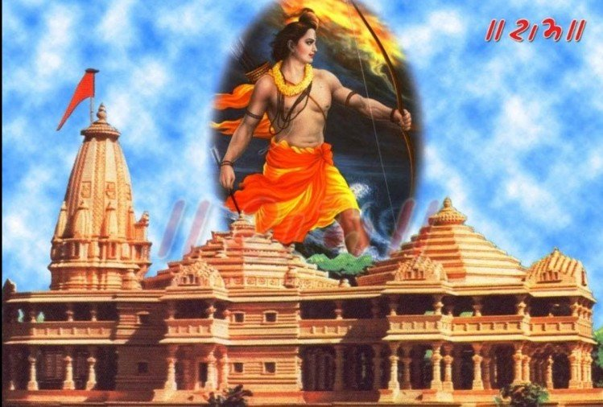
TA - 3
Where was Prabhu Sri Ram born?
Options
Mathura
Lanka
Ayodhya
Kanchi

Slide 86
TA - 3 - Answer
C. Ayodhya

Slide 87
TA - 4
Among Dashavatar of Vishnu, which Avatar is yet to happen/arrive ?
Options
Krishna
Kalki
Kurma
Narasimha

Slide 88
TA - 4 - Answer
B. Kalki

Slide 89
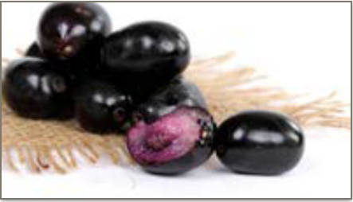
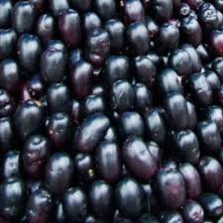
SF - 5
Identify the fruit

Slide 90
SF - 5 - Answer
Kala Jamun/Nerale Hannu/Black Plum/Indian Blackberry
Health Benifits
Helps in controlling diabetes and improve kidney function as well.
It has cooling and soothing effect on the body which also improves the proper functioning of digestive system

Slide 91
SF - 6
Leaf juice of which fruit is very useful for reducing fever caused by 'Dengue’
Options
Guava
Papaya
Jamun
Cucumber

Slide 92
SF - 6 - Answer
B. Papaya

Slide 93
END of Quiz
Scores

