Slide 1
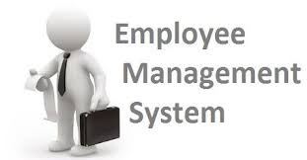
Streamlining HR Operations Through Data-Driven Solutions
By – Subhransu Priyaranjan Nayak
IIT Bhubaneswar

Slide 2
Introduction
A comprehensive database solution designed to centralize and optimize employee data management across all organizational levels.
Integrates employee profiles, payroll processing, leave management, and qualification tracking in a unified relational database system.
Enables data-driven decision making through advanced analytics and reporting capabilities for strategic HR management.

Slide 3
Project Objectives
Build an efficient, normalized relational database for all employee data.
Track full employee lifecycle—personal, job, salary, qualifications, leave, payroll.
Enforce data quality with constraints and relationships.
Provide quick, accurate, real-time data to streamline HR workflows and decisions.
Enable deep HR analytics (compensation, performance, leave patterns, workforce planning).

Slide 4
System Scope & Features
Key Features of Project:
Employee Management: Maintain complete employee profiles, departments, and job roles.
Payroll & Compensation: Automate payroll, bonuses, deductions; generate compensation reports.
Qualification Tracking: Manage skills, qualifications, training, and certifications.
Leave Management: Handle leave requests/approvals; analyse leave patterns.
Analytics & Reporting: Provide advanced HR metrics, performance trends, and workforce planning tools.
Relational Database: 6 interconnected tables for complete employee data.
Advanced Analytics: SQL queries for workforce insights, pay equity, and performance trends.

Slide 5
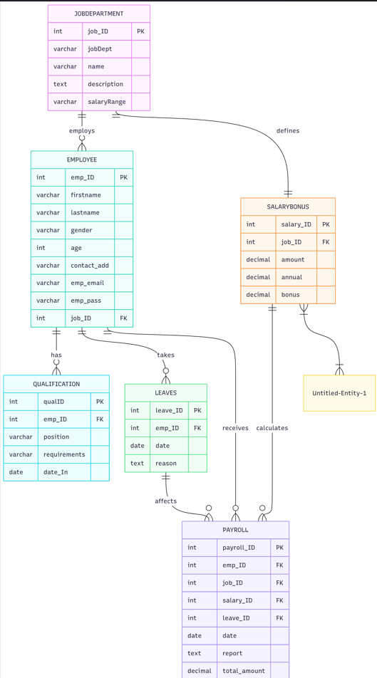
ER
Diagram

Slide 6
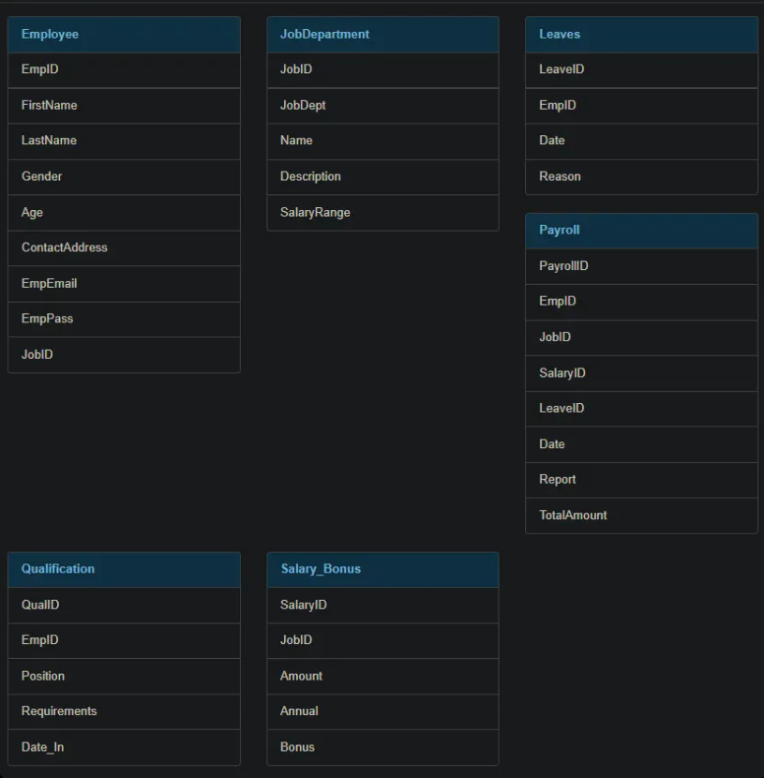
Tables
for complete employee Data

Slide 7
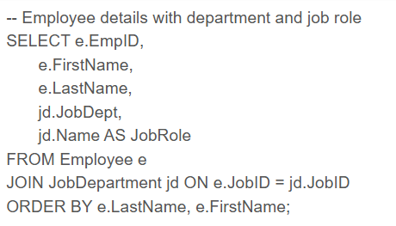
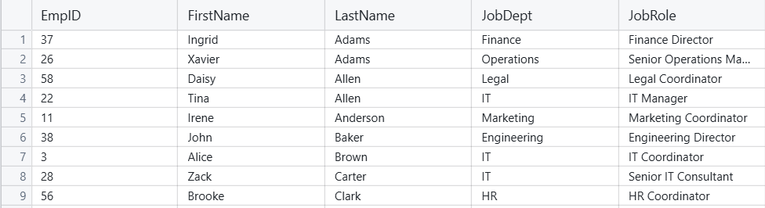
SQL Queries and Insights about Employee
1. Employee Headcount & Basic Info

Slide 8
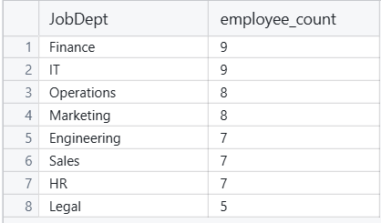
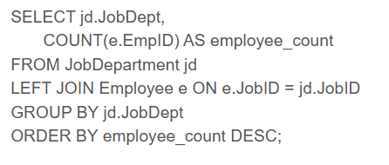
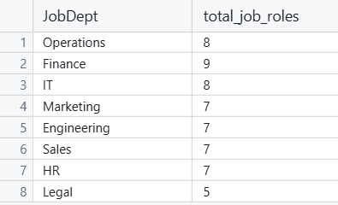
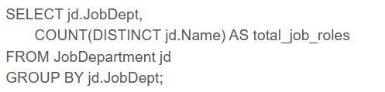
SQL Queries and Insights about Employee
2. Employee count per department
3. Number of different job roles per department

Slide 9
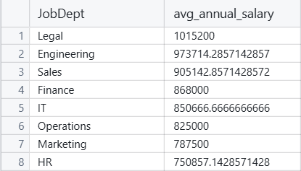
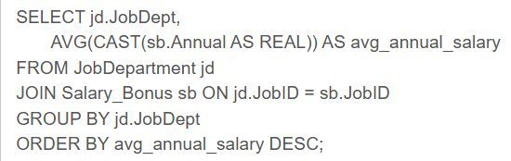
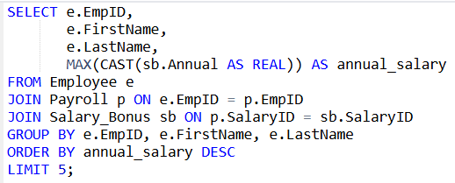
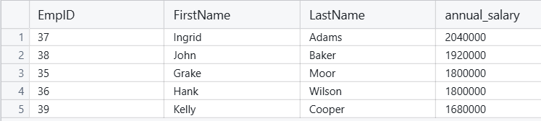
SQL Queries and Insights about Employee
4. Average salary per department
5. Top 5 highest-paid employees

Slide 10
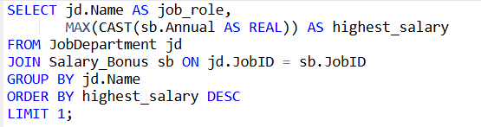

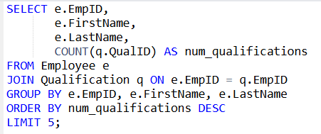
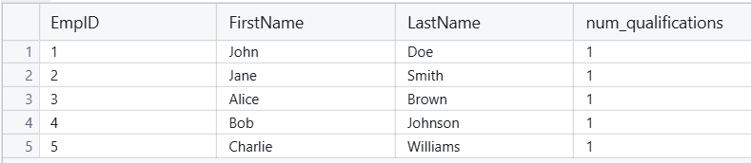
SQL Queries and Insights about Employee
6. Which job role offers the highest salary?
7. Employees with highest number of qualifications

Slide 11
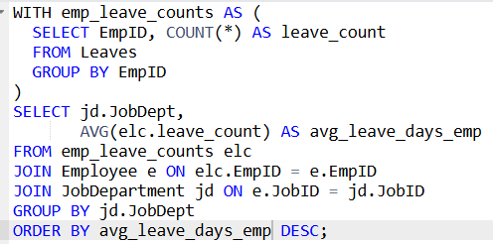
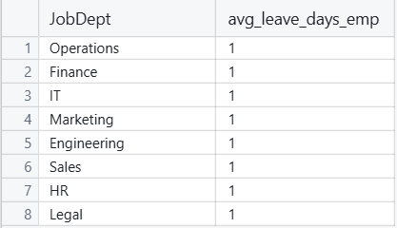
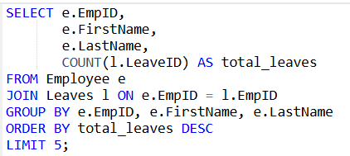
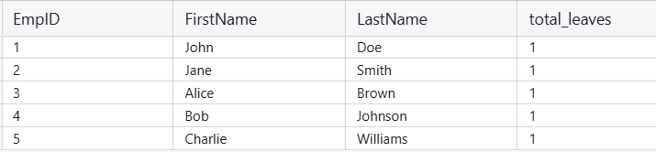
SQL Queries and Insights about Employee
8. Average leave count per department
9. Employees with most leaves

Slide 12
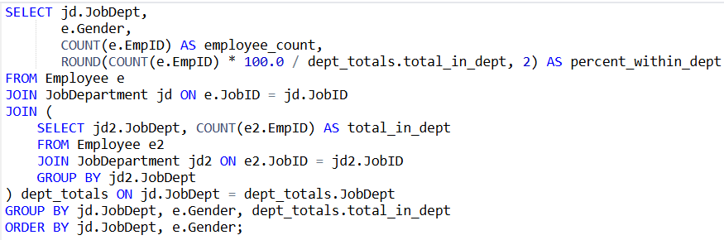
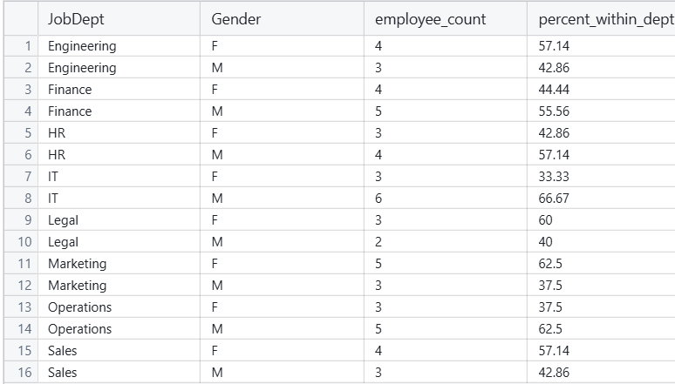
SQL Queries and Insights about Employee
10. Gender distribution across departments

Slide 13
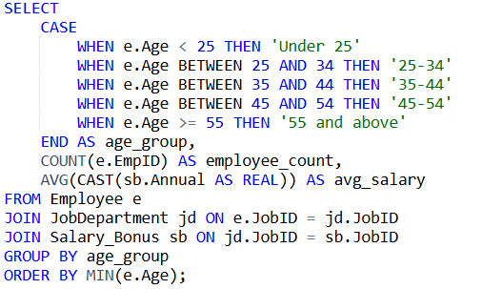
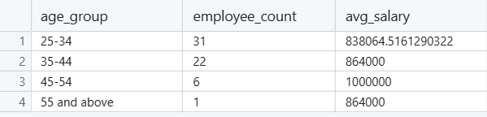
SQL Queries and Insights about Employee
11.Age distribution analysis

Slide 14
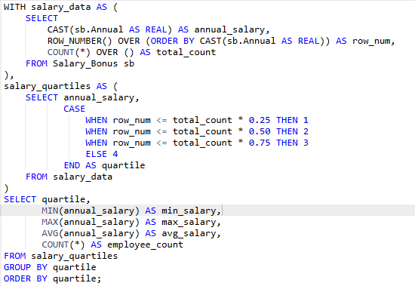
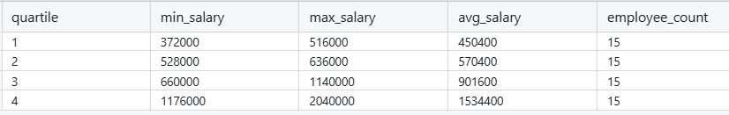
SQL Queries and Insights about Employee
12.Compensation quartiles analysis (using manual quartile calculation)

Slide 15
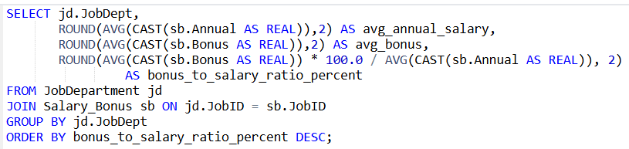
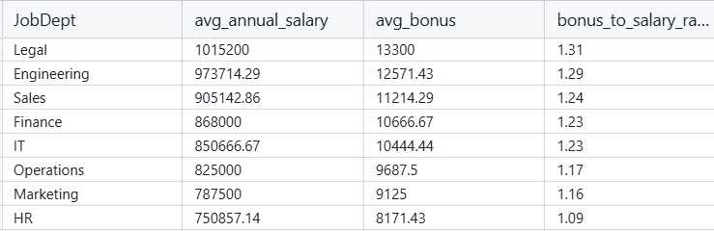
SQL Queries and Insights about Employee
13.Salary vs Bonus ratio analysis by department

Slide 16
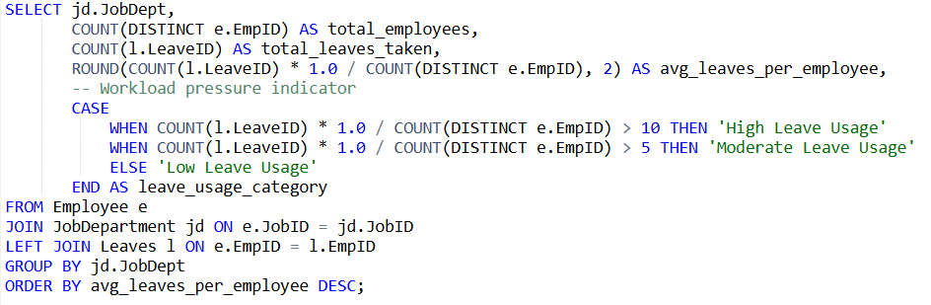
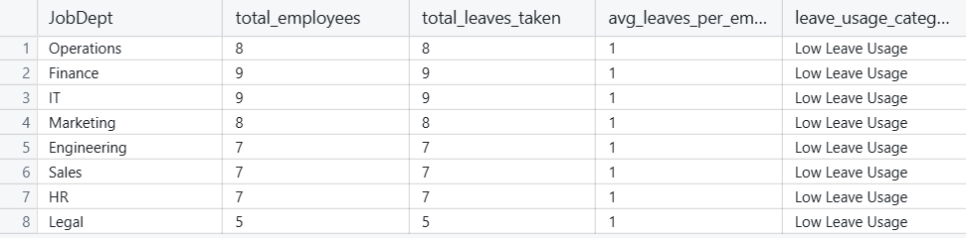
SQL Queries and Insights about Employee
14. Department workload analysis (employees vs leave patterns)

Slide 17
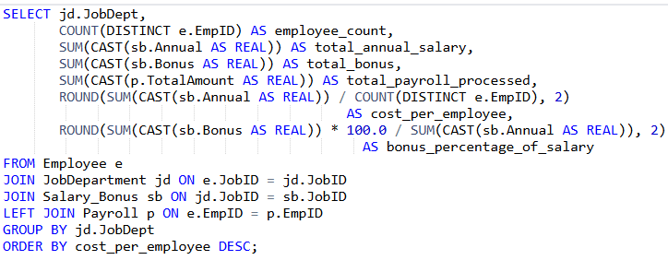
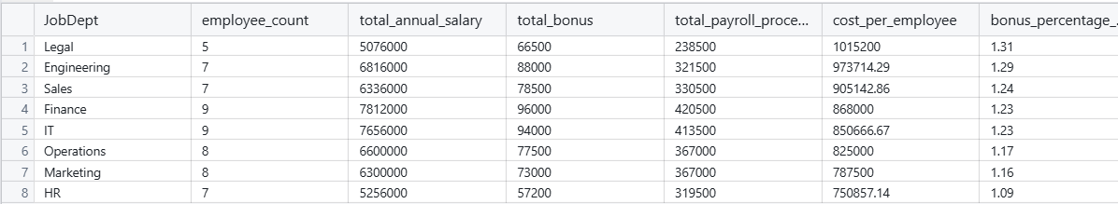
SQL Queries and Insights about Employee
15.Department cost analysis and budget efficiency

Slide 18
Conclusion
Project Summary:
Built a robust SQL-based Employee Management System covering personal profiles, job roles, salary/bonus, qualifications, leave, and payroll with six linked tables ensuring data integrity and easy access.
Used advanced SQL analytics for workforce demographics, pay equity, performance, and leave patterns. Enabled complex joins, aggregated analytics, and real-time reporting for actionable insights.
Supports data-driven HR decisions, optimizes workforce management, improves satisfaction, and enhances operational efficiency. Helps HR identify talent, monitor compensation, and manage leave trends effectively.
Provides a scalable, analytics-driven platform for modern HR operations and strategic organizational growth.

