Slide 1

Employee Management System

Slide 2

Introduction
This presentation gives an overview of the Employee Management System SQL project. This project is designed to make handling employee data easier and more organized . Key queries are shown with simple explanations to make data management easy to understand. The focus is on insights into employee data, payroll, salary, bonus, department analysis, roles, and leave management.

Slide 3

Objective
To design and implement a system that efficiently stores and manages employee-related data.
To track employee information including personal details, job roles, salary, qualifications, leaves, and payroll..
To ensure integrity and consistency of data using relational tables and foreign keys.
To simplify HR operations by making employee data easily accessible and accurate.

Slide 4
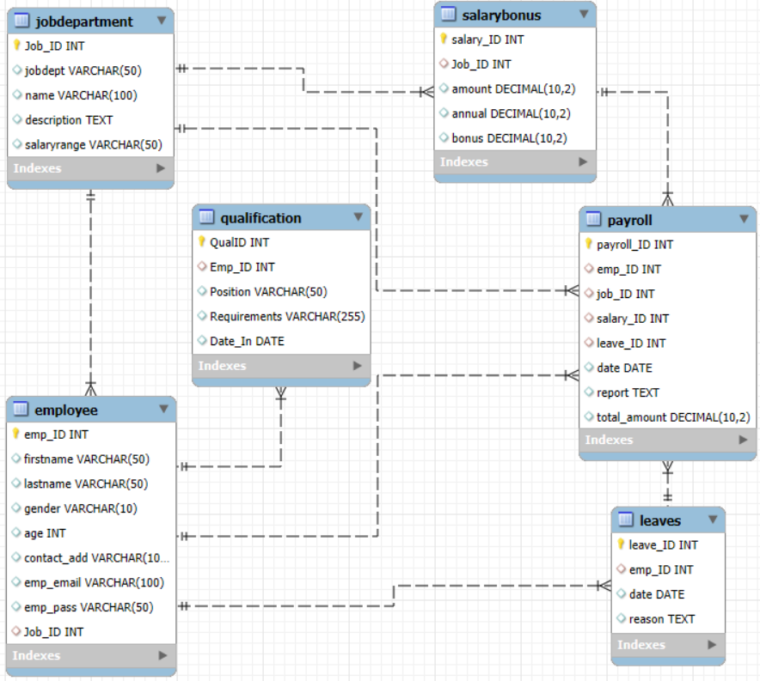
ER Diagram

Slide 5


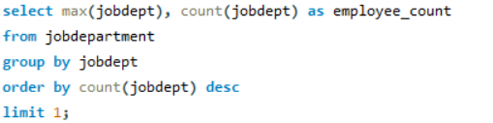

Analysis Questions
1. EMPLOYEE INSIGHTS
How many unique employees are currently in the system?
Which departments have the highest number of employees?

Slide 6
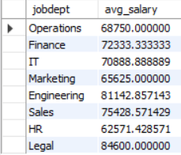



What is the average salary per department?
What is the total salary expenditure across the company?

Slide 7
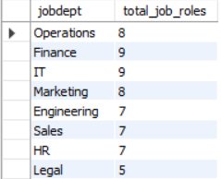

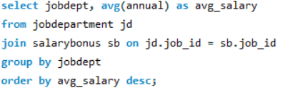
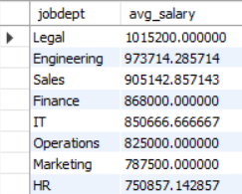
2. JOB ROLE AND DEPARTMENT ANALYSIS
How many different job roles exist in each department?
What is the average salary range per department?

Slide 8
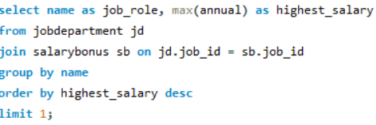

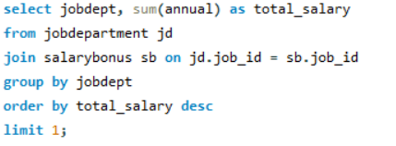

Which job roles offer the highest salary?
Which departments have the highest total salary allocation?

Slide 9


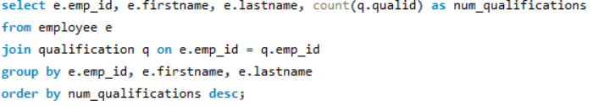
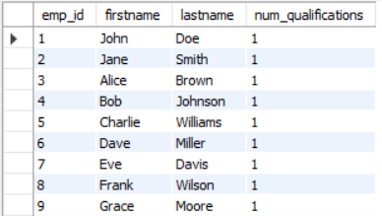
3. QUALIFICATION AND SKILLS ANALYSIS
How many employees have at least one qualification listed?
Which employees have the highest number of qualifications?

Slide 10


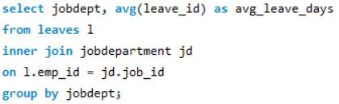
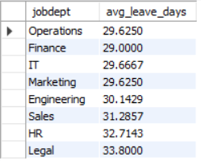
4. LEAVE AND ABSENCE PATTERNS
Which year had the most employees taking leaves?
What is the average number of leave days taken by its employees per department?

Slide 11
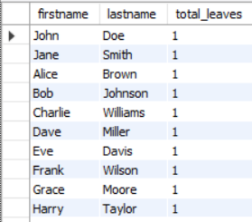



Which employees have taken the most leaves?
What is the total number of leave days taken company-wide?

Slide 12
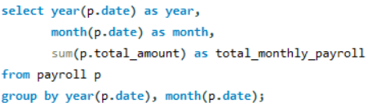

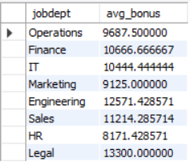
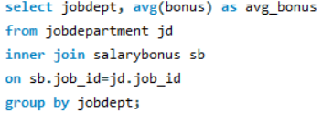
5. PAYROLL AND COMPENSATION ANALYSIS
What is the total monthly payroll processed?
What is the average bonus given per department?

Slide 13


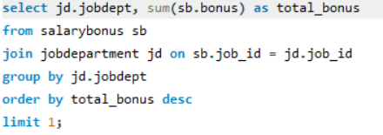

What is the average value of total_amount after considering leave deductions?
Which department receives the highest total bonuses?

Slide 14
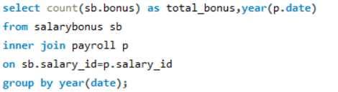

6. EMPLOYEE PERFORMANCE AND GROWTH
Which year had the highest number of employee promotions?

Slide 15

Conclusion
This SQL project successfully designs a Employee management system that manages employees, their job departments, salaries, bonuses, qualifications, leaves, and payroll reports. By using key SQL queries This SQL project successfully designs a payroll management system that manages employees, their job departments, salaries, bonuses, qualifications, leaves, and payroll reports.
These insights provide a solid foundation for data-driven HR decisions, organization development strategies aimed at optimizing workforce management.

Slide 16

THANK YOU

