Slide 1


SQL Case Study : Pizza Runner

Slide 2

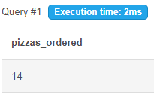
Question 1: How many pizzas were ordered?
Solution: Total 14 pizzas were ordered.

Slide 3

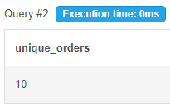
Question 2: How many unique customer orders were made?
Solution : There were total 10 unique orders.

Slide 4
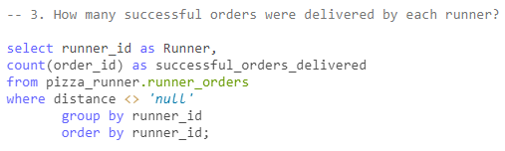
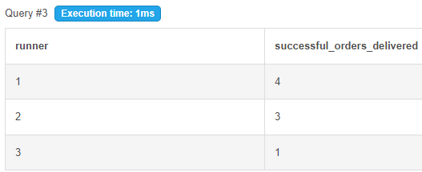
Question 3: How many successful orders were delivered by each runner?
Solution:

Slide 5
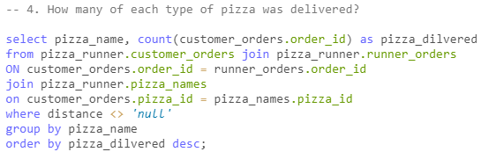
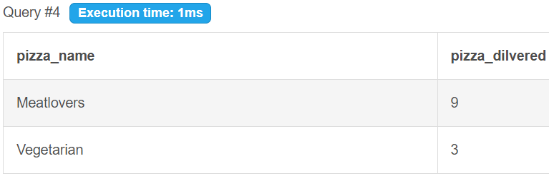
Question 4: How many of each type of pizza was delivered?
Solution:

Slide 6


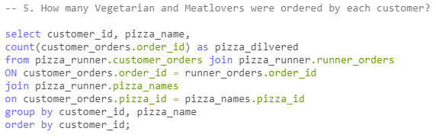
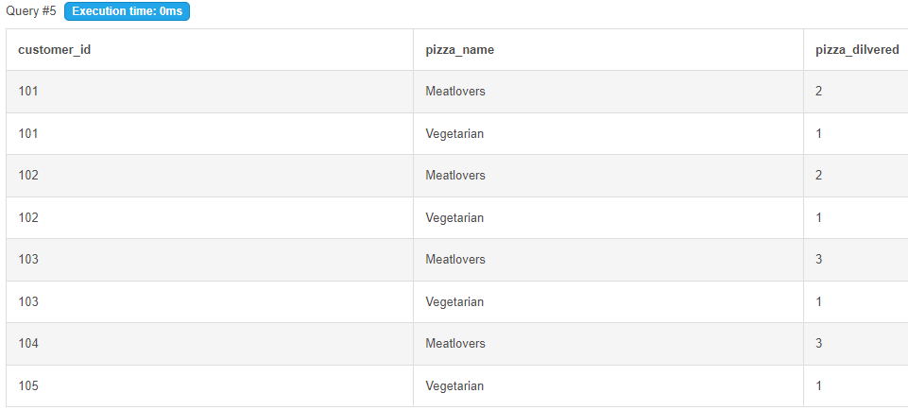
Question 5: How many Vegetarian and Meatlovers were ordered by each customer?
Solution:

Slide 7
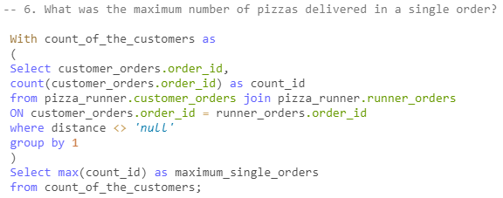
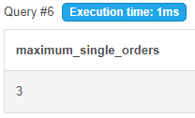
Question 6: What was the maximum number of pizzas delivered in a single order?
Solution:

Slide 8
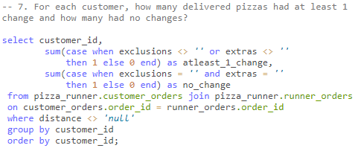
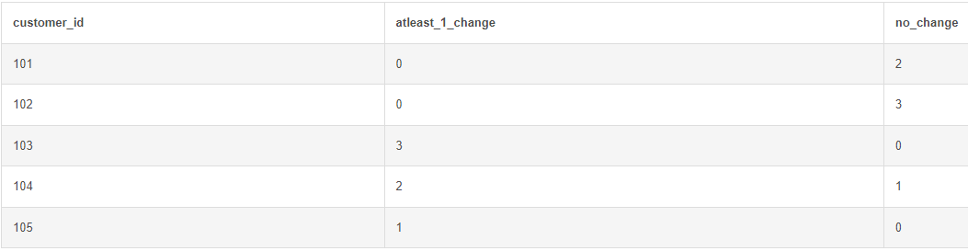
Question 7: For each customer, how many delivered pizzas had at least 1 change and how many had no changes?
Solution:

Slide 9
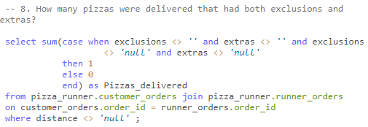
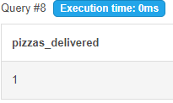
Question 8: How many pizzas were delivered that had both exclusions and extras?
Solution:

Slide 10
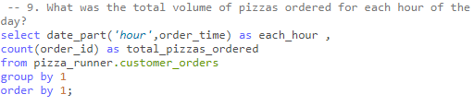
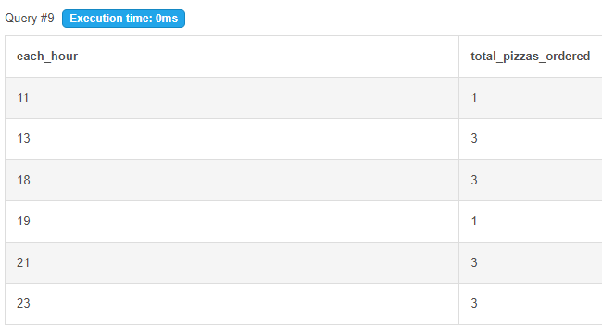
Question 9: What was the total volume of pizzas ordered for each hour of the day?
Solution:

Slide 11
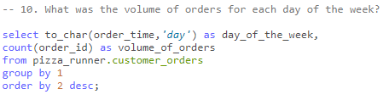
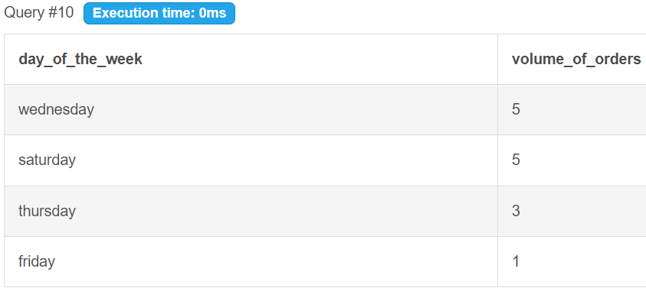
Question 10: What was the Volume of orders for each day of the week?
Solution:

Slide 12
Thank you

