Slide 1



WELLCOME TO
MERCHANDISING MANAGEMENT ERP SYSTEM

Slide 2

Prepared By :
Md Nayamul Islam
ID: 1281745
^{59th} Batch (session 2024)
Department : Web and Mobile App Development using Spring Boot, Android & Flutter
Email: nayamulislam@gmail.com
IsDB-BISEW IT Scholarship Programme
Moshaidul Islam
IsDB-BISEW IDB Bhaban (4th Floor)
E/8-A, Rokeya Sharani Sher-e-Bangla Nagar
Dhaka-1207, Bangladesh

Slide 3
Introduction
In today's fast-paced and competitive garment industry, effective merchandising management is crucial for success. The Merchandising Management ERP System is designed to streamline and enhance the merchandising process, ensuring that businesses can efficiently manage their resources, meet customer demands, and optimize their supply chain operations.
This innovative web application leverages the power of Angular for a dynamic and responsive user interface, Spring Boot for robust backend services, and MySQL for reliable data management. Together, these technologies create a seamless experience for users, allowing them to manage everything from raw material procurement to garment production and quality control.
Our ERP system focuses on the core aspects of merchandising, including:
Inventory Management: Track raw materials and finished goods in real-time to ensure optimal stock levels.
Order Processing: Streamline order entry, processing, and fulfillment to meet customer demands promptly.
Quality Control: Implement quality assurance protocols to maintain high standards in garment production.
Reporting and Analytics: Gain insights into sales trends, inventory turnover, and customer preferences to make informed decisions.
By integrating these functionalities into a single platform, the Merchandising Management ERP System empowers businesses to enhance their operational efficiency, reduce costs, and improve customer satisfaction. This presentation will guide you through the features, benefits, and implementation of our ERP solution, showcasing how it can transform your merchandising operations and drive growth in the competitive apparel market.

Slide 4
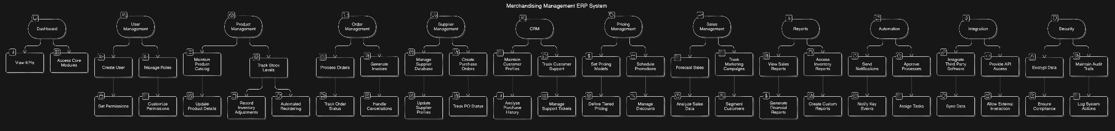
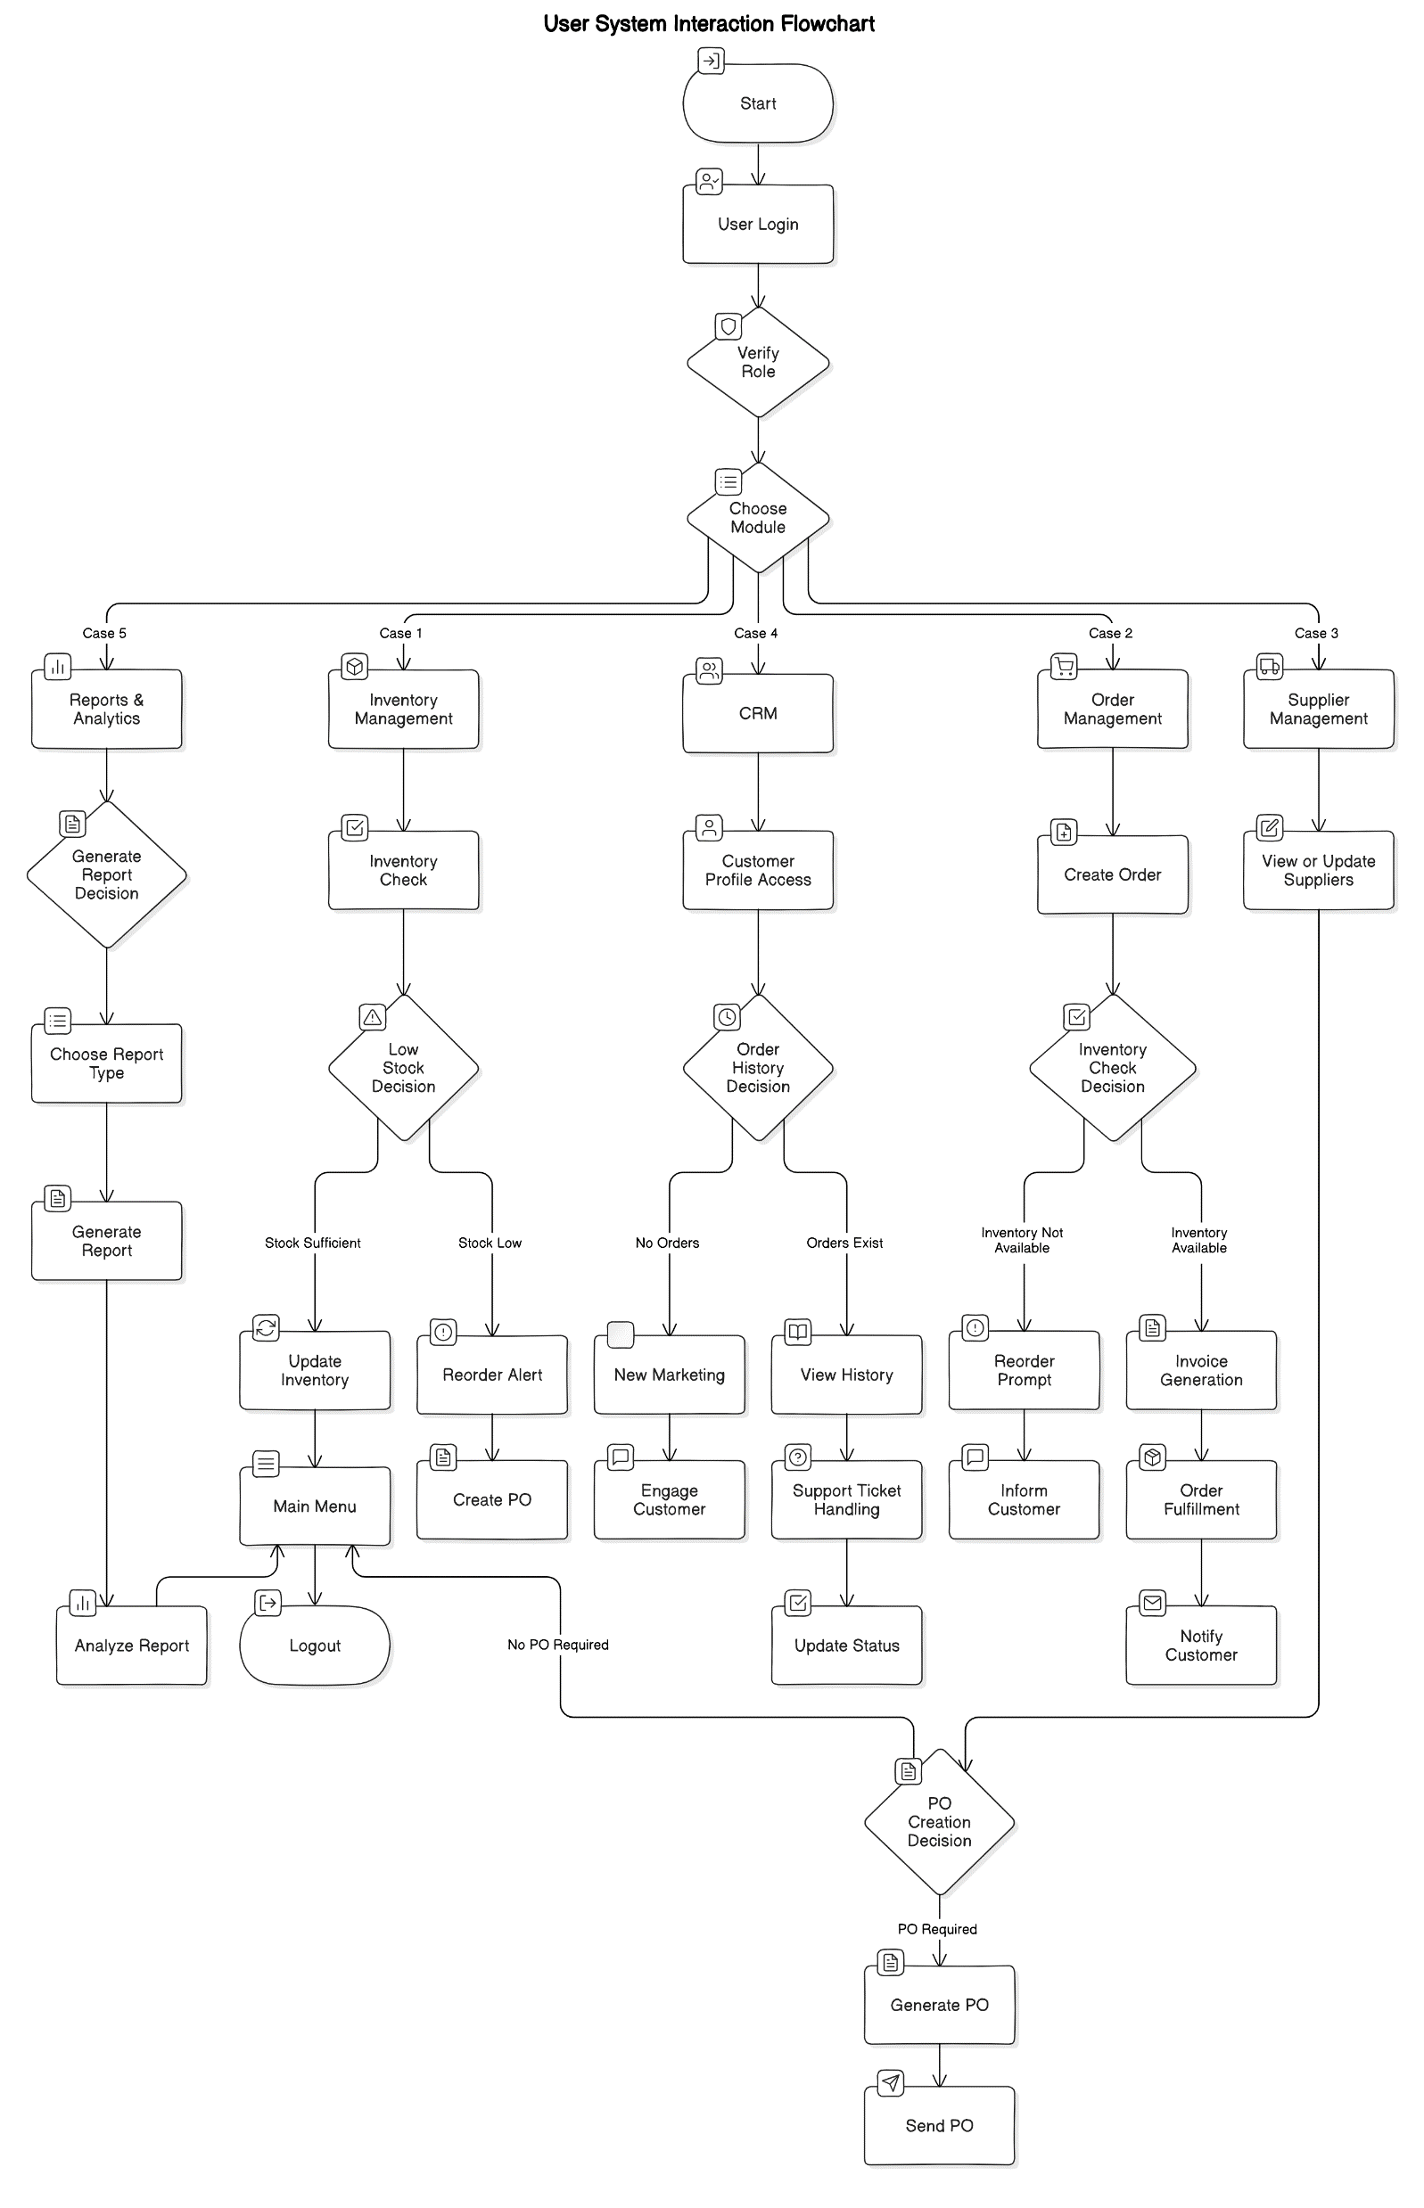
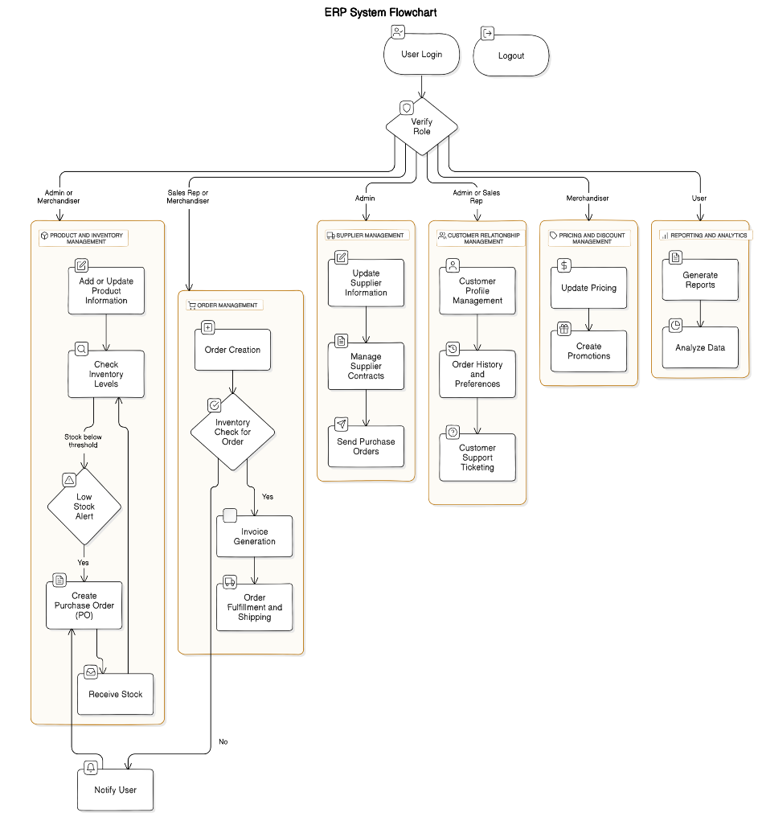
DIAGRAM FOR MERCHANDISING MANAGEMENT ERP SYSTEM

Slide 5
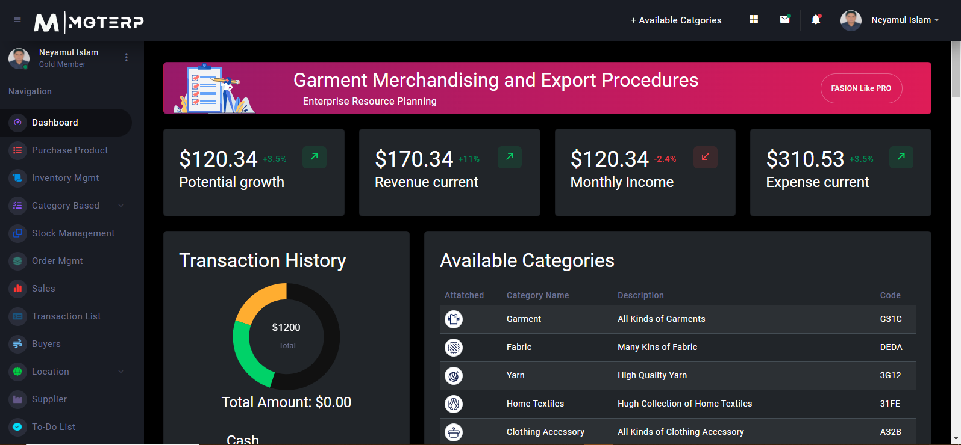
Main Dashboard Overview of Merchandise Management ERP

Slide 6
Merchandise Management ERP System
Overview
The Merchandise Management ERP System is an innovative web application designed to streamline merchandise operations for retail businesses. With a focus on enhancing customer satisfaction and profitability, this ERP system provides essential tools to manage inventory, orders, and supplier relationships effectively.
Technical Stack:
Frontend: Angular (TypeScript, HTML, CSS)
Backend: Spring Boot (Java)
Database: MySQL
APIs: RESTful APIs facilitate communication between the frontend and backend.
Authentication: Implementing JWT (JSON Web Tokens) for secure user authentication.

Slide 7
Key Features Merchandise Management ERP System
Inventory Management:
  Real-time tracking of stock levels
  Notifications for low or excessive stock
  Conduct regular inventory audits
Order Management:
  Streamlined order fulfillment
  Minimized picking and packing errors
  Detailed sales analytics to identify trends
Supplier Tracking:
  Organized supplier database
  Performance evaluation based on delivery and quality
  Contract management with renewal alerts

Slide 8
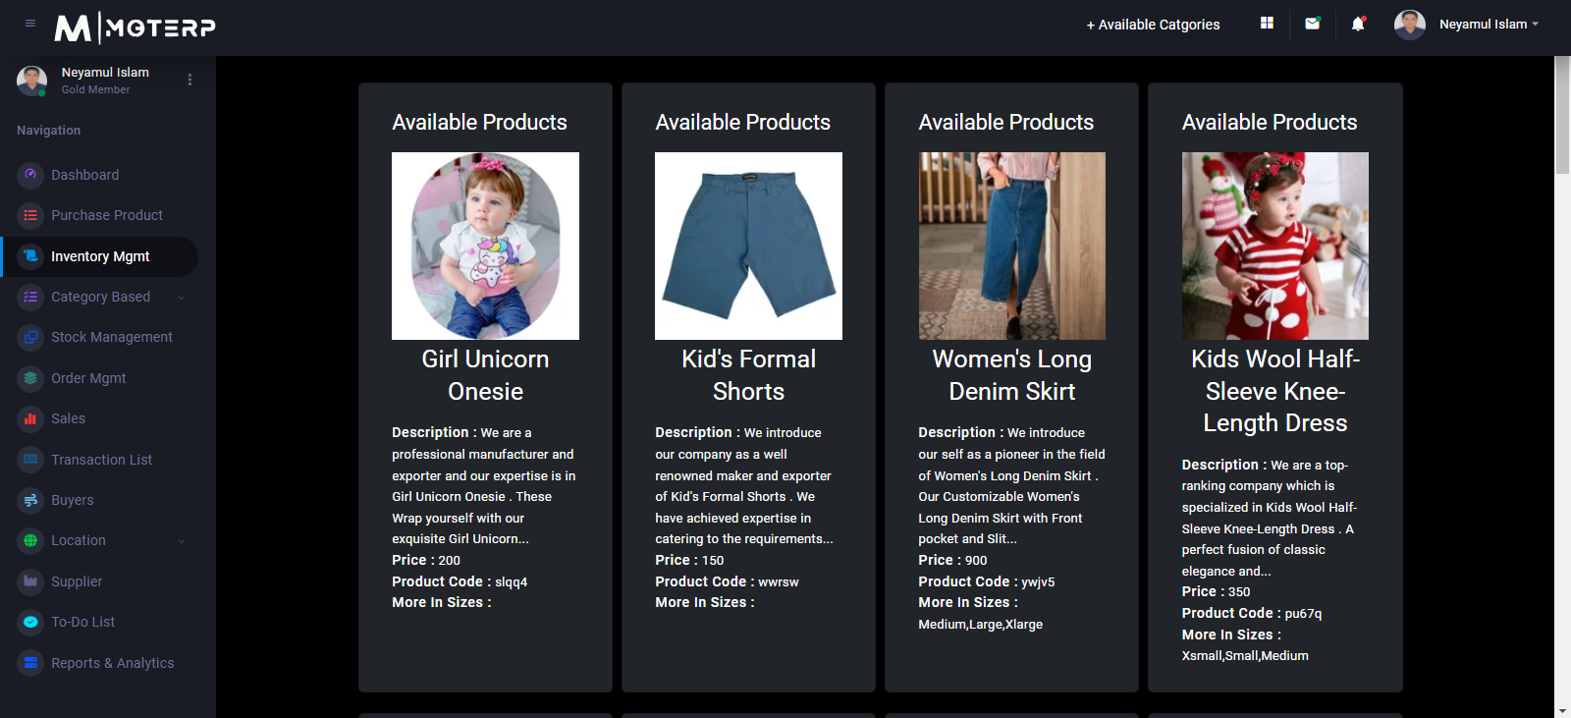
Inventory Management Futures

Slide 9
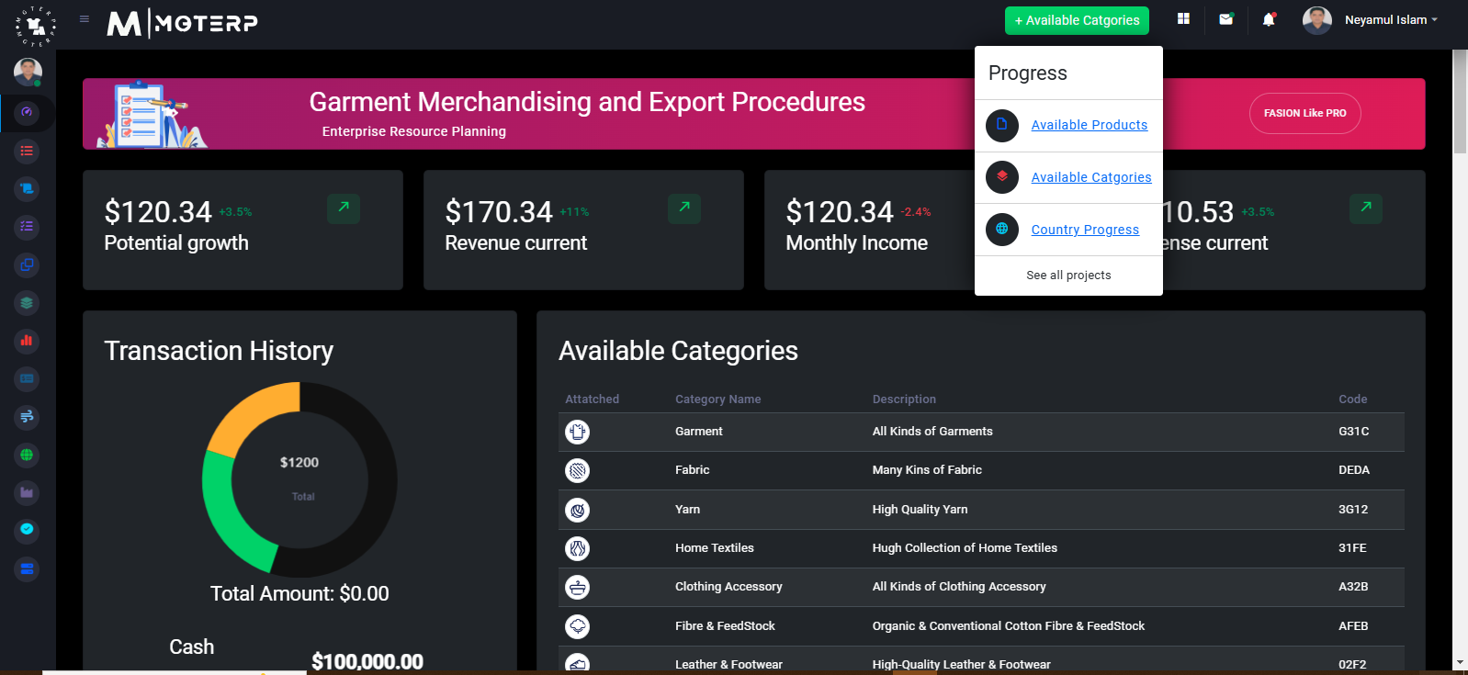
Progress Overview With Transaction History

Slide 10
User Management and Security
Role-Based User Management:
  Define user roles and permissions
  Secure access to sensitive data
Authentication:
Implementing JWT (JSON Web Tokens) for secure, stateless user authentication

Slide 11
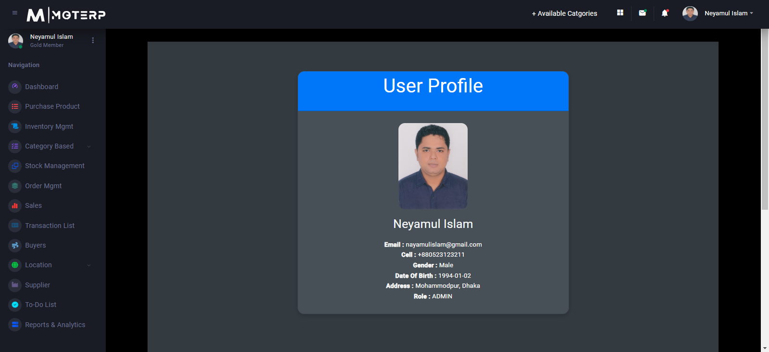
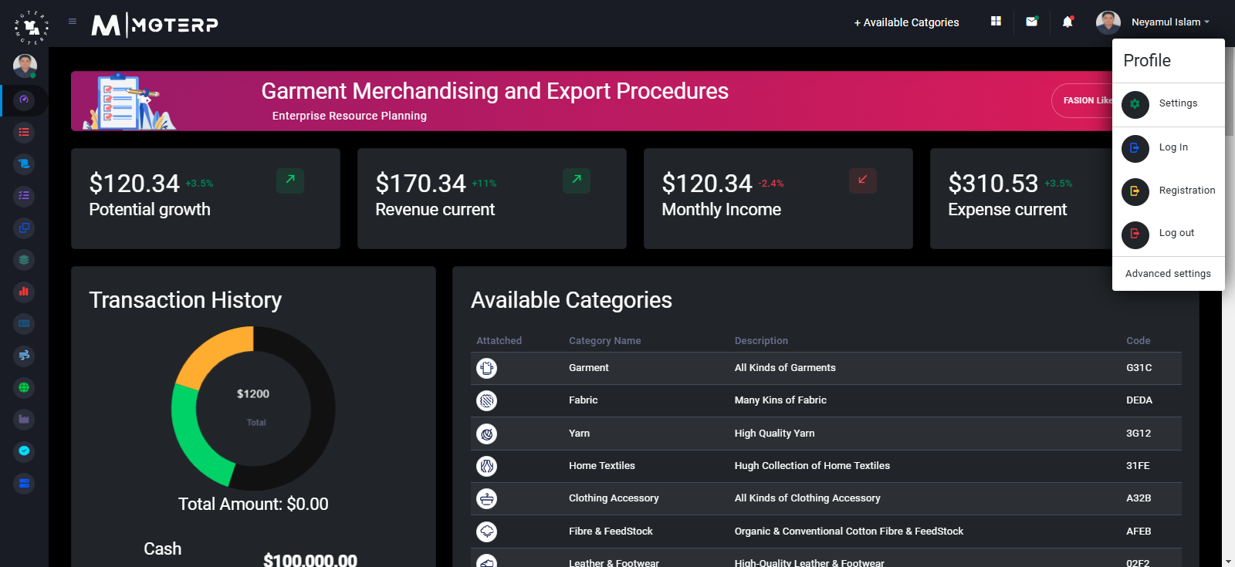

Slide 12
Technical Stack
Frontend:
  Angular (TypeScript, HTML, CSS)
Backend:
  Spring Boot (Java)
Database:
  MySQL for efficient data management
APIs:
  RESTful APIs ensure smooth communication between frontend and backend

Slide 13
Responsive Design
Accessibility Across Devices:
  User-friendly interface adaptable for desktops, tablets, and mobile devices
  Ensures management on the go

Slide 14
Goals and Objectives
Enhance operational efficiency in retail businesses
Improve profitability and customer satisfaction
Enable strategic growth through streamlined operations

Slide 15
Conclusion
The Merchandise Management ERP System is a vital tool for retailers looking to optimize their operations. With its comprehensive features, secure architecture, and user-friendly design, it empowers businesses to navigate the complexities of modern retail effectively, driving growth and ensuring long-term success.

Slide 16


Slide 17

Thank you!
Feel free to ask any questions

Slide 18


http://www.textilelab.blogspot.com (Visit )
1. Yarn Manufacturing Technology
Link : http://www.facebook.com/pages/Yarn-Manufacturing-Technology/485014954866808
2. Fabric Manufacturing Technology
Link : http://www.facebook.com/pages/Fabric-Manufacturing-Technology/459520217425605
3. Garments Manufacturing Technology
Link : http://www.facebook.com/pages/Garments-Manufacturing-Technology/472364799463126
3. Wet processing Technology
Link : http://www.facebook.com/pages/Wet-Processing-Technology-Dyeing-/468645219825404
4. Fashion-Design-and-Technology
Link : http://www.facebook.com/pages/Fashion-Design-and-Technology/587655294583875?ref=ts&fref=ts
My Facebook Textile related Pages

