Slide 1

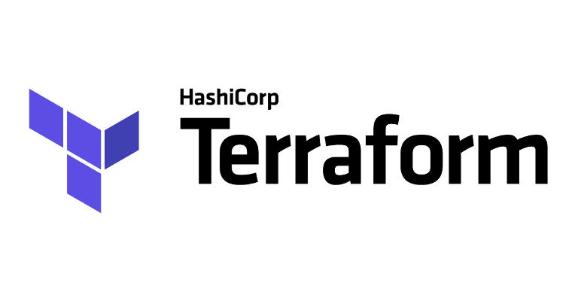
Terraform

Slide 2
What is Terraform?
tool for building, changing, and versioning infrastructure.
infrastructure as a code (IaC) tool
helps build, manage, and scale your infrastructure easily and effectively.
supports multi-cloud like Amazon Web Services, Microsoft Azure, and Google Cloud Platform, or on-prem in private clouds such as VMWare vSphere, OpenStack, or CloudStack.
primary use : ensure infrastructure never drifting away from its desired configuration.
The language used for configuration is Hashicorp Configuration Language (HCL).

Slide 3
What is Infrastructure as Code (IaC)?
process of managing infrastructure in a file or files rather than manually configuring resources in a user interface.
A resource in this instance is any piece of infrastructure in a given environment, such as a virtual machine, security group, network interface, etc.
terraform allows you to use HCL to build files that contain your desired resource configuration and automates the creation of those resources at any time using the apply command.

Slide 4
How does it work?
create a set of files with a list of resources you want to deploy and then deploy those to your environment using terraform CLI which handles all the state management and upgrades for you as your codebase and requirements increase over time.
Resource Scope - A general idea of what resources you need in your cloud environment to build configuration files for them.
Configuration Files - Creating the configuration file based on the scoped resource list.
Initialize – Runningi”Terraform init” n the project directory with the configuration files.
Plan - to verify creation process
Apply - create resources as well as state file that compares future changes in your configuration files to what actually exists in your deployment environment.

Slide 5
Installing Terraform on Windows
Download the Executable Zip file for Terraform.
Unzip the package downloaded from the official Hashicorp website to any local directory of your choice.
Copy the terraform.exe from the extracted files, and store it inside your C:\\Windows folder. This ensures that you can run the terraform commands using PowerShell or CMD from any folder on your computer.
If you don't prefer the previous method to store the file inside your Windows directory, you can store the executable anywhere as long as you update your 'Environment Variables' with the path to the terraform executable.

Slide 6
Some basic Commands
Terraform Help
Terraform Init
Terraform Plan
Terraform Apply
Terraform Destroy
Terraform State

Slide 7

Questions ? Please !

