Slide 1
Association
Nisheeth
4th January 2018

Slide 2
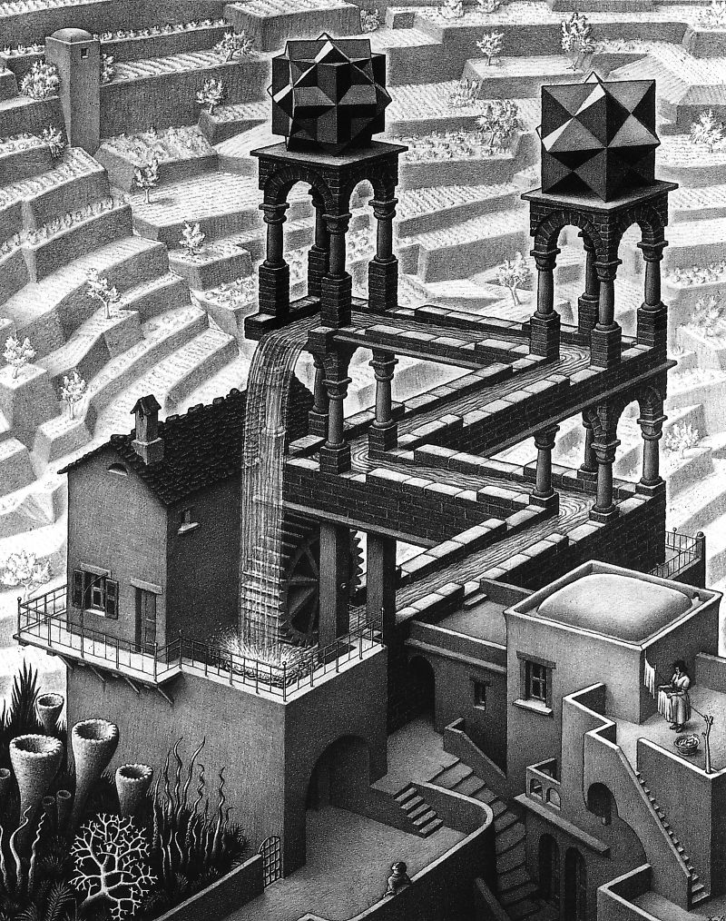
Welcome to CS786 - a computational cognitive science course!

Slide 3
Mind
Cognition
World
Cognition is the process by which the observer assembles what is observed into knowledge based on what the observer already knows

Slide 4
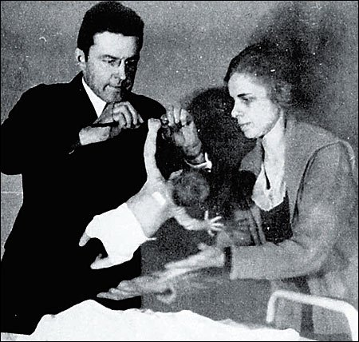
Does cognition have a cold start problem?
Developmental psychologists have found that even newborns come with a large bag of phenotypic and genetic experience

Slide 5
Cognition and computation
Cognition is fundamentally path-dependent
Purely analytic approaches fare poorly with path-dependence
Computation maps on to cognitive path-dependence well
Mind
Cognition
World

Slide 6
About me
I’m Nisheeth
I sit in KD303
Office hours for this course will be Friday 1500-1700?
Informal office hours right after the class everyday
Email : nsrivast at cse.iitk.ac.in
Phone: 7916

Slide 7
Course details
CS786
TThF 0800-0850
KD101
7 quizzes (best 6 of 7 contribute 10% to course grade each)
May include take home programming components
Programming prep needed
ESC101
Courage
No midsem or endsem
20% grade for class participation
20% grade for experiment participation

Slide 8
Course structure
Sequence of seven modules
Each module will last two weeks = 6 lectures
Split into 5 lectures + 1 quiz-cum-discussion hour
Quiz will sometimes have a take-home programming component
Can ask TAs for help with programming problems
Reading material will be assigned as web-links within each lecture
If you don’t read, you won’t be able to contribute in the discussion hour, which will draw upon these readings
Students are also encouraged to suggest their own readings; I will add them to the list if they seem relevant
Don’t have to read all the material assigned, but the more you do, the more fun you will have in the discussion hour

Slide 9
Course content
Organizational principles
Foundations
Association
Reinforcement
Hierarchy
Perception-action-control loop
Knowledge representation
Similarity and categorization
Perception
Memory
Knowledge processing
Decision-making
From knowledge to behavior
Motor control
Language

Slide 10
Course policies
Attendance is voluntary
But the class sessions will be the most important element of the course
You won’t be able to keep up with the course just by following the slides
Add-drop deadline is 12th Jan
Drops beyond that will require instructor and DUGC permission
My permission can be taken for granted
Assuming good faith on your part (regular attendance and participation), the lowest possible grade you will get is C

Slide 11
Course philosophy
This is a science course, not an engineering course
Emphasis is on following the chain of understanding where it leads, not developing technical competence
We will cover a lot of topics, many unrelated to each other
Quizzes will be very easy
If you have come to class and read the reading material, you will have no trouble
Collaboration in programming assignments is acceptable (with acknowledgement)
There will be a lot of math
But only math to read, not math to do
Don’t let it scare you

Slide 12
This module - foundations
Association (today)
Reinforcement (tomorrow)
Classical cognitive architectures (Tuesday)
Modern cognitive architecture (Thursday)
Quiz + discussion (Friday)

Slide 13
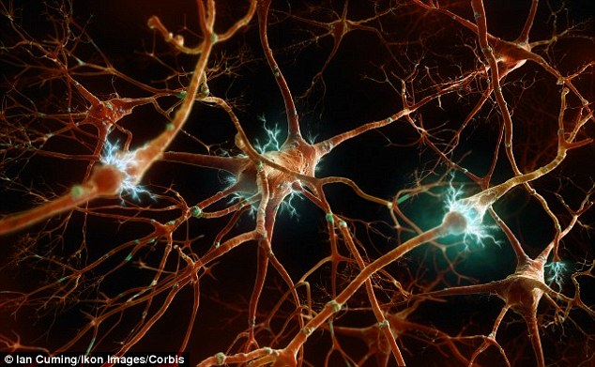
Association
A computer stores information randomly. A mind contains concepts associatively

Slide 14
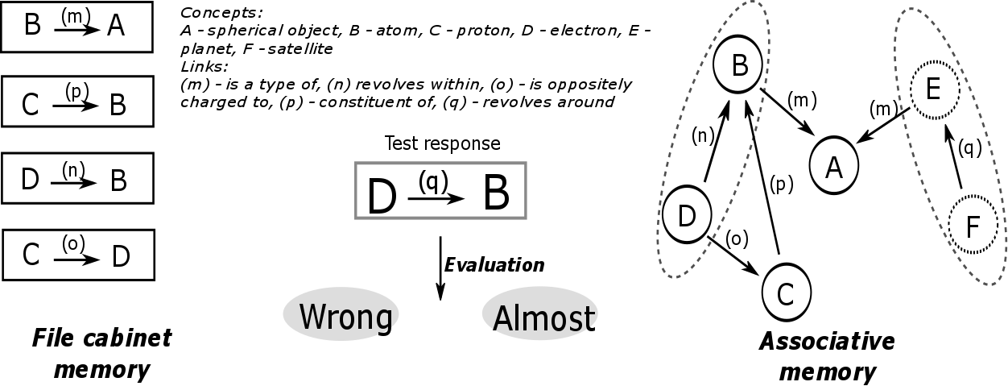
Knowing concepts associatively
Related concepts are activated concurrently

Slide 15
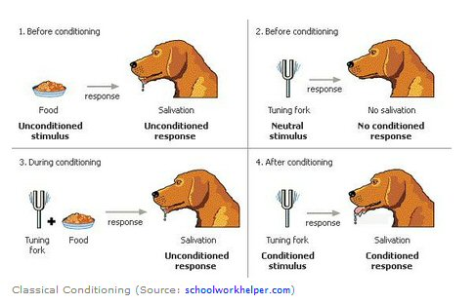
What is relatedness?
Co-occurrence → Among the first behavior invariants discovered
Functionally unrelated concepts become related when they are presented together
Pavlov’s dogs learned to associate sound with food.

Slide 16
Associativity is at the heart of human learning
Spin a story that would make this student’s associative error plausible

Slide 17
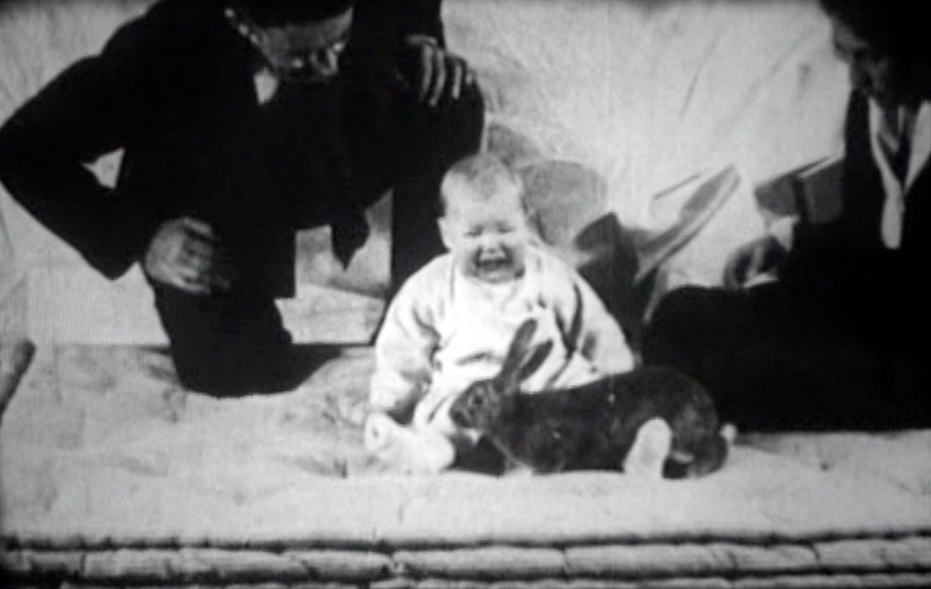
Studied systematically in conditioning experiments
Not all as interesting as Watson’s Little Albert experiment (pictured below)

Slide 18

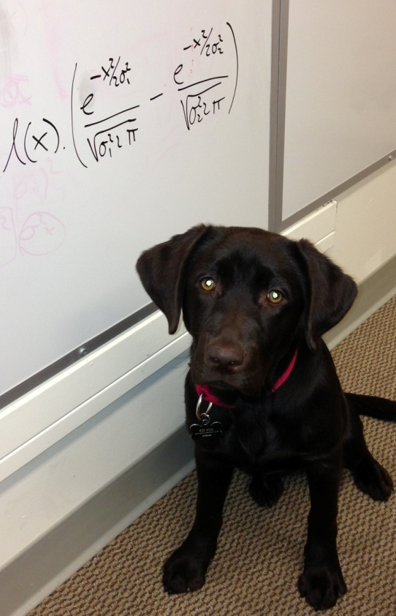
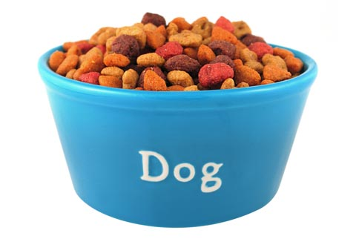
Appearance of stimulus is closely followed by a particular behavior

Slide 19
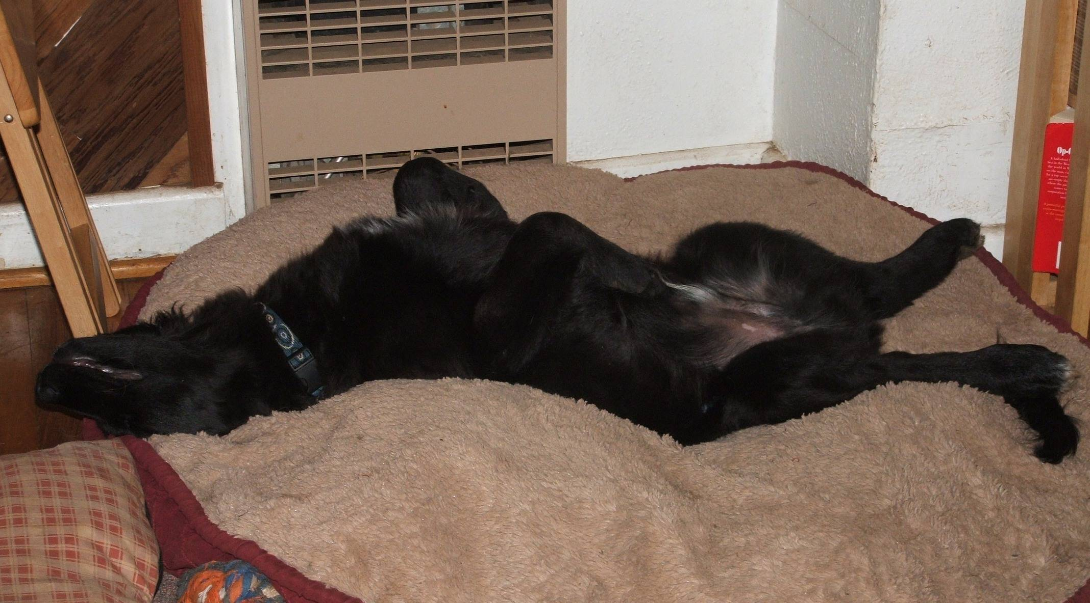
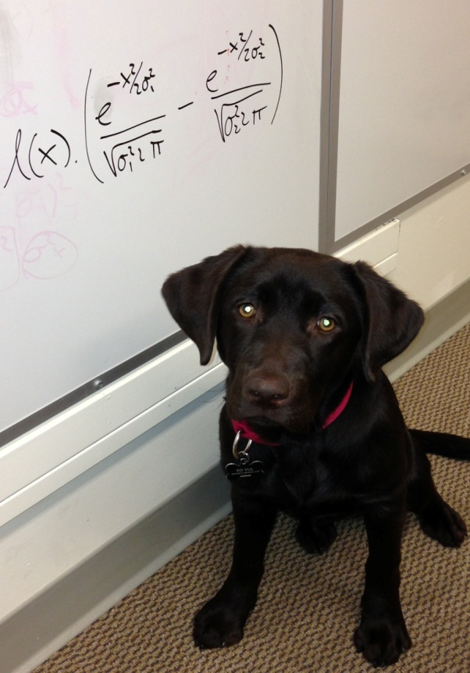


Slide 20



CS: conditioned stimulus
US: unconditioned stimulus

Slide 21
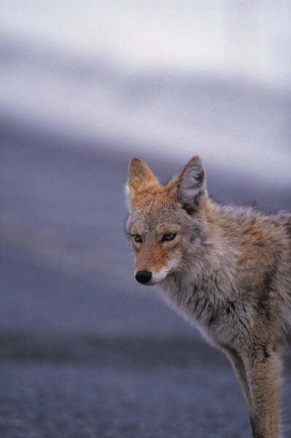
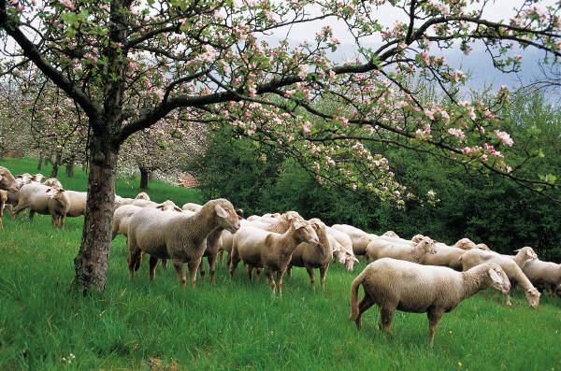
Real-Life Examples of Classical Conditioning
Gustavson and Gustavson (1985) – Conditioned Taste Aversion
Coyotes killing sheep – problem to sheep farmers
Study conditioned coyotes not to eat the sheep
Sheep meat (CS) sprinkled with a chemical (UCS) that would produce a stomachache (UCR)
After coyotes ate the treated meat,
they avoided the live sheep (CR)
This humane application of conditioned taste aversion might be used to control other predators as well

Slide 22

Real-Life Examples of Classical Conditioning
Metalmikov & Chorine (1926, 1928) – Immune System
Injected Guinea Pigs with Foreign agents (non lethal)
→ antibodies → boost their immune system
Then paired injections with Lights
Lights + Injections = better immunity
Lights alone = better immunity
Later Injected Cholera: animals with prior conditioning
better survival vs controls with no conditioning

Slide 23

In A Clockwork Orange, a mass murderer, is strapped to a chair and forced to watch violent movies while he is injected with a drug that nauseates him. So he sits and gags and retches as he watches the movies. After hundreds of repetitions of this, he associates violence with nausea, and it limits his ability to be violent.

Slide 24

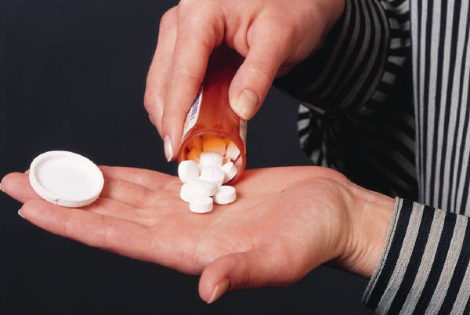
Real-Life Examples of Classical Conditioning
Drug Tolerance Drug Overdose
drug users become increasingly less responsive
to the effects of the drug
tolerance is specific to specific environments (e.g. bedroom)
familiar environment becomes associated with a compensatory response (Physiology)
taking drug in unfamiliar environment leads to lack of tolerance → drug overdose

Slide 25


Slide 26
Clinical therapies
People keep trying to use conditioning-based methods, e.g. ‘flooding’ to treat phobias, fears and trauma-related disorders
Doesn’t work very well – fear conditioning is much stronger than fear extinction
For reasons that may become clearer as we go along
Can you think why? response more resistant to extinction

Slide 27
Modeling classical conditioning
Most popular approach for years was the Rescorla-Wagner model
Could reproduce a number of empirical observations in classical conditioning experiments
Some versions replace V_{tot} with V_{x}; what is the difference?
http://users.ipfw.edu/abbott/314/Rescorla2.htm

Slide 28
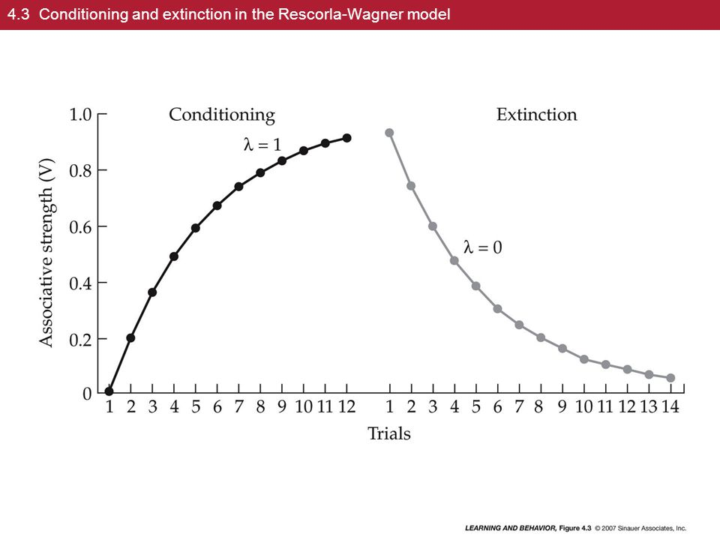

Slide 29
What RW could explain

Slide 30

What it couldn’t
Pre-exposed
Latent inhibition

Slide 31
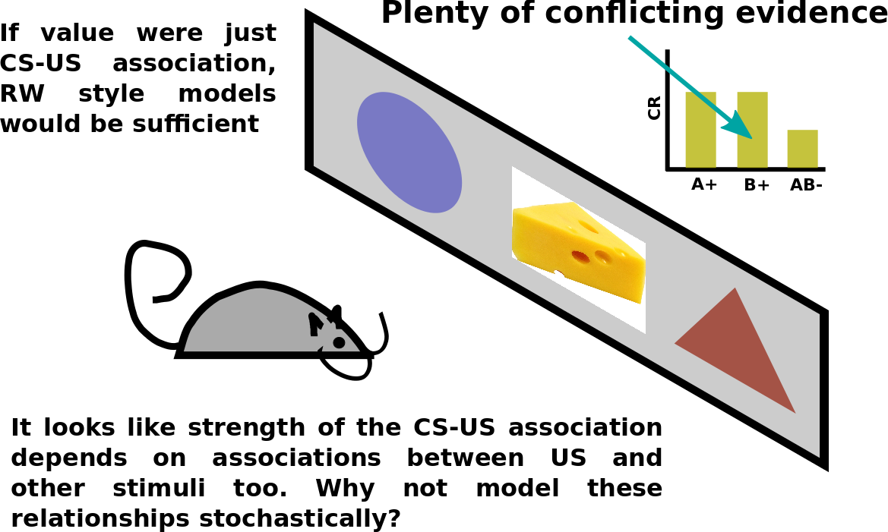
https://en.wikipedia.org/wiki/Rescorla%E2%80%93Wagner_model

Slide 32
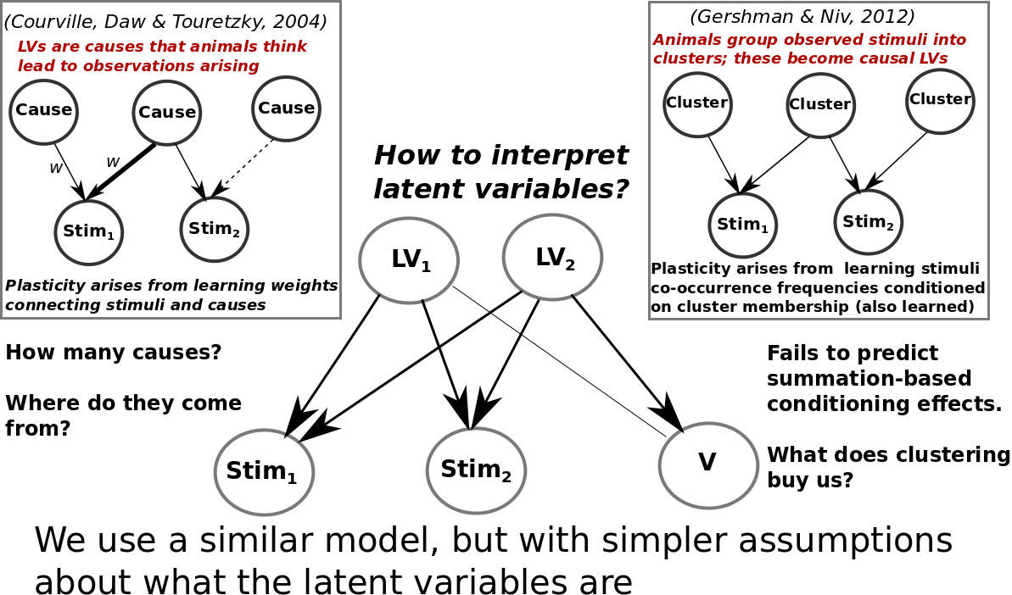
Bayesian models of classical conditioning

Slide 33
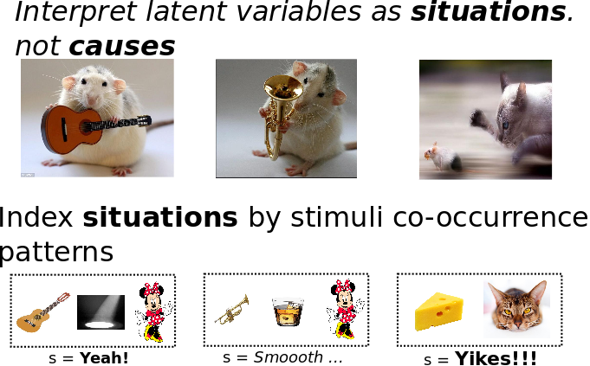
https://link.springer.com/article/10.3758/s13420-012-0080-8

Slide 34
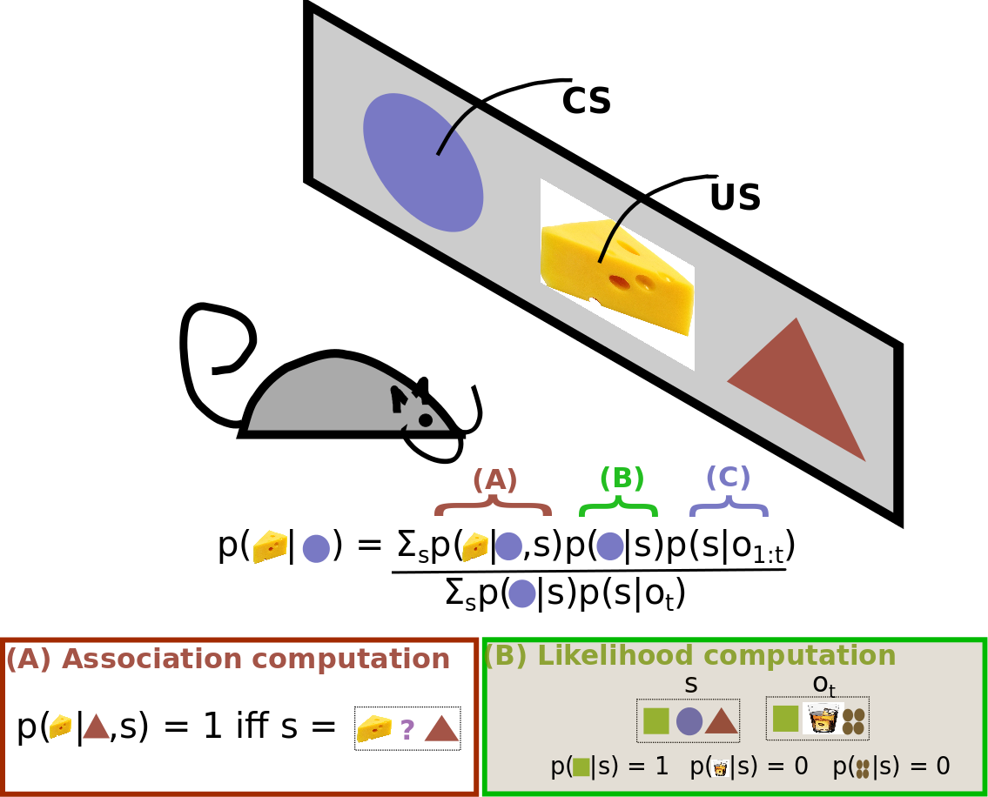

Slide 35
Problems for Bayesian conditioning models
How to incorporate the role of time?
How to incorporate the role of attention and salience?
How to model the process by which animals learn the higher-order structure within latent causes?

Slide 36
Summary
The mind learns by association
Associates novel with known, based on a number of ways of relation
Association of novel to known causes generalization
Association of known with known causes reinforcement
We will talk about reinforcement next

