Slide 1
Reinforcement
Nisheeth
5th Jan 2018

Slide 2
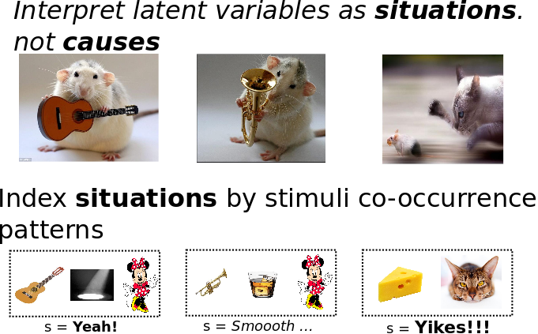
https://link.springer.com/article/10.3758/s13420-012-0080-8

Slide 3
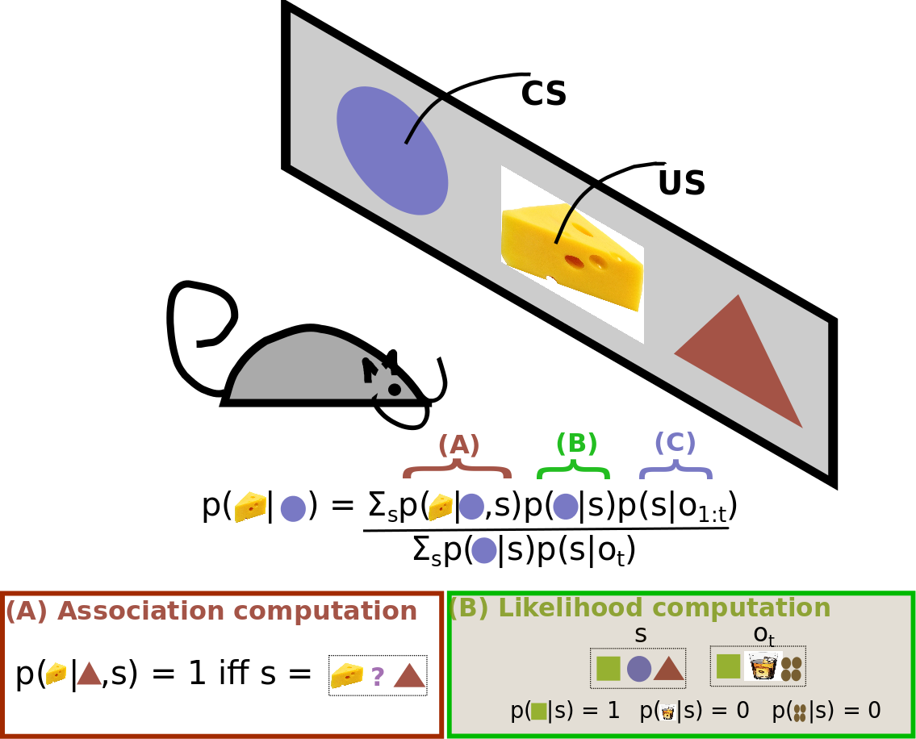

Slide 4
Bayes 101
Bayes theorem is a simple consequence of conditional probability factoring
Lends itself easily to sequential updates
Great fit for cognitive modeling
Models interaction of already known with new data

Slide 5
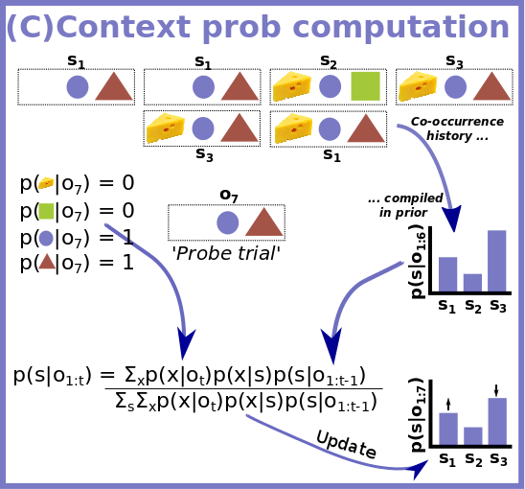

Slide 6
Some RW failures explained by latent cause model
Spontaneous recovery from extinction
Facilitated reacquisition
Conditioned inhibitor pairing
Pre-exposure effect
Higher order conditioning

Slide 7
Association vs reinforcement
Association: things that occur together in the world, occur together in the mind
Tested using classical conditioning
Environment acts on the observer
Reinforcement: actions that are rewarded become desirable in future
Tested using operant/instrumental conditioning
Observer acts on the environment

Slide 8
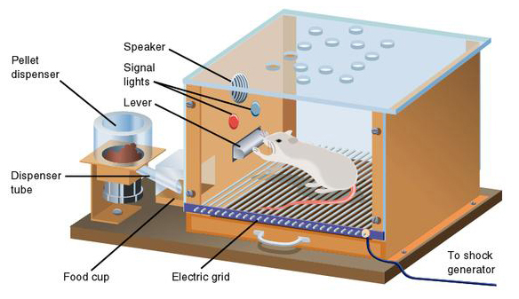
Operant conditioning
Observers act upon the world, and face consequences
Consequences can be interpreted as rewards

Slide 9
Modeling classical conditioning
Most popular approach for years was the Rescorla-Wagner model
Could reproduce a number of empirical observations in classical conditioning experiments
Some versions replace V_{tot} with V_{x}; what is the difference?

Slide 10
Can modify to accommodate reward prediction
Original equation
Update size based on associative strength available
Bush-Mosteller model of reinforcement, for action a

Slide 11
Generalized reinforcement learning
Bush Mosteller style models simply update value based on a discounted average of received rewards
Useless in trying to predict the value of sequential events, e.g. A → B → reward
A more generalized notion of reward learning was needed
Temporal difference learning
Other flavors of reinforcement learning (out of scope)

Slide 12
Reinterpreting the learning gradient
In Bush Mosteller, the reward prediction error is driven by the difference between
A discounted average of received rewards
The current reward
In TD learning, RPE is the difference between
Expected value of discounted future rewards
Information suggesting the expectation is mistaken
http://www.scholarpedia.org/article/Temporal_difference_learning

Slide 13
The TD learning algorithm
Bush Mosteller algorithm
TD algorithm
Discounted future rewards not available instantaneously
Use math trick

Slide 14
The TD reward prediction error
Learning continues until reward expectations are perfectly aligned with received reward

Slide 15
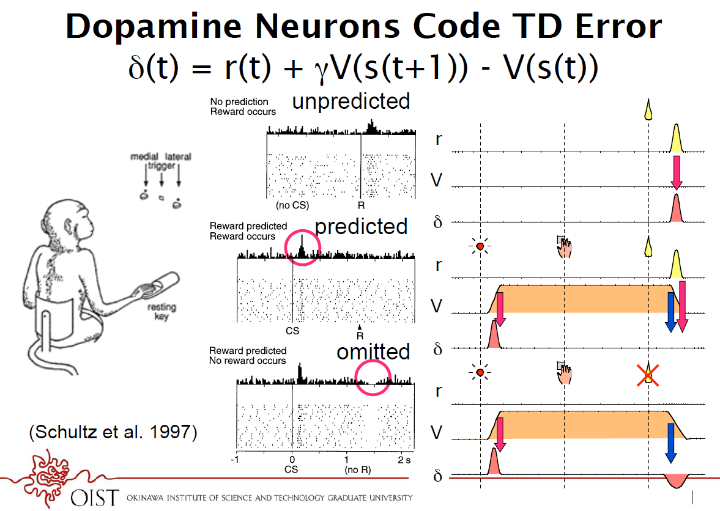

Slide 16
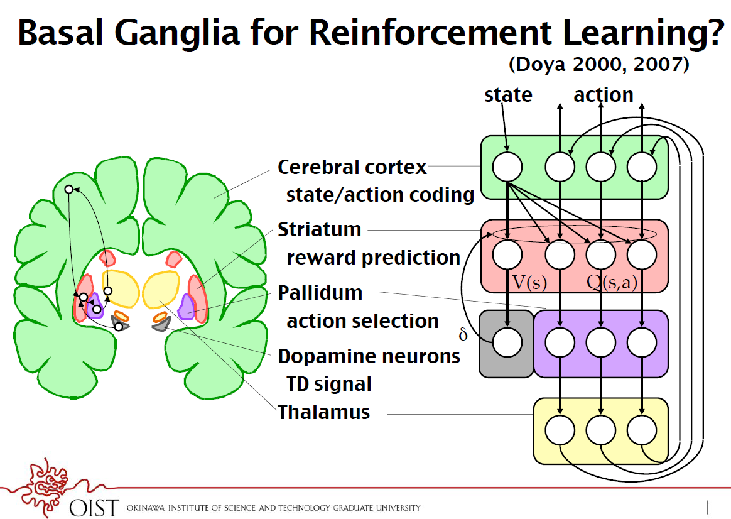
http://www.pnas.org/content/108/Supplement_3/15647.full

Slide 17
Addiction as a computational process gone awry
David A. Redish, Science 2004
Under natural circumstances, the temporal difference signal is the following:
The idea is that the drug (especially dopaminergic drugs like cocaine) may induce a small temporal difference signal directly (D), such that:
In the beginning the temporal difference signal is high, because of the high reward value of the drug (rational addiction theory). But with longer use, the reward value might sink, and negative consequences would normally reduce the non-adaptive behavior. But because d is always at least D, the behavior can not be unlearned.

Slide 18
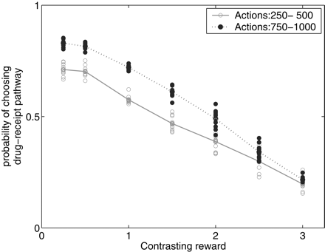
Increased wanting (not more liking)
The model predicts that with continued use, the drug-seeking behavior becomes more insensitive to contrasting reward.

Slide 19
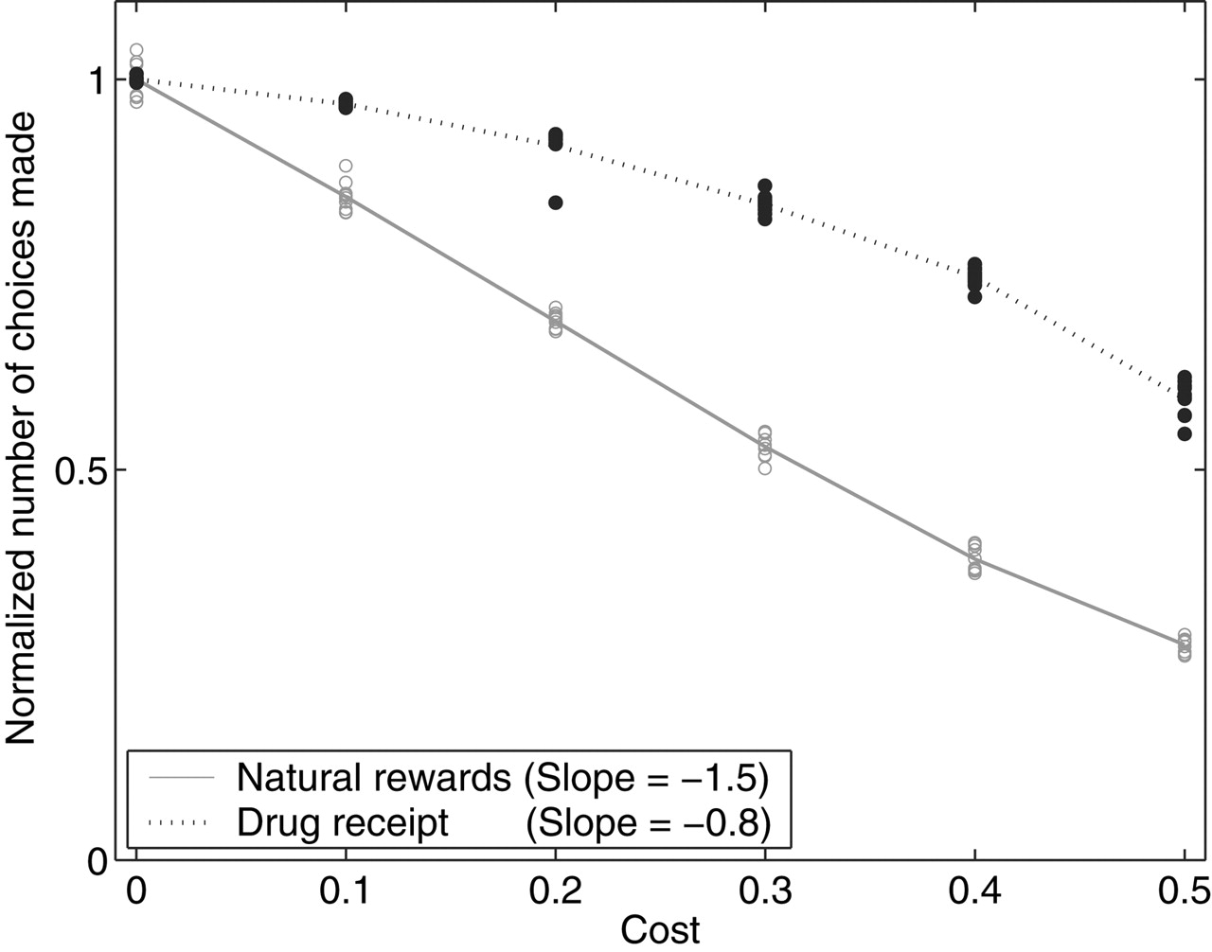
Decreased Elasticity
Elasticity is a term from economics. It measures how much the tendency to buy products decreases, as the price increases.
Because drug-seeking can not easily be unlearned, the behavior become less and less elastic with prolonged drug use.

Slide 20
Open questions
Exploration, curiosity
Locus of control and its effects
Sub-goal construction and state hierarchy construction

