Slide 1
Symbolic cognitive architectures
Nisheeth
9th Jan 2018

Slide 2
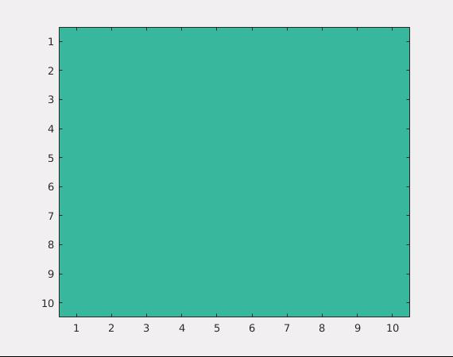
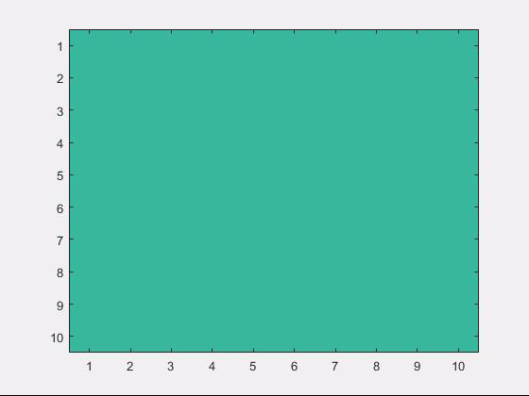
RL review
Bush-Mosteller
TD learning

Slide 3
Insight from RL simulation
Unrealistic to expect agents to explore the entire state space
Agent actions likely governed by their existing value function
Perception-action loop
Sensory stimuli
Knowledge update
Action selection

Slide 4
Cognitive architectures
Try to model this loop
Try to model a combination of
Memory
Learning
Decision-making
Historical examples
ACT-R
SOAR
Copycat

Slide 5
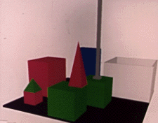
Cognitive science meets AI
Person: PICK UP A BIG RED BLOCK.
Computer: OK. (does it)
Person: GRASP THE PYRAMID.
Computer: I DON'T UNDERSTAND WHICH PYRAMID YOU MEAN.
Person: FIND A BLOCK WHICH IS TALLER THAN THE ONE YOU ARE HOLDING AND PUT IT INTO THE BOX.
Computer: BY "IT", I ASSUME YOU MEAN THE BLOCK WHICH IS TALLER THAN THE ONE I AM HOLDING.
Computer: OK. (does it)
Person: WHAT DOES THE BOX CONTAIN?
Computer: THE BLUE PYRAMID AND THE BLUE BLOCK.
Person: WHAT IS THE PYRAMID SUPPORTED BY?
Computer: THE BOX.
Person: HOW MANY BLOCKS ARE NOT IN THE BOX?
Computer: FOUR OF THEM.
Person: IS AT LEAST ONE OF THEM NARROWER THAN THE ONE WHICH I TOLD YOU TO PICK UP?
Computer: YES, THE RED CUBE.
Person: IS IT SUPPORTED?
Computer: YES, BY THE TABLE.
Person: CAN THE TABLE PICK UP BLOCKS?
Computer: NO.
Person: CAN A PYRAMID BE SUPPORTED BY A BLOCK?
Computer: YES.
Person: CAN A PYRAMID SUPPORT A PYRAMID?
Computer: I DON'T KNOW.
Person: STACK UP TWO PYRAMIDS.
Computer: I CAN'T.

Slide 6
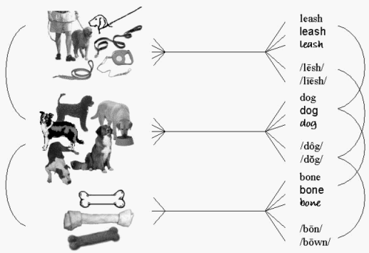
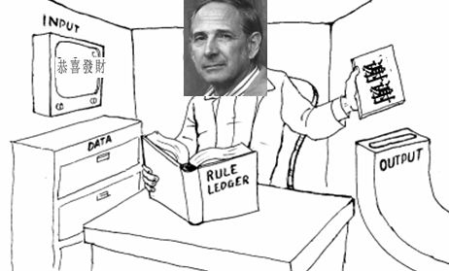
The symbol grounding problem
How to relate words to stimuli?
https://en.wikipedia.org/wiki/Symbol_grounding_problem

Slide 7
Symbolic cognitive architectures
Symbolic cognitive architectures assume the symbol grounding problem solved
Mapping from stimuli to knowledge assumed known
Multiple other assumptions to bypass hard neuroscience and psychology problems
Study behavior modulo such assumptions

Slide 8
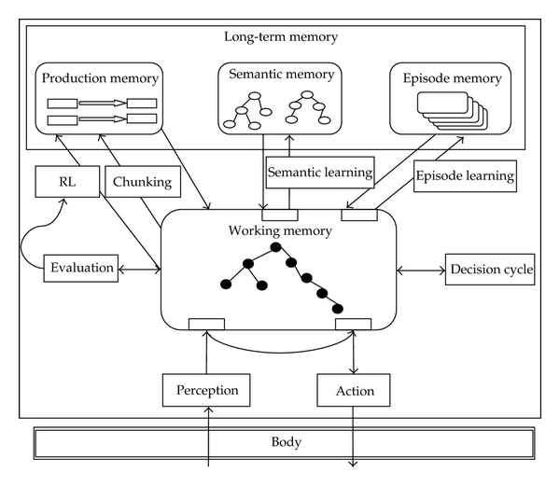
Typical components
SOAR architecture

Slide 9
SOAR in action
Basic unit of SOAR are production rules
Production rules → If this state, then this action
Memory with three components
Procedural
Semantic
Episodic
Perception to memory mapping assumed known
http://courses.csail.mit.edu/6.034f/ai3/SOAR.pdf

Slide 10
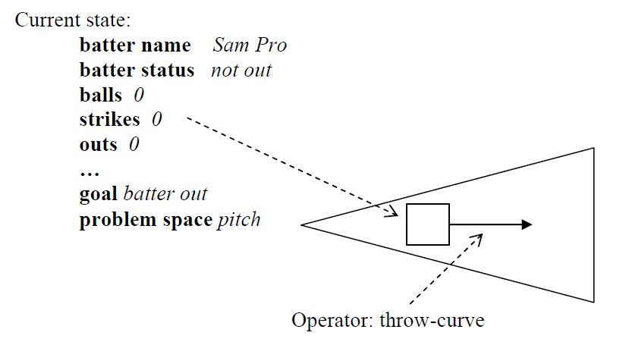
The algorithm
Need lists of possible states and actions in advance

Slide 11
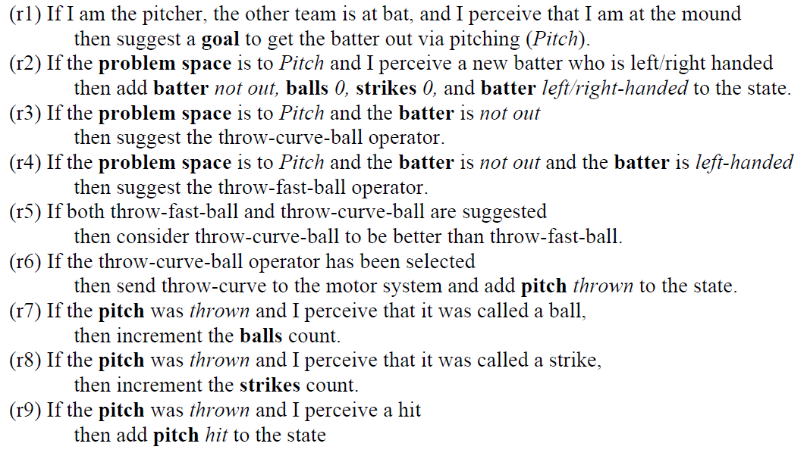
The memory representation
Some production rules have to be built in by the designer.

Slide 12
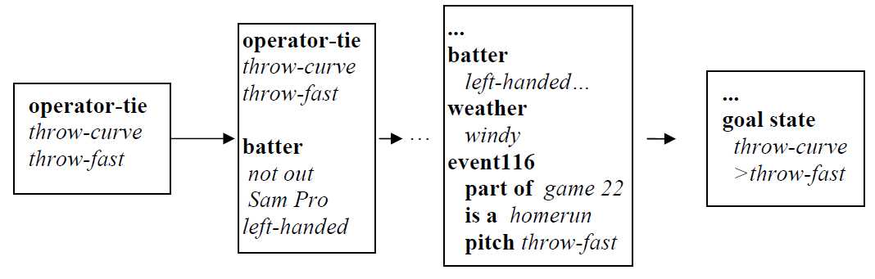
Learning
Episodic memory leads to development of a new production rule

Slide 13
Applications
Several AI agents
Starcraft
Quake II
Unreal Tournament
Some robotics applications
Some emotion-learning applications

Slide 14
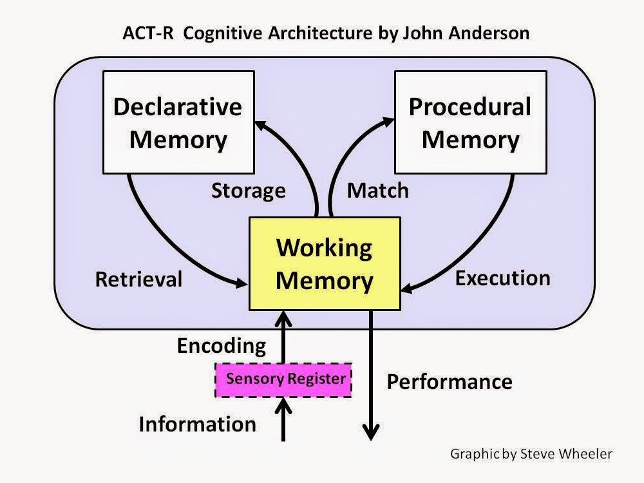

Slide 15
ACT-R
Influential cognitive architecture developed by John Anderson at CMU
Builds on Anderson’s rational analysis program
Production system, same as SOAR
Differences
Attention module
No episodic memory
More sophisticated learning

Slide 16
Rational analysis
To study a cognitive system
Define its goals precisely
Model the agent’s environment
Make assumptions about computational limitations
Derive an optimization function from the steps above
Compare with data
Repeat with improvements
We will look at rational analysis in more detail later

Slide 17
Application: modeling driving behavior
Model the driver as a hierarchy of three modules
Control component: maps perceptual variables to vehicle controls
Monitoring component: keeps an updated log of the environment
Decision-making component: makes decisions involved in driving maneuvers
http://journals.sagepub.com/doi/pdf/10.1518/001872006777724417

Slide 18
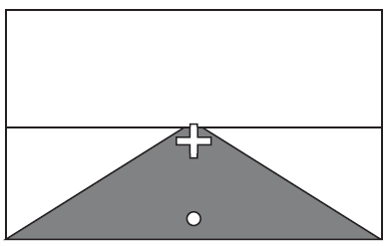
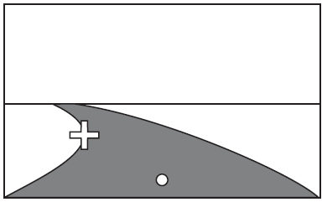
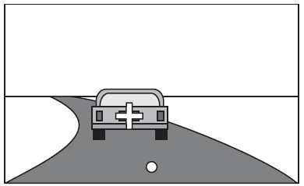

Steering control
A salient point-based model of steering
When changing to a new lane, far point is assumed to be in center of other lane

Slide 19

Speed control
Based on headway time, assumed available via the monitoring component

Slide 20
Monitoring
Tracks occupancy of neighboring lanes
Tracks area ahead and behind car
Sampling randomly from these four locations

Slide 21
Decision-making
Using US driving etiquette
Drive in right lane
Pass cars in left lane
In right lane
Check thw
If dropping, change lane
If not dropping, stay in lane
In left lane
Is there a car ahead of me?
Yes, stay in lane
No, return to right lane

Slide 22
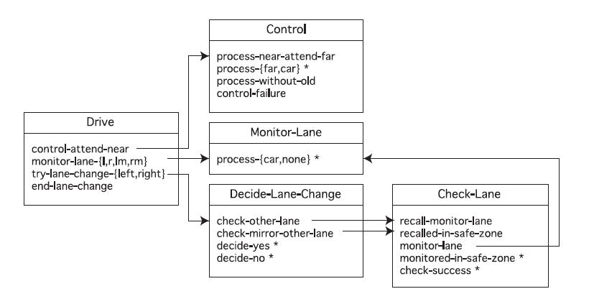
Decision-making
When lane change?
When monitoring does not detect any vehicles within a safe distance in either lane
Integrated view of system

Slide 23
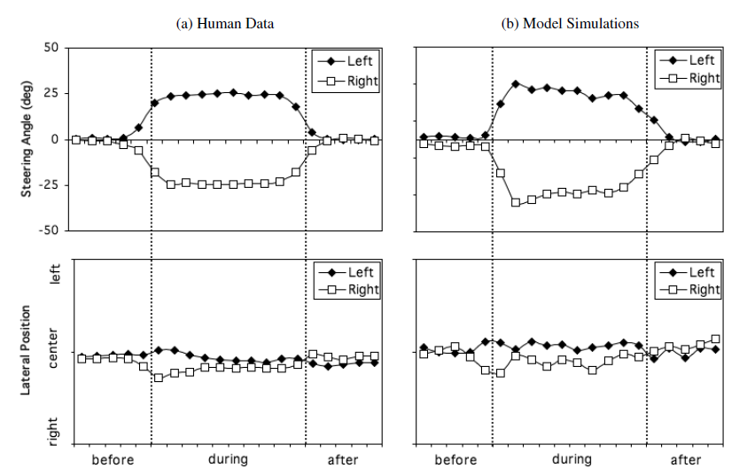
Validation
Driving on a curved road

Slide 24
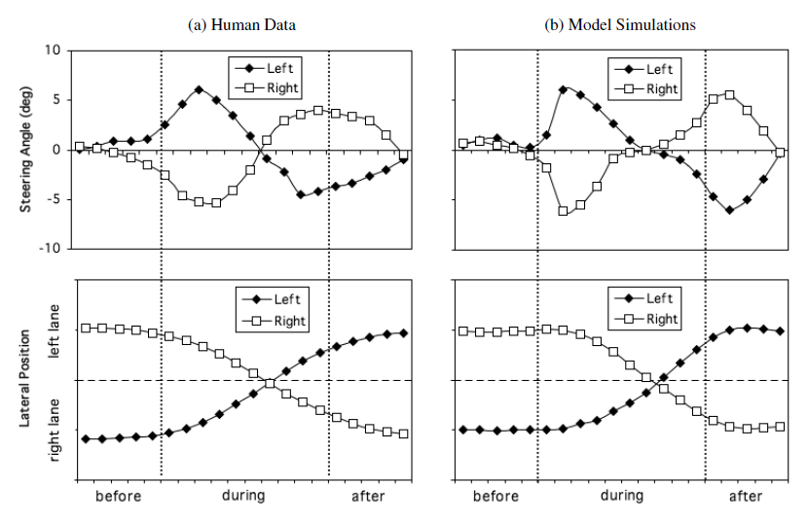
Validation
Lane change

Slide 25
Summary
Cognitive architectures provide a scaffolding within which researchers can formulate theories about cognitive tasks
Can be very useful in modeling real-world applications
Tend to ignore the most important and interesting cognitive problems

Slide 26


Slide 27
Segregation problem

Slide 28


Slide 29
Combination problem

