Slide 1
Modern cognitive architectures
Nisheeth
11th Jan 2018

Slide 2
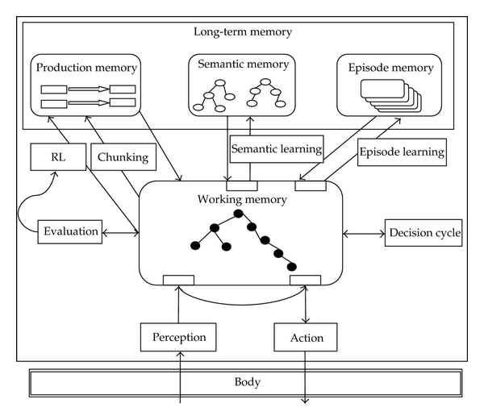
Symbolic cognitive architectures
SOAR architecture

Slide 3
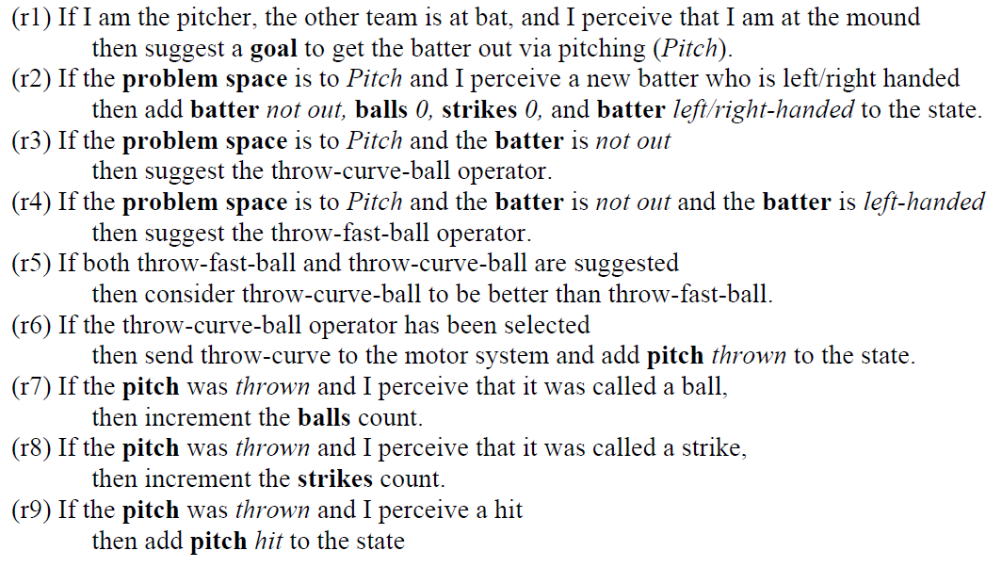
Intelligence hard-wired using rules
Some production rules have to be built in by the designer.

Slide 4
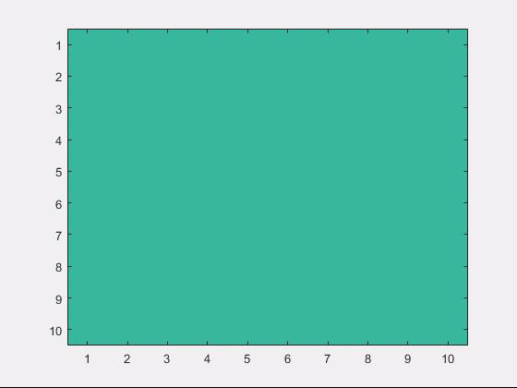
Design goal
Design agents that can learn what to do in the world
Generalized intelligent behavior across changing contexts
Could reinforcement learning be the answer?

Slide 5
Q-learning
Make TD learning useful by incorporating role of agent actions
One such approach – Q-learning
Instead of a state-specific value function V(s), learn a state-action pairing quality function Q(s,a)
Algorithm
Choose a from s using Q(s,a)
Observe R,s’
Update
s ← s’

Slide 6
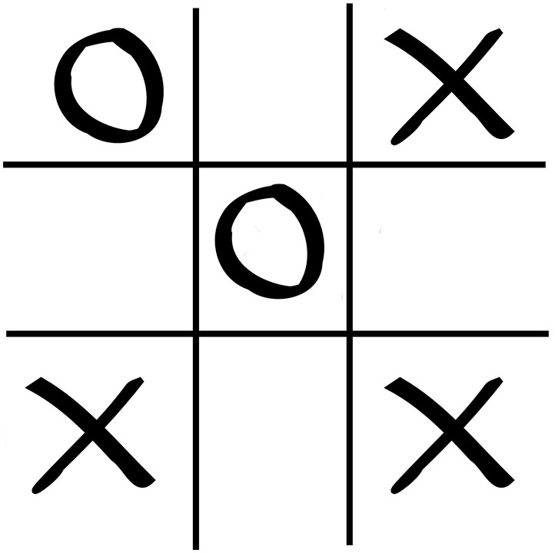
The problem
Number of states quickly becomes too large
Even for trivial applications
Learning becomes too dependent on right choice of exploration parameters
Explore-exploit tradeoffs become harder to solve
State space = 765 unique states

Slide 7
Solution approach
Cluster states
Design features to stand in for important situation elements
Close to win
Close to loss
Fork opp
Block fork
Center
Corner
Empty side

Slide 8
Value function approximation
RL methods have traditionally approximated the state value function using linear basis functions
θ is a K valued parameter vector, where K is the number of features that are part of the function φ
Implicit assumption: all features contribute independently to evaluation

Slide 9
Limitations
Designing feature functions by hand is hard work
Never quite know if we’ve got it right
No scope for improvement

Slide 10
Non-linear approximations
Universal approximation theorem – a neural network with even one hidden layer can approximately represent any continuous-valued function
Neural nets were always attractive for their representation generality
But were hard to train
That changed with the GPU revolution ten years ago

Slide 11
The big idea
Approximate Q values using non-linear function approximation
Where θ are the parameters of the neural network and f(x) is the output of the network for input x
Combines both association and reinforcement principles
Association buys us state inference
Reinforcement buys as action policy learning
https://www.nature.com/articles/nature14236

Slide 12
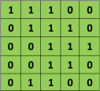

Conv nets basics
Image patch
Filter
Convolution
https://ujjwalkarn.me/2016/08/11/intuitive-explanation-convnets/

Slide 13
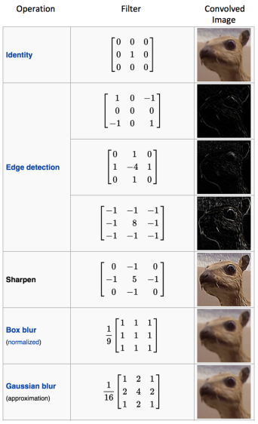
Discriminability from diverse filtering

Slide 14
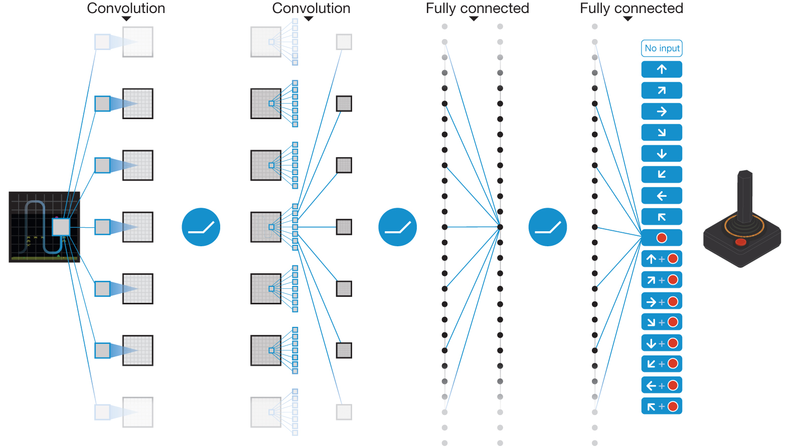

Schematic illustration of the convolutional neural network.
V Mnih et al. Nature 518, 529-533 (2015) doi:10.1038/nature14236

Slide 15

Deep Q network
Basic Q learning algorithm augmented a bunch of different ways
Use of experience replay
Use of batch learning
Use of non-linear function approximation

Slide 16
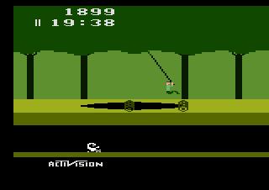
The Atari test bench
A very popular RL test bench
Limited space of actions
Non-stop reward feedback
Free to use
Earlier methods used features handcrafted for each game

Slide 17
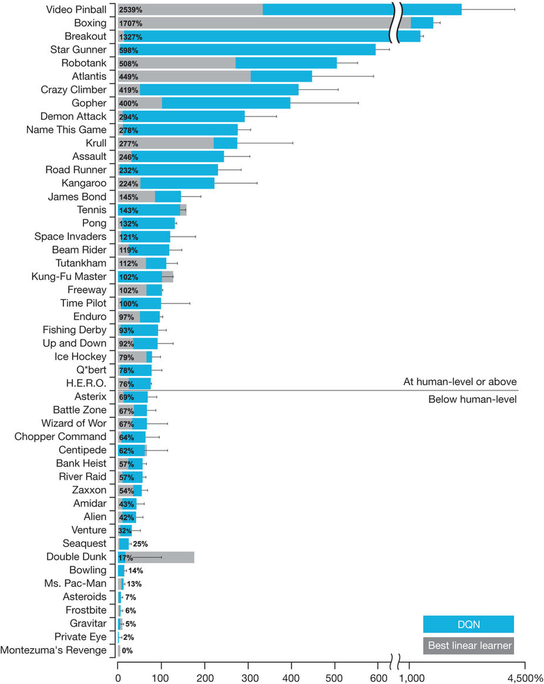

Slide 18
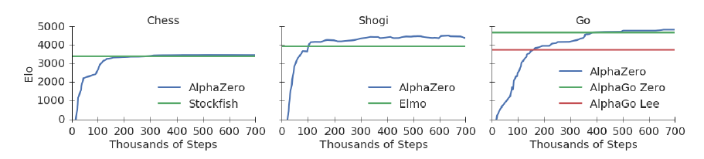
AlphaZero
Figure 1: Training AlphaZero for 700,000 steps. Elo ratings were computed from evaluation games between different players when given one second per move. a Performance of AlphaZero in chess, compared to 2016 TCEC world-champion program Stockfish. b Performance of AlphaZero in shogi, compared to 2017 CSA world-champion program Elmo. c Performance of AlphaZero in Go, compared to AlphaGo Lee and AlphaGo Zero (20 block / 3 day) (29).

Slide 19
Secret ingredient
Some algorithmic innovations
MCTS
Mostly, just lots and lots of computation
5000 TPUs to generate game-play
64 TPUs to train the DQN
If results hold up, this work closes a long chapter in game-based AI research

Slide 20
Summary
Deep reinforcement learning is the cognitive architecture of the moment
Perhaps of the future also
Beautifully combines the cognitive concepts of association and reinforcement
Excellent generalizability across toy domains
Limitations exist: timing, higher-order structure, computational complexity etc.

