Slide 1
Classical psychophysics
Nisheeth
January 16th 2018

Slide 2
Introduction
What do we mean by “Sensation & Perception?”
Sensation: The ability to detect a stimulus (convert to nervous system activity)
Perception: The act of giving meaning to a detected sensation. (Schieber say “integration” → “objects”)
Cognition: The manipulation of perceptual objects (in the service of goals)
Sensory processes are not available to consciousness but the products of perceptual processes are the objects of awareness

Slide 3
Introduction
Sensation and perception are central to mental life.
Without them, how would we gain knowledge of the world?

Slide 4
Introduction
The study of sensation and perception is a scientific pursuit and requires scientific methods.
Thresholds: Finding the limits of what can be perceived.
Scaling: Measuring private experience.
Signal detection theory: Measuring difficult decisions.
Sensory neuroscience: The biology of sensation and perception.
Neuroimaging: An image of the mind.

Slide 5
Psychophysical
Thresholds

Slide 6
Thresholds and the Dawn of Psychophysics
First, some formal definitions:
Just noticeable difference (JND): The smallest detectable difference between two stimuli, or the minimum change in a stimulus that can be correctly judged as different from a reference stimulus; also known as difference threshold.
Absolute threshold: Minimum amount of stimulation necessary for a person to detect a stimulus 50% of the time.

Slide 7
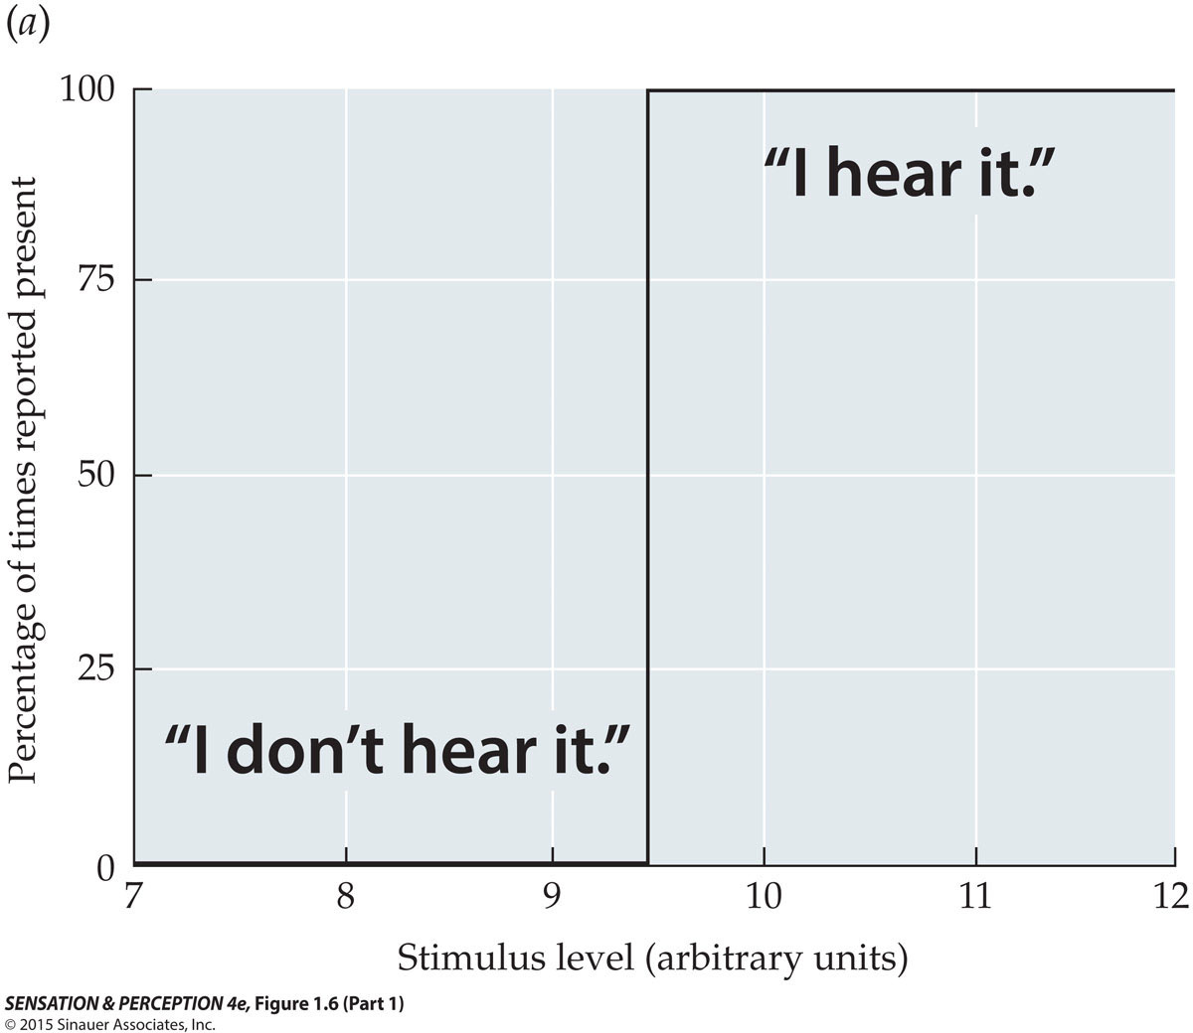
The Concept of Absolute Threshold
Ideal Absolute Threshold
Notes:
SensationPerception4e-Fig-01-06-1R.jpg

Slide 8
The Concept of Absolute Threshold
But….
early experimental psychologists like Fechner discovered that humans were not ideal observers.
Instead,
behavior at the boundary of sensory sensitivity appeared to reflect probabilistic processes rather than ideal detection.
Notes:
SensationPerception4e-Fig-01-06-1R.jpg

Slide 9
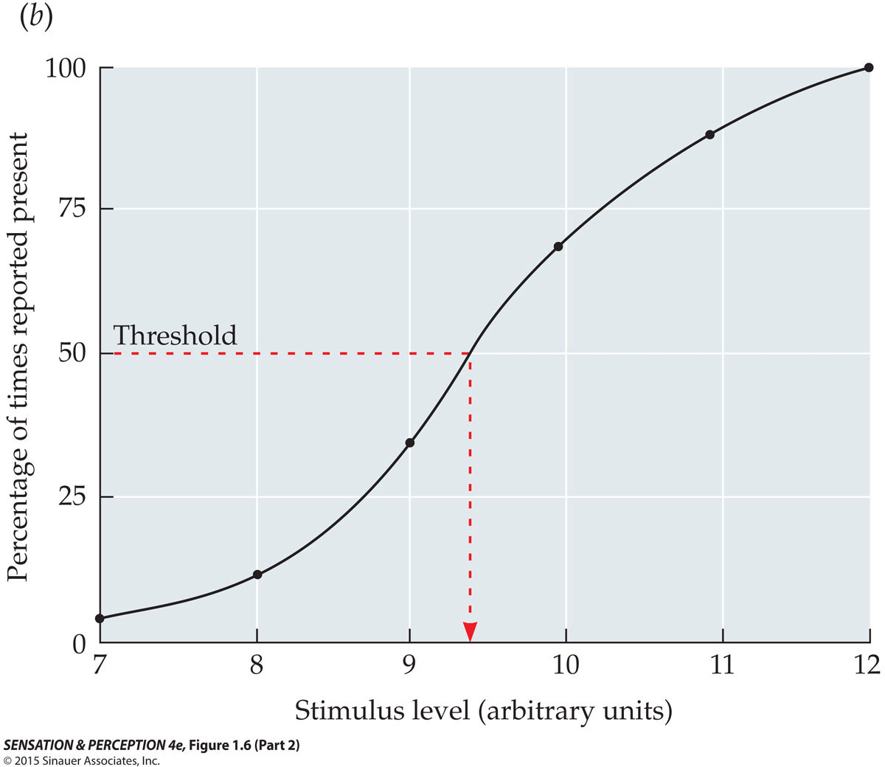
The Concept of Absolute Threshold
Psychometric function demonstrating the probabilistic (statistical) nature of the threshold
Notes:
SensationPerception4e-Fig-01-06-2R.jpg

Slide 10
Thresholds and the Dawn of Psychophysics
Ernst Weber discovered that the smallest change in a stimulus that can be detected is a constant proportion of the stimulus level.
i.e. human sensory sensitivity is relative rather than absolute in nature
This relationship has been formalized as Weber’s Law (see next slide)

Slide 11
Thresholds and the Dawn of Psychophysics
Scientific psychology’s first law (Weber’s Law)
algebraically rephrased as

Slide 12
Thresholds and the Dawn of Psychophysics
If we know the value of “k” and “I”, we can use Weber’s Law to determine how much a stimulus needs to change in order for the average person to detect that change.
For example:
If the Weber fraction (k) for judging weight = 0.02 then the JND (delta I) for a 10 ounce weight would be (10 ounce x k) = (10 x 0.02) = 0.2 ounces
Hence, an 10.1 ounce weight would be indistinguishable from a 10 ounce weight…but a 10.2 ounce weight would appear heavier than the same 10 ounce weight (i.e., >= JND).

Slide 13
Thresholds and the Dawn of Psychophysics
How many ounces would you need to add to a 100 ounce weight before you could tell the difference?
What about a 1 ounce weight?
How about a 0.01 ounce weight? (This one is a “trick question”)

Slide 14
Some common Weber Fractions (k)

Slide 15
Fechner’s law
Fechner mathematically extended Weber’s law to make it more universal.
Fechner’s law: A principle describing the relationship between stimulus magnitude and resulting sensation magnitude such that the magnitude of subjective sensation increases proportionally to the logarithm of the stimulus intensity.
Sensation = log(Stimulus Intensity)
S = k log(I)

Slide 16
Thresholds and the Dawn of Psychophysics
Fechner’s major assumptions were that:
(1) The basic unit of analysis for modeling psychological processes was the JND (“just noticeable difference”)
(2) Mathematical functions capturing such processes could be “anchored” using the absolute threshold (a “relative” zero point)

Slide 17
1. Plot sequential JNDs (1 thru 6 here)
I

Slide 18
2. Find a mathematical “model” that fits the data:
S = k log(I) (i.e. Fechner’s Law)
The strength of sensory experience grows at a slower rate than the physical stimulus
sensory
compression
I
(textbook)

Slide 19
Stevens’ Law
Suprathreshold magnitude estimates are well described by Stevens’ power law
(textbook formula)

Slide 20
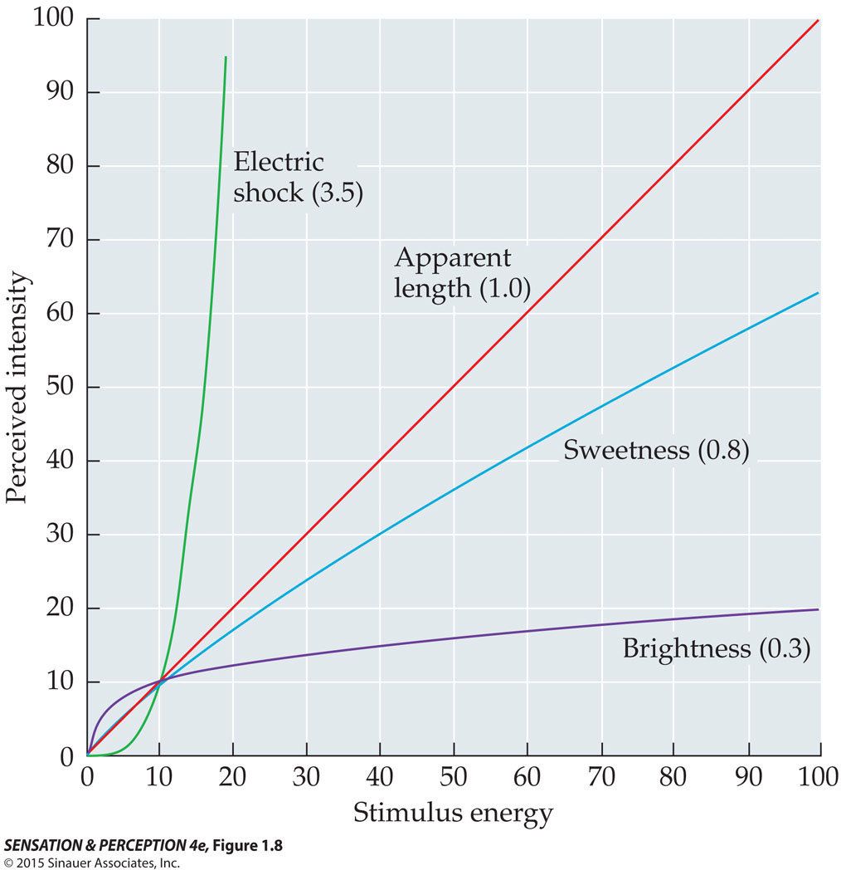
Stevens’ Law

Slide 21
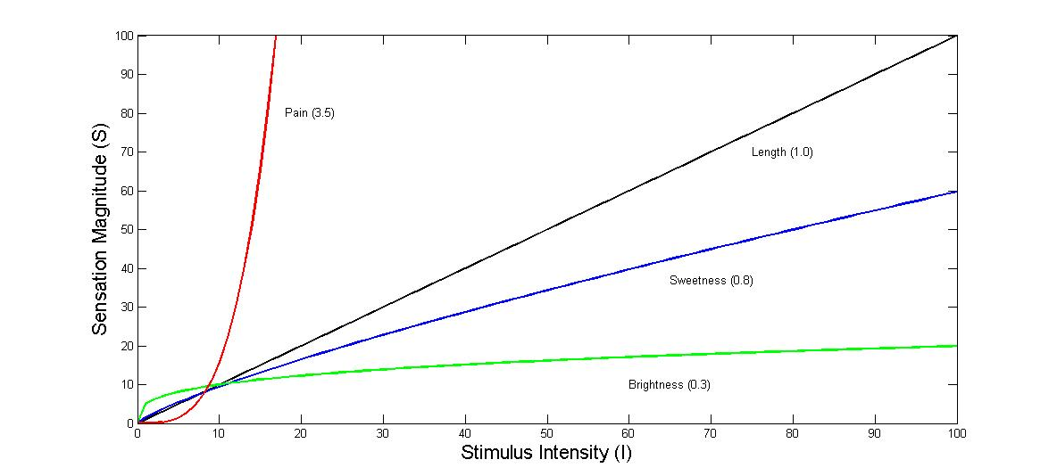
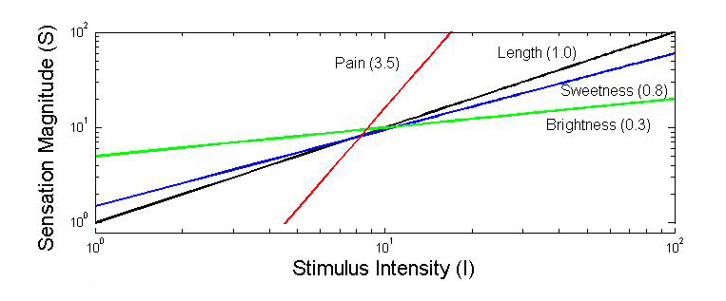
Stevens’ exponents

Slide 22
Some sample Power Law Exponents
Loudness (SP @ 3kHz) 0.67 Brightness (point source) 1.0 Visual area 0.7 Visual Length 1.0 Smell (heptane) 0.6 Taste (sucrose) 1.3 Vibration (finger @ 60Hz) 0.9 Electric shock (pain) 3.5

Slide 23
Psychophysical
Measurement

Slide 24
Psychophysical methods
Psychophysical methods
Method of constant stimuli: Many stimuli, ranging from rarely to almost always perceivable, are presented one at a time.
Method of limits: The magnitude of a single stimulus or the difference between two stimuli is varied incrementally until the participant responds differently.

Slide 25
Psychophysical methods
Psychophysical methods (continued)
Method of adjustment: Similar to the method of limits, but the participant controls the stimulus directly.
Magnitude estimation: The participant assigns values according to perceived magnitudes of the suprathreshold stimuli.
All methods except Magnitude Estimation were developed by Fechner

Slide 26
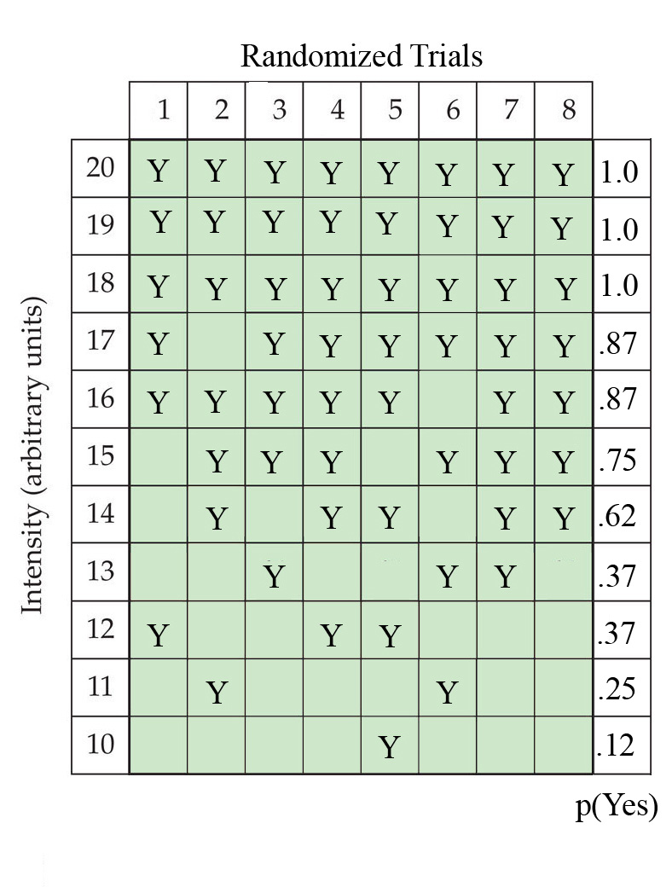
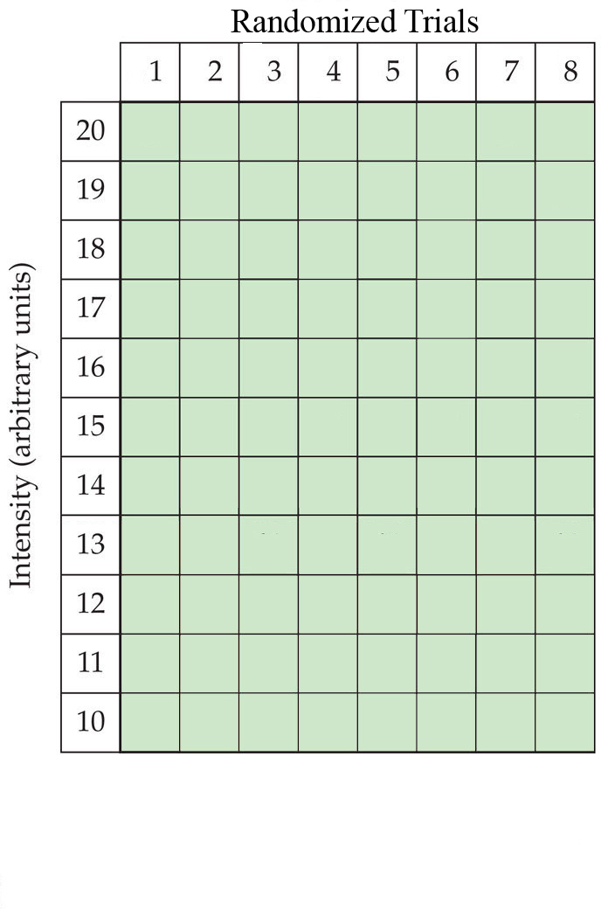
Method of constant stimuli

Slide 27
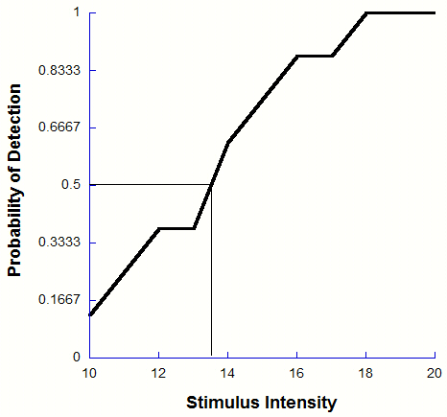
Method of constant stimuli

Slide 28
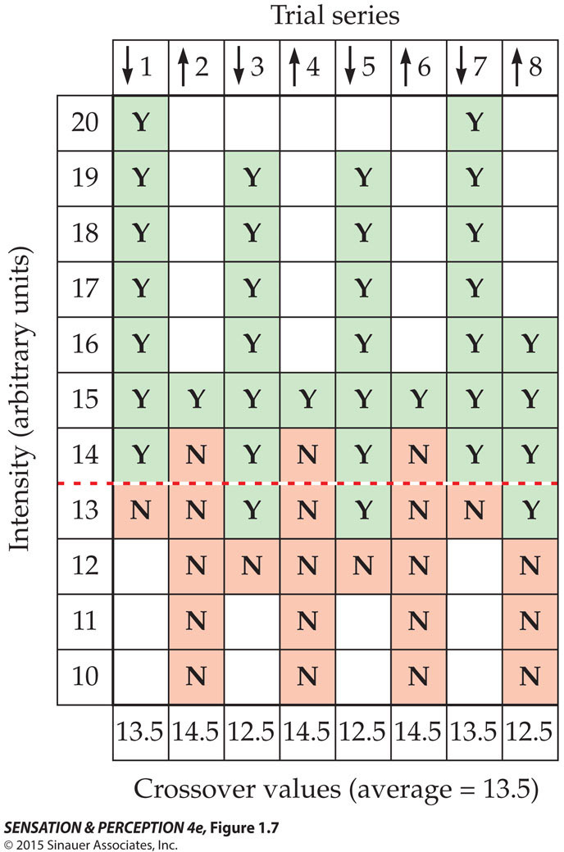
The method of limits
Notes:
SensationPerception4e-Fig-01-07-0.jpg

Slide 29
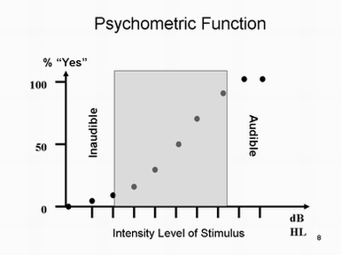
Psychometric function
Mathematical device
Parametrically model relationship between stimuli features and observer response
Yes/no
2AFC
nAFC

Slide 30
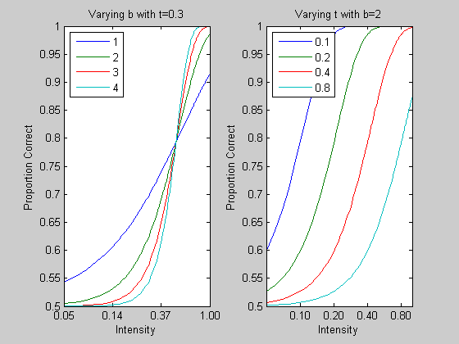
Fitting psychometric functions
Typically use a function of approximately sigmoid form
Probit
Sigmoid
Weibull
Modified by a lapse and a guess parameter
Ψ(x) = δ + (1 – δ - λ)F(x;α,β)
E.g. F = 1 – exp(-(x/α)^{β})
Fit using least squares/ML
Key psychometric parameters
Slope
Threshold
Guess
Lapse

