Slide 1
Signal detection theory
Nisheeth
January 18th 2018

Slide 2
Signal detection theory
Signal detection theory: A psychophysical theory that quantifies the response of an observer to the presentation of a signal in the presence of noise.

Slide 3
Signal detection theory
Four possible stimulus/response situations in signal detection theory:
Hit: Stimulus is present and observer responds “Yes.”
Miss: Stimulus is present and observer responds “No.”
False alarm: Stimulus is not present and observer responds “Yes.”
Correct rejection: Stimulus is not present and observer responds “No.”

Slide 4
Key concepts
Signal detection theory makes a distinction between an observers’ ability to perceive a signal and their willingness to report it. These are two separate concepts:
Sensitivity
Criterion

Slide 5
Key concepts
Sensitivity: A value that defines the ease with which an observer can tell the difference between the presence and absence of a stimulus or the difference between stimulus 1 and stimulus 2.
Criterion: An internal threshold that is set by the observer.
If the internal response is above criterion, the observer gives one response.
Below criterion, the observer gives another response.

Slide 6
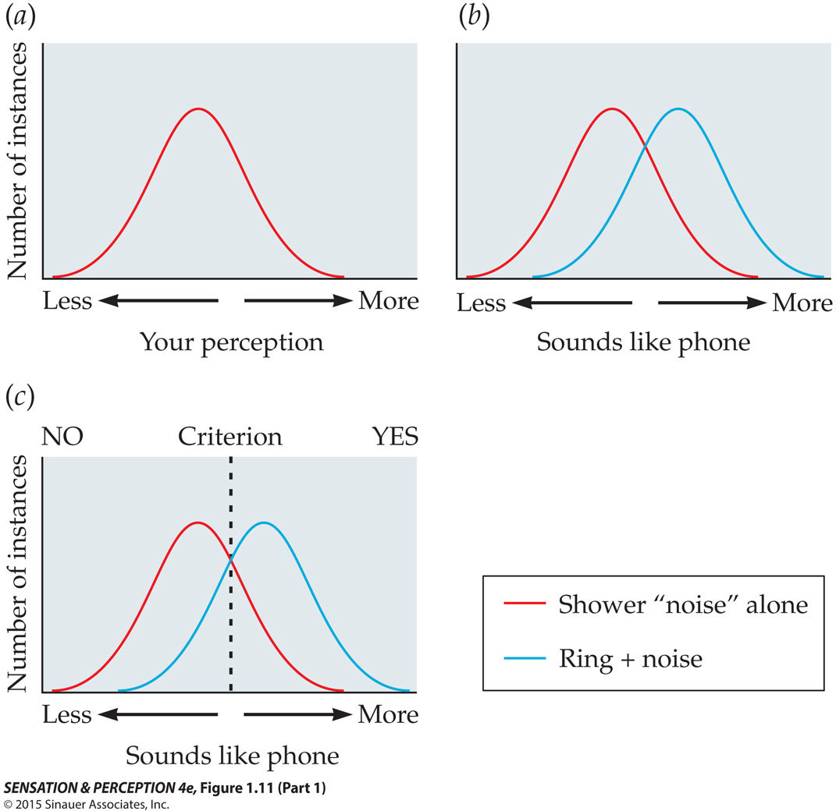
Notes:
SensationPerception4e-Fig-01-11-1R.jpg

Slide 7
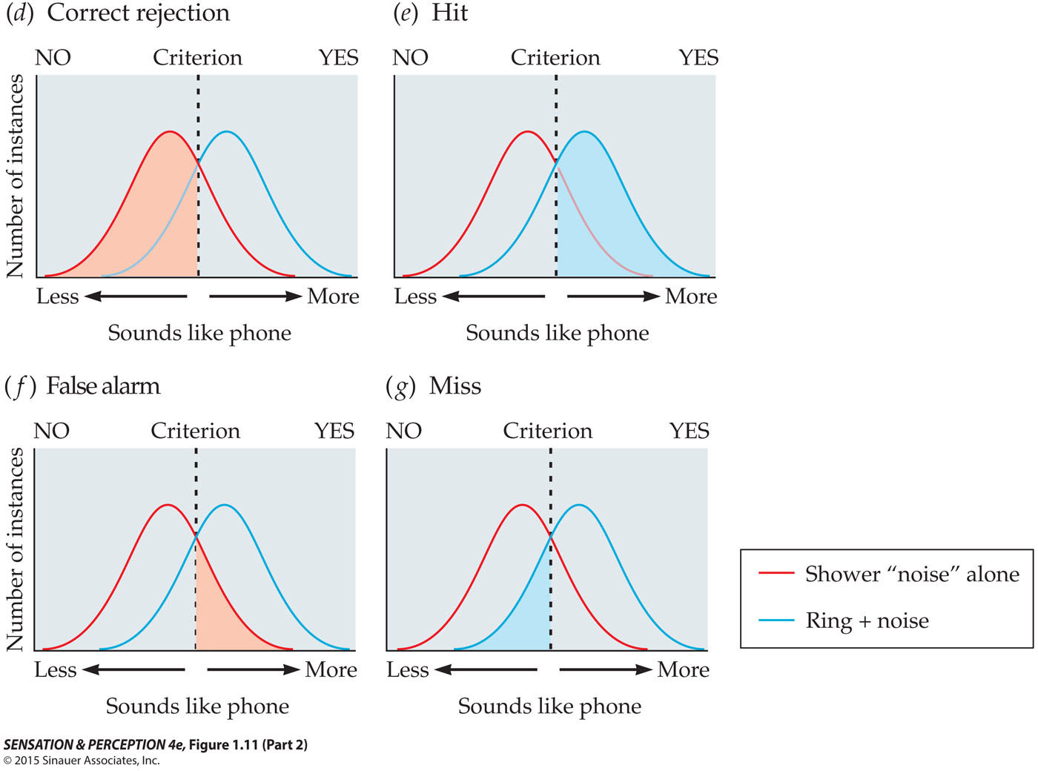
Notes:
SensationPerception4e-Fig-01-11-2R.jpg

Slide 8
What does the variance in response to stimuli mean?
Mixed selectivity of stimulus-neuron mapping
Stimuli
Neuron
Stimuli to neuron mapping is many-to-many, so for any one stimulus, multiple neurons will respond to varying degrees
http://www.sciencedirect.com/science/article/pii/S0959438816000118?via%3Dihub

Slide 9
Hubel & Wiesel’s cat experiment
https://www.youtube.com/watch?time_continue=59&v=IOHayh06LJ4
https://www.youtube.com/watch?time_continue=170&v=Cw5PKV9Rj3o

Slide 10
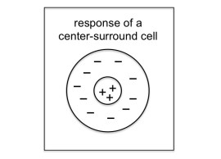
Hubel-Wiesel model of vision

Slide 11
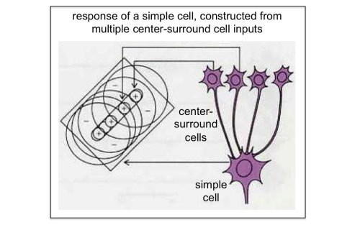
Emergent orientation selectivity
http://www.scholarpedia.org/article/Models_of_visual_cortex

Slide 12
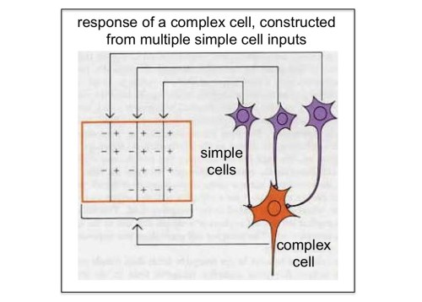
Complexity from simplicity
http://www.brains-explained.com/how-hubel-and-wiesel-revolutionized-neuroscience/

Slide 13
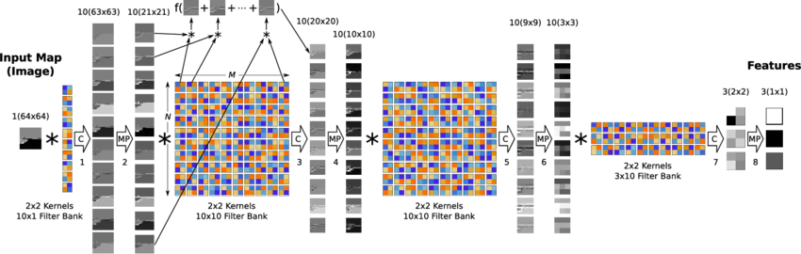
Influenced models of object recognition
Most successful models of visual function use mixed selective feed-forward information transfer now, e.g. CNN

Slide 14
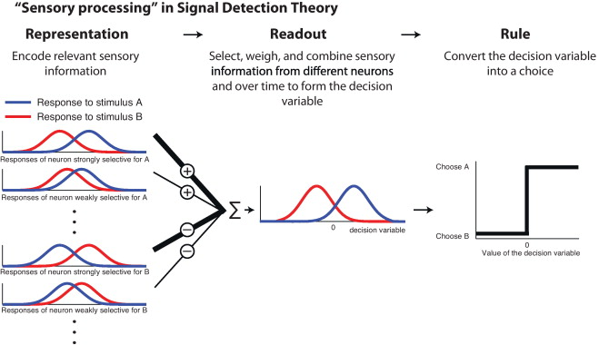
(Gold & Ding, 2013)

Slide 15
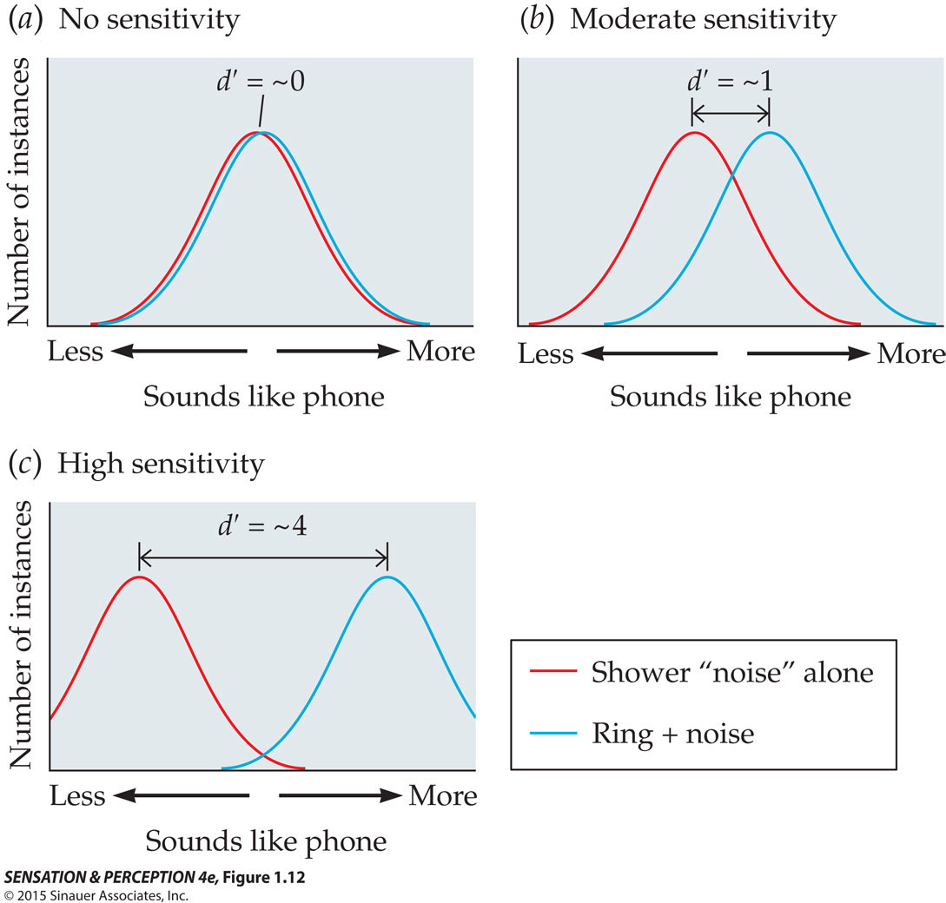
Notes:
SensationPerception4e-Fig-01-12-0.jpg

Slide 16
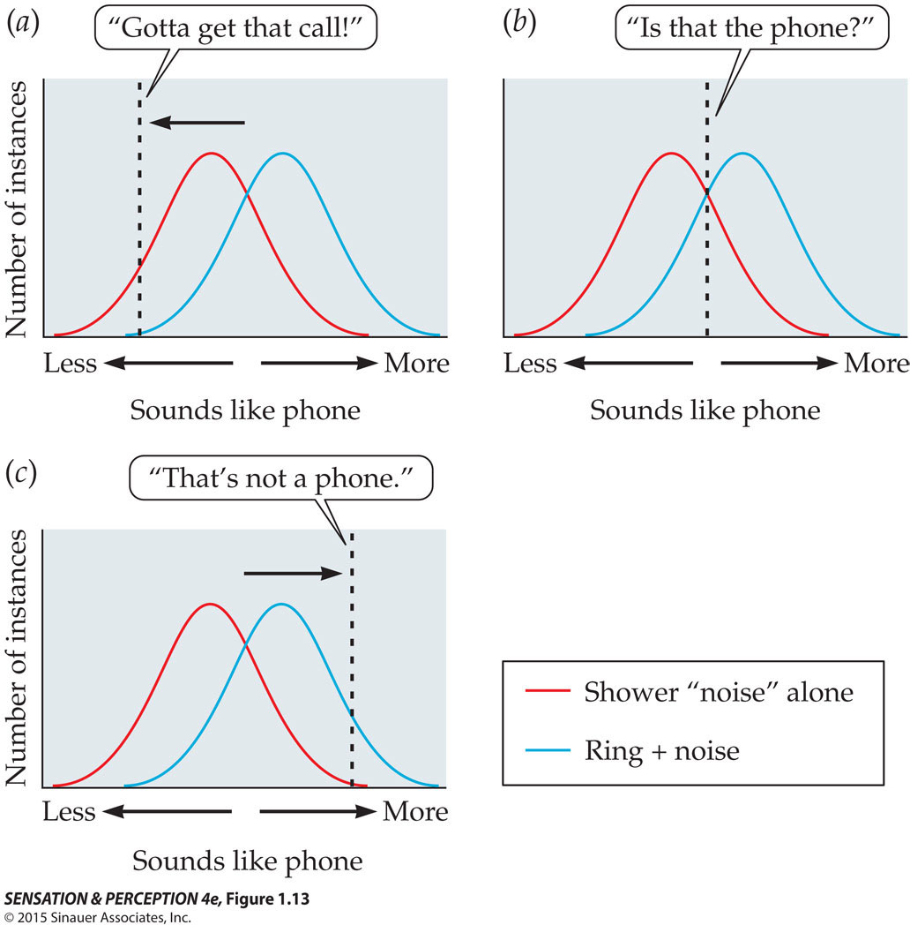
Notes:
SensationPerception4e-Fig-01-13-0.jpg

Slide 17
ROC
Receiver operating characteristic (ROC): In studies of signal detection, the graphical plot of the hit rate as a function of the false alarm rate.
Chance performance will fall along the diagonal.
Good performance (high sensitivity) “bows out” towards the upper left corner.

Slide 18
ROC
Plotting the ROC curve allows one to predict the proportion of hits for a given proportion of false alarms, and vice-versa.
Changes in criteria move performance along a curve but do not change the shape of the curve.
Application: we want to figure out how good radiologists are in looking for tumors in CT scans

Slide 19
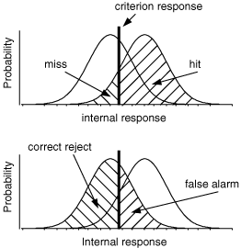
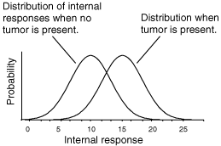
Tumor perception
Internal responses will have some variability because of mixed neuronal selectivity
Criterion for deciding if there is a tumor present in a scan will determine classification performance

Slide 20
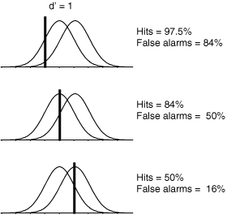
Criterion shift affects performance
Conservative criterion → low false alarm rate, low hit rate
Aggressive criterion → high hit rate, high false alarm rate

Slide 21
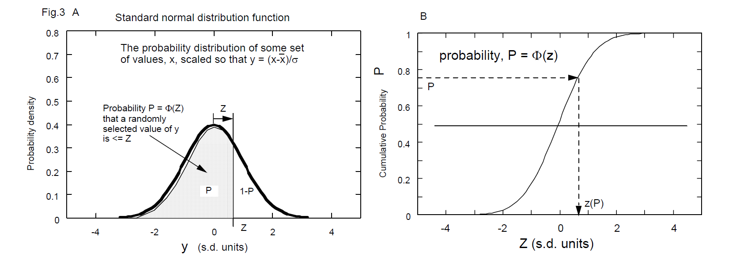
SDT tries to disambiguate
D’ measures sensitivity
Estimated as z(HR) – z(FAR)
C measures criterion
Calculated as -0.5[z(HR) + z(FAR)]
https://www.birmingham.ac.uk/Documents/college-les/psych/vision-laboratory/sdtintro.pdf

Slide 22
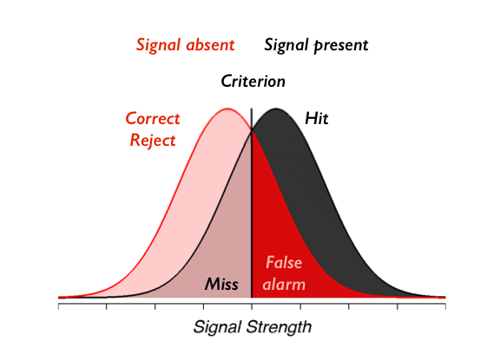
D’ calculation
D’ = z(HR) – z(FAR). Assume N(0,1) for numerical calculation

Slide 23
C calculation
C = midpoint between z(HR) and z(FAR)

Slide 24
Example
HR = 0.84, FAR = 0.16
D’ = z(0.84) – z(0.16) = 1 – (-1) = 2
C = 0
HR = 0.5, FAR = 0.023
D’ = z(0.5) – z(0.023) = 0 – (-2) = 2
C = [z(0.5) + z(0.023)]/2 = 1 (bias for saying no)
Same information present for both decision-makers

Slide 25
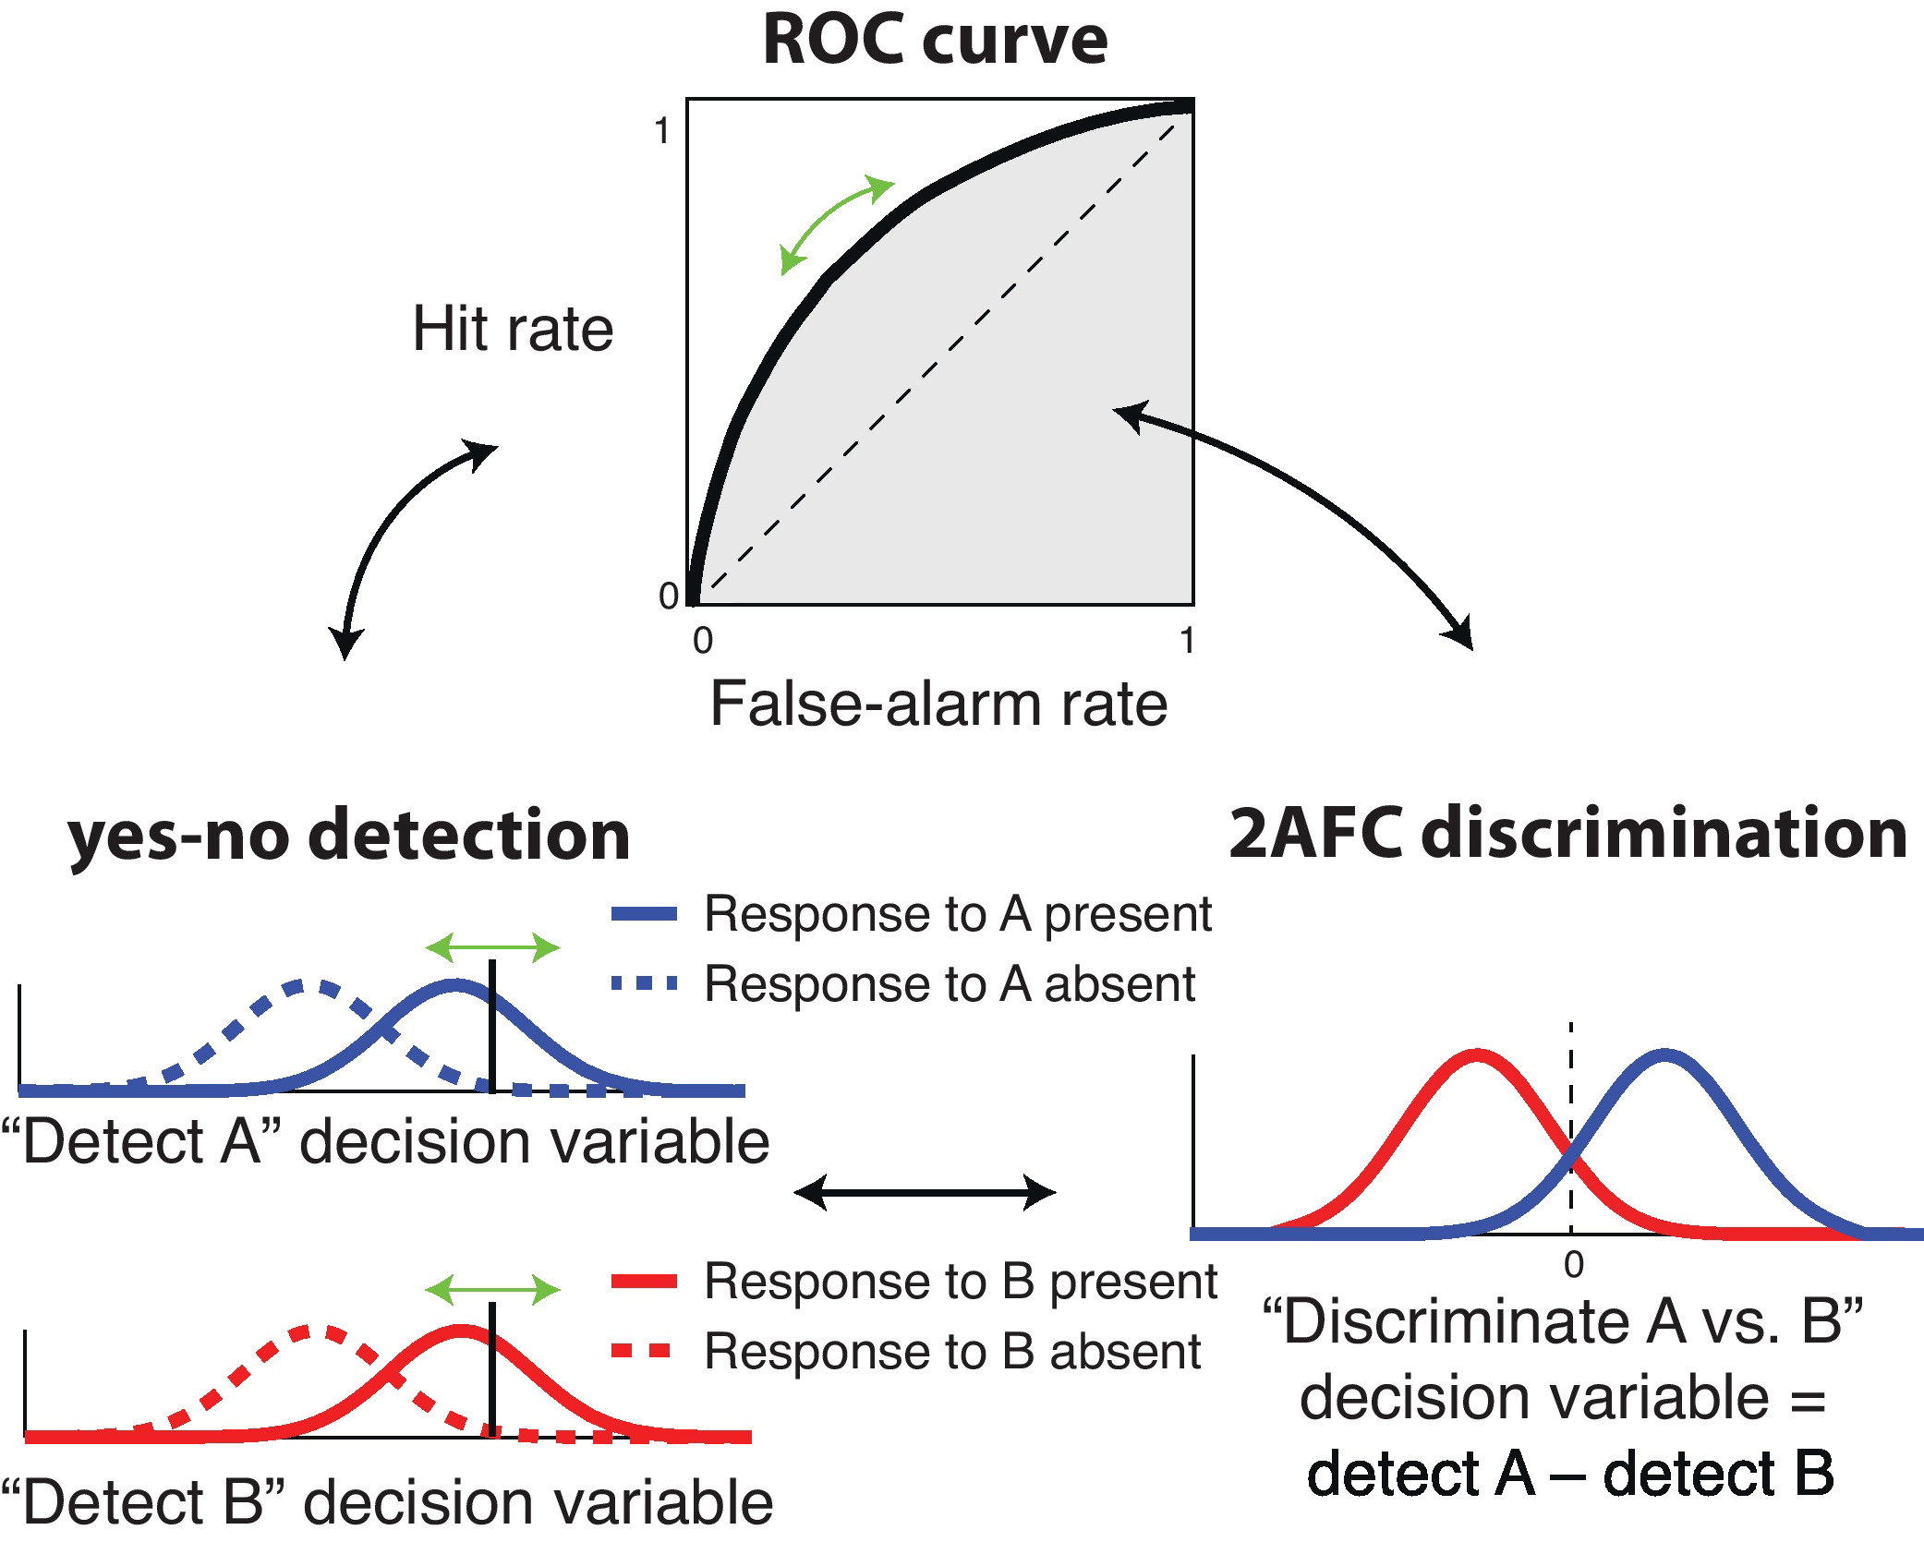

Slide 26
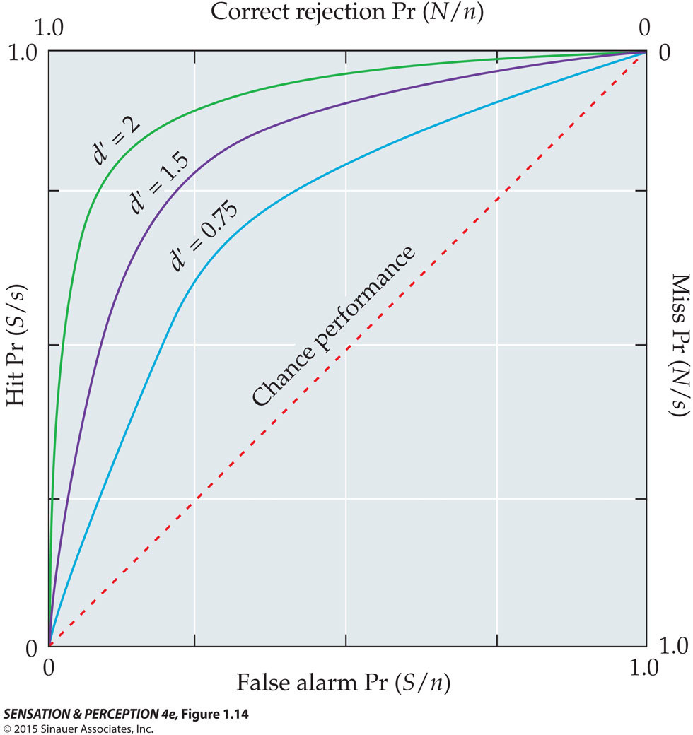
Criterion shift moves decision-maker along ROC curve
Notes:
SensationPerception4e-Fig-01-14-0.jpg

