Slide 1
Visual search
Nisheeth
19th January 2018

Slide 2
SDT recap
My friend claims to be a psychic.
When I show her a series of 50 photos, 20 of which are of people that are distantly related to me and 30 of people who are not,
she correctly picked out 15 of the 20 related people,
but also incorrectly picked out 20 of the 30 unrelated people as related to me.
What can I say quantitatively about her psychic sensitivity?

Slide 3
Visual search
X
X
X
X
X
O
O
X
X
X
X
X
X
O
X
X
X
X
O
X
O
O
X
X
X
X
X
Feature search
Conjunction search
Treisman & Gelade 1980

Slide 4
“Serial” vs “Parallel” Search
Reaction Time (ms)
Set size

Slide 5
Feature Integration Theory: Basics (FIT) Treisman (1988, 1993)
Distinction between objects and features
Attention used to bind features together (“glue”) at the attended location
Code 1 object at a time based on location
Pre-attentional, parallel processing of features
Serial process of feature integration

Slide 6
FIT: Details
Sensory “features” (color, size, orientation etc) coded in parallel by specialized modules
Modules form two kinds of “maps”
Feature maps
color maps, orientation maps, etc.
Master map of locations

Slide 7
Feature Maps
Contain 2 kinds of info
presence of a feature anywhere in the field
there’s something red out there…
implicit spatial info about the feature
Activity in feature maps can tell us what’s out there, but can’t tell us:
where it is located
what other features the red thing has

Slide 8
Master Map of Locations
codes where features are located, but not which features are located where
need some way of:
locating features
binding appropriate features together
[Enter Focal Attention…]

Slide 9
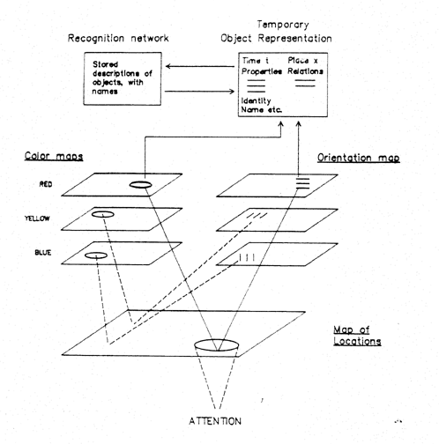
Role of Attention in FIT
Attention moves within the location map
Selects whatever features are linked to that location
Features of other objects are excluded
Attended features are then entered into the current temporary object representation

Slide 10
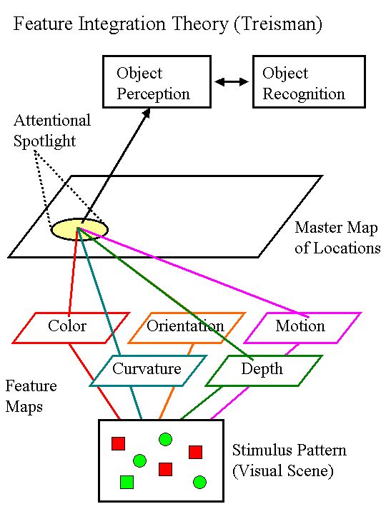

Slide 11
Evidence for FIT
Visual Search Tasks
Illusory Conjunctions

Slide 12
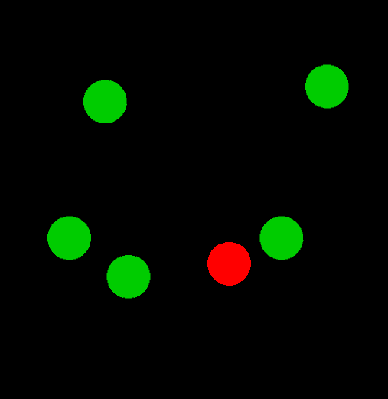
Feature Search: Find red dot

Slide 13
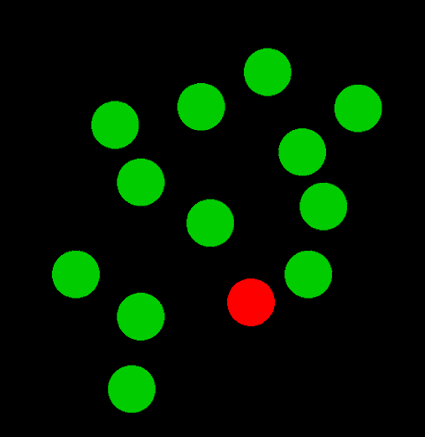
“Pop-Out Effect”

Slide 14
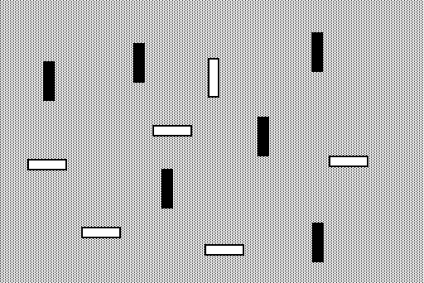
Conjunction: white vertical

Slide 15

1 Distractor

Slide 16
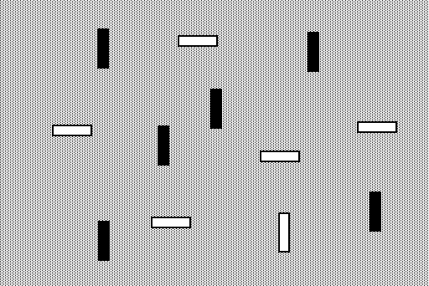
12 Distractors

Slide 17
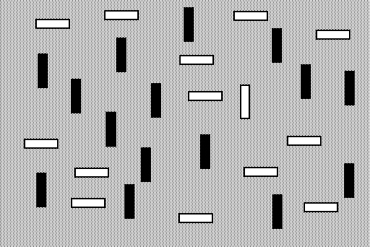
29 Distractors

Slide 18
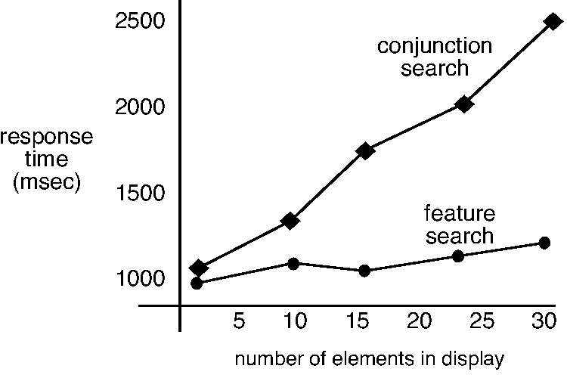

Slide 19
Feature Search
Is there a red T in the display?
Target defined by a single feature
According to FIT target should “pop out”
T
T
T
T
T
T
T
T
T
T
T

Slide 20
Conjunction Search
T
Is there a red T in the display?
Target defined by shape and color
Target detection involves binding features, so demands serial search w/focal attention
X
X
T
X
T
T
T
T
T
T
T
X
X

Slide 21
Visual Search Experiments
Record time taken to determine whether target is present or absent
Vary the number of distracters
FIT predicts that
Feature search should be independent of the number of distracters
Conjunction search should get slower w/more distracters

Slide 22
Typical Findings & interpretation
Feature targets pop out
flat display size function
Conjunction targets demand serial search
non-zero slope

Slide 23
… not that simple...
X
O
X
O
X
X
O
X
O
X
O
O
X
easy conjunctions - -
depth & shape, and movement & shape
Theeuwes & Kooi (1994)

Slide 24
Guided Search
Triple conjunctions are frequently easier than double conjunctions
This lead Wolfe and Cave modified FIT --> the Guided search model
- Wolfe & Cave

Slide 25
Guided Search - Wolfe and Cave
X
O
X
O
X
X
O
X
O
X
O
O
X
Separate processes search for Xs and for white things (target features), and there is double activation that draws attention to the target.

Slide 26
Problems for both of these theories
Both FIT and Guided Search assume that attention is directed at locations, not at objects in the scene.
Goldsmith (1998) showed much more efficient search for a target location with redness and S-ness when the features were combined (in an “object”) than when they were not.

Slide 27
more problems Hayward & Burke (2000)
Lines
Lines in circles
Lines + circles

Slide 28
Results - target present only
a popout search should be unaffected by the circles

Slide 29
more problems Enns & Rensink (1991)
Search is very fast in this situation only when the objects look 3D - can the direction a whole object points be a “feature”?

Slide 30
Duncan & Humphreys (1989)
SIMILARITY
visual search tasks are :
easy when distracters are homogeneous and very different from the target
hard when distracters are heterogeneous and not very different from the target

Slide 31
Asymmetries in visual search
Vs
Vs
the presence of a “feature” is easier to find than the absence of a feature

Slide 32
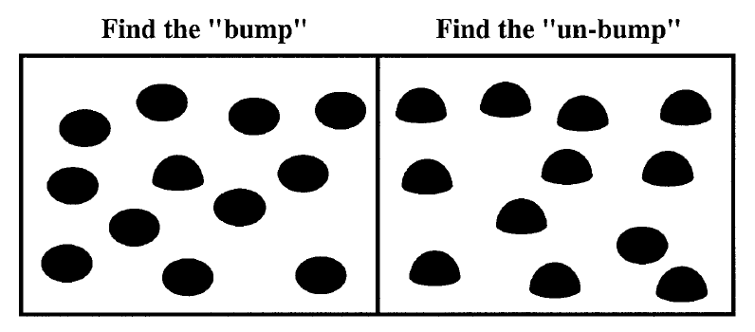
Kristjansson & Tse (2001)
Faster detection of presence than absence - but what is the “feature”?

Slide 33
Familiarity and asymmetry
asymmetry for German but not Cyrillic readers

Slide 34
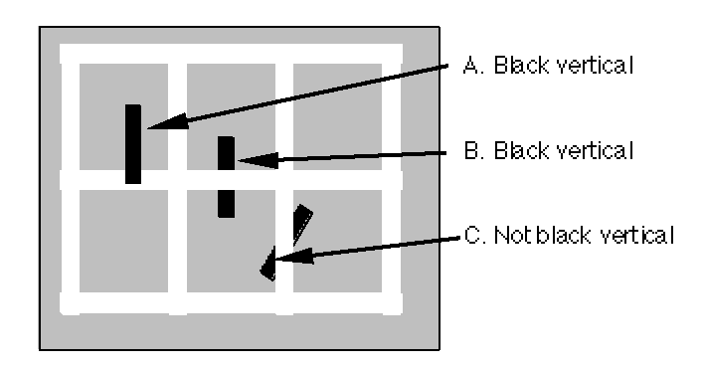
Other high level effects
finding a tilted black line is not affected by the white lattice - so “feature” search is sensitive to occlusion
Wolfe (1996)

Slide 35

Gestalt effects

Slide 36
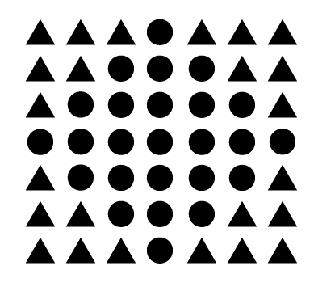
Pragnanz
Perception is not just bottom up integration of features. There is more to a whole image than the sum of its parts.

Slide 37
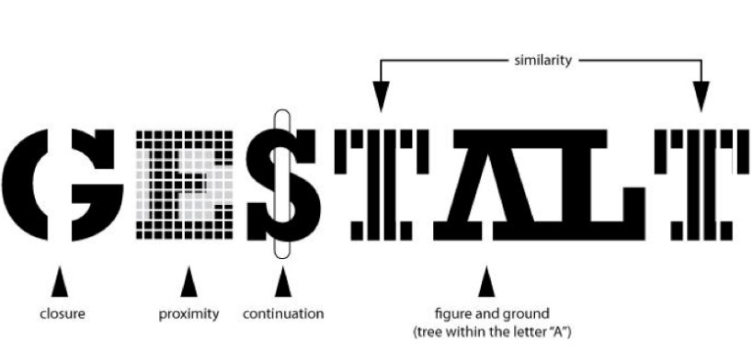
Not understood computationally
Principles are conceptually clear; DCNNs can learn them, but translation is missing
https://arxiv.org/pdf/1709.06126.pdf

Slide 38
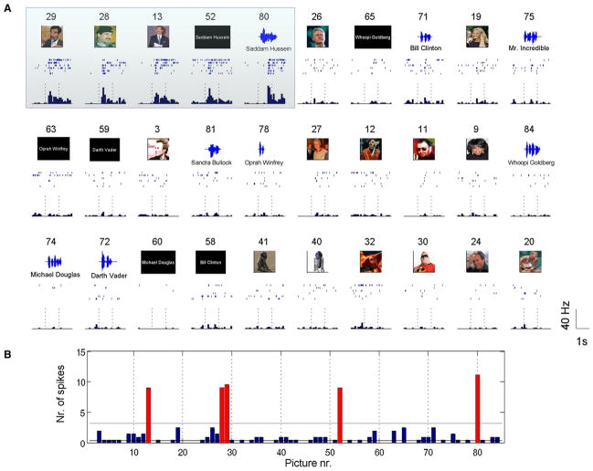
Concept-selective neurons
https://www.newscientist.com/article/dn7567-why-your-brain-has-a-jennifer-aniston-cell/

Slide 39
Summary
Classic accounts of visual perception have focused on bottom-up integration of features
Consistent with data from visual search experiments
Inconsistent with phenomenological experience in naturalistic settings
Top down influences affect visual perception
But how?
We will see some computational approaches in the next class

