Slide 1
Bayesian vision
Nisheeth
23rd January 2018

Slide 2
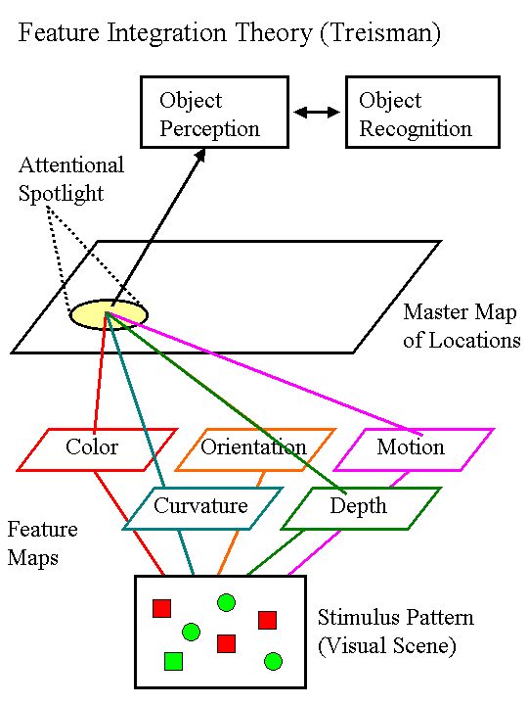

Slide 3
Asymmetries in visual search
Vs
Vs
the presence of a “feature” is easier to find than the absence of a feature

Slide 4
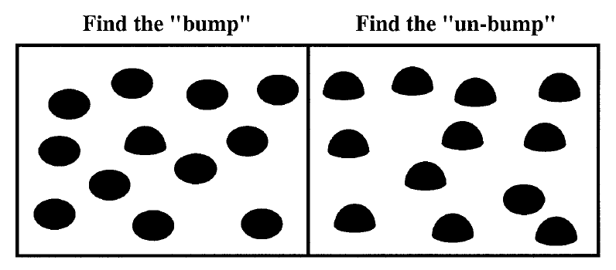
Kristjansson & Tse (2001)
Faster detection of presence than absence - but what is the “feature”?

Slide 5
Familiarity and asymmetry
asymmetry for German but not Cyrillic readers

Slide 6
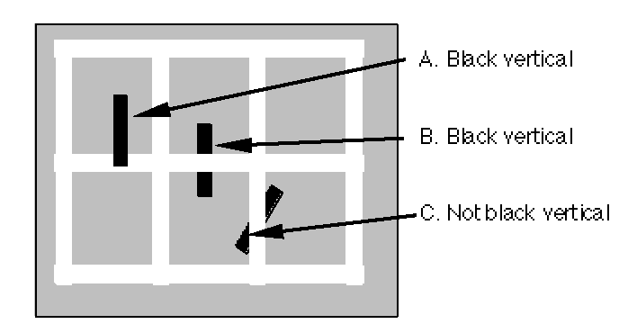
Other high level effects
finding a tilted black line is not affected by the white lattice - so “feature” search is sensitive to occlusion
Wolfe (1996)

Slide 7
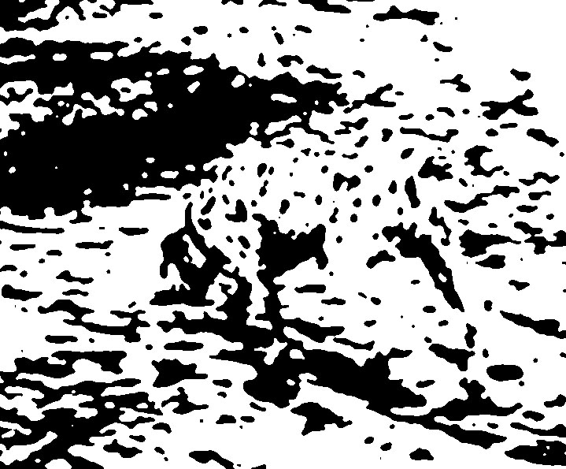
Gestalt effects

Slide 8
Summary
Classic accounts of visual perception have focused on bottom-up integration of features
Consistent with data from visual search experiments
Inconsistent with phenomenological experience in naturalistic settings
Top down influences affect visual perception
But how?
We will see one promising modeling strategy today

Slide 9
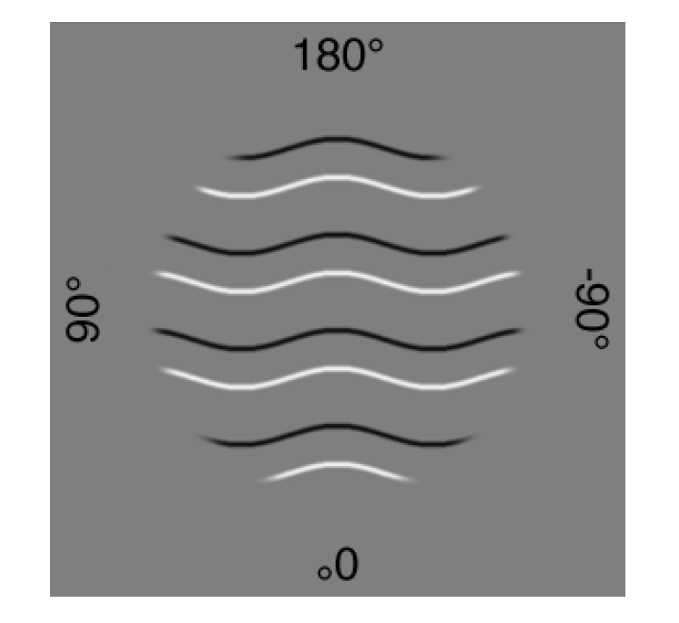
Which curves are raised?

Slide 10
Which curves are raised?

Slide 11
http://www.psych.nyu.edu/maloney/MamassianLandyMaloney.MITPress2003.pdf

Slide 12
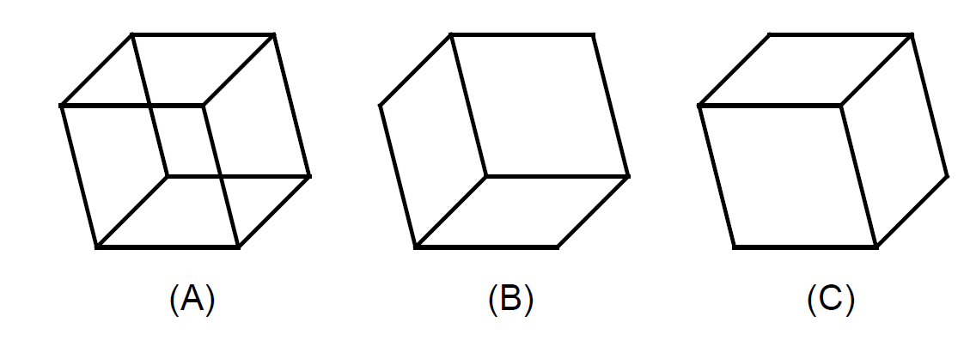
Vision uses more information than impacts the retina
What you see isn’t exactly what you get

Slide 13
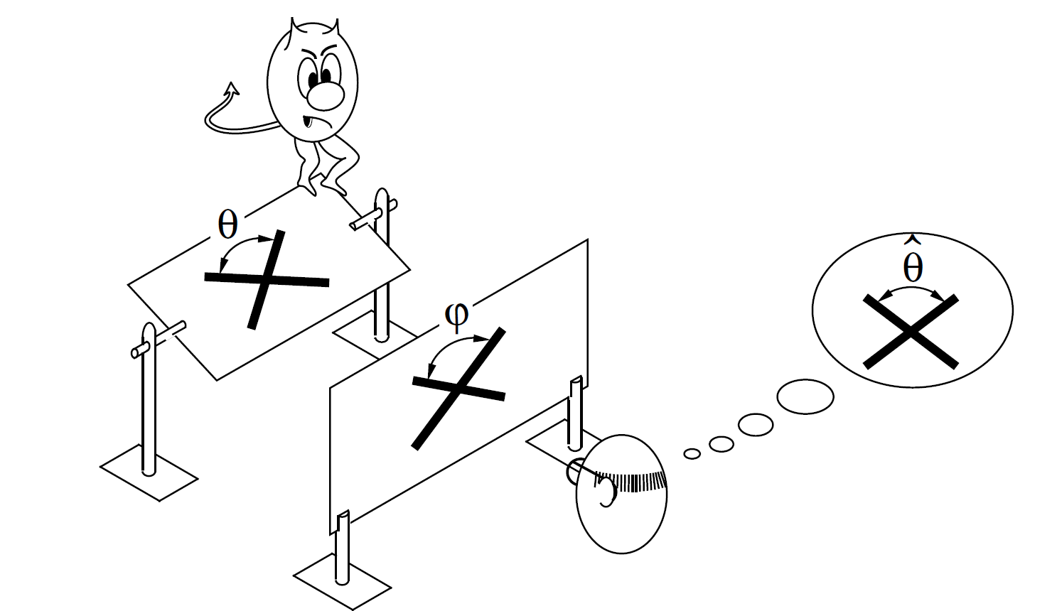
Perception as inference
Want to know θ, get to see φ

Slide 14
Bayesian visual perception
Observer constructs p(θ|φ) using
p(φ|θ), physiologically determined likelihood
p(θ), visual priors on percepts
Bayesian revolution in perception
Using Bayesian analysis to estimate visual priors using behavior responses

Slide 15
Bayesian prior estimation
Regular sequential Bayes
Update prior by multiplying with likelihood
Obtain posterior
Use posterior as prior for next time step
Inverse procedure
Know posterior distribution given all data
Divide posterior by data likelihood sequentially
Each obtained prior serves as posterior for earlier time step
Finally left with original prior

Slide 16
Bayesian parameter estimation
Typically hard to obtain likelihoods for multiple sequential updates in closed form
Alternative procedure
Generate posterior distributions using different parameters determining the prior
Find parameters that yield posterior distributions that best fit the true distribution
Frequently have to use some form of MCMC sampling

Slide 17
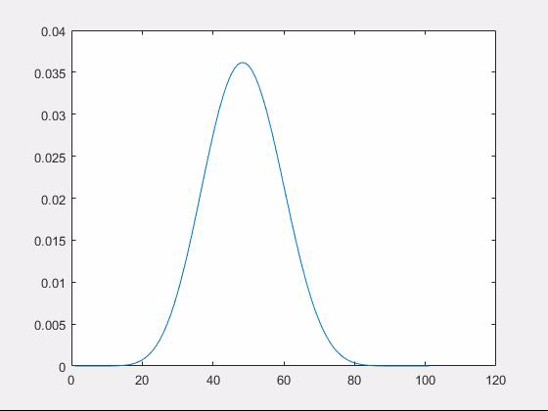
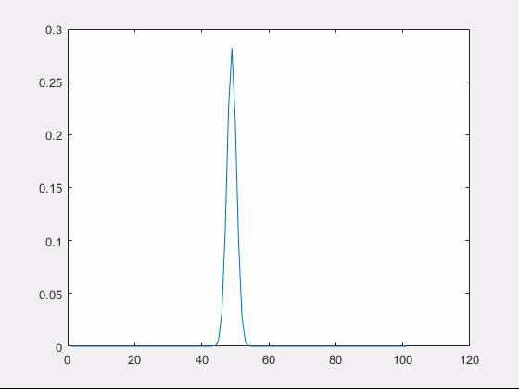
Demo
String of binary observations modeled using binomial likelihood and beta prior
Posterior update
Prior estimation

Slide 18
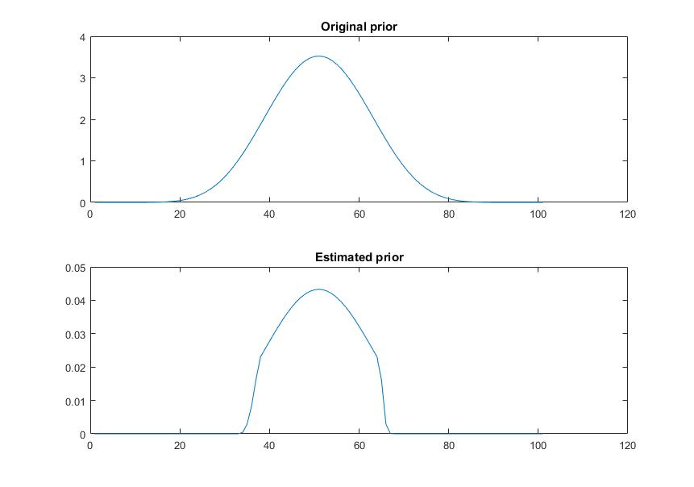
Prior estimation

Slide 19
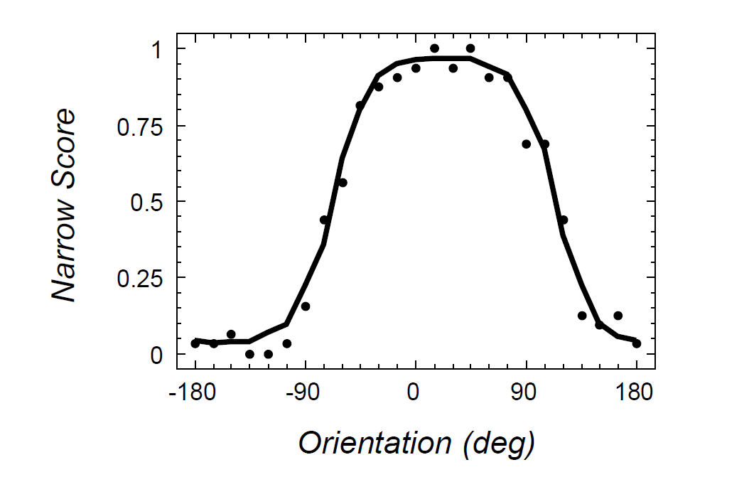
Applied to vision data
Narrow score = proportion of times image is described with bulging narrow ridges
http://www.psych.nyu.edu/maloney/MamassianLandyMaloney.MITPress2003.pdf

Slide 20
Simplifying assumptions
Response proportions assumed to reflect posterior probability p(narrow|image)
Prior biases assumed to influence response independently
R
Model illumination and viewpoint as drawn from a normal distribution on the respective angles

Slide 21
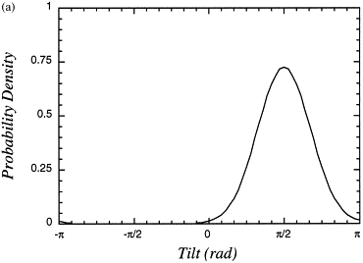
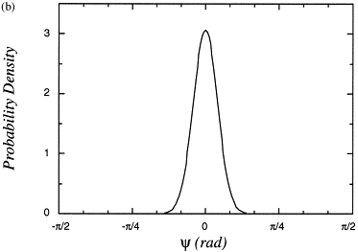
Findings
Illumination angles are a priori assumed to be above and to the left
Increasing shading contrast reduces the variance of the illumination prior
Increasing contour contrast reduces the variance of the viewpoint prior
In other experiments, shown that
People think they are looking at objects from above
People think angles are a priori likely to be right angles
And many more

Slide 22
What does it mean?
Bayesian models of visual perception give us a way of describing the priors that people use
But they don’t explain how the priors come to be the way they are
Positives: can describe both perceptual and cognitive priors
Negatives: Hard to characterize the true provenance of empirically determined priors

