Slide 1
Perceptual learning
Nisheeth
25th January 2018

Slide 2
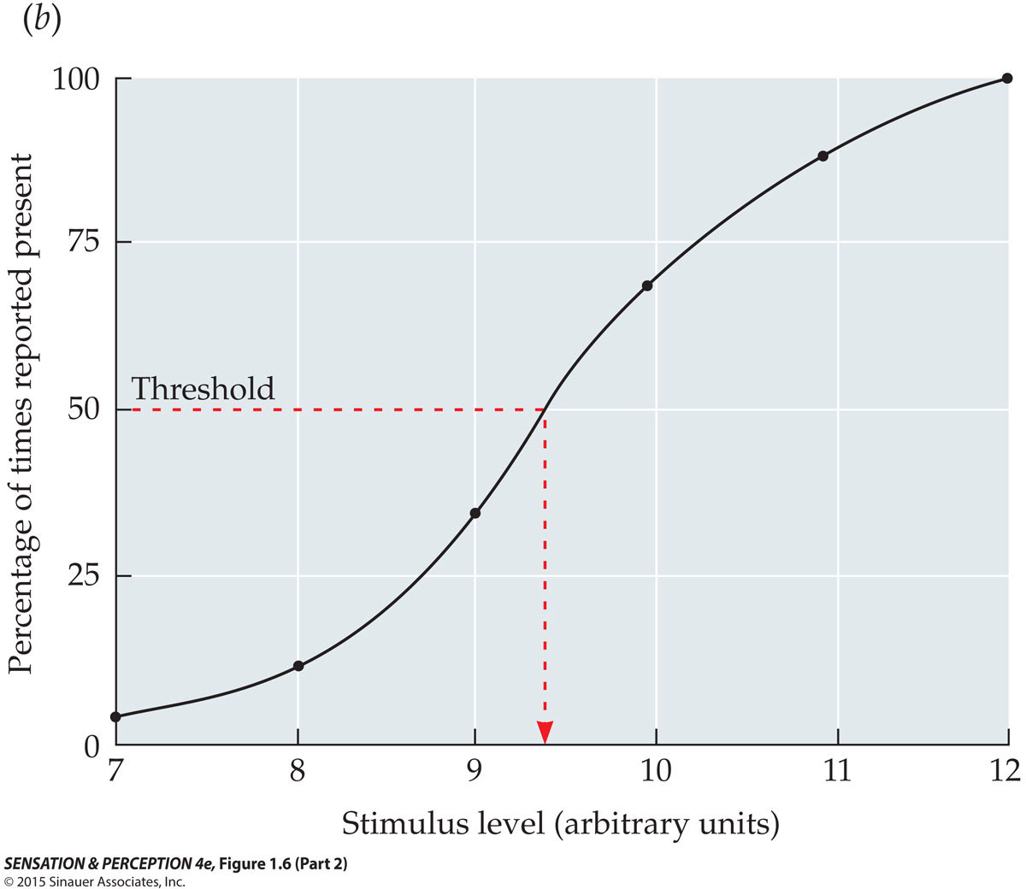
The Concept of Absolute Threshold
Psychometric function demonstrating the probabilistic (statistical) nature of the threshold
Notes:
SensationPerception4e-Fig-01-06-2R.jpg

Slide 3
2. Find a mathematical “model” that fits the data:
S = k log(I) (i.e. Fechner’s Law)
The strength of sensory experience grows at a slower rate than the physical stimulus
sensory
compression
I
(textbook)

Slide 4
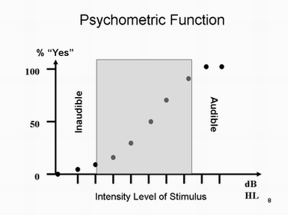
Psychometric function
Mathematical device
Parametrically model relationship between stimuli features and observer response
Yes/no
2AFC
nAFC

Slide 5
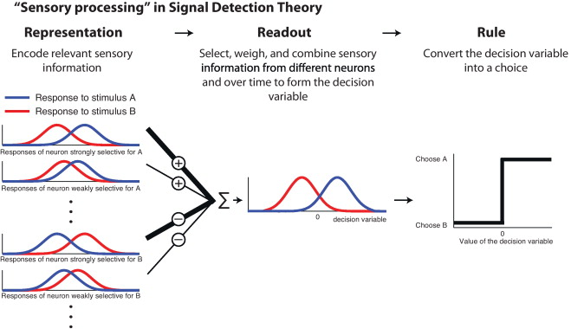
(Gold & Ding, 2013)

Slide 6
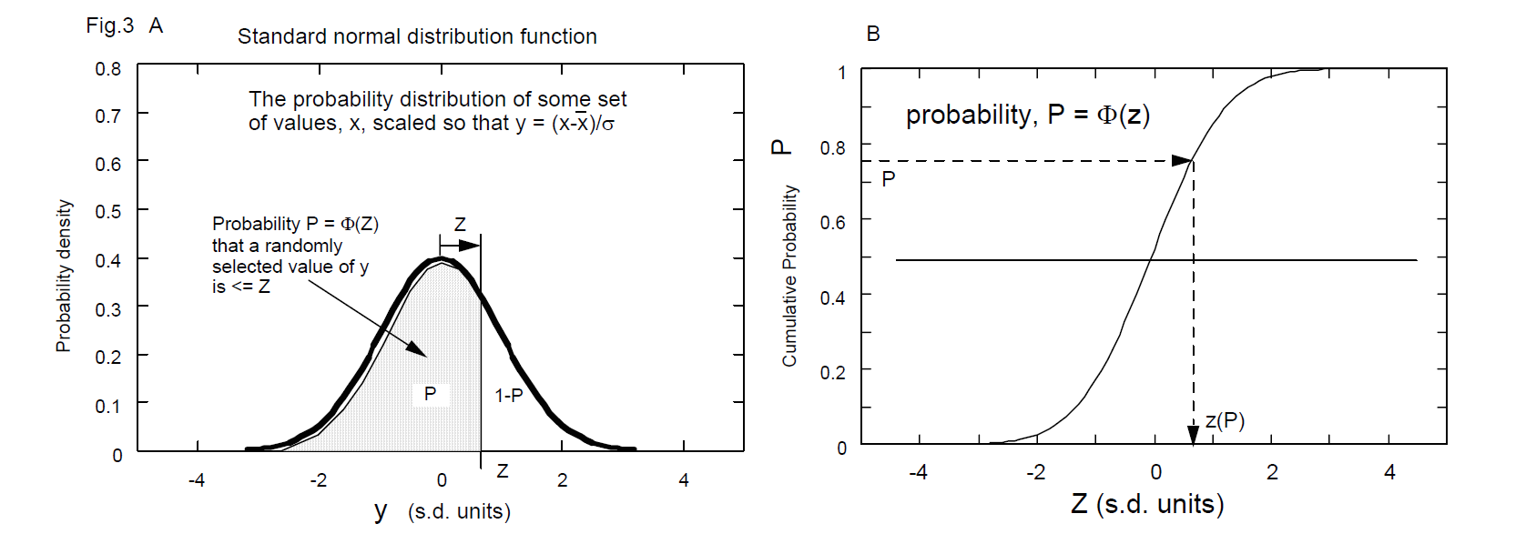
SDT tries to disambiguate
D’ measures sensitivity
Estimated as z(HR) – z(FAR)
C measures criterion
Calculated as -0.5[z(HR) + z(FAR)]

Slide 7
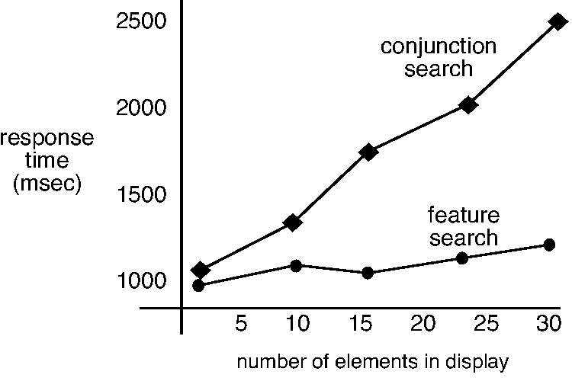

Slide 8
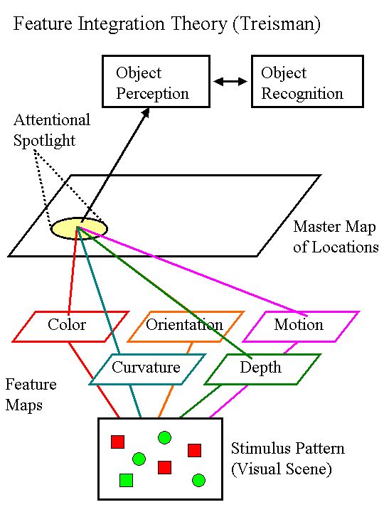

Slide 9
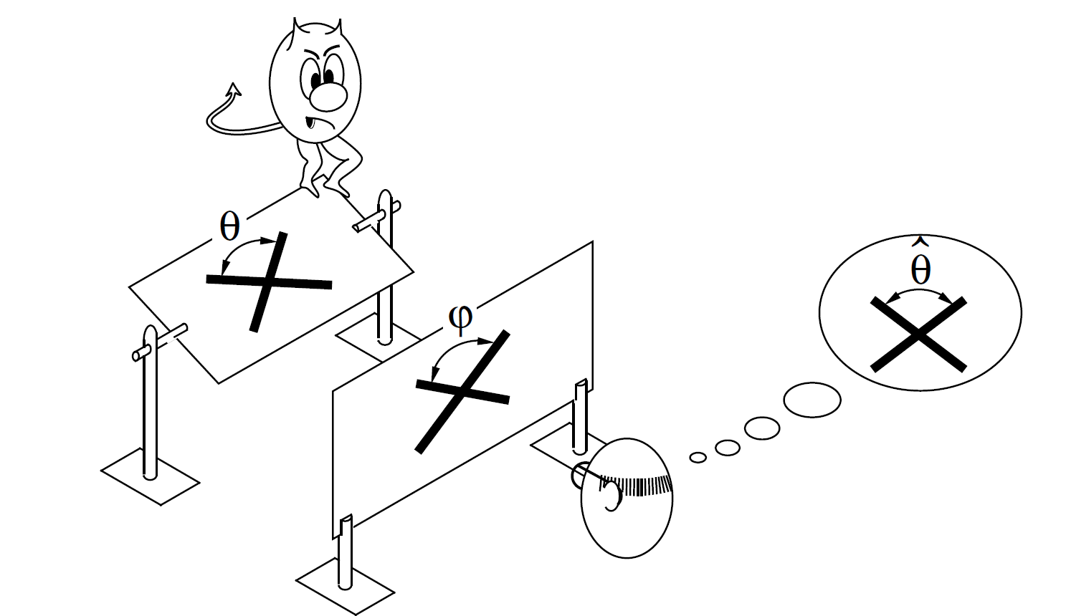
Perception as inference
Want to know θ, get to see φ

Slide 10
Can perceptual ability improve?
Classic psychophysics imagined perception to be governed by absolute limits
Signal detection theory was developed to measure these limits
Visual perception research shows
Perception strongly influenced by prior knowledge
Question: how does this influence work?
Evidence for perceptual learning presents some hypotheses

Slide 11
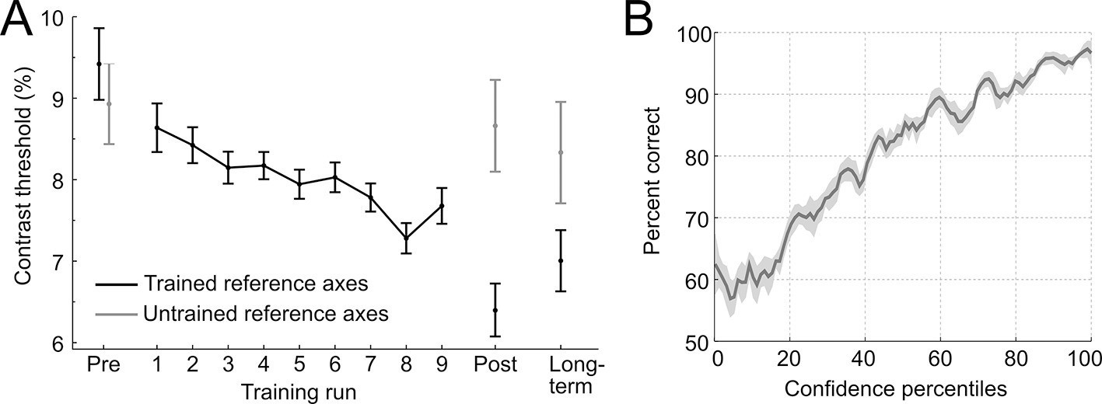
Perceptual learning
Perceptual discrimination improves with training
(Guggenmos, Wilbertz, Hebart & Sterzer, 2016)

Slide 12
Practice makes perfect
https://www.youtube.com/watch?v=Qzhs1Z8Rwnk

Slide 13
Hypotheses
Attentional weighting
Observers learn to attend to discriminative features of stimuli
Stimulus imprinting
Detectors developed that are specialized for stimuli
Differentiation
Perceptual adaptation by the development of increasingly differentiated object representations
Unitization
Development of sensory units that are triggered when a complex configuration occurs

Slide 14
Hypotheses
Attentional weighting
Observers learn to attend to discriminative features of stimuli
Stimulus imprinting
Detectors developed that are specialized for stimuli
Differentiation
Perceptual adaptation by the development of increasingly differentiated object representations
Unitization
Development of sensory units that are triggered when a complex configuration occurs

Slide 15
Perceptual learning as improved decision-making
(Gold & Ding, 2013)

Slide 16
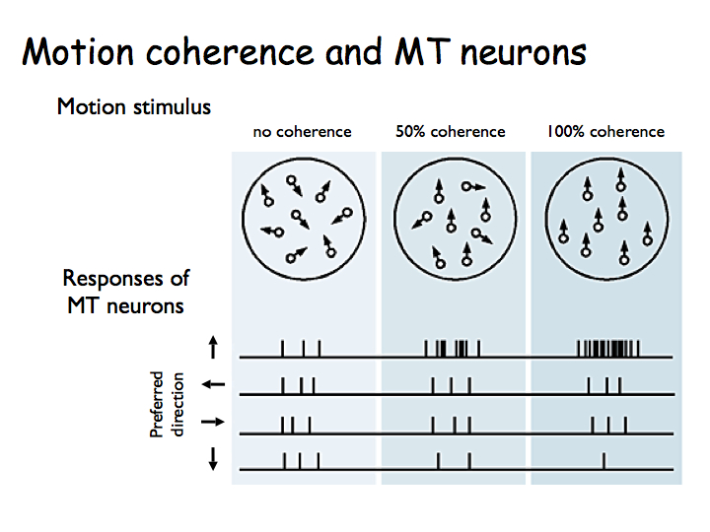

Slide 17
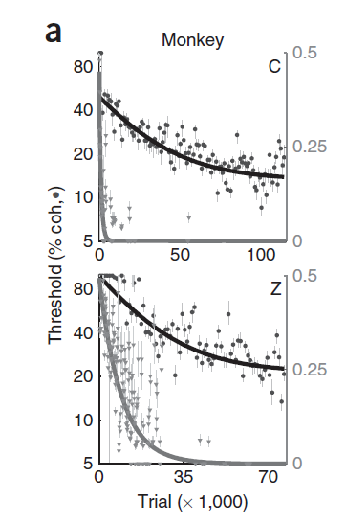
The dataset
Recorded spiking response of neurons in monkey LIP cortex
Neurons responsive to different motion directions
Measured behavioral and neural data across multiple sessions (e.g. 165 sessions over 645 days for monkey C)
Lapse rate

Slide 18
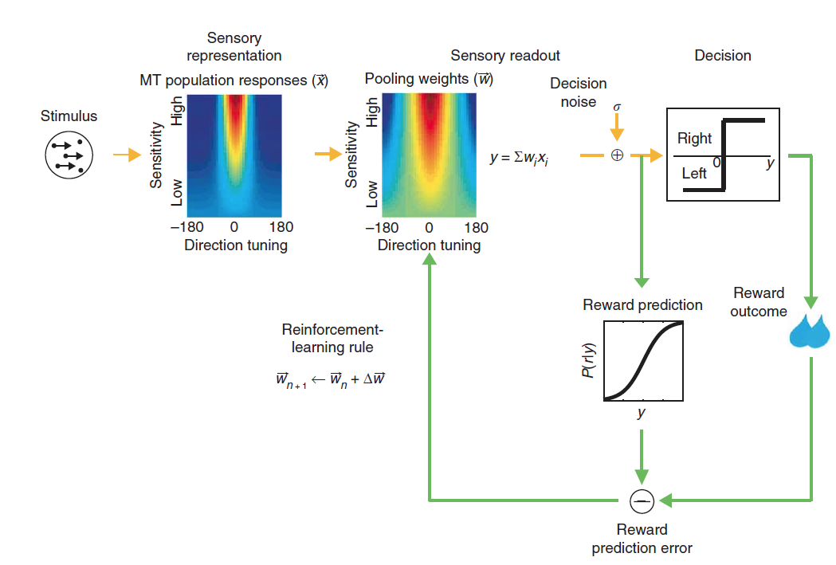
The model
(Law & Gold, 2009)

Slide 19
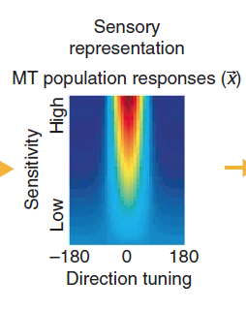
Sensory representation
MT modeled as a population of 7200 neurons
200 for each of 36 evenly spaced directions in the 2D plane
Trial-by-trial stimulus responses fixed using neuronal data

Slide 20

Individual neuron model
Each neuron’s response to a given stimulus modeled as Gaussian with mean m
k0 is spiking response at 0% coherence
kn is spiking response at 100% coherence in null direction
kp is spiking response at 100% coherence in preferred direction
COH is coherence as a fraction
Θ is the neuron’s preferred direction

Slide 21
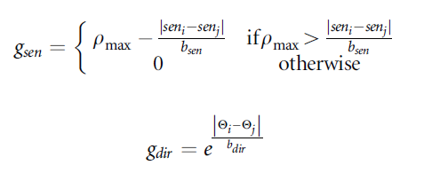

Interneuron correlations
Neurons with shared direction tuning should fire frequently together
Equally excitable neurons should fire frequently together
So neuron spiking rates should be correlated, based on similarity in
directional tuning
motion sensitivity

Slide 22
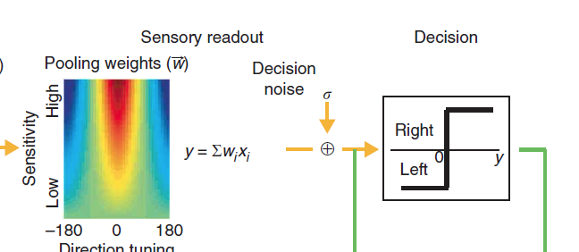
Decision variable construction
Variable constructed by pooling neuronal responses

Slide 23

Pooled neuronal responses
Construct a 7200 bit vector x
Here, r = Uz, z ~ N(0,1) and U is the square root of the correlation matrix
All neuron responses pooled to yield decision variable corrupted by decision noise

Slide 24
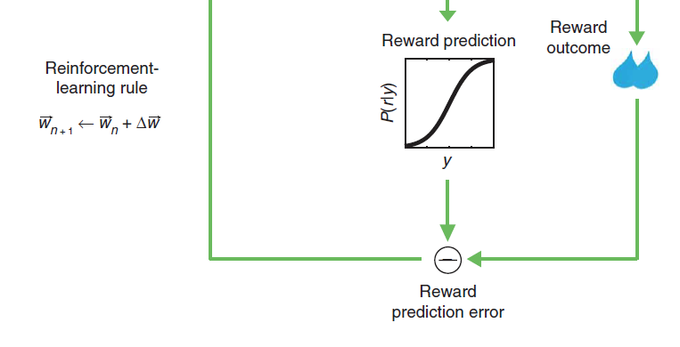
The magic sauce: weight learning
Using reinforcement learning

Slide 25

Reinforcement learning in neurons
Prediction error
C is -1 for left, +1 for right
r is whether there was success or not on the trial
E[r] is the predicted probability of responding correctly given the pooled MT responses y
x is the vector of MT responses
E[x] is the vector of baseline MT responses
M = 1, n = 0 for the most successful rule

Slide 26
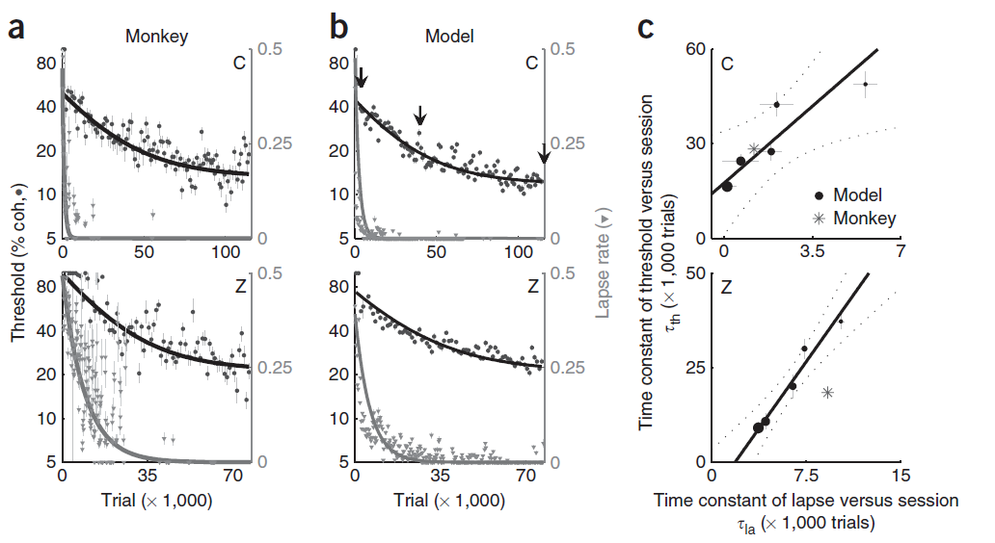
Good fit for the behavioral data

Slide 27
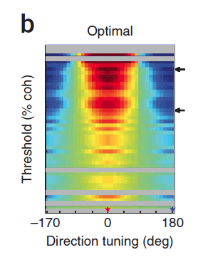
How did the tuning weights vary?
Graph plots neuron weights on y-axis and directional tuning on x-axis
This plot shows the optimal weights to discriminate motion directions 180 degrees apart
Some neurons (not all) learn that direction 0 should get high positive weights and direction 180 should get high negative weights

Slide 28
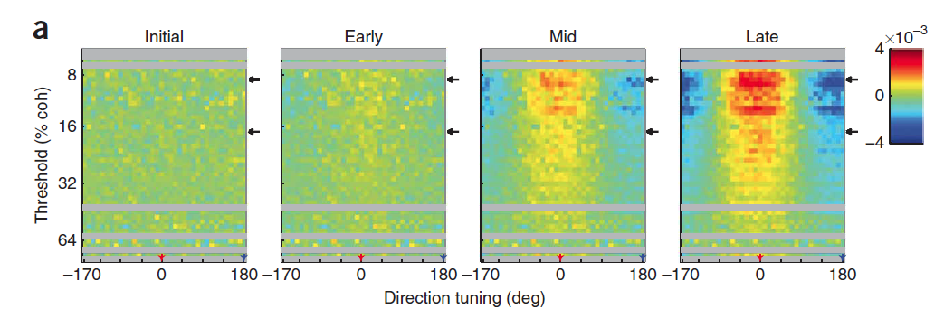
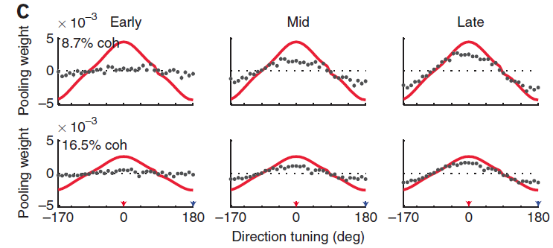
They were headed the right way

Slide 29
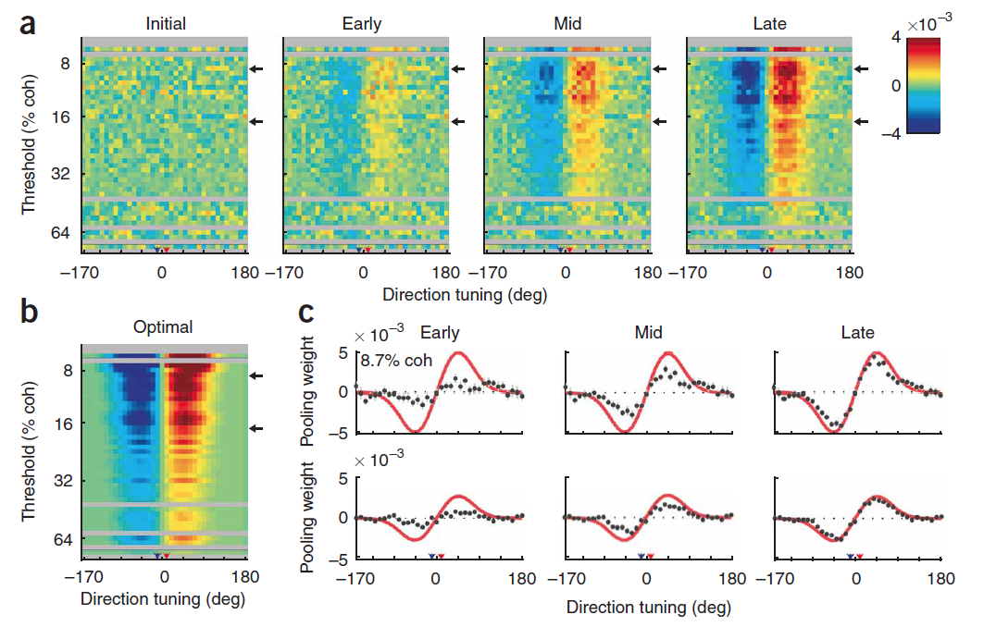
Fine discrimination task

Slide 30
Perceptual learning is hyper-specific
Training with horizontal Vernier scales can improve discrimination threshold 6-fold
But horizontal training does not translate to vertical direction

Slide 31
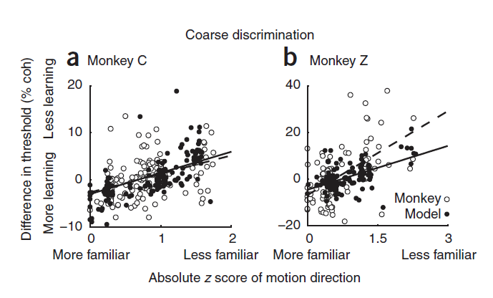
Training specificity predictions
Infrequently seen directions show less learning

Slide 32
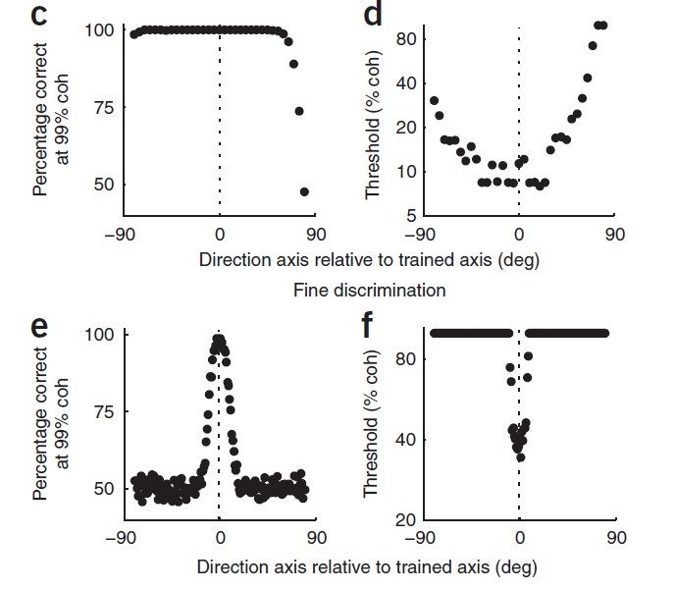
Model predicts differential sensitization
Sensory-motor association
Perceptual sensitivity

Slide 33
The model
(Law & Gold, 2009)

Slide 34
Perceptual learning as improved decision-making
(Gold & Ding, 2013)

