Slide 1
Classic categorization models
Nisheeth
2nd Feb 2018

Slide 2
Functions of Concepts
By dividing the world into classes of things to decrease the amount of information we need to learn, perceive, remember, and recognise: cognitive economy
They permit us to make accurate predictions
Categorization serves a communication purpose

Slide 3
Outline
Hierarchical Structure
Is there a preferred level of conceptualization?
Organization of Concepts
classical view: defining-attribute approach
prototype theory
exemplar models
Semantic similarity
Query likelihood model

Slide 4
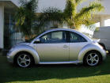
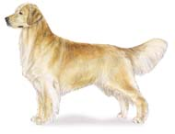

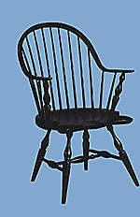
Is there a preferred level of conceptualization?

Slide 5
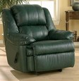



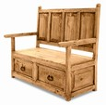



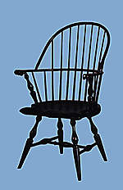
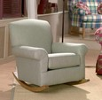
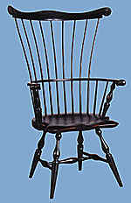
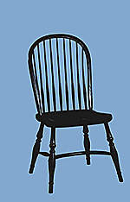
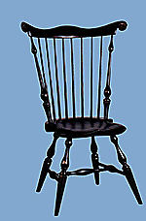
Superordinate level
Superordinate
Furniture
Preferred level
BASIC LEVEL
Basic
Chair
Subordinate level
Subordinate
Windsor

Slide 6
What’s special about the basic level
1) most abstract level at which objects have similar shapes

Slide 7
What’s special about the basic level
2) development
First words are learned at the basic level (e.g., doggy, car, ball)
3) Language
natural level at which objects are named
languages first acquire basic level terms

Slide 8
most general BASIC most specific
maximize accuracy
little predictive power
maximize predictive power
little accuracy

Slide 10
Organization of Concepts

Slide 11
Representation of Conceptual Knowledge
How do we represent concepts? How do we classify items?
CLASSICAL VIEW
concepts can be defined in terms of singly necessary and jointly sufficient features
singly necessary: every instance of the concept must have that property
jointly sufficient: every entity having all those features must be an instance of the concept

Slide 12
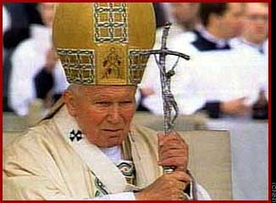
Problems with Classical View
Bachelor: unmarried, male, adult
?
Notes:
almost any definition has exceptions

Slide 13
What is a game?
Ludwig Wittgenstein (1953) proposed that games could not be defined or categorized by features.
Rather, any game shares some family resemblance to some (but not all) other games.
Notes:
Consider the game “Hide and Go Seek”. These might have these features:
multiple players
for fun
rules
competition
starting & ending
strategy
winning and losing
hiding places
Now, consider “Olympic Games” and mark with X features that do not apply:
multiple players
X for fun
rules
competition
starting & ending
strategy
winning and losing
X hiding places
Now, consider “Solitaire” and mark with X features that do not apply:
X multiple players
for fun
rules
X competition
starting & ending
strategy
X winning and losing
X hiding places
Are these non-marked features jointly sufficient to define “Game”?
X multiple players
X for fun
rules
X competition
starting & ending
strategy
X winning and losing
X hiding places

Slide 14
Prototype and Exemplar Models
A new exemplar is classified based on its similarity to a stored category representation
Types of representation
prototype
exemplar

Slide 15
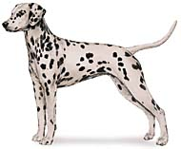
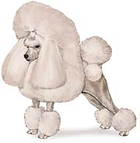
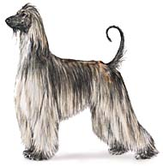
Prototypes Representations
Central Tendency
P
Learning involves abstracting a set of prototypes

Slide 16
Typicality Effects
typical
robin-bird, dog-mammal, book-reading, diamond-precious stone
atypical
ostrich-bird, whale-mammal, poem-reading, turquoise-precious stone
Notes:
According to the Classical View, anything that follows the rules is a member of the concepts … no typicality effects are predicted

Slide 17

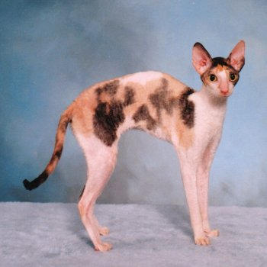
Is this a “chair”?
Is this a “cat”?
Is this a “dog”?

Slide 18
Graded Structure
Typical items are similar to a prototype
Typicality effects are naturally predicted
atypical
P
typical

Slide 19
Classification of Prototype
Prototype are often easy to classify and remember
Even if the prototype is never seen during learning
Posner & Keele DEMO: http://psiexp.ss.uci.edu/research/teaching/Posner_Keele_Demo.ppt

Slide 20
Problem with Prototype Models
All information about individual exemplars is lost
category size
variability of the exemplars
correlations among attributes (e.g., only small birds sing)

Slide 21


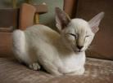

Exemplar model
category representation consists of storage of a number of category members
New exemplars are compared to known exemplars – most similar item will influence classification the most
dog
dog
??
cat
dog
cat
dog
cat

Slide 22
Exemplar Models
Model can explain
Prototype classification effects
Prototype is similar to most exemplars from a category
Graded typicality
How many exemplars is new item similar to?
Effects of variability
pizzas and rulers
Overall, compared to prototype models, exemplar models better explain data from categorization experiments (Storms et al., 2000)

Slide 23
Sample exemplar model
Nosofsky’s 1986 Generalized Context Model (GCM) has been very influential
Stimuli stored in memory as combinations of features
Context for a feature are the other features with which it co-occurs
Assumes that stimuli are points in interval-scaled multidimensional space

Slide 24

GCM similarity function
Compute psychological distance between memory exemplar x and stimulus y as
Alpha are attention weights
Similarity is calculated as
Note: Distance function is always greater than zero
Use abs outside the summation if necessary

Slide 25

Category response in GCM
Exemplars vote for the category with which they are associated
N(R,x) is the count of the number of times x has been recorded as being in category R before
Gamma is a response bias parameter
Equation is basically counting total votes cast for category R by exemplars divided by total votes cast

Slide 26
What do the parameters do?
Gamma reflects environmental priors on categorization
Beta reflects the bias-variance tradeoff in similarity judgments
What does alpha do?
Reflects the role of semantic knowledge in categorization

Slide 27
Knowledge-based Views
Murphy (2002, p. 183):
“Neither prototype nor exemplar models have attempted to account for knowledge effects . . . The problem is that these models start from a kind of tabula rasa [blank slate] representation, and concept representations are built up solely by experience with exemplars.”

Slide 28
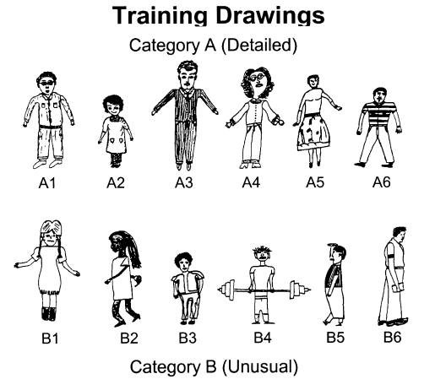
Effect of Knowledge on Concept Learning
Concept learning experiment involving two categories of children’s drawings
Two learning conditions:
neutral labels for categories (Group 1 vs. Group 2 children)
Category labels induced use of background knowledge: “Creative and non-creative children created category A and B drawings respectively”
Note: same stimuli are used in both conditions
Palmeri & Blalock (2000)
Notes:
FIGURE 1 FROM THE PAPER: “Training and transfer drawings used in the experiment (adapted from Wisniewski & Medin, 1994).
The top portion of the figure displays the 12 training drawings.
Category A drawings have the abstract property of being relatively `detailed' and could be classi®ed using simple perceptual rules such as `curly
hair and arms not at the sides', or `light-colored shoes or smiling', or `wearing a collar or tie'.
Category B drawings have the abstract property of being relatively `unusual' and could be classi®ed using simple
perceptual rules such as `straight hair or arms at the sides', or `dark-colored shoes and not smiling', or
`ears and short sleeves'.

Slide 29
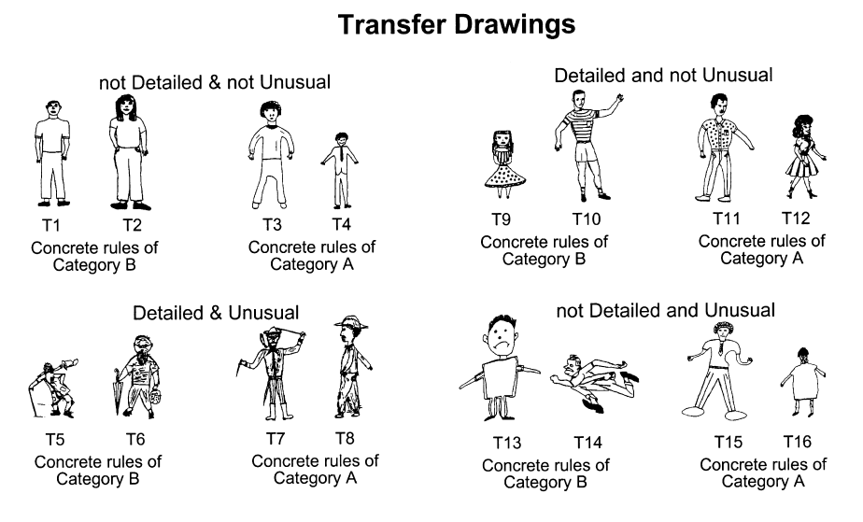
By manipulating the meaningfulness of the labels applied to those categories of drawings, subjects classified new drawings in markedly different ways. E.g., neutral labels led to an emphasis of concrete features. The “creative vs. non-creative” labels led to an emphasis of abstract features
Background knowledge and empirical information about instances closely interact during category learning
Palmeri & Blalock (2000)
Notes:
the 16 transfer drawings. The ®rst set
(T1±T4) have abstract properties of neither category, the second set (T5±T8) have the abstract properties
of both categories, the third set (T9±T12) have the abstract properties of category A, and the fourth set
(T13±T16) have the abstract properties of category B. Within each set of transfer drawings, two drawings
follow the simple perceptual rules of category A and two drawings follow the simple perceptual rules of
category B.”
“For example, T13 has the abstract properties of
category B and the concrete perceptual features of category B, whereas T10 has the
abstract properties of category A but the concrete perceptual features of category B.
W&M observed that subjects classi®ed transfer drawings that con¯icted on abstract
properties and perceptual features in a manner consistent with the type of labels they
were provided. Subjects provided meaningful labels classi®ed according to abstract
properties (e.g. tending to classify T10 and T13 as members of different categories),
whereas subjects provided meaningless labels classi®ed according to perceptual
features (e.g. tending to classify T10 and T13 as members of the same category).”

Slide 30
Learning an exemplar model from labels
Original GCM model had no learning
Parameters fit to data
Basically just a clustering model (unsupervised)
Later models offer learning mechanisms
Kruschke’s ALCOVE model (1992)
Assumes a supervised learning setting
Learner predicts categories
Teacher teaches true category

Slide 31


Supervised learning in ALCOVE
Activation of category k given stimulus y
Training loss function
Where t is a training label that is 1 if the predicted response is correct and 0 otherwise

Slide 32


Optimization using gradient descent
All weights and parameters are learned using gradient descent
Weight update
Exemplar-wise error
Attention update

Slide 33
Variations
GCM-class models assume the presence of interval-scaled psychological distances
Can make different assumptions about similarity function, e.g. categorical instead of continuous scale
# of matches
# of mismatches
# matches - # mismatches
Can make different assumptions about the learning mechanism
Anderson’s Rational Model of Categorization
We will see this next week

