Slide 1
Semantic Similarity
Nisheeth
13th Feb 2018

Slide 2
The similarity function
Objects represented as points in some coordinate space
Metric distances between points reflect observed similarities
But what reason do we have to believe the similarity space is endowed with a metric distance?
Near
Far
https://pdfs.semanticscholar.org/9bc7/f2f2dd8ca2d5bdc03c82db264cbe0f2c0449.pdf

Slide 3
What makes a measure metric?
Minimality
D(a,b) ≥ D(a,a) = 0
Symmetry
D(a,b) = D(b,a)
Triangle inequality
D(a,b) + D(b,c) ≥ D(c,a)
Do similarity judgments satisfy any of these properties?

Slide 4
Tversky’s set-theoretic similarity
Assumptions
Matching: s(a,b) = f(a∩b, a-b, b-a)
Monotonicity: s(a,b) ≥ s(a,c) whenever a∩c is a subset of a∩b, a - b is a subset of a - c, and b - a is a subset of c –a
Independence: the joint effect on similarity of any two feature components is unaffected by the impact of other components
Satisfying model = add up matching features, subtract out distinct features
Feature definition unspecified

Slide 5
What Gives Concepts Their Meaning?
Goldstone and Rogosky (2002)
External grounding: a concept’s meaning comes from its connection to the external world
Conceptual web: a concept’s meaning comes from its connections to other concepts in the same conceptual system
Examples of “conceptual web” approach:
Semantic Networks
Probabilistic language models

Slide 6
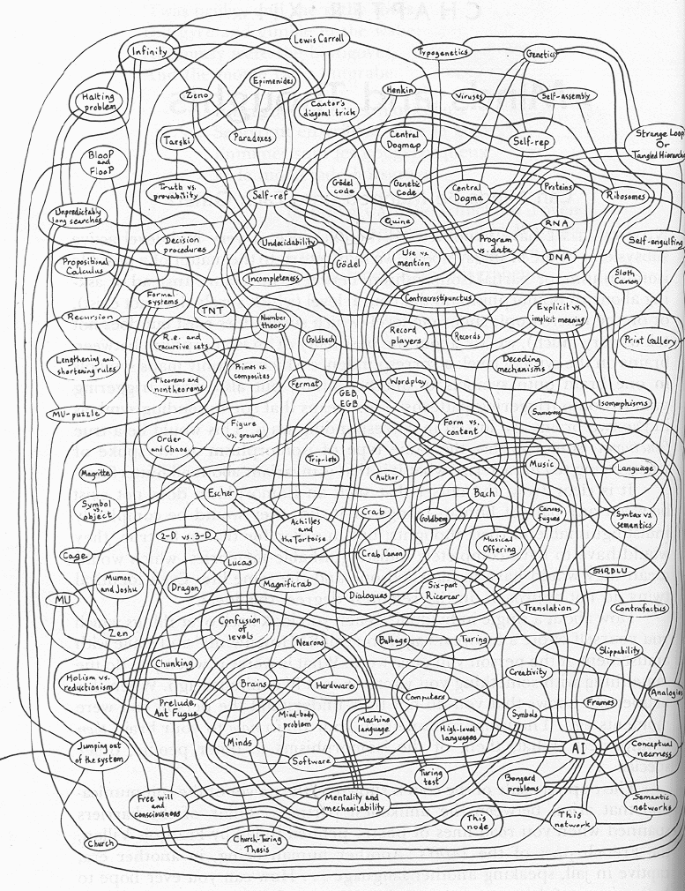
Semantic Networks
Hofstadter. Godel, Escher, Bach.

Slide 7
Language Model
Unigram language model
probability distribution over the words in a language
generation of text consists of pulling words out of a “bucket” according to the probability distribution and replacing them
N-gram language model
some applications use bigram and trigram language models where probabilities depend on previous words

Slide 8
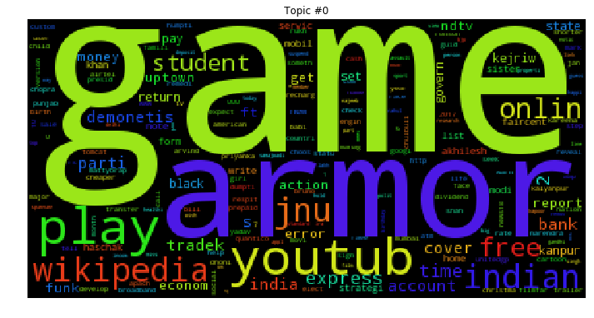
Sample topic

Slide 9
Language Model
A topic in a document or query can be represented as a language model
i.e., words that tend to occur often when discussing a topic will have high probabilities in the corresponding language model
The basic assumption is that words cluster in semantic space
Multinomial distribution over words
text is modeled as a finite sequence of words, where there are t possible words at each point in the sequence
commonly used, but not only possibility
doesn’t model burstiness

Slide 10
Language models in information retrieval
3 possibilities:
probability of generating the query text from a document language model
probability of generating the document text from a query language model
comparing the language models representing the query and document topics
Commonly used in industry applications

Slide 11
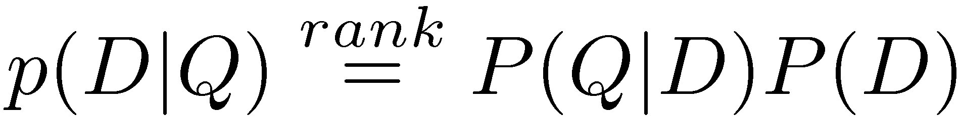
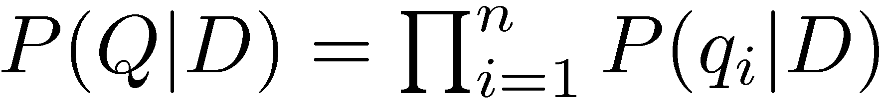
Query-Likelihood Model
Rank documents by the probability that the query could be generated by the document model (i.e. same topic)
Given query, start with P(D|Q)
Using Bayes’ Rule
Assuming prior is uniform, unigram model

Slide 12
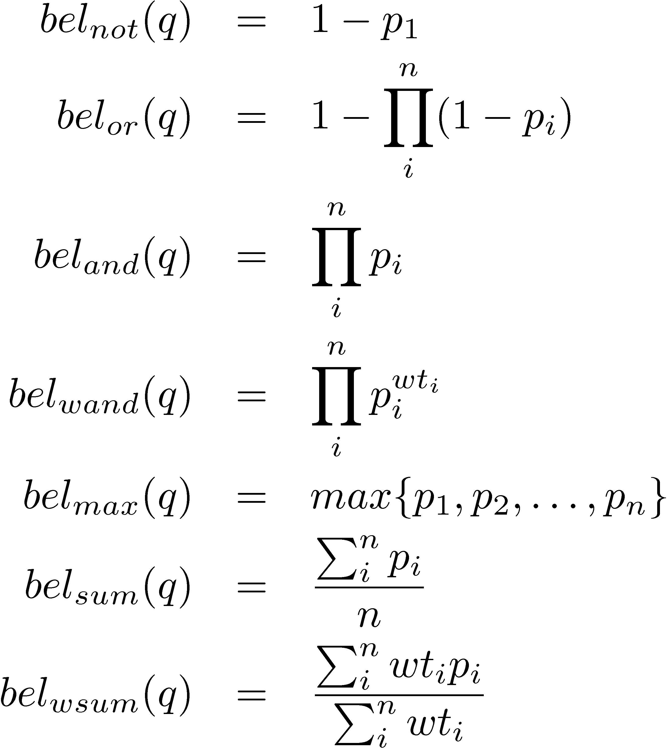
Other query constructions

Slide 13
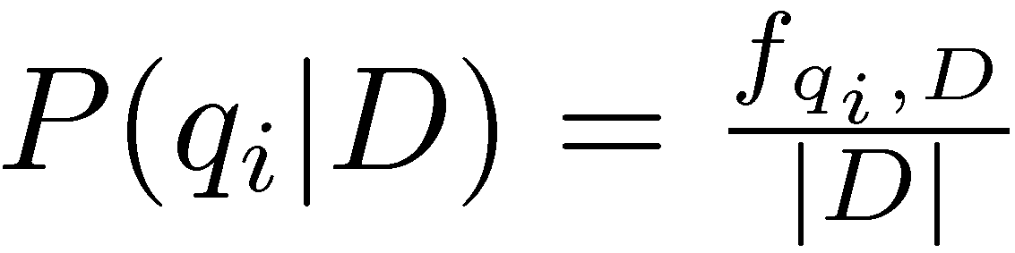
Estimating Probabilities
Obvious estimate for unigram probabilities is
Maximum likelihood estimate
makes the observed value of fqi;D most likely
If query words are missing from document, score will be zero
Missing 1 out of 4 query words same as missing 3 out of 4

Slide 14
Smoothing
Document texts are a sample from the language model
Missing words should not have zero probability of occurring
Smoothing is a technique for estimating probabilities for missing (or unseen) words
lower (or discount) the probability estimates for words that are seen in the document text
assign that “left-over” probability to the estimates for the words that are not seen in the text

Slide 15
Estimating Probabilities
Estimate for unseen words is α_{D}P(q_{i}|C)
P(q_{i}|C) is the probability for query word i in the collection language model for collection C (background probability)
α_{D} is a parameter
Estimate for words that occur is
(1 − α_{D}) P(q_{i}|D) + α_{D} P(q_{i}|C)
Different forms of estimation come from different α_{D}

Slide 16
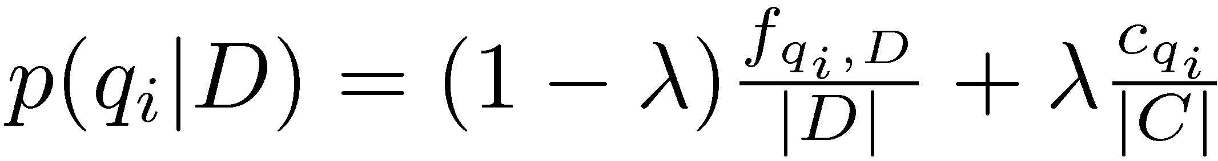
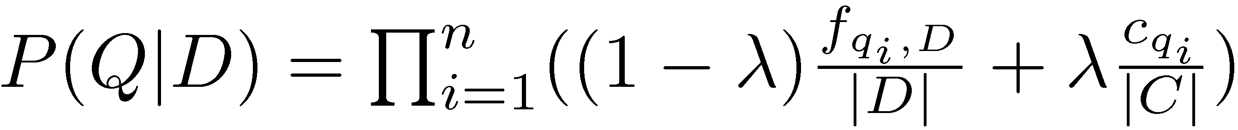
Jelinek-Mercer Smoothing
α_{D} is a constant, λ
Gives estimate of
Ranking score
Use logs for convenience
accuracy problems multiplying small numbers

Slide 17
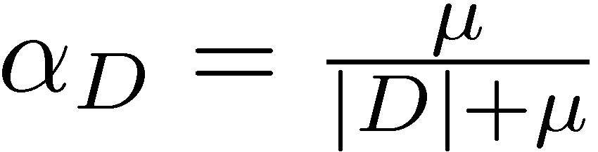
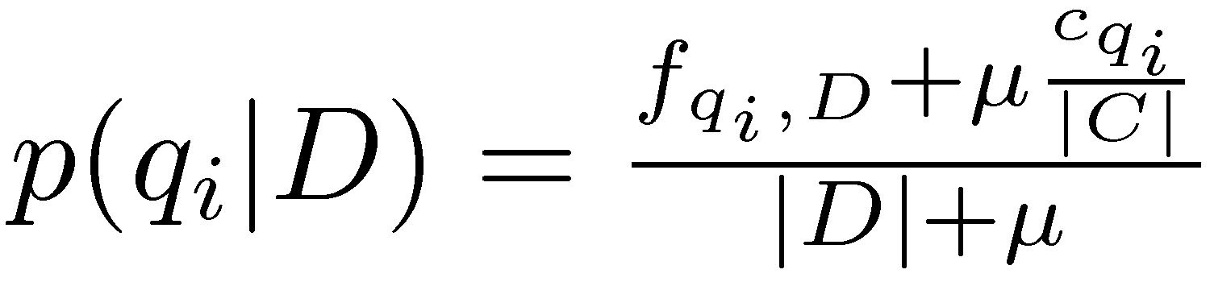
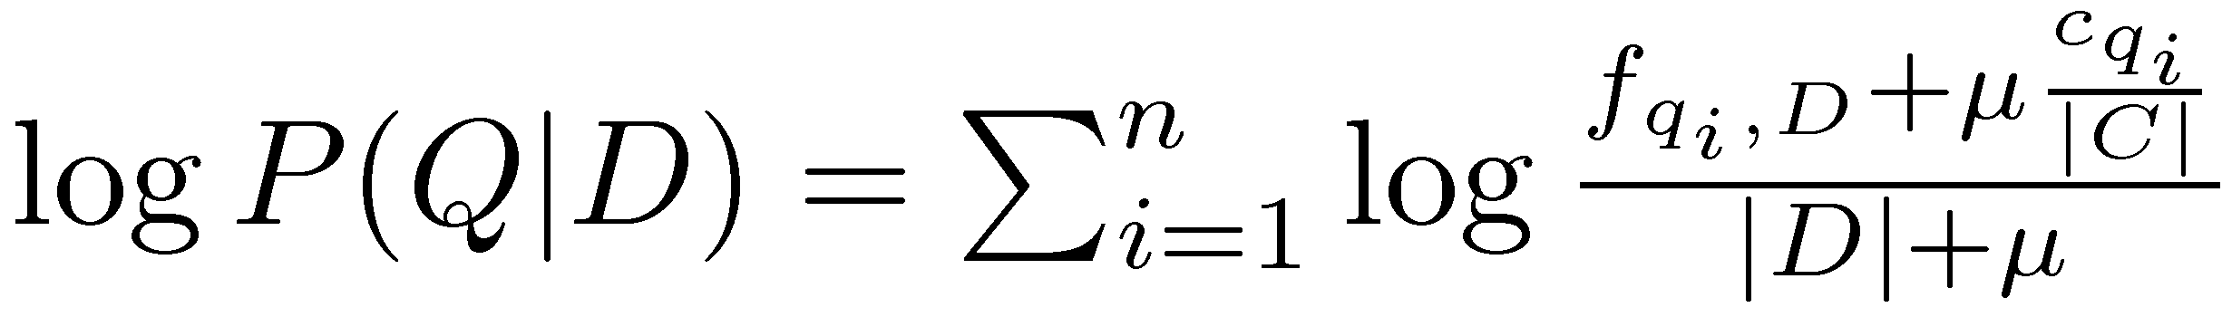
Dirichlet Smoothing
α_{D} depends on document length
Gives probability estimation of
and document score
Take home question: what is Dirichlet about this smoothing method?

Slide 18
Query Likelihood Example
For the term “president”
f_{qi,D} = 15, c_{qi} = 160,000
For the term “lincoln”
f_{qi,D} = 25, c_{qi} = 2,400
document |d| is assumed to be 1,800 words long
collection is assumed to be 10⁹ words long
500,000 documents times an average of 2,000 words
μ = 2,000

Slide 19
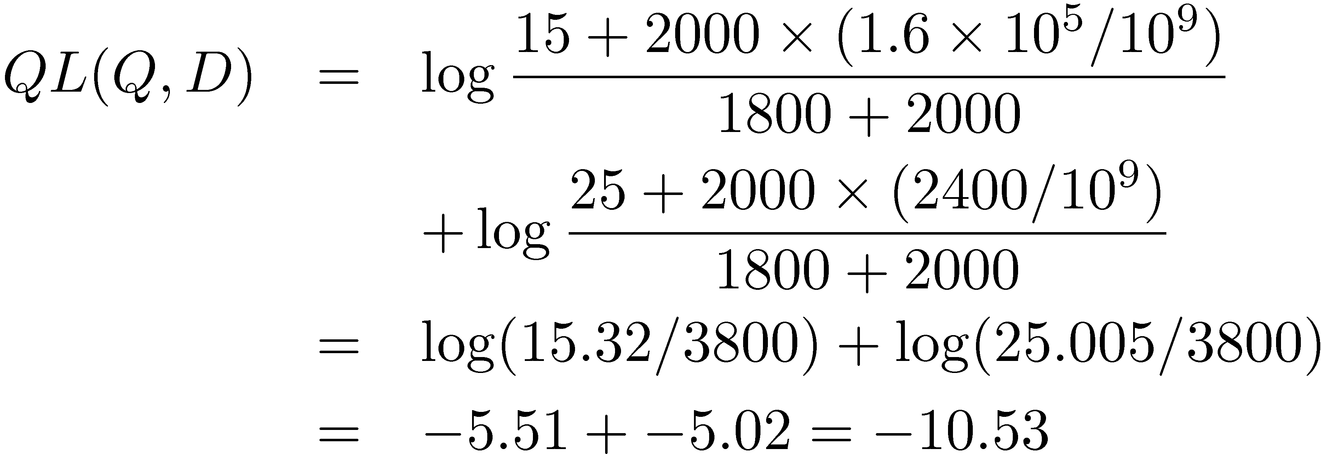
Query Likelihood Example
Negative number because summing logs of small numbers

Slide 20
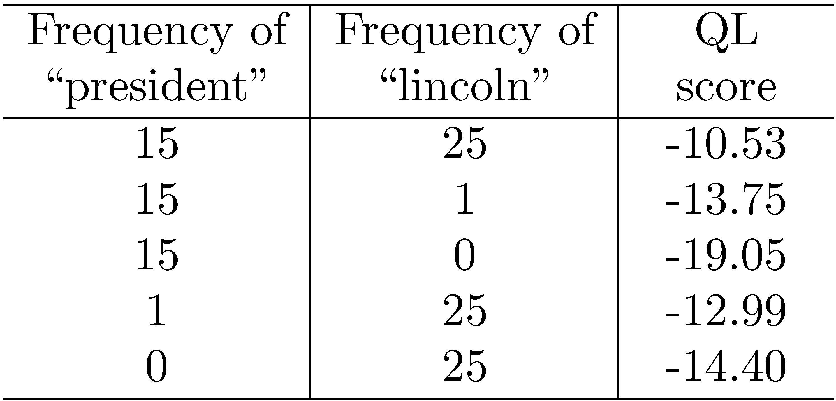
Query Likelihood Example

Slide 21
Latent Semantic Analysis (LSA)
Latent Semantic Analysis (LSA; Landauer & Dumais, 1997) is a theory of semantics in which meaning of words is learned from large text corpora (e.g., magazine articles, book chapters, newspaper articles)
Basic idea: words similar in meaning occur in similar verbal contexts. Example: “CAT” and “DOG” often co-occur together in same document.
Produces a feature-like representation for a word where similar words have similar representations
The same principle informs word embeddings in modern NN models like word2vec

Slide 22
Latent Semantic Analysis (LSA)
Use large corpus of written text. For example, a selection of books that a typical person might read from childhood to college (approximately 93 million words)
Count number of times words occur in documents. Create a matrix of counts
Use statistical methods (singular value decomposition) to reduce the dimensionality of the matrix (from 50,000 to 300 dimensions)
The resulting vectors (in a 300 dimensional space) are the semantic representations

Slide 23
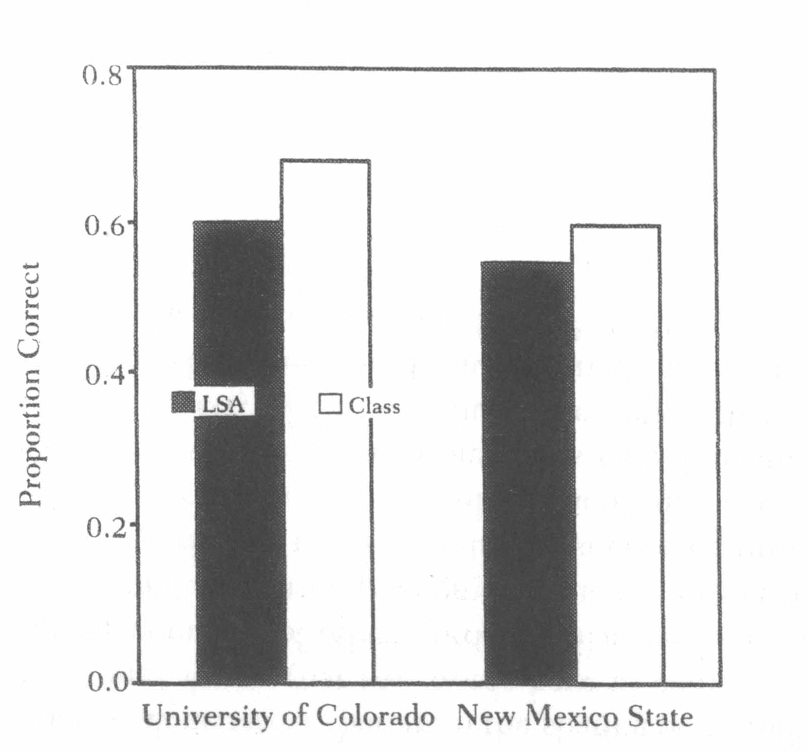
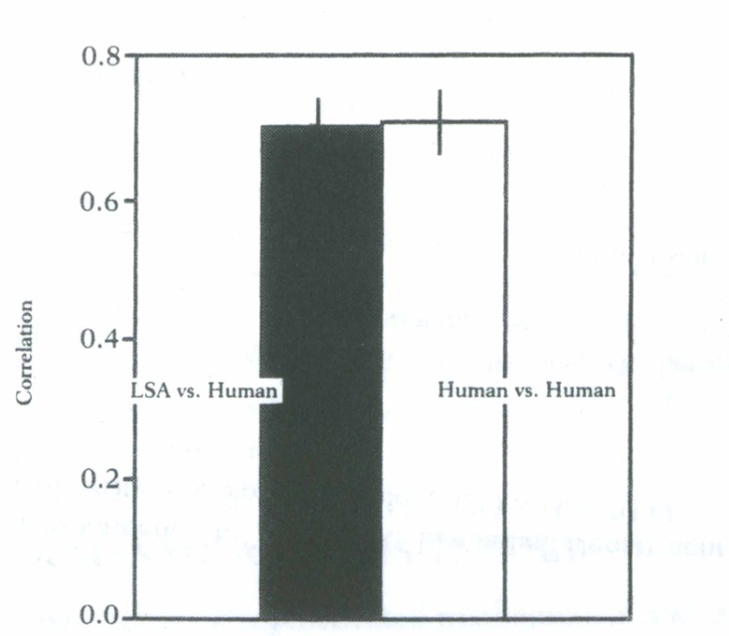
Applications of LSA
Can pass various exams and tests (e.g. psychology exams and TOEFL tests)
Automatically grading essays.
Explaining semantic similarity & priming
Understanding metaphors
Text comprehension
For demos of Latent Semantic Analysis: http://lsa.colorado.edu/
Performance of LSA and students on a multiple-choice psychology exam.
Average agreement (correlation) between LSA and human expert scoring of essay exam questions in various domains

Slide 24
Other Applications of Concept Learning Research
20 Questions: http://20q.net/
Google Sets: http://labs.google.com/sets

Slide 25
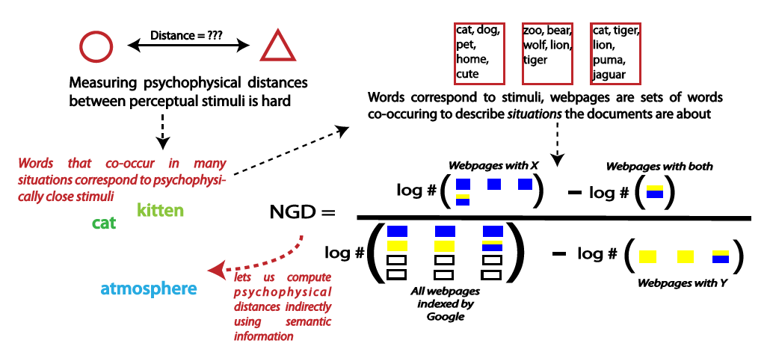
Extension: Google Distance

Slide 26
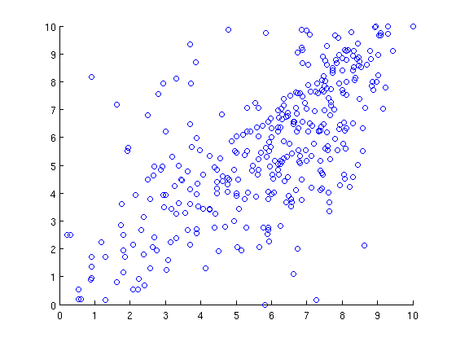
Strong correlation with human similarity ratings
Scaled NGD
Human similarity ratings

Slide 27
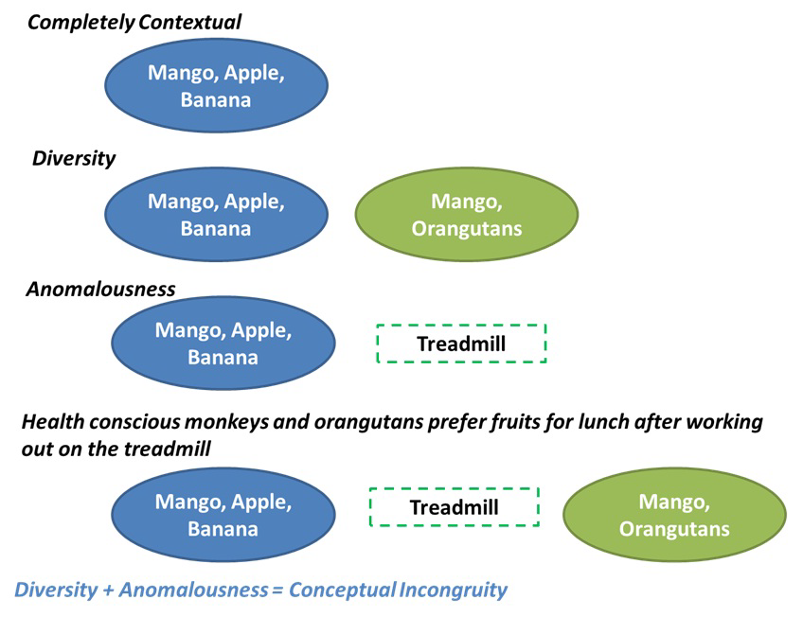
Can operationalize creativity

