Slide 1
Learning concepts
Nisheeth
13th Feb 2018

Slide 2
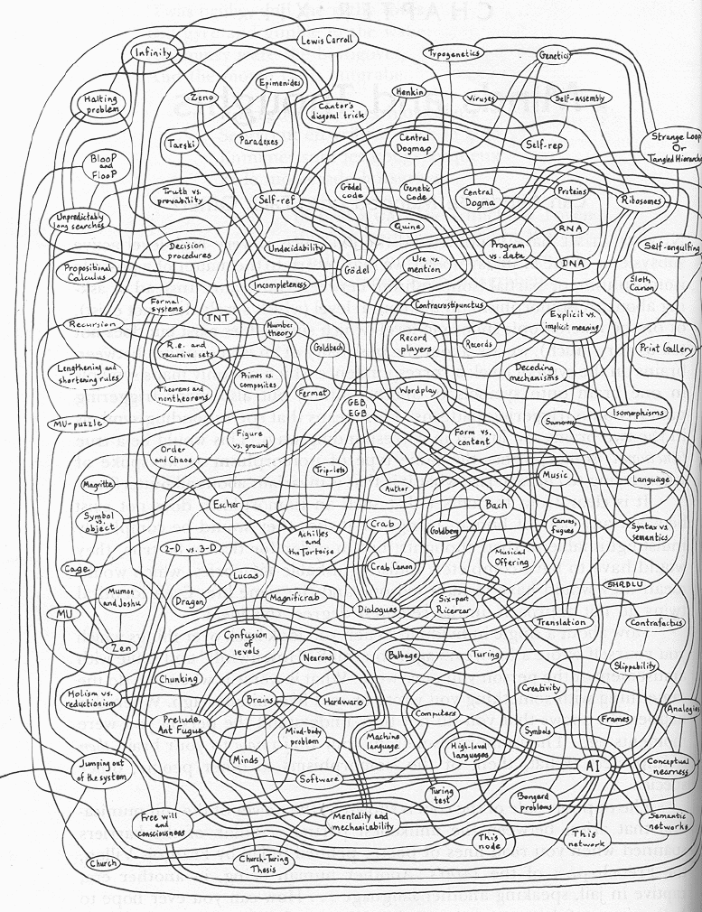
Semantic Networks
Hofstadter. Godel, Escher, Bach.

Slide 3
Language Model
A topic in a document or query can be represented as a language model
i.e., words that tend to occur often when discussing a topic will have high probabilities in the corresponding language model
The basic assumption is that words cluster in semantic space
Multinomial distribution over words
text is modeled as a finite sequence of words, where there are t possible words at each point in the sequence
commonly used, but not only possibility
doesn’t model burstiness

Slide 4
Language models in information retrieval
3 possibilities:
probability of generating the query text from a document language model
probability of generating the document text from a query language model
comparing the language models representing the query and document topics
Commonly used in industry applications

Slide 5
Implicit psychological premise
Document
Document
Query
Document
Document
Hofstadter. Godel, Escher, Bach.
Rank documents by the closeness of the topics they represent in semantic space to the topic represented by the search query

Slide 6
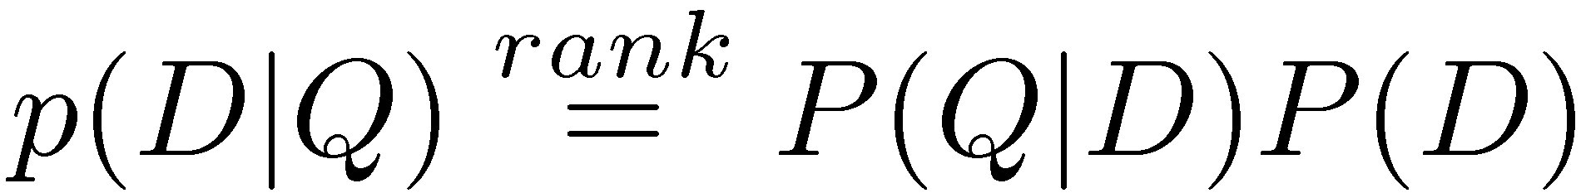
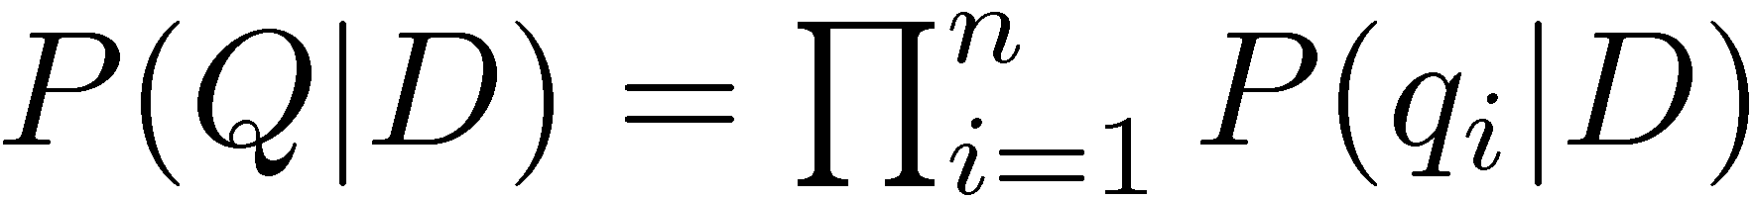
Query-Likelihood Model
Rank documents by the probability that the query could be generated by the document model (i.e. same topic)
Given query, start with P(D|Q)
Using Bayes’ Rule
Assuming prior is uniform, unigram model

Slide 7
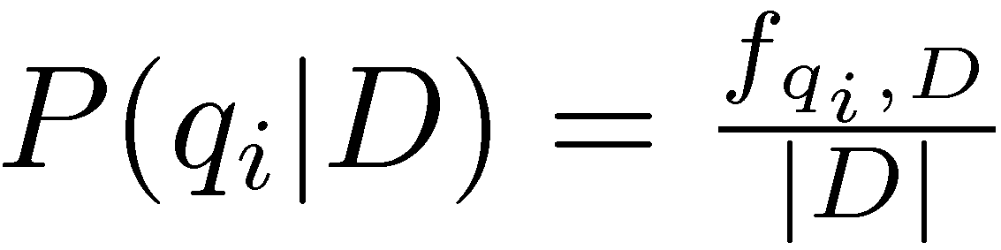
Estimating Probabilities
Obvious estimate for unigram probabilities is
Maximum likelihood estimate
makes the observed value of fqi;D most likely
If query words are missing from document, score will be zero
Missing 1 out of 4 query words same as missing 3 out of 4

Slide 8
Smoothing
Document texts are a sample from the language model
Missing words should not have zero probability of occurring
Smoothing is a technique for estimating probabilities for missing (or unseen) words
lower (or discount) the probability estimates for words that are seen in the document text
assign that “left-over” probability to the estimates for the words that are not seen in the text

Slide 9
Estimating Probabilities
Estimate for unseen words is α_{D}P(q_{i}|C)
P(q_{i}|C) is the probability for query word i in the collection language model for collection C (background probability)
α_{D} is a parameter
Estimate for words that occur is
(1 − α_{D}) P(q_{i}|D) + α_{D} P(q_{i}|C)
Different forms of estimation come from different α_{D}

Slide 10
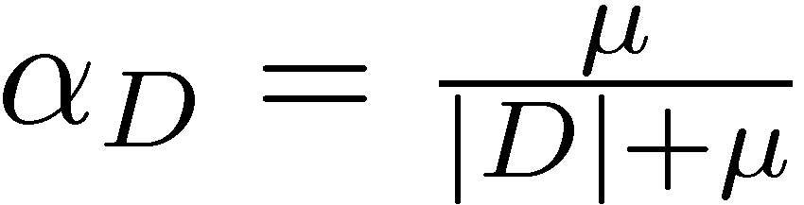
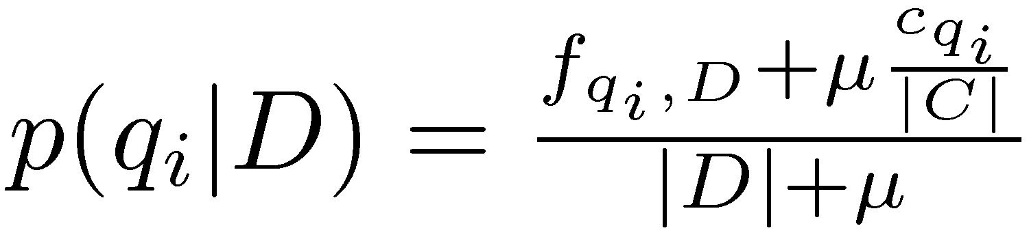
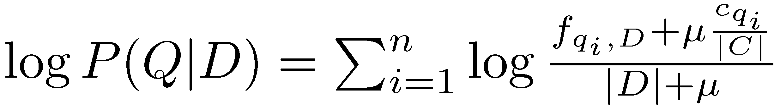
Dirichlet Smoothing
α_{D} depends on document length
Gives probability estimation of
and document score
Take home question: what is Dirichlet about this smoothing method?

Slide 11
Query Likelihood Example
For the term “president”
f_{qi,D} = 15, c_{qi} = 160,000
For the term “lincoln”
f_{qi,D} = 25, c_{qi} = 2,400
document |d| is assumed to be 1,800 words long
collection is assumed to be 10⁹ words long
500,000 documents times an average of 2,000 words
μ = 2,000

Slide 12
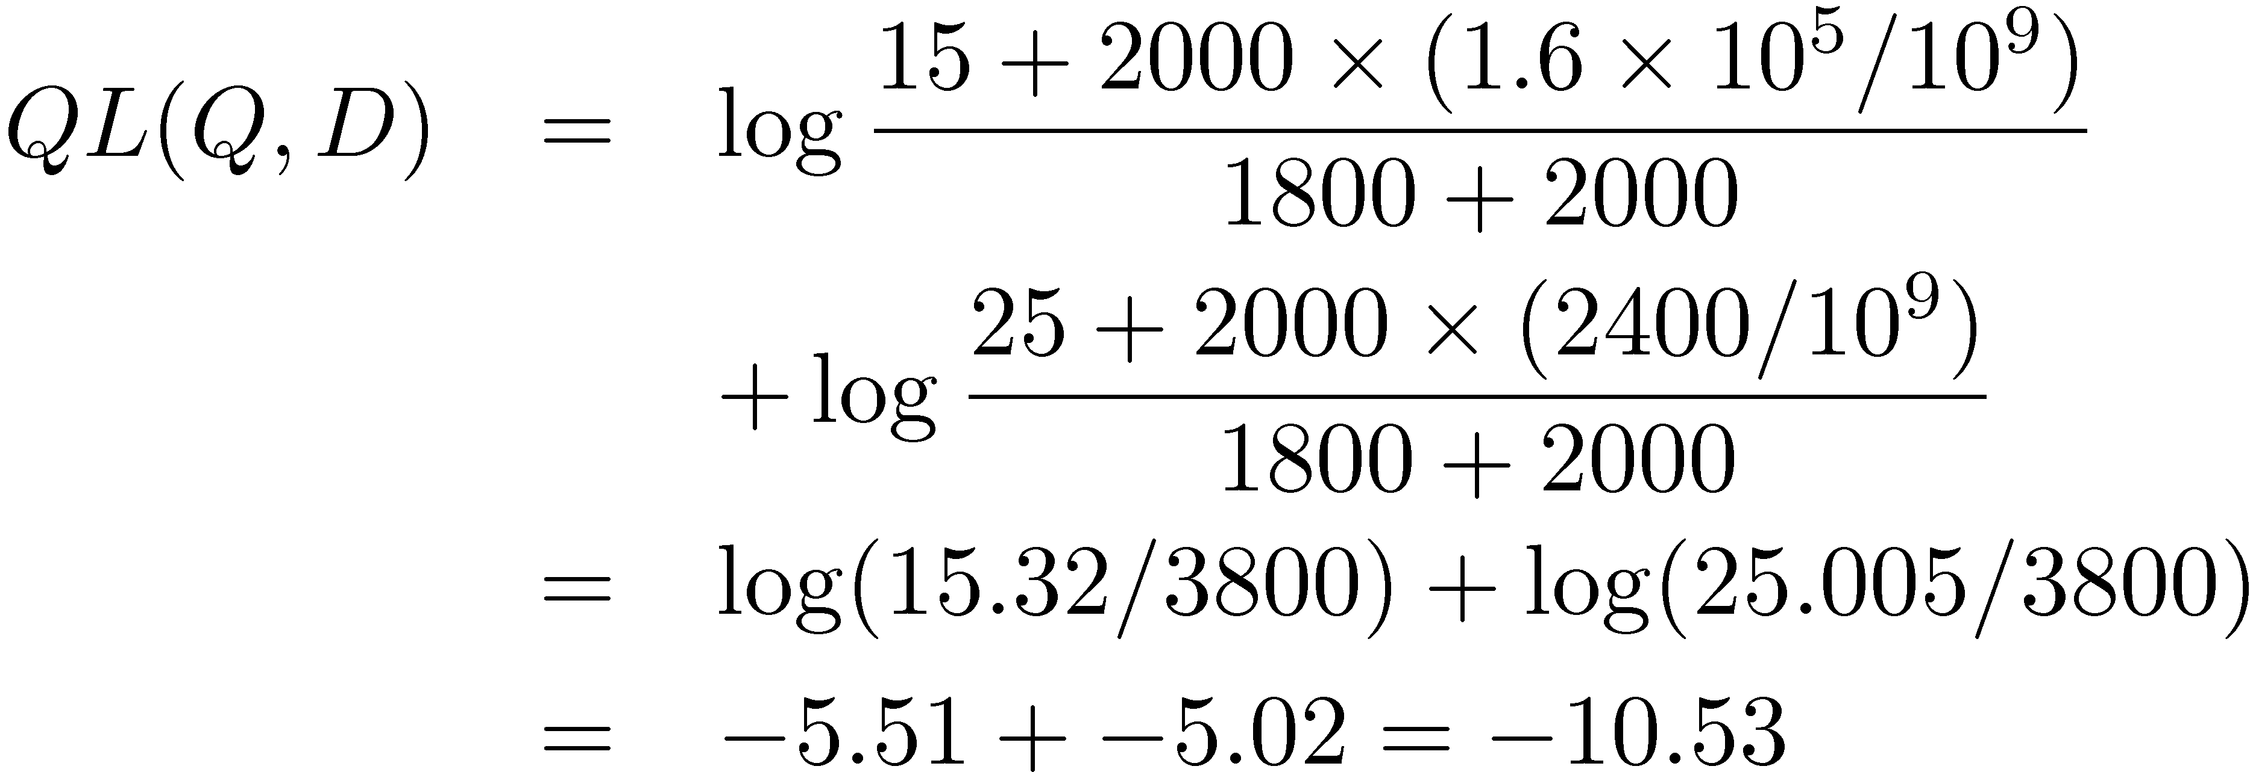
Query Likelihood Example
Negative number because summing logs of small numbers

Slide 13
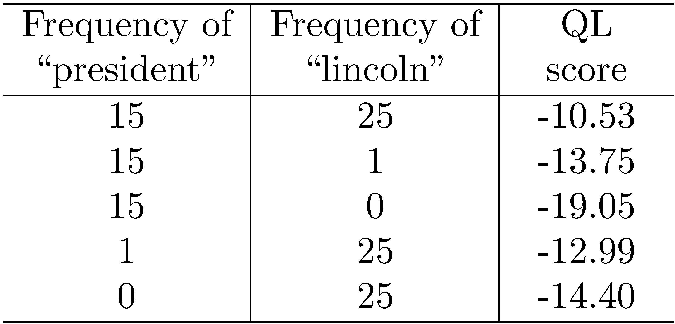
Query Likelihood Example

Slide 14
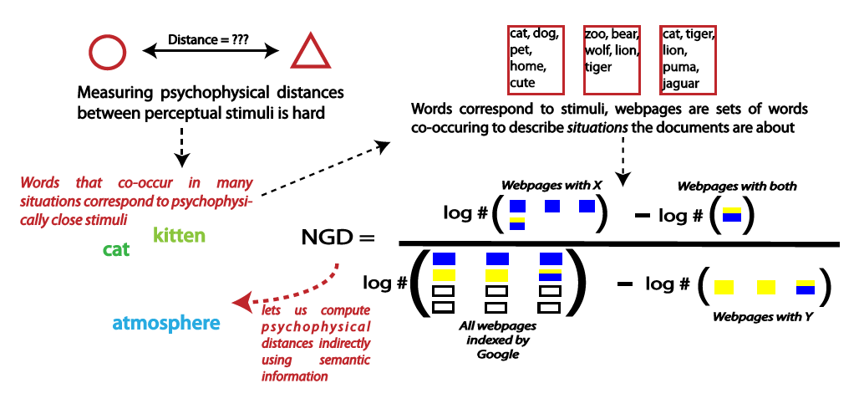
Extension: Google Distance

Slide 15
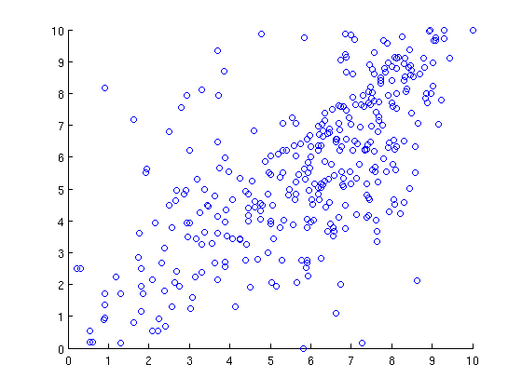
Strong correlation with human similarity ratings
Scaled NGD
Human similarity ratings

Slide 16
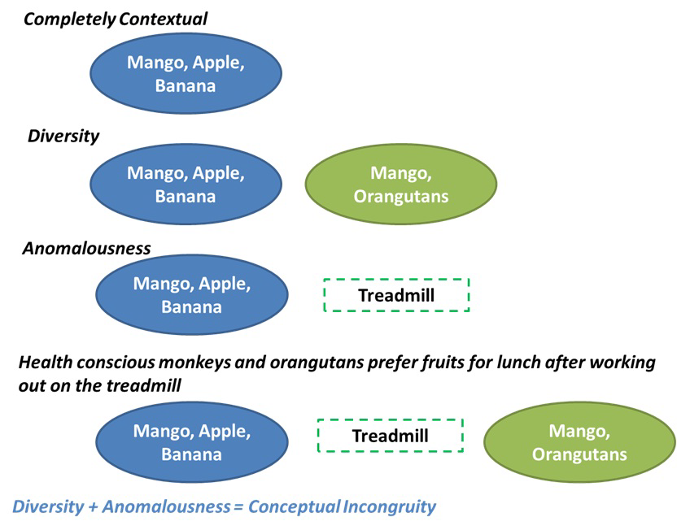
Can operationalize creativity
http://www.pnas.org/content/early/2017/07/18/1700811114

Slide 17
Learning the form of concepts

Slide 18
The discovery of form
The ball is big and blue
The blue is big and ball?
The sun brings the morning
The morning brings the sun
Concepts aren’t just labels
There are underlying structures that govern their usage
Hofstadter. Godel, Escher, Bach.

Slide 19
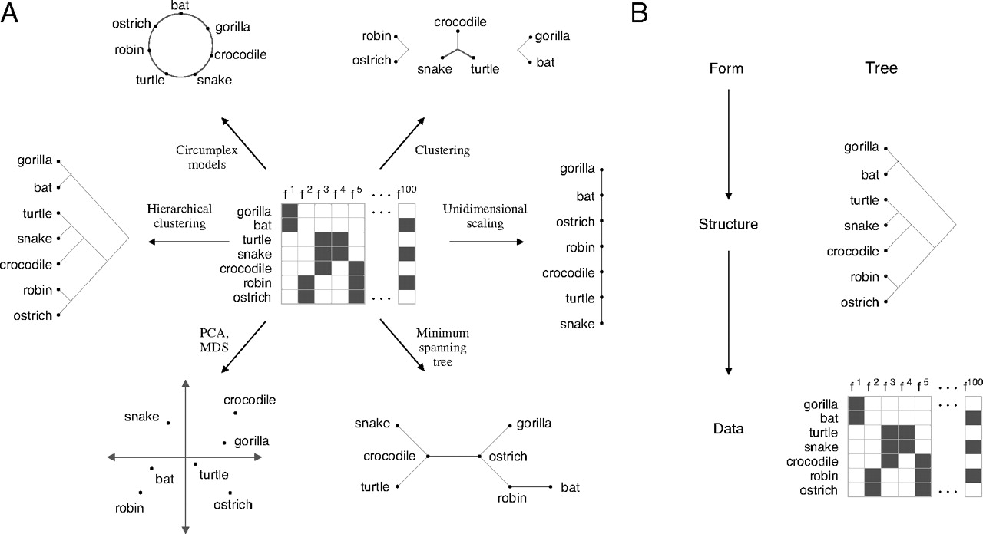

Finding structure in data.
Charles Kemp, and Joshua B. Tenenbaum PNAS 2008;105:31:10687-10692
©2008 by National Academy of Sciences
Notes:
Finding structure in data. (A) Standard structure learning algorithms search for representations of a single form that is fixed in advance. Shown here are methods that discover six different kinds of structures given a matrix of binary features. (B) A hierarchical model that discovers the form F and the structure S that best account for the data D. The model searches for the form and structure that jointly maximize P(S, F|D) ∝ P(D|S)P(S|F)P(F).

Slide 20
An observer model of form discovery
Forms are distinct arrangement patterns of entities
Structures are instantiations of specific forms that represent the organization of specific concepts
Each node in a structure is a cluster of objects
Data are similarity ratings, relational observations etc. stored as a feature matrix
Form
Structure
Data

Slide 21
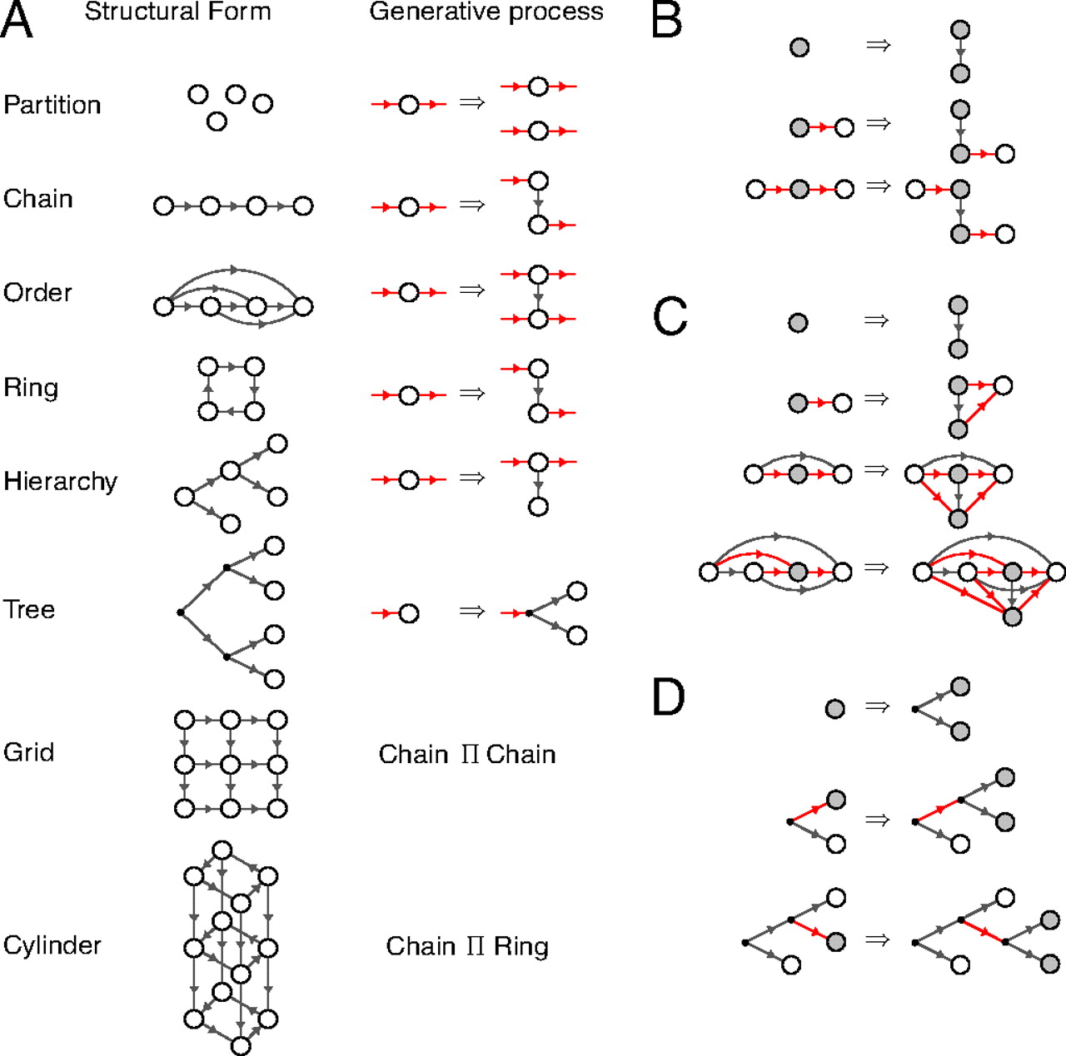
A hypothesis space of structural forms.
Charles Kemp, and Joshua B. Tenenbaum PNAS 2008;105:31:10687-10692
©2008 by National Academy of Sciences
Notes:
A hypothesis space of structural forms. (A) Eight structural forms and the generative processes that produce them. Open nodes represent clusters of objects: A hierarchy has objects located internally, but a tree may only have objects at its leaves. The first six processes are node-replacement graph grammars. Each grammar uses a single production, and each production specifies how to replace a parent node with two child nodes. The seed for each grammar is a graph with a single node (in the case of the ring, this node has a self-link). (B–D) Growing chains, orders, and trees. At each step in each derivation, the parent and child nodes are shown in gray. The graph generated at each step is often rearranged before the next step. In B, for instance, the right side of the first step and the left side of the second step are identical graphs. The red arrows in each production represent all edges that enter or leave a parent node. When applying the order production, all nodes that previously sent a link to the parent node now send links to both children.

Slide 22
Computational model
Bayesian observer model
p(f) is a uniform prior over all candidate forms
p(s|f) is the likelihood of a particular structure being generated from a form
Prefers fewer node graphs
Has to respect graph-theoretic compatibility with the generating form
p(d|s) is the likelihood of the observed feature matrix
This is high when objects close in a structure have similar feature values
p(s,f|d) α p(d|s)p(s|f)p(f)

Slide 23
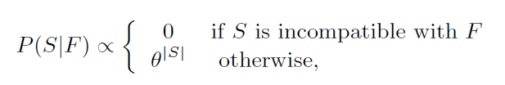
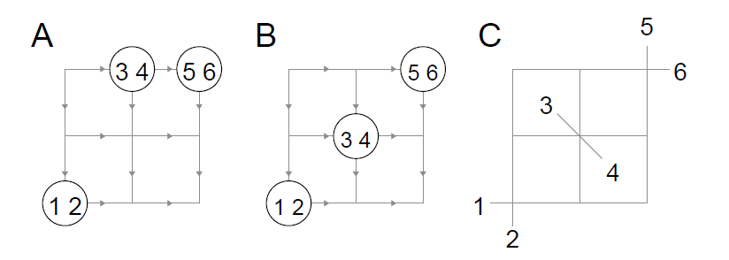
The structure likelihood
Remember: structures are graphs with object clusters as nodes
Not compatible with a grid form
Compatible with a grid form
Corresponding object graph

Slide 24

The data likelihood
Has to be high when nearby objects in the object graph have similar features
Model this probabilistically by assuming features are sampled conditionally independently from a Gaussian distribution over the graph
Where w are inverse edge lengths

Slide 25
Optimization
Separate greedy search for each candidate form
Initialization → all objects in one cluster
Each time step
split cluster using production rule for the current form; do this for subsets of active clusters
Evaluate p(f,s|d) using these new proposals
Search concludes when the posterior probability can no longer be improved

Slide 26
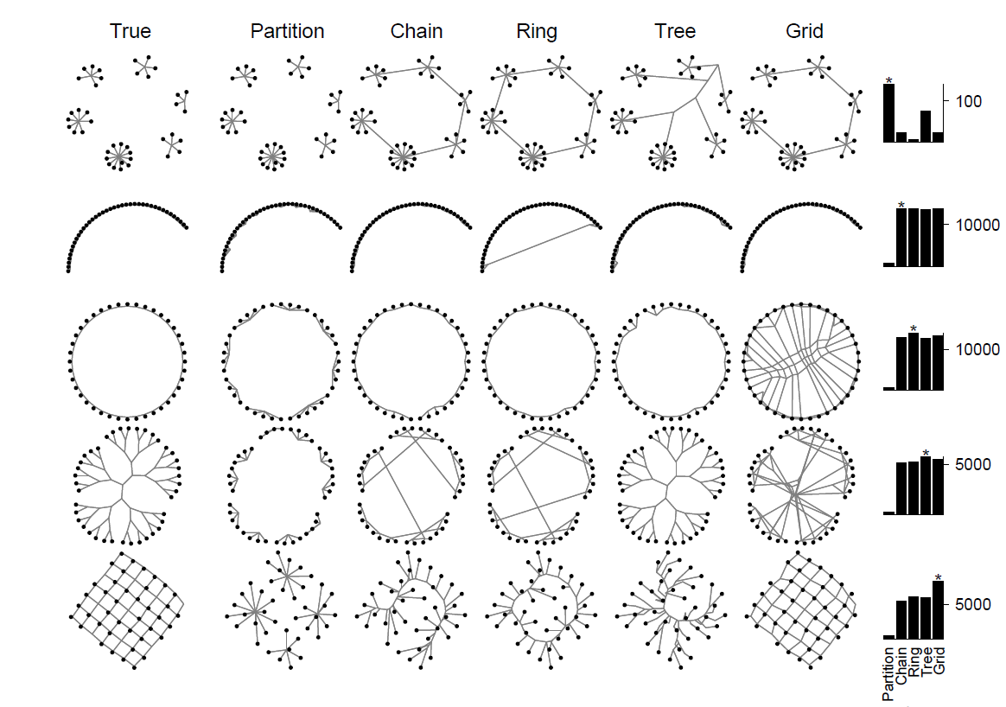

Slide 27
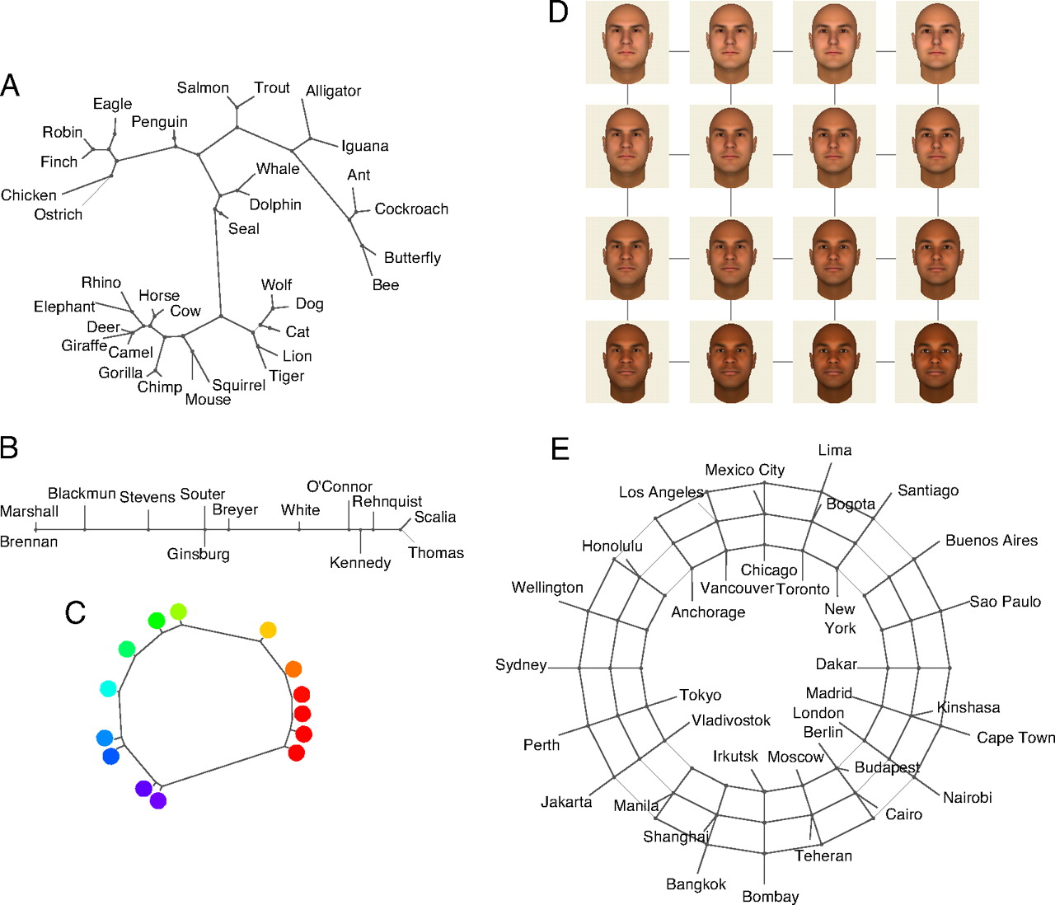
Structures learned from biological features (A), Supreme Court votes (B), judgments of the similarity between pure color wavelengths (C), Euclidean distances between faces represented as pixel vectors (D), and distances between world cities (E).
Charles Kemp, and Joshua B. Tenenbaum PNAS 2008;105:31:10687-10692
©2008 by National Academy of Sciences
Notes:
Structures learned from biological features (A), Supreme Court votes (B), judgments of the similarity between pure color wavelengths (C), Euclidean distances between faces represented as pixel vectors (D), and distances between world cities (E). For A–C, the edge lengths represent maximum a posteriori edge lengths under our generative model.

Slide 28
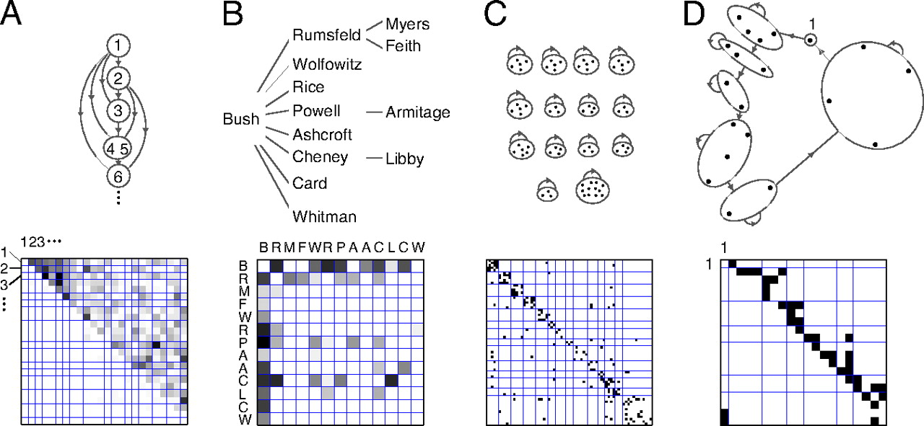
Structures learned from relational data (Upper) and the raw data organized according to these structures (Lower).
Charles Kemp, and Joshua B. Tenenbaum PNAS 2008;105:31:10687-10692
©2008 by National Academy of Sciences
Notes:
Structures learned from relational data (Upper) and the raw data organized according to these structures (Lower). (A) Dominance relationships among a troop of sooty mangabeys. The sorted data matrix has most of its entries above the diagonal, indicating that animals tend to dominate only the animals below them in the order. (B) A hierarchy representing interactions between members of the Bush administration. (C) Social cliques representing friendship relations between prisoners. The sorted matrix has most of its entries along the diagonal, indicating that prisoners tend only to be friends with prisoners in the same cluster. (D) The Kula ring representing armshell trade between New Guinea communities. The relative positions of the communities correspond approximately to their geographic locations.

Slide 29
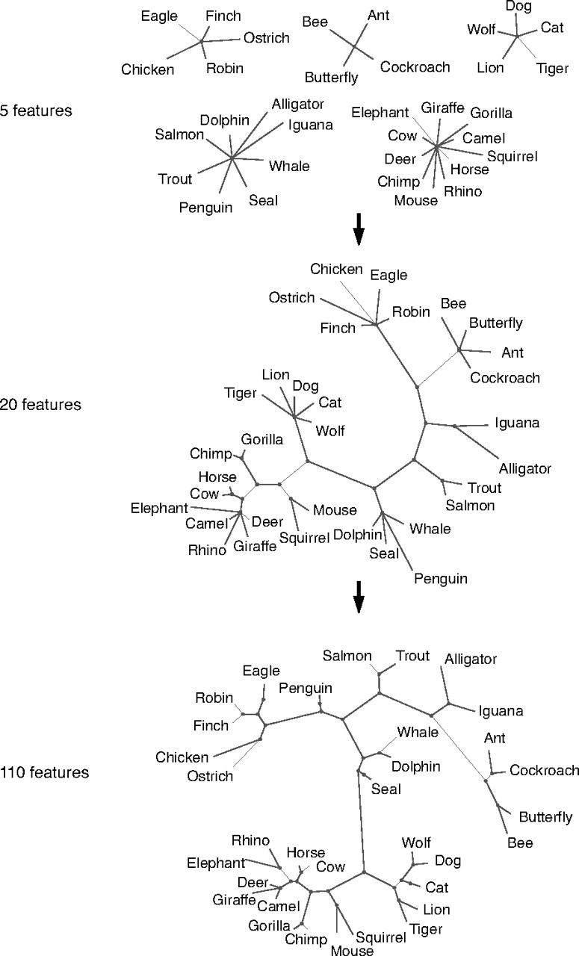
Developmental changes as more data are observed for a fixed set of objects.
Charles Kemp, and Joshua B. Tenenbaum PNAS 2008;105:31:10687-10692
©2008 by National Academy of Sciences
Notes:
Developmental changes as more data are observed for a fixed set of objects. After observing only five features of each animal species, the model chooses a partition, or a set of clusters. As the number of observed features grows from 5 to 20, the model makes a qualitative shift between a partition and a tree. As the number of features grows even further, the tree becomes increasingly complex, with subtrees that correspond more closely to adult taxonomic intuitions: For instance, the canines (dog, wolf) split off from the other carnivorous land mammals; the songbirds (robin, finch), flying birds (robin, finch, eagle), and walking birds (chicken, ostrich) form distinct subcategories; and the flying insects (butterfly, bee) and walking insects (ant, cockroach) form distinct subcategories. More information about these simulations can be found in SI Appendix.

Slide 30
Summary
A Bayesian observer model combined with simple graph grammars can learn conceptual networks from similarity and relational data
Model is computationally simple, but algorithmically mysterious
Is there an actual graph meta-grammar that is invariant across people?
This would be a big discovery
How might the actual optimization be taking place in organisms?

