Slide 1
Memory
Nisheeth
6th March 2018

Slide 2
Course trajectory
Foundations
Perception
Categorization
Memory
Behavior
Motor
Mental
Speech

Slide 3
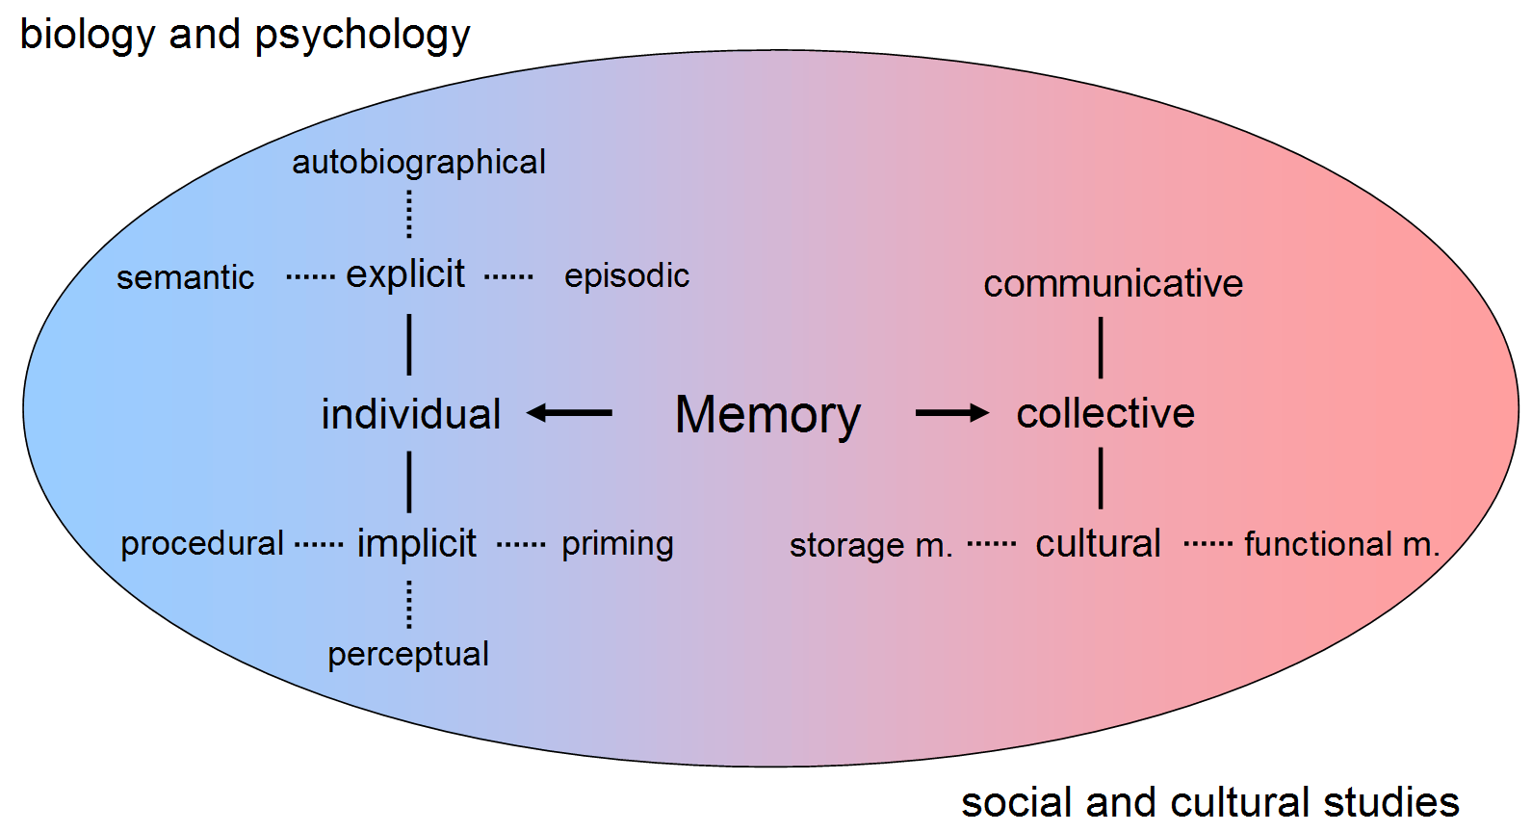
What do we mean by memory?
This module focuses on explicit memory

Slide 4
Explicit memory
Table | Kitten
Candle | Doorknob
Maple | Folder
Subway | Concrete
Pencil | Railroad
Coffee | Doctor
Towel | Sunshine
Softball | Letter
Curtain | Turkey
Player | Hammer
Take two minutes to memorize this list

Slide 5
What can you remember?
Table
Candle
Kitten
Player
Turkey
Hammer
….

Slide 6
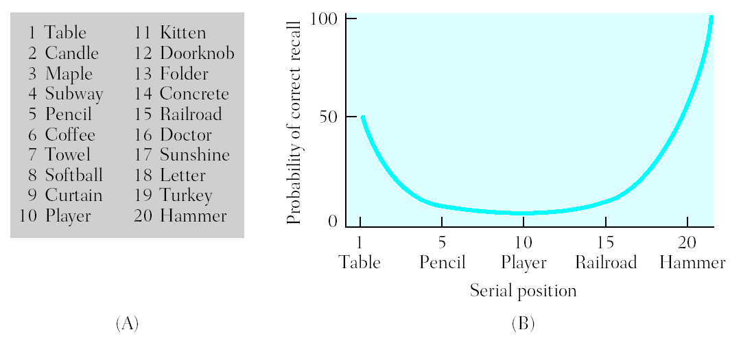
Serial Position Effects
In free recall, more items are recalled from start of list (primacy effect) and end of the list (recency effect)
First items recalled tend to be from end of study list

Slide 7
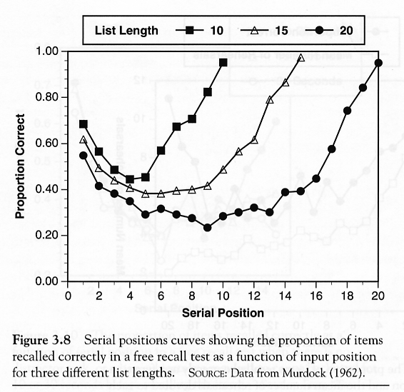
Effects are list-length independent
Modal model explanation for primacy:
early items can be rehearsed more often → more likely to be transferred to long-term memory
Modal model explanation for recency:
Last items of list are still in short-term memory → they can be read out easily from short-term memory
Primacy effect
Recency effect

Slide 8
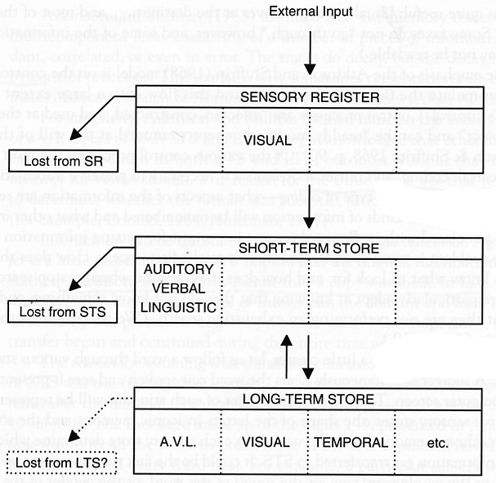
Modal Model of Memory (Atkinson & Shiffrin, 1968)
Short-term memory is a limited capacity store for information -- place to rehearse new information from sensory buffers
Items need to be rehearsed in short-term memory before entering long-term memory
Probability of encoding in LTM directly related to time in STM

Slide 9
Effects are list-length independent
Modal model explanation for primacy:
early items can be rehearsed more often → more likely to be transferred to long-term memory
Modal model explanation for recency:
Last items of list are still in short-term memory → they can be read out easily from short-term memory
Primacy effect
Recency effect

Slide 10
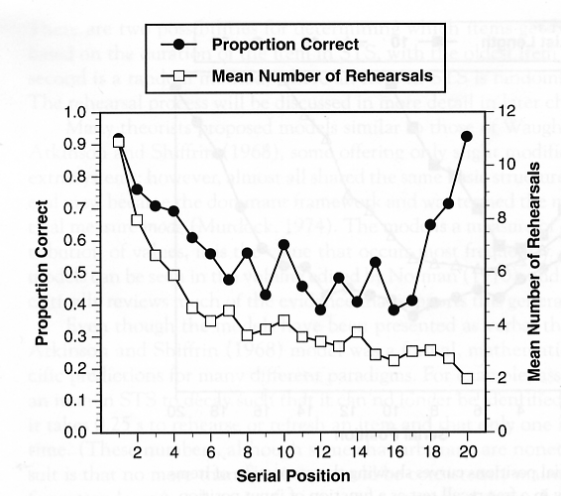
Other observations
There should be more rehearsal for early items
Have subjects rehearse overtly
(Rundus & Atkinson, 1970)

Slide 11
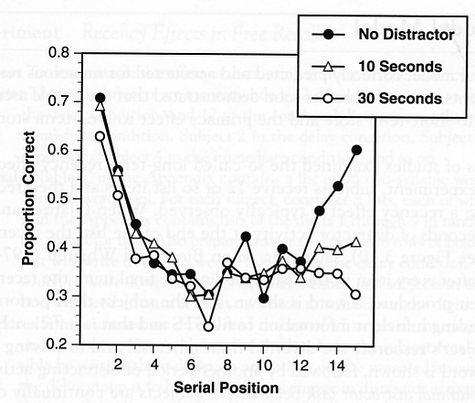
Other observations
Recency effect should disappear with delay.
During delay, contents of STS should be lost
(Glanzer & Cunitz, 1966)

Slide 12
The modal model’s components
Views memory as composed of three relatively distinct stages
Sensory
Short-Term
Long-Term

Slide 13
Sensory Memory
Consists of a set of five registers (temporary storage places, one from each sense) for incoming sensory information from the physical environment until we attend to it, interpret it, and it proceeds to the next stage of memory (short-term memory)

Slide 14
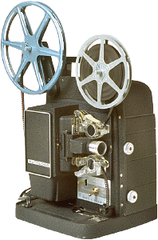
Iconic Memory
Is an exact copy of visual information
Less than a second in duration
Very large capacity
Consider the example of a cartoon movie, which is nothing more than a series of still drawings flashed in rapid succession
Iconic memory allows us to perceive motion in the drawings

Slide 15
Testing Iconic Memory
Sperling’s full- and partial-report procedures present participants with a different 3 x 3 matrix of unrelated consonants (a total of 9) for 50 ms across numerous experimental trials
Here is an example:
L Z Q
R B P
S K N

Slide 16
Testing Iconic Memory
In the full-report procedure participants had to report the entire matrix
Participants said they sensed the entire matrix but that it had faded from memory before they could report all 9 letters

Slide 17
Testing Iconic Memory
In the partial-report procedure, the participants had to report only one row of the matrix, a row indicated by an auditory cue on each trial
When the auditory cue was given immediately after the brief presentation of the letter matrix, participants recalled the indicated row 100% of the time
When there was a one second delay between presentation of the matrix and the auditory cue, participants’ recall of the cued row worsened

Slide 18
Short-Term Memory
Is the memory stage in which the recognized informa-tion from sensory memory enters consciousness
It is where you are doing your present conscious cognitive processing
Serves as a place to rehearse information so it can be transferred to long-term memory and as a place to bring information from long-term memory when asked to recall it
Must concentrate on information in short-term memory or it will be lost in 30 seconds

Slide 19
Capacity of Short-Term Memory
The memory span task tests for the capacity of short-term memory by giving a series of items one at a time
The person has to remember the items in the order in which they were presented
Memory span is the average number of items you can remember across a series of memory span trials
Humans have a memory span of 7+/- 2 (5 to 9) chunks of information
A chunk is a meaningful unit of information
Experts in a given domain tend to have larger chunks for information in their area of expertise

Slide 20
Chunks in short-term memory
BZTK
DJRNQP
MTXHVLFCSR
FROGBATPIGDUCK

Slide 21
Duration of Short-Term Memory
Measured using distractor and span tasks, e.g.
people are given a small amount of information (e.g., three unrelated consonants such as CWZ)
immediately distracted from concentrating on the information for a brief time period (by counting backwards aloud by 3’s)
asked to recall the information
To keep information in short-term memory, we use maintenance rehearsal (i.e., repeating information in short-term memory to keep in from fading from short-term memory)

Slide 22
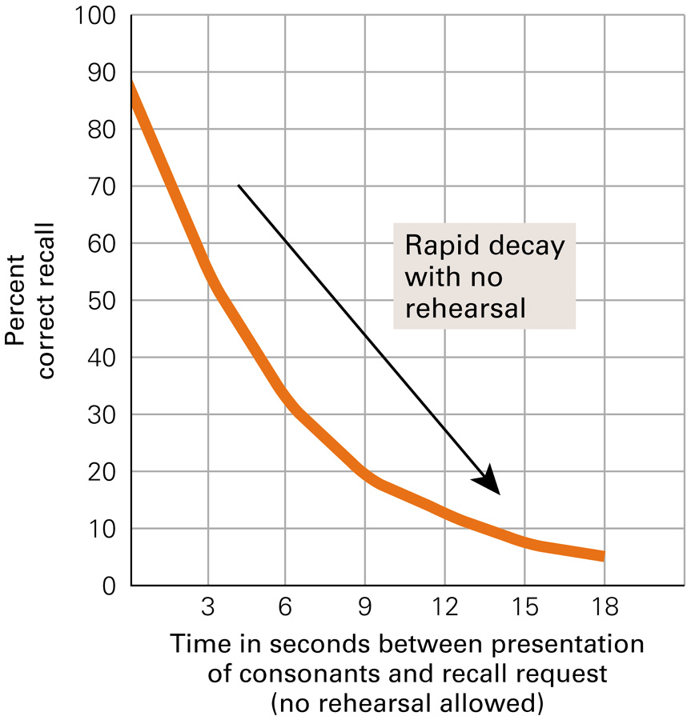
Results for the Short-Term Memory Distractor Task

Slide 23
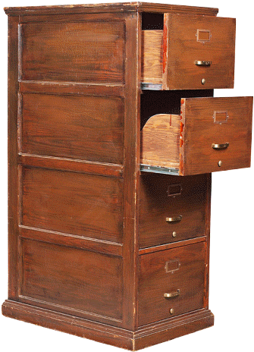
Long-Term Memory
Allows storage of information for a long period of time (perhaps permanently) and its capacity is essentially unlimited

Slide 24
Types of Long-Term Memory
Explicit memory (also called declarative memory) is long-term memory for factual knowledge and personal experiences and requires conscious recall
Two types of explicit memories:
Semantic memories are memories for factual knowledge that is true of everyone (e.g., the current President of the United States)
Episodic memories are memories for personal life experiences (e.g., your senior prom night)

Slide 25

Types of Long-Term Memory
Implicit memory (also called non-declarative memory) is long-term memory that influences our behavior, but does not require conscious awareness or declarative statements (e.g., for most adults, driving a car; walking)
Some implicit memories are procedural memories because they have a physical procedural aspect to them
For a tennis expert the movements to play the game are implicit, procedural memories, whereas for the average person, such movements require conscious recall, and are more semantic memories
Other implicit memories have become automatic responses to certain stimuli

Slide 26
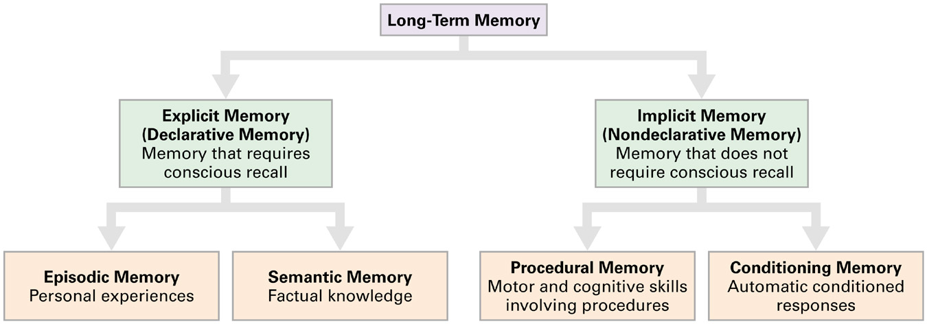
Types of Long-Term Memory

Slide 27
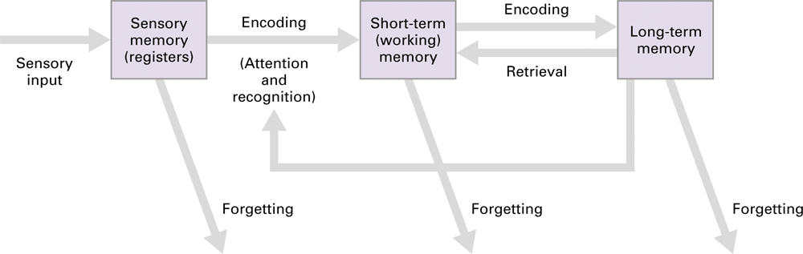
The modal model

Slide 28
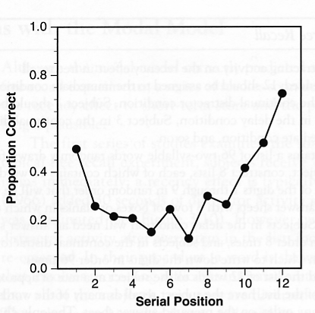
Problems with Modal model (1)
The recency effect re-appears with distractor activity after every list item, including the last item
Addressed by the temporal context model (Sederberg & Kahana, 2008)
We’ll talk about this later
(Watkins, Neath & Sechler, 1989)

Slide 29
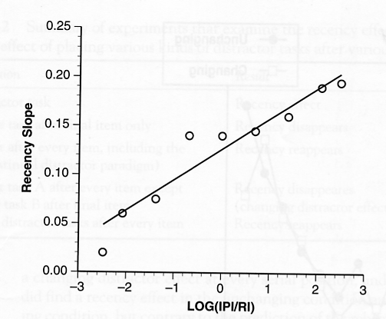
Problems with Modal model (2)
Long-term “recency” effects can occur even after weeks – STS contents should be lost by then
Size of recency effect depends on the relative duration of retention interval (RI) to interitem presentation interval (IPI)
(Nairne, Neath, Serra, & Byun, 1997)

Slide 30
Problems with Modal model (3)
STS “knows” the identity of items coming from the sensory register
How does it know?
The sensory register has to make to make contact with LTS → model loses appealing simplicity

