Slide 1
Baddeley’s WM
Nisheeth
8th March 2018

Slide 2
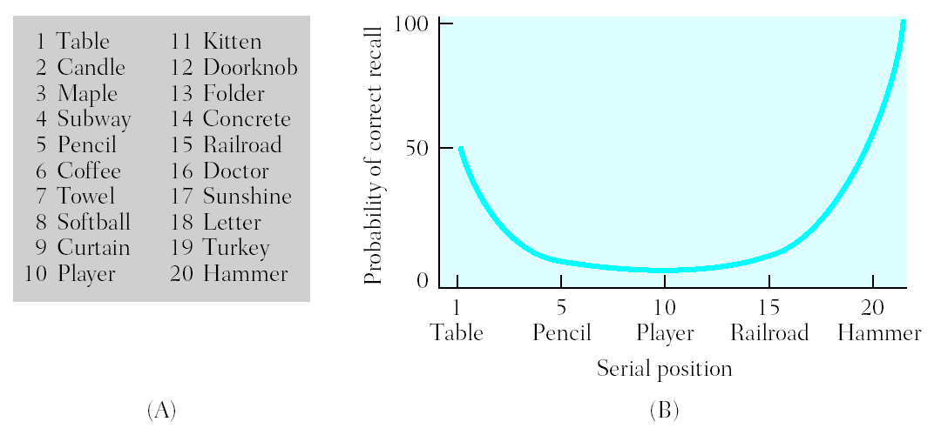
Serial Position Effects
In free recall, more items are recalled from start of list (primacy effect) and end of the list (recency effect)
First items recalled tend to be from end of study list

Slide 3
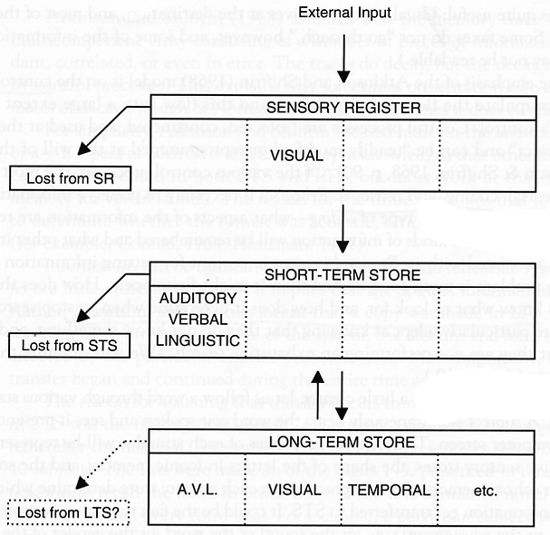
Modal Model of Memory (Atkinson & Shiffrin, 1968)
Short-term memory is a limited capacity store for information -- place to rehearse new information from sensory buffers
Items need to be rehearsed in short-term memory before entering long-term memory
Probability of encoding in LTM directly related to time in STM

Slide 4
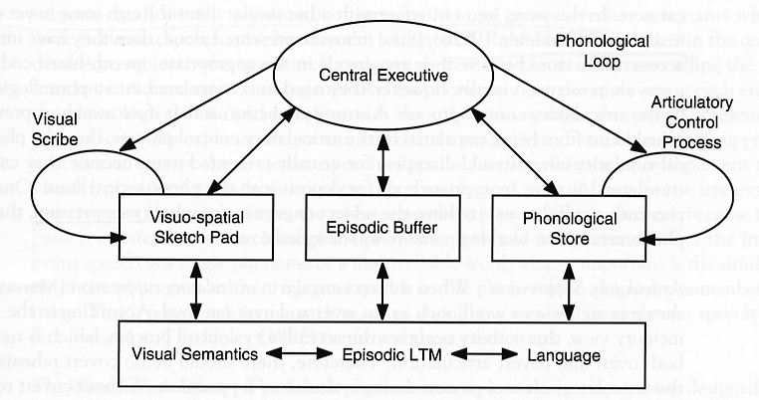
Baddeley’s theory of Working Memory
Fills in some of the conceptual gaps of the Atkinson-Shiffrin model, particularly with respect to maintenance rehearsal

Slide 5
Word-length effect
List 1:
“Burma, Greece, Tibet, Iceland, Malta, Laos”
List 2:
“Switzerland, Nicaragua, Afghanistan, Venezuela, Philippines, Madagascar”
Typical results: list 1 → 4.2 words list 2 → 2.8 words
Phonological loop limited by syllables/phonemes, not words

Slide 6
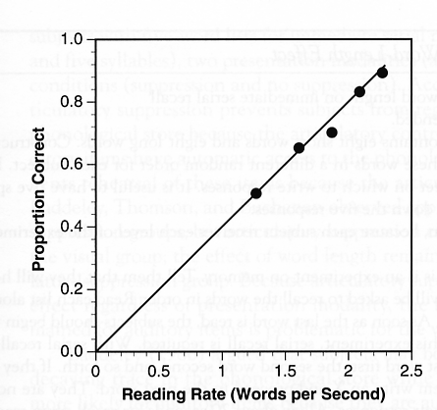
Reading rate determines serial recall
Baddeley (1986) tested recall for five words
1 syllable: wit, sum, harm, bay, top
5 syllables: university, opportunity, aluminum, constitutional, auditorium
Reading rate seems to determine recall performance
Phonological loop stores a limited number of sounds, not words

Slide 7
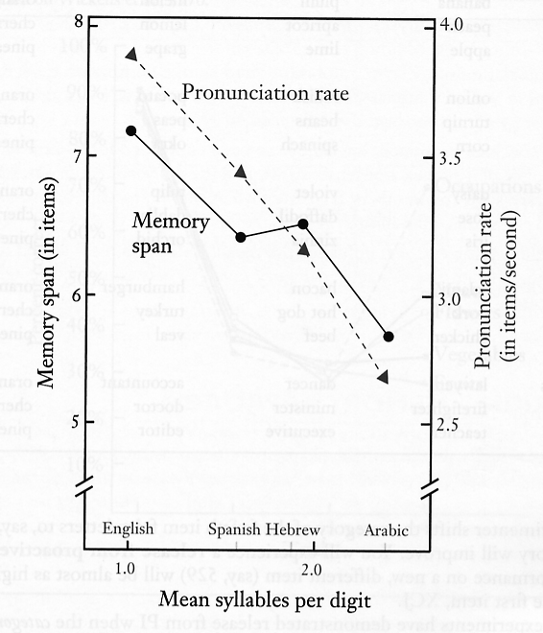
Working memory and Language Differences
Different languages have different #syllables per digit
22
Twenty two (3)
Baees (2)
Araba-em-iyat wa-ashryn (7)
Therefore, recall should be different for English (numbers can be spoken rapidly) from Spanish and Arabic (numbers take longer to pronounce)
(Naveh-Benjamin & Ayres, 1986)

Slide 8
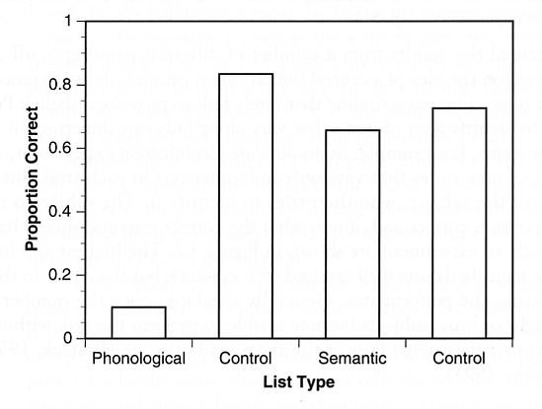
Phonological Similarity
Note: most working memory tasks involve serial recall
Short-term memory worse for phonologically similar items → interference in phonological loop
man mad
cap
can
map
pen
rig
day
bar
cup
big
huge
broad
long
tall
old
late
thin
wet
hot
(Baddeley, 1966)

Slide 9
Baddeley’s working memory model
Highlights the role of the phonological loop in transferring information from STS to LTM
Consistent with multiple empirical studies showing deficits in memory as a function of phonological deficits
Vital in early childhood learning
Doesn’t make clear quantitative predictions about encoding and retrieval

Slide 10
Random access memory
Computer memory can be randomly accessed given address locations
RAM
Address in
Data out
But human memory doesn’t have consistent physical addressing. So how does it still work effectively?

Slide 11
Content addressable memory
Content addressable memories are used in some high-speed search operations
CAM
Data in
Address out
Human memory is closer to content addressable than random addressable
https://en.wikipedia.org/wiki/Content-addressable_memory

Slide 12
Retrieval depends on joint encoding
“Neurons that fire together wire together” – Hebbian postulate
Any memory encoding must store both the target to be stored and the cue that will trigger its retrieval
Can’t store single items in memory
But what are retrieval cues?
Hard to identify in natural settings
Hard to nail down even in experimental settings
In principle, could be any datum of experience

