Slide 1
Encoding and retrieval
Nisheeth
9th March 2018

Slide 2
Retrieval depends on joint encoding
“Neurons that fire together wire together” – Hebbian postulate
Any memory encoding must store both the target to be stored and the cue that will trigger its retrieval
Can’t store single items in memory
But what are retrieval cues?
Hard to identify in natural settings
Hard to nail down even in experimental settings
In principle, could be any datum of experience

Slide 3
Encoding experiences in memory
Not as straightforward as putting things in boxes and taking them out later
How is the experience represented?
How is it indexed?
How is it retrieved?
What factors affect encoding?

Slide 4
Environmental Effects on Encoding
Encoding specificity principle proposes that the cues present during encoding serve as the best cues for retrieval
This is why elaborative rehearsal helps memory performance
Elaborative rehearsal → plant: tree :: sea: o____, generating targets helps in retention
State-dependent memory is memory that depends upon the relationship of one’s physiological state at the time of encoding and at the time of retrieval
Relationship of smell to memory is a common literary trope, see c.f. Proust’s Remembrance of things past

Slide 5
Environmental Effects on Encoding
Mood-dependent memory effects attest to the fact that memory is better when a person’s mood is the same during encoding and retrieval
For example, if you are happy during encoding information, it is easier to retrieve that information if you are happy at the time of retrieval
Mood-congruence effect is the fact that memory is better for experiences that are congruent with a person’s current mood
For example, when we are sad it is easier to retrieve negative events in our lives

Slide 6
Encoding Specificity
– When conditions of retrieval are similar to conditions of encoding, retrieval is more likely to be successful
– You are more likely to remember things if the conditions under which you recall them are similar to the conditions under which you learned them

Slide 7
Encoding Specificity
Context effects—environmental cues to recall
State dependent retrieval—physical, internal factors
Mood Congruence—factors related to mood or emotions

Slide 8
Encoding-dependent memory tricks
The spacing effect (or distributed study effect) shows that your memory will improve if you study for an exam over an extended time interval rather than just a few days before the exam
Can be because studying in a diverse set of circumstances makes more retrieval cues accessible for encoding
Overlearning is studying material past the point of initial learning, and has been demonstrated to aid in retrieval of that information
Can be because multiple retrieval cues are associated with the same target, aiding retrieval

Slide 9
Measuring memory performance
Recall is a measure of retrieval that requires the reproduction of the information with essentially no retrieval cues
Typical measure = # of items successfully retrieved/# of items on list
Recognition is a measure of retrieval that only requires the identification of the information in the presence of retrieval cues
Typical measure = d’ in n-AFC with n-1 non-targets
Relearning, also called the savings method, is a measure of the amount of time saved when learning the information for a second time

Slide 10
Why do we forget?
Sensory memory
The senses momentarily register
amazing detail
Forgetting can occur at any memory stage
Short-term memory
A few items are both noticed
and encoded
Long-term storage
Some items are altered or lost
Retrieval from long-term memory
Depending on interference, retrieval
cues, moods, and motives, some
things get retrieved, some don’t
Notes:
Hockenbury slides (Schulman)
key words: forgetting

Slide 11

Why We Forget
Encoding failure : sometimes forgetting is not really forgetting, information never entered long-term memory in the first place
Storage decay theory suggests that forgetting occurs because of a problem in the storage of the information
The biological trace of the memory gradually decays over time and the periodic usage of the information helps to maintain it in storage
Highly recommended extra work: watch Inside Out

Slide 12
A classic relearning experiment
Ebbinghaus conducted the first experimental studies on human memory more than 100 years ago using the relearning method.
He would study a list of nonsense syllables until he could correctly recite the complete list without any hesitations. He then put the list aside and waited some period of time and then relearned the list to the same criterion.
To get a measure of learning, he computed a savings score – the reduction in the number of trials it took him to reach criterion.
Result? The “forgetting curve” reveals that most forgetting occurs in the first two days after learning material.

Slide 13
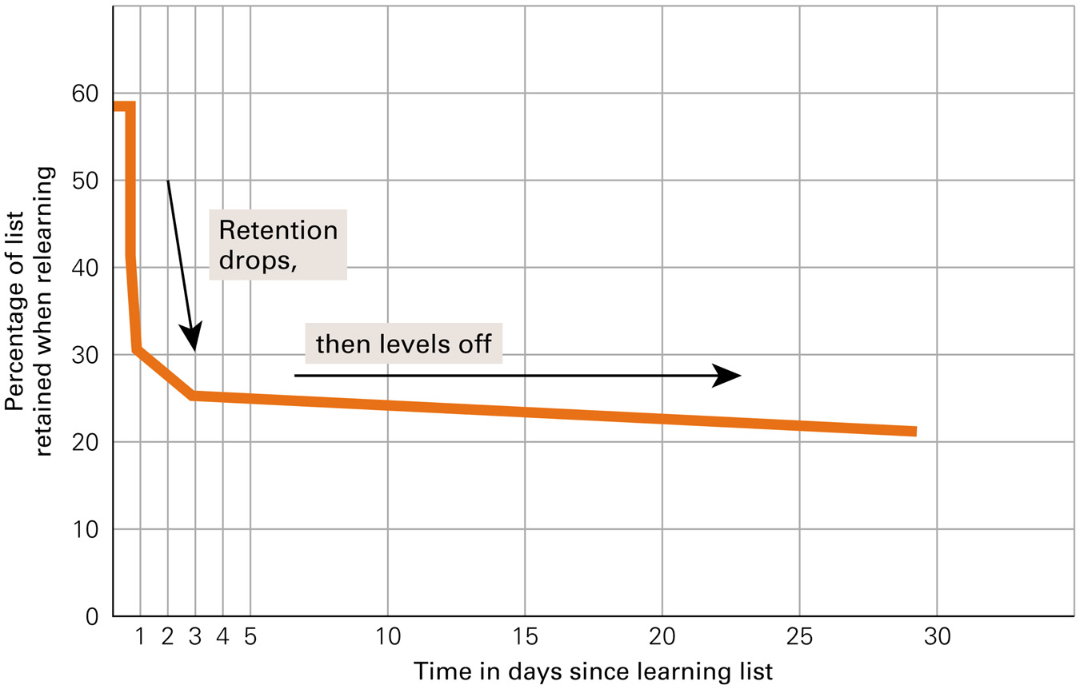
Forgetting Curve for Long-Term Memory

Slide 14
Decay Theories
100%
Memories fade away or decay gradually if unused
Time plays critical role
Ability to retrieve info declines with time after original encoding
Lately subsumed quite well by cue-dependent forgetting theories
Average
percentage of information
retained
20
mins
1
hr
8
hrs
24
hrs
2
days
6
days
31
days
Interval between original learning of nonsense syllables and memory test

Slide 15
Why We Forget
Cue-dependent theory says we forget because the cues necessary for retrieval are not available
The information is in memory, but we cannot access it
This theory is analogous to knowing a book is in the library but you cannot access it because the library lacks call numbers
Interference theory proposes that other similar information interferes and makes the forgotten information inaccessible

Slide 16
Types of Interference
Proactive interference occurs when information you already know makes it hard to retrieve newly learned information
Retroactive interference occurs when information you just learned makes it hard to retrieve old information

Slide 17
Types of Interference
Think about changing phone numbers after having a certain number for many years. When asked for your new phone number, remembering the old one interferes with retrieving the new one.
This is proactive interference
Now think about being at a party with many people you don’t know. You meet someone whom you want to talk to later, but after meeting her, you are introduced to many more people. Now, you cannot remember her name.
This is retroactive interference

