Slide 1
Search of associative memory
Nisheeth
March 10th 2018

Slide 2
Elements of memory models
Search
To explain list-length and fan effects
Direct access
To explain rapid true negatives in recognition
Implicit recognition
To explain the mind’s solution to the correspondence problem
https://pdfs.semanticscholar.org/7ebc/6fb776eb2250da7c925946424b9fee37097c.pdf

Slide 3
Modeling retrieval
Search of associative memory (SAM) was the first modern computational model of memory retrieval (Gillund & Shiffrin, 1984)
Assumes that information is stored in a distributed manner as memory ‘images’
Images contain item, associative and contextual information
Retrieval is modeled as a cue-dependent process
Whether an image is retrieved or not is a function of the associative strengths of the retrieval cues to that image
Single process model of recall and recognition

Slide 4
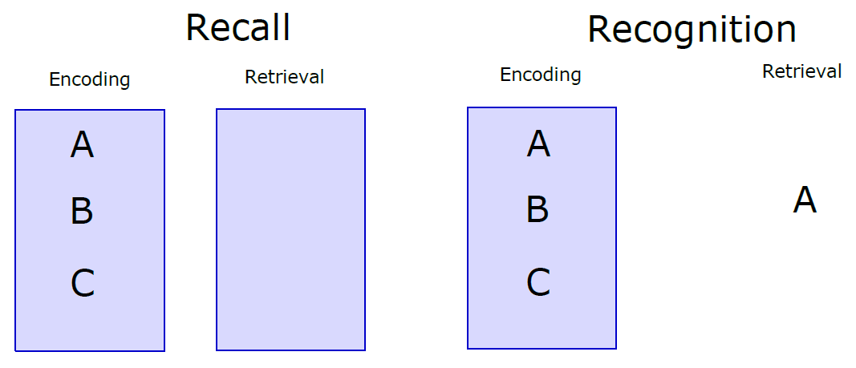
Recognition and recall

Slide 5
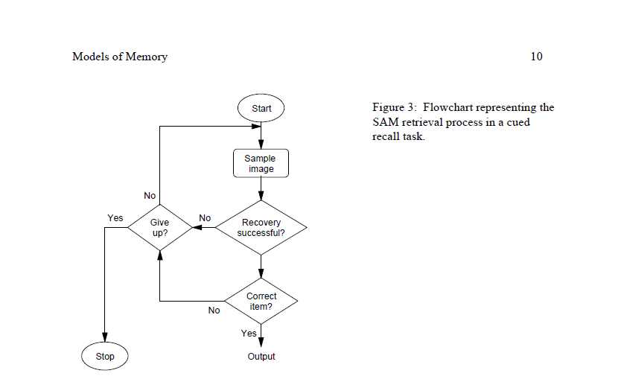
SAM basic idea

Slide 6


SAM implementation
Assume the retrieval probe contains multiple cues Q₁, Q₂, … Q_{m}
Combined activation of image I_{i} is a multiplicative combination of individual image-cue associations
Probability of sampling an image is a simple Luce choice rule
Not the same as the probability of successful memory retrieval
An image may or may not activate recovery of the correct target of retrieval

Slide 7


SAM implementation
Probability of successful recovery
Probability of recall success
If attempt succeeds, association between probe cues and sampled image strengthens
SAM had basic learning built into it

Slide 8
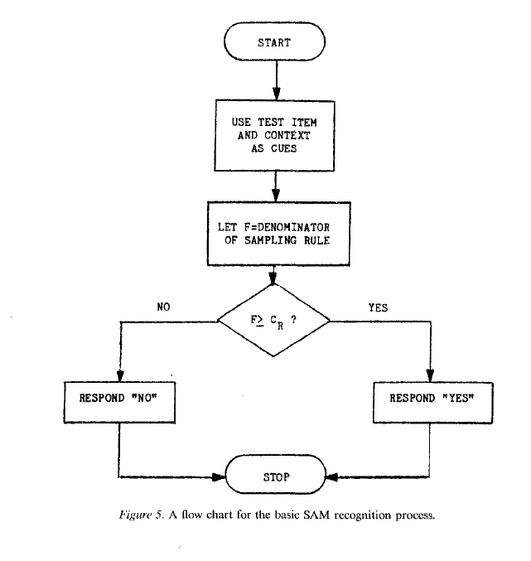
SAM recognition algorithm

Slide 9
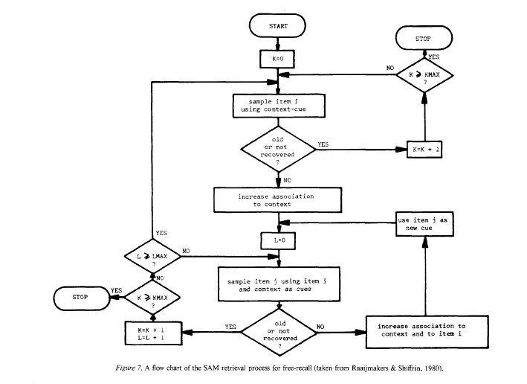
SAM recall algorithm

Slide 10
Successful predictions
List length effects in recall
Probability of sampling an item decreases as the number of items increases
Presentation time effects
Increased presentation time → stronger associations → better recall and recognition
Primacy effects
In recall because of reinforcement of previous samples
In recognition because of the generation of new images corresponding to each successful recognition

Slide 11
Successful predictions
Part set cuing
Cuing set reduces set of items that can be sampled from
This is what the browser experiment is testing
Word frequency effects
Recall prefers high frequency items because they have more associations
Recognition prefers low frequency items because there is a lower variance in the associative strength distribution for LF items

Slide 12
SAM failures
Long term recency effects
Null list length effect in recognition
Empirical list length observations in recognition confounded with time to testing
Recognition memory for up to 10000 images documented (Standing, 1973; Brady et al., 2014)
List strength effect
Strength of items = presentation time
Recognition of strong items in lists of purely strong items better than in mixed lists
Recognition of weak items in lists of purely weak items worse than recognition in mixed lists
Mirror effect
Greater true positives and fewer false positives in recognition of low frequency items

Slide 13
Temporal context model
SAM makes no assumptions about the effect of the environment on retrieval cues guiding the memory process
Accepted as inputs
Recent retrievals can become cues for subsequent retrievals
The temporal context model (TCM) changes this
Assumes a linear drift of the temporal context cue that goes into every episodic memory encoding
Recommended reading: (Howard & Kahana, 2002)

Slide 14
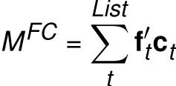
TCM encoding
Items are represented as feature vectors f
Context is also represented as feature vectors c – on a different feature space
Both item and feature vectors are time-indexed
Construct an item-context mapping via an outer product

Slide 15
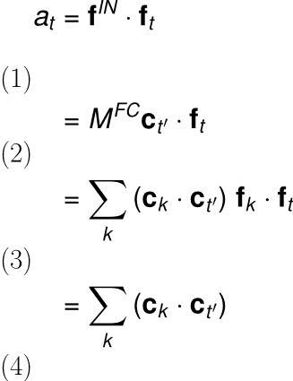
TCM retrieval
Retrieval happens via spreading activation
A state c on C will provide activation input f^{out} = M^{FC} c
Similarity of this input to a given item f can be measured as a dot product
This quantifies the retrieval pull the context exerts on each item
Follows from f orthonormality (assumed)

Slide 16

The context drift assumption
Assume a linear drift in context
A little bit like a recurrent network
Naturally makes contexts at closer times more similar than contexts at farther times from the probe point
Yields long-term recency predictions

