Slide 1
Modeling memory associativity
Nisheeth
13th March 2018

Slide 2
Search of associative memory
In the last class, we saw the SAM model of memory encoding and retrieval
If we can assume that we know the associative strength between all possible targets and cues
We can predict various experimental outcomes in memory experiments
But how do associative strengths get to be the way they are in your head?

Slide 3
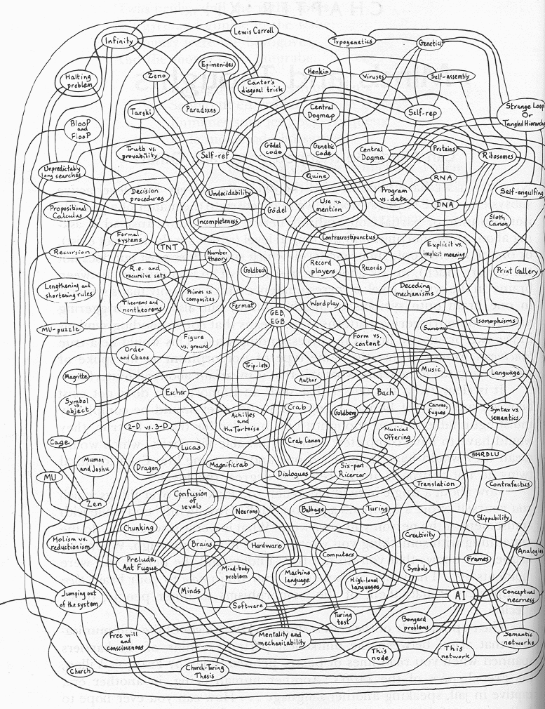
Semantic Networks
Explains everything and predicts nothing
Hofstadter. Godel, Escher, Bach.

Slide 4
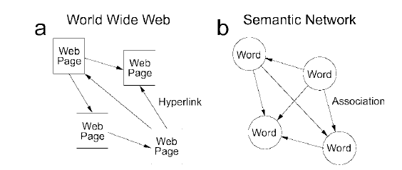
Can we be more precise in dealing with semantic networks?
Griffiths and Steyvers made a great observation
Search in the semantic network has the same information-theoretic constraints as relevance search on the internet
Recommended reading: Griffiths, Steyvers & Firl. Google in the mind.

Slide 5
Basic idea
Use PageRank to predict word completing task performance
PageRank:
Consider the adjacency matrix of all web pages L
Important websites are linked to by other important websites
Consider each link to be transporting some of each website’s importance to the outbound connection
Solve for importance; list websites containing search term in order of importance

Slide 6
Memory hypothesis
All brain areas stimulated by a particular retrieval cue constitute nodes in a graph
Consider the adjacency matrix of this graph, measure in terms of synaptic connectivity
Consider accessibility of a memory engram as the equivalent of website ‘importance’
We have a correspondence between web and memory search

Slide 7
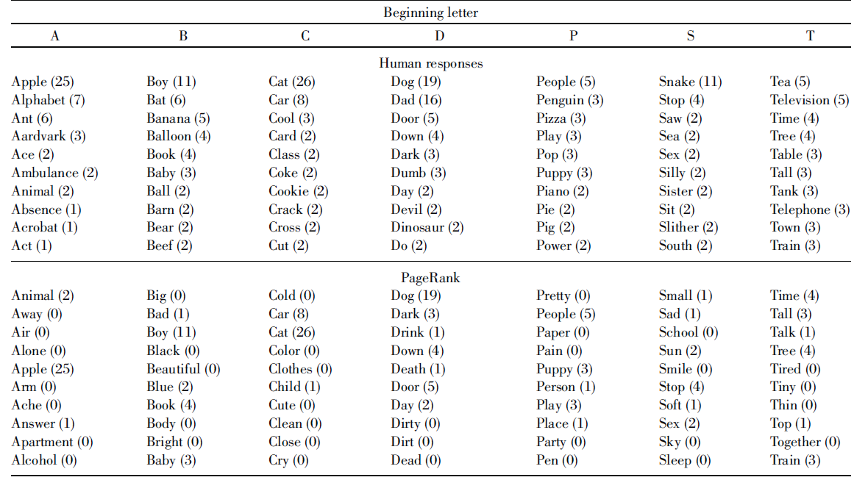
Word completion task
Given a letter, come up with as many words as you can that start with that letter

Slide 8
How to model this?
PageRank-like associativity is the outcome
What is the process?
One possibility
Activation spreads from node to node along associative links
Assume each node spreads its activation equally over all nodes it is connected to
New activation = old activation – decay + inputs

Slide 9


Modeling formally
Assume the vector x is activation for all nodes
Here M is a matrix whose entries are
L are binary outbound links in the graph

Slide 10
Semantic Networks
Can say something about how the semantic network comes about
Spreading activation from node to node brings the graph into its present shape
Some predictions are possible
Hofstadter. Godel, Escher, Bach.

Slide 11
Exploration in the semantic network
Exploration of memory is affected by the familiar exploration-exploitation tradeoff
But how? Search in memory is impossible?
By manipulation of cues
What sort of effect can environmental factors or previous tasks have on memory exploration?
https://warwick.ac.uk/fac/sci/psych/people/thills/thills/2015hillstics.pdf

Slide 12
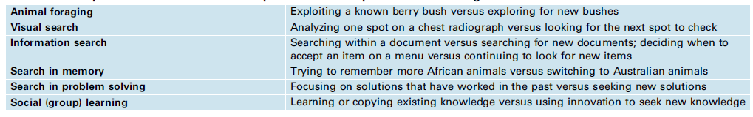
Thomas Hills’ memory search
Optimal foraging theory
Animal spends some time looking for food
When it finds a patch of food, the rate of food acquisition drops over time
Goal is to maximize rate of food accumulation
Optimal theory predicts: shift to a new patch when food acquisition rate drops below global mean

Slide 13
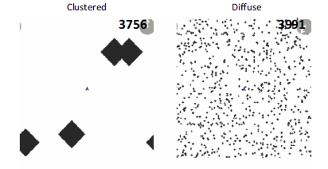
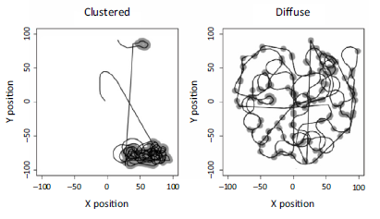
A spatial foraging task
Experimental task: find hidden areas of high reward
Strategies differ

Slide 14
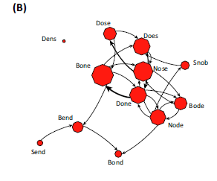
Same participants do a memory task
Scrabble: find all words in the letter set NSBDOE

Slide 15
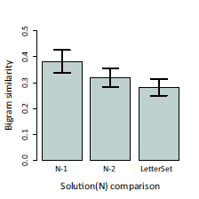
Word production shows sequential dependence

Slide 16
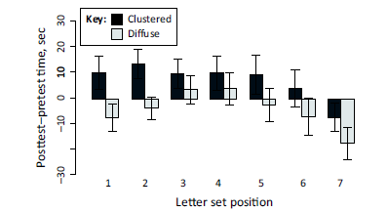
Previous task appears to control exploration propensity
Semantic network traversal is cognitively controllable

Slide 17
Temporal context model
SAM makes no assumptions about the effect of the environment on retrieval cues guiding the memory process
Accepted as inputs
Recent retrievals can become cues for subsequent retrievals
The temporal context model (TCM) changes this
Assumes a linear drift of the temporal context cue that goes into every episodic memory encoding
Recommended reading: (Howard & Kahana, 2002)

