Slide 1
Neurobiology of memory
Nisheeth
March 15th 2018

Slide 2
Today’s class
Finish up with models of memory encoding
Temporal context model
Look at experimental paradigms and observations constraining the neurobiological substrate of memory
The glutamate receptor model of memory
Look at models of brain activity that support memory performance under these constraints

Slide 3
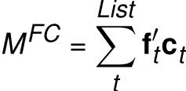
TCM encoding
Items are represented as feature vectors f
Context is also represented as feature vectors c – on a different feature space
Both item and feature vectors are time-indexed
Construct an item-context mapping via an outer product

Slide 4
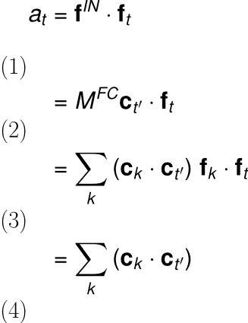
TCM retrieval
Retrieval happens via spreading activation
A state c on C will provide activation input f^{out} = M^{FC} c
Similarity of this input to a given item f can be measured as a dot product
This quantifies the retrieval pull the context exerts on each item
Follows from f orthonormality (assumed)

Slide 5

The context drift assumption
Assume a linear drift in context
A little bit like a recurrent network
Naturally makes contexts at closer times more similar than contexts at farther times from the probe point
Yields long-term recency predictions

Slide 6
Summary
Spreading activation models used to model memory associativity
Co-occurrence frequency appears to drive most of associativity
Other cognitive factors – salience, attention etc. also interact
Still a young modeling space
Lots to do

Slide 7
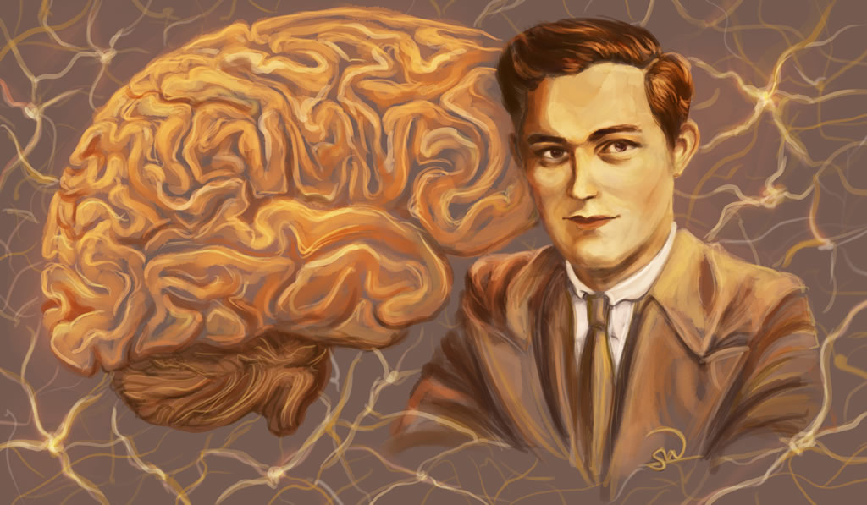
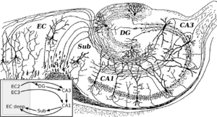
Hippocampus as the seat of memory
Identified by lesion studies as critical for memory formation
Case of H.M.
Dentate gyrus in particular is vital for conjunctive coding of observations
https://en.wikipedia.org/wiki/Hippocampus

Slide 8

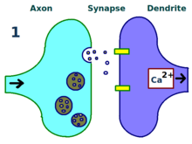
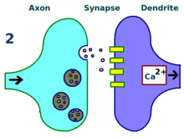
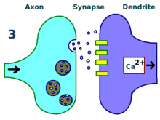
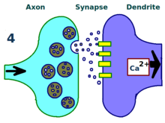
Glutamate receptors and memory function
Glutamate receptors are critical for long-term potentiation (LTP) of neurons
How do glutamate receptors affect the acquisition of a behavioral memory?
This was the question Richard Morris addressed in his classic 1986 paper. This paper was a classic because it was the first to outline an approach to the problem and produce some reasonable data.
https://en.wikipedia.org/wiki/Long-term_potentiation

Slide 9
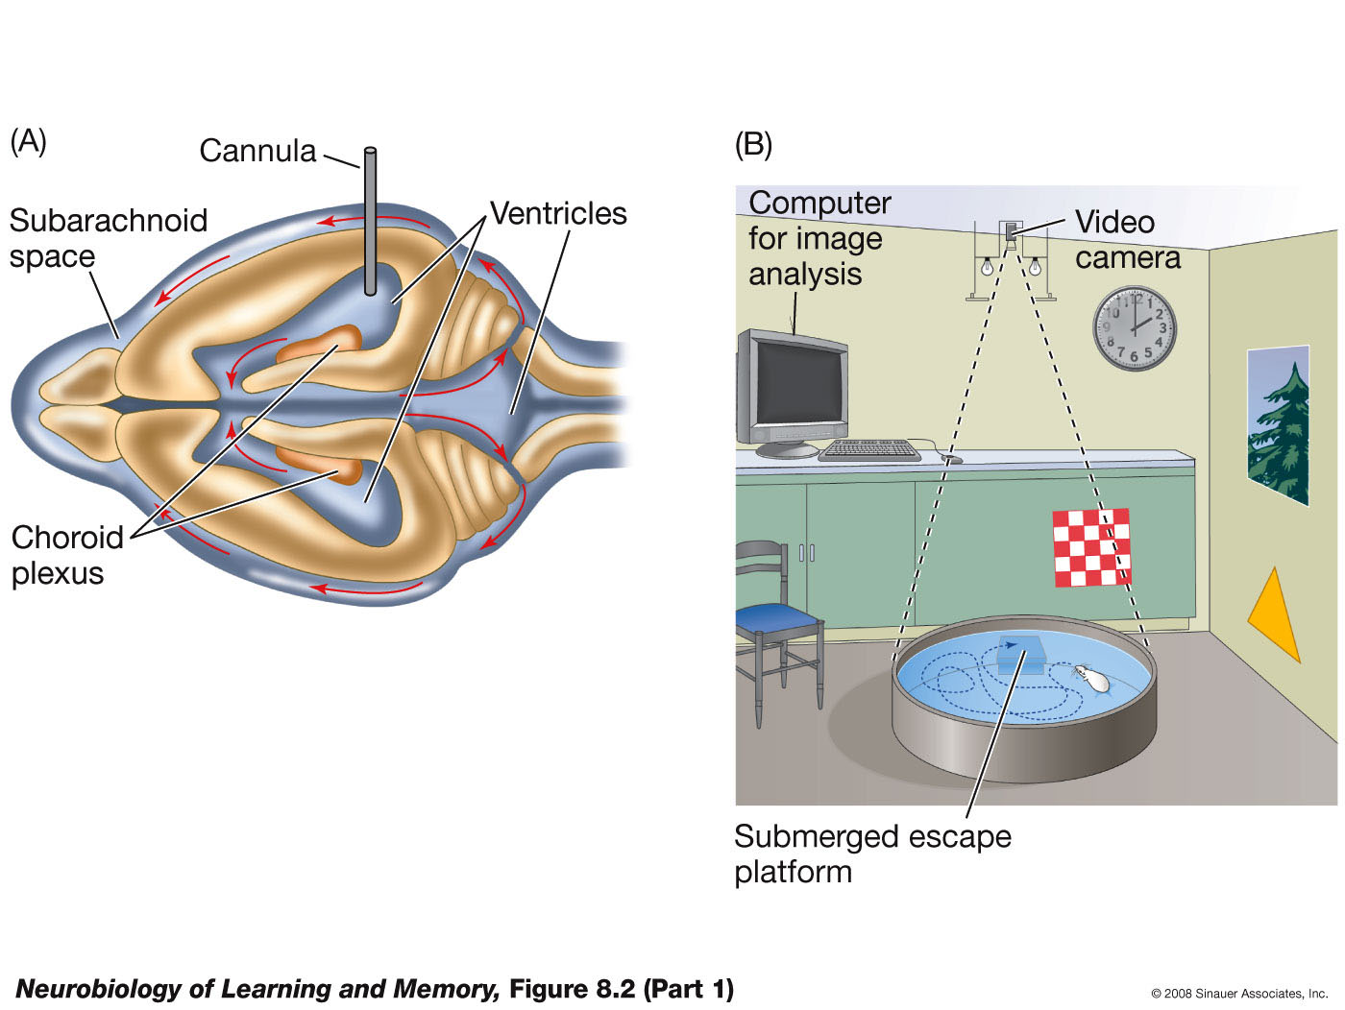
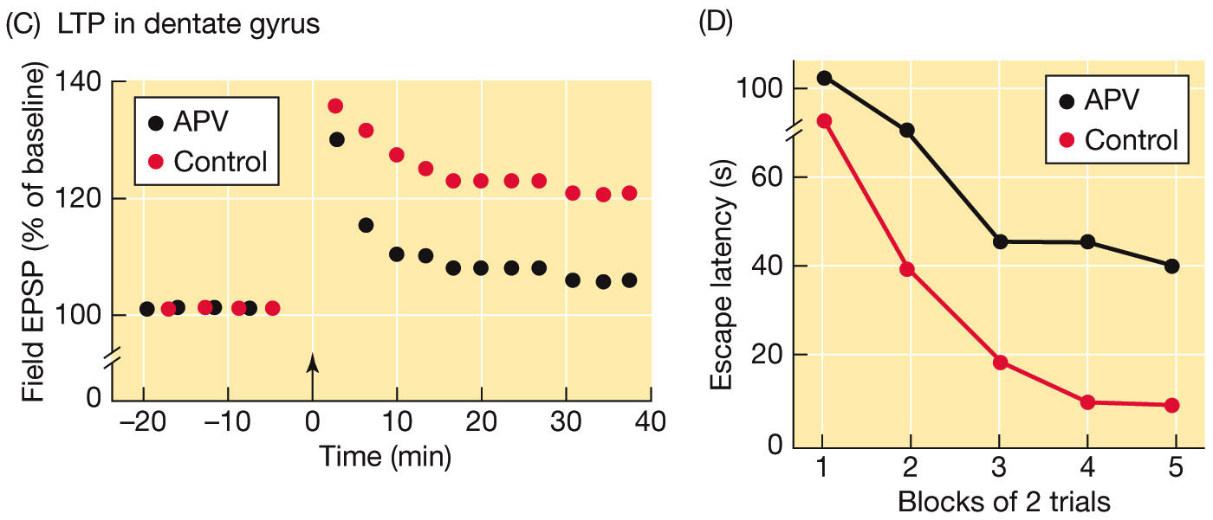
Morris water maze experiment
Notes:
Components of the classic Morris experiment. (A) A cannula was implanted into the ventricles of the rat’s brain and attached to a time-release pellet that contained the NMDA receptor antagonist, APV. (B) Rats were trained on the place-learning version of the water-escape task. (C) Rats infused with APV could not sustain LTP in the dentate gyrus. (D) Rats injected with APV were impaired in learning the location of the hidden platform. (E) Control rats selectively searched the quadrant that contained the platform during training, but rats injected with APV did not. T = training quadrant; A = adjacent quadrant; O = opposite quadrant.

Slide 10
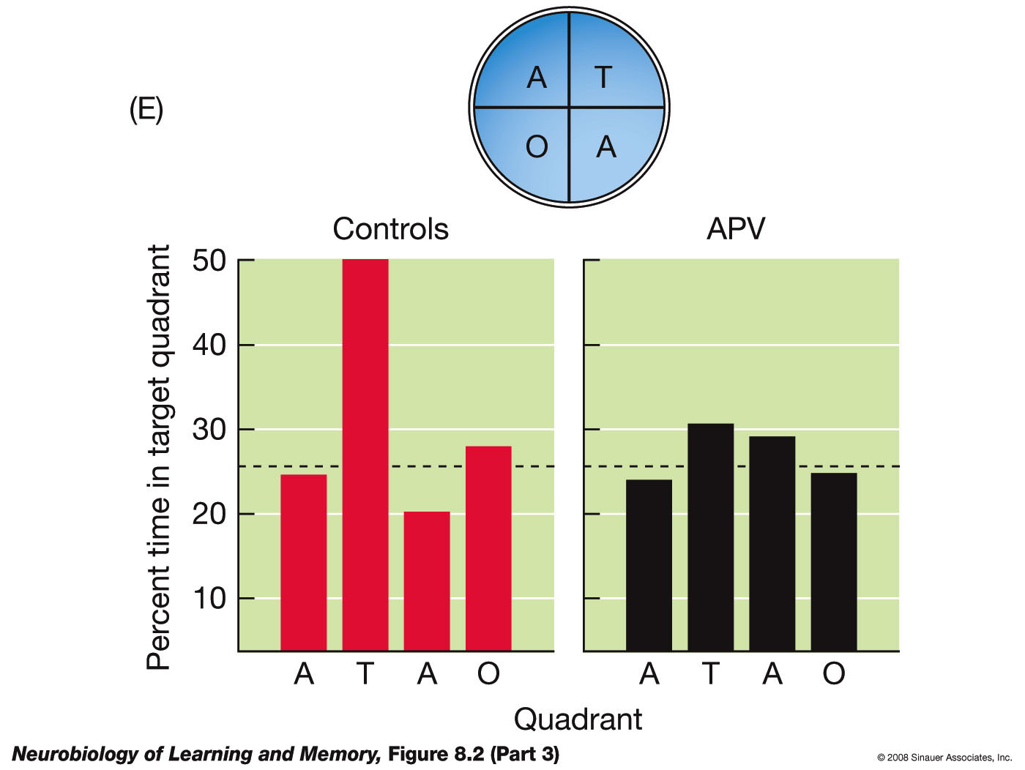
NMDA receptors potentiate place learning
Many of the following slides taken from this book’s corresponding slide deck
Notes:
Components of the classic Morris experiment. (A) A cannula was implanted into the ventricles of the rat’s brain and attached to a time-release pellet that contained the NMDA receptor antagonist, APV. (B) Rats were trained on the place-learning version of the water-escape task. (C) Rats infused with APV could not sustain LTP in the dentate gyrus. (D) Rats injected with APV were impaired in learning the location of the hidden platform. (E) Control rats selectively searched the quadrant that contained the platform during training, but rats injected with APV did not. T = training quadrant; A = adjacent quadrant; O = opposite quadrant.

Slide 11
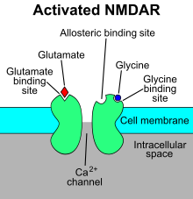
How do glutamate receptors work?
Neurotransmitter is the agonist for a receptor
Activated receptor allows cation flow
NMDA gates calcium channels
If enough receptors are activated, enough cations flow to cause an action potential (firing event)

Slide 12
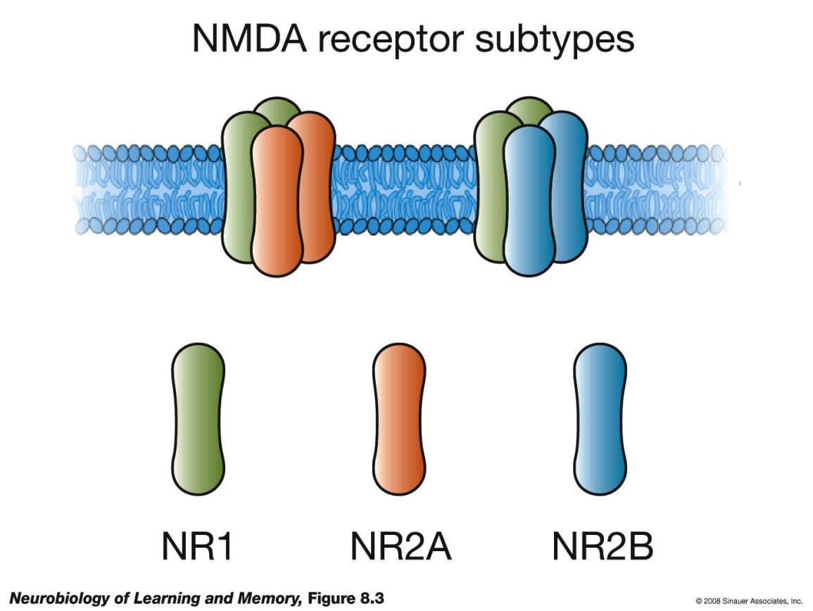
NMDA experiments
NMDA receptors are composed of NR1 and NR2 subunits. All functional receptors contain NR1 subunits. NR1 subunits come in two categories, NR2A and NR2B.
Notes:
NMDA receptors are composed of four subunits. All functional NMDA receptors contain NR1 subunits. There are a variety of NR2 subunits. This figure illustrates NMDA-receptor complexes composed of NR1–NR2A and NR1–NR2B subunits.

Slide 13

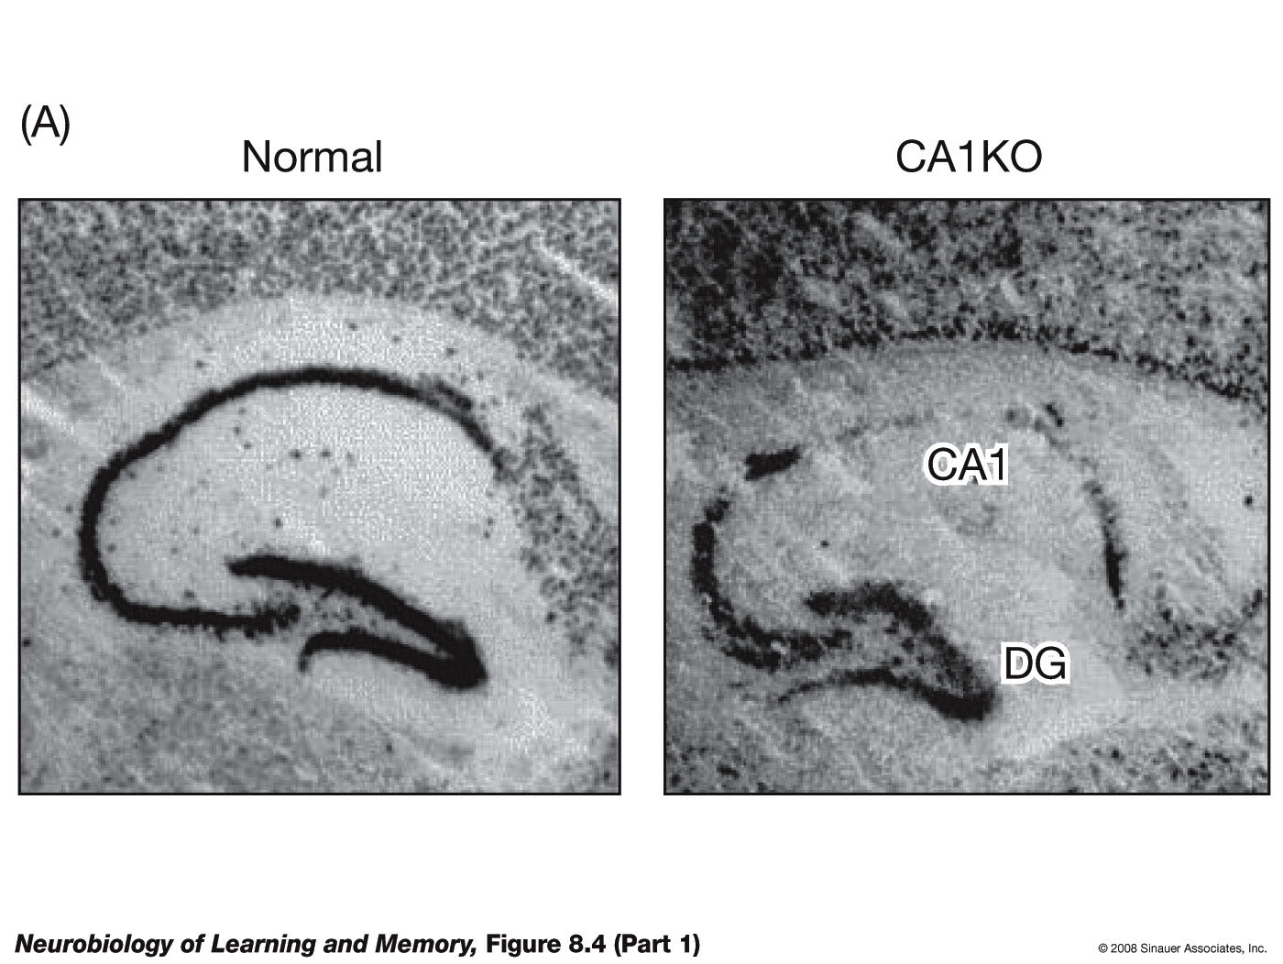
Removing a subunit
Notes:
(A) This photomicrograph shows a section of a normal hippocampus (left section) that has been stained to reveal the presence of the NR1 subunit. Note that the NR1 subunit is absent in the CA1 region of the section taken from the genetically engineered mouse, called a CA1 knockout or CA1KO (right section), but is present in the dentate gyrus (DG). (B) LTP cannot be induced in CA1 in slices taken from mice lacking the NR1 subunit. (C) LTP can be induced in the dentate gyrus in slices taken from the genetically engineered mice because the NR1 subunit is still present. (D) The CA1KO mice are impaired on the place-learning version of the Morris water-escape task. (E) These mice also do not selectively search the training quadrant on the probe trial. (After Tsien et al., 1996.)

Slide 14
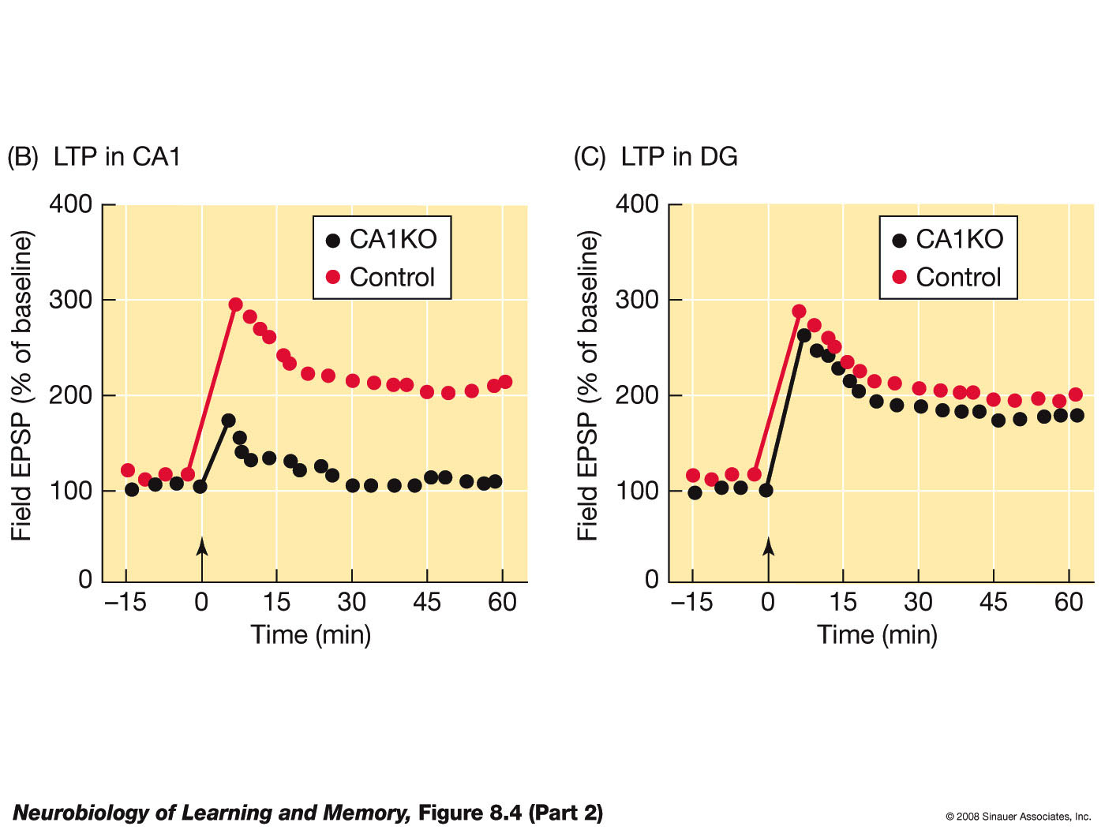
Removing a subunit
Notes:
(A) This photomicrograph shows a section of a normal hippocampus (left section) that has been stained to reveal the presence of the NR1 subunit. Note that the NR1 subunit is absent in the CA1 region of the section taken from the genetically engineered mouse, called a CA1 knockout or CA1KO (right section), but is present in the dentate gyrus (DG). (B) LTP cannot be induced in CA1 in slices taken from mice lacking the NR1 subunit. (C) LTP can be induced in the dentate gyrus in slices taken from the genetically engineered mice because the NR1 subunit is still present. (D) The CA1KO mice are impaired on the place-learning version of the Morris water-escape task. (E) These mice also do not selectively search the training quadrant on the probe trial. (After Tsien et al., 1996.)

Slide 15
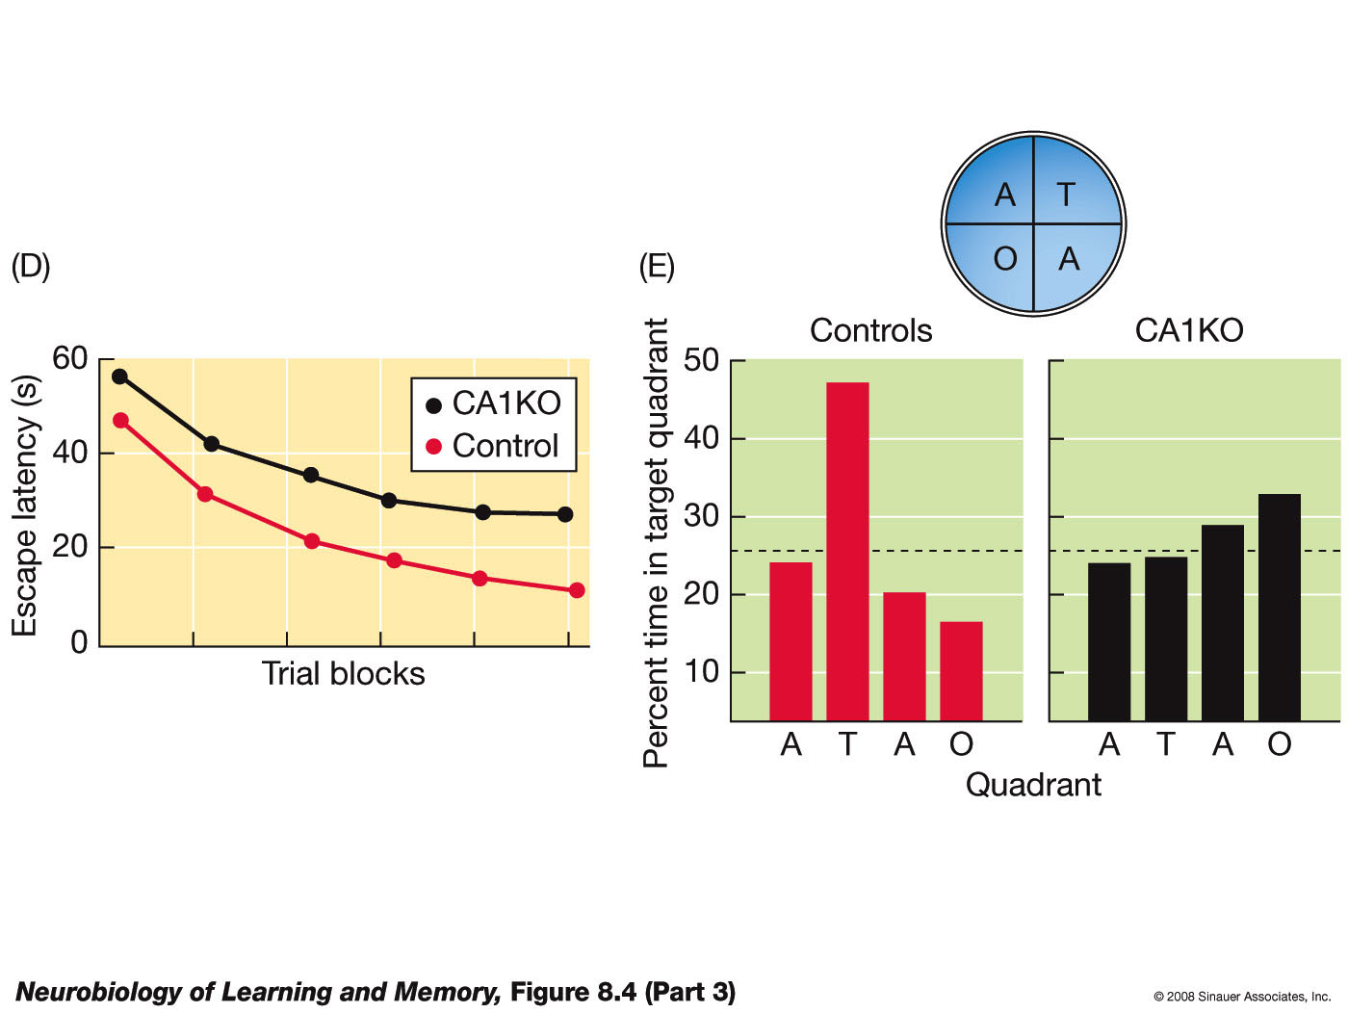
Removing a subunit
Notes:
(A) This photomicrograph shows a section of a normal hippocampus (left section) that has been stained to reveal the presence of the NR1 subunit. Note that the NR1 subunit is absent in the CA1 region of the section taken from the genetically engineered mouse, called a CA1 knockout or CA1KO (right section), but is present in the dentate gyrus (DG). (B) LTP cannot be induced in CA1 in slices taken from mice lacking the NR1 subunit. (C) LTP can be induced in the dentate gyrus in slices taken from the genetically engineered mice because the NR1 subunit is still present. (D) The CA1KO mice are impaired on the place-learning version of the Morris water-escape task. (E) These mice also do not selectively search the training quadrant on the probe trial. (After Tsien et al., 1996.)

Slide 16
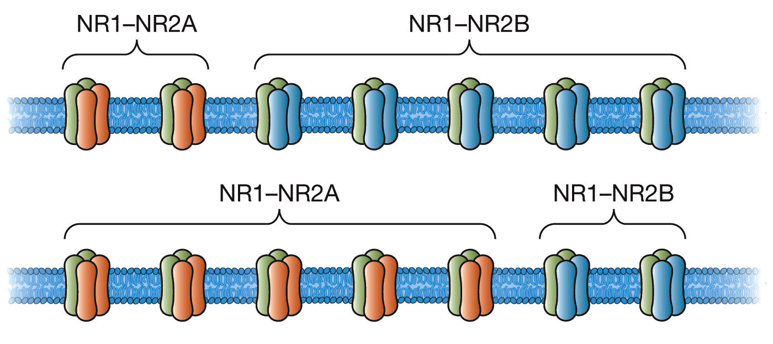
Maturation affects NMDA composition
This figure illustrates the shift in the ration of NR1–NR2A and NR1–NR2B NMDA receptors that takes place as the brain develops. Top: During the early postnatal period there are relatively more NR1–NR2B receptor complexes. Bottom: With maturation there is a shift in the balance so that there are now more NR1–NR2A receptor complexes.

Slide 17
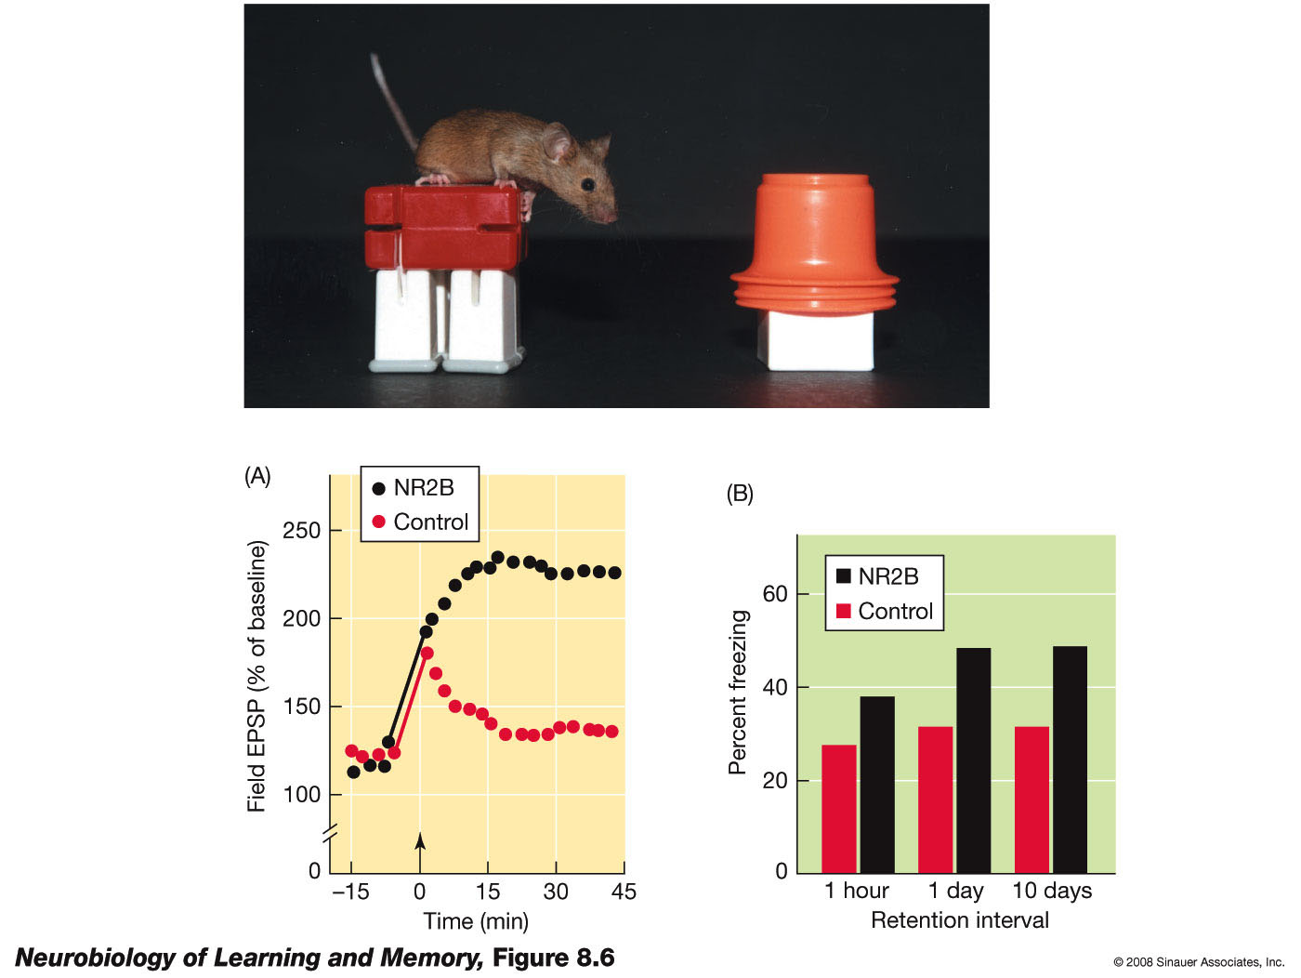

Genetic amplification
Notes:
In the Doogie mouse, the NR1–NR2B NMDA complex is overexpressed in several regions of the brain, including the cortex, hippocampus, and amygdala. (A) Slices from the Doogie mouse show enhanced LTP. (B) The Doogie mouse shows a stable and enhanced memory for a contextual fear-conditioning experience. (Photo provided by J. Z. Tsien.)

Slide 18
But, conditions apply*
Phase 1
Phase 2
Results
Rats first trained on the task in Room 1.
Rats trained on the task in Room 2 were injected with APV.
LTP in DG was blocked but APV had no effect on place learning. Thus pretraining in a different room abolished the behavioral effects of antagonizing NMDA receptors.

Slide 19
Other limitations
NMDA may be gating processes that support memory among other behavior
Water maze experiments are confounded with
Thigmotaxis (trying to stay in touch with a solid surface)
Mice being smart about outcomes

Slide 20
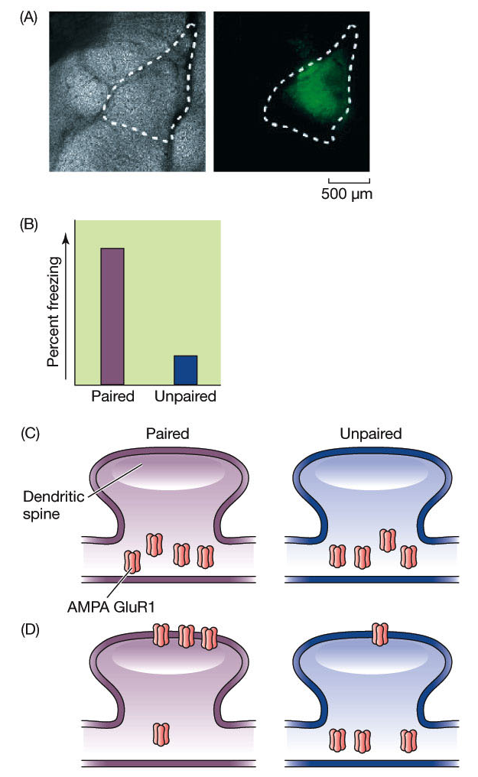

AMPA receptors’ influence
Notes:
Malinow and his colleagues used a special technique to insert modified glutamate receptors, GluR1, into the lateral amygdala. (A) These receptors were labeled with a fluorescent molecule and could be visualized. (B) Rats with these fluorescent-tag AMPA receptors were tested for fear of a tone paired with shock or tested for fear of a tone unpaired with shock. Rats in the paired condition displayed fear to the tone. The rats were then sacrificed and slices were taken from their brains. An analysis of these slices revealed fear conditioning had driven the GluR1 AMPA receptors into the spines. (C) Schematic representation of the distribution of the GluR1 receptors prior to training. (D) After the training, rats in the paired condition had more GluR1 receptors trafficked into the plasma membrane than rats in the unpaired condition. These results indicate that a behavioral experience that produces fear conditioning also drives AMPA receptors into the synapse. (After Rumpel et al., 2005.)

Slide 21
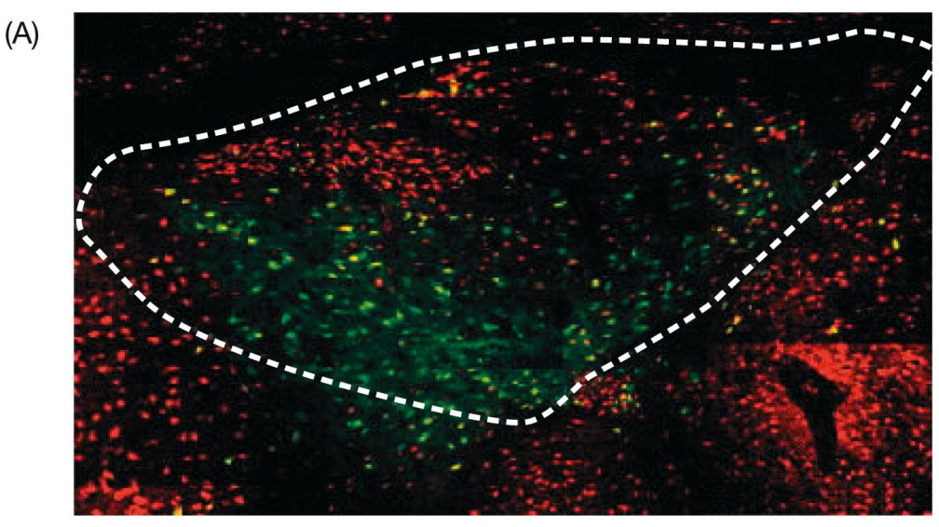
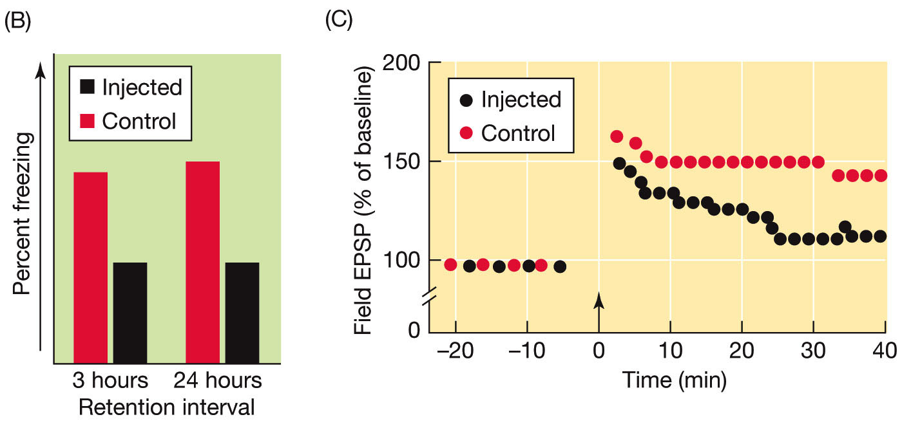
AMPA receptors’ influence
Notes:
(A) Modified nonfunctional GluR1 receptors are injected into the lateral amygdala. These modified receptors compete with endogenous functional GluR1 receptors for trafficking into spines. (B) Rats injected with this receptor display impaired fear conditioning to a tone paired with shock. (C) Slices from animals injected with the modified receptor cannot sustain LTP induced in the lateral amygdala. (After Rumpel et al., 2006.)

Slide 22
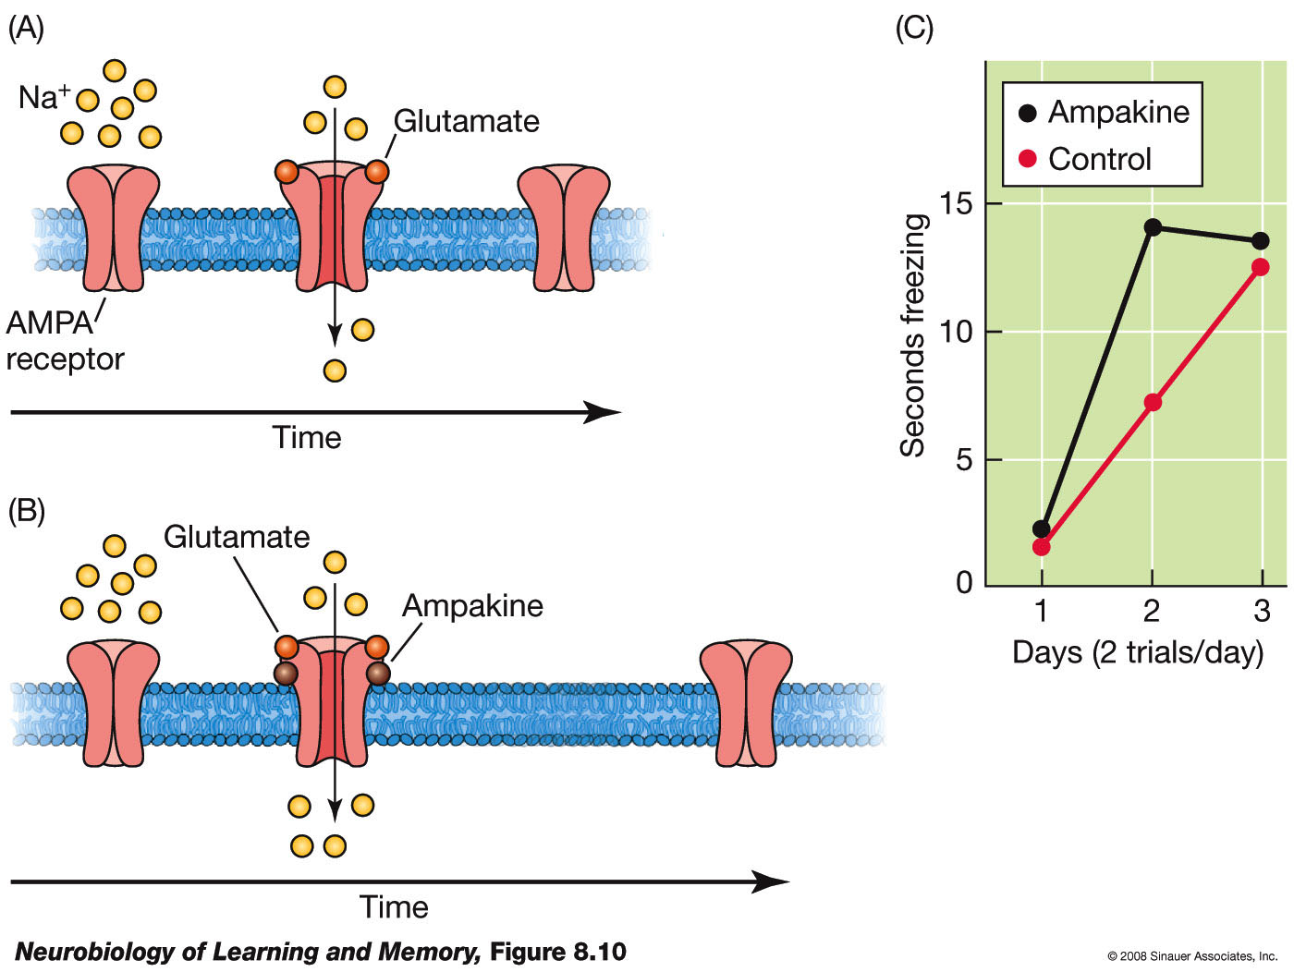
Amplifying AMPA
Notes:
(A) When glutamate binds to AMPA receptors the conductance channel is briefly opened and this allows positive ions to enter. (B) When ampakines and glutamate both bind to the AMPA receptor, the channel stays open longer and therefore more ions enter and the synaptic response is enhanced. (C) Ampakines enhance the rate of auditory fear conditioning.

Slide 23
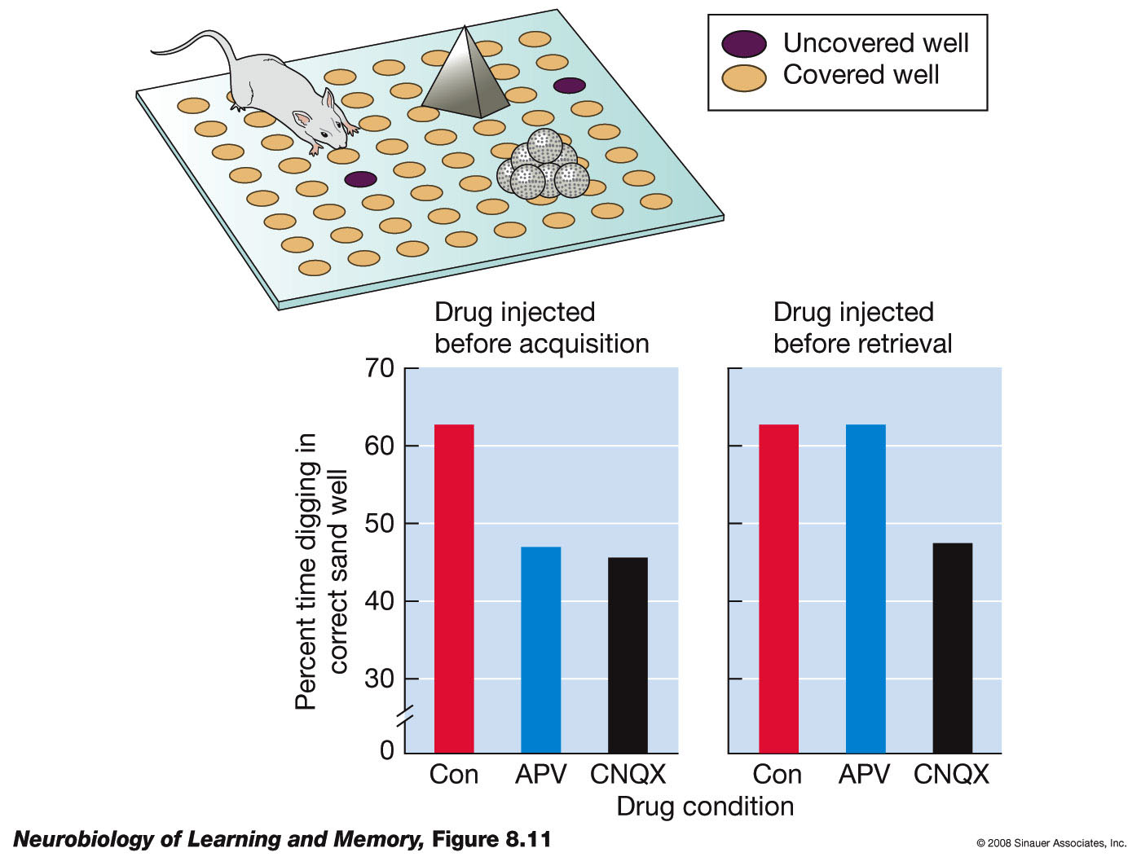
Differences between NMDA and AMPA effects
AMPA antagonist affects encoding and retrieval both. NMDA antagonist affects only encoding.
Notes:
The top of this figure is a schematic of the arena Morris and his colleagues used to study the role of glutamate receptors in the acquisition and retrieval of a memory for the location of flavored food pellets. On the retrieval test, the two sand wells that contained the flavored pellets on the acquisition trial were uncovered. The rat was fed one of the pellets in the release point. Its task was to remember which sand well contained that pellet during acquisition. When given before acquisition, both APV and CNQX interfered with establishing the food-location memory. However, only CNQX, the AMPA receptor antagonist, interfered with the retrieval of the memory. Con = control group. (After Day et al., 2003.)

Slide 24
Modeling the glutamate receptor contribution to memory and learning
Generic excitation
Dendritic spine
Pre-synaptic terminal
AMPA
NMDA
Specific excitation
http://www.nature.com/articles/361031a0.pdf

