Slide 1
Intro to decision-making
Nisheeth
March 22nd 2018

Slide 2
Course trajectory
Foundations
Perception
Categorization
Memory
Behavior
Motor
Mental
Speech

Slide 3
Let’s make some decisions

Slide 4
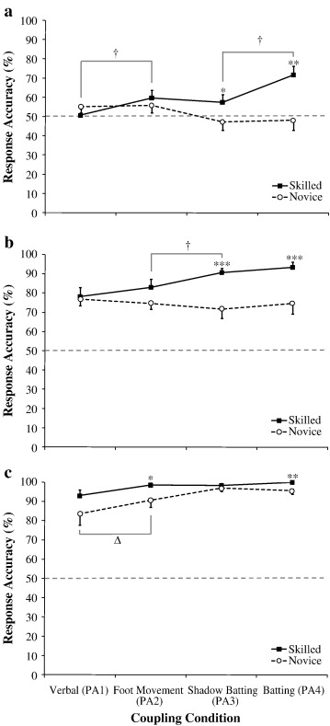
Novices at chance, experts better than chance only when simulating batting action
Experts better than novices
All participants able to predict side very well
(Mann, Abernethy & Farrow, 2010)

Slide 5
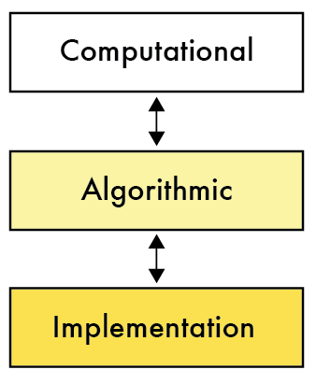
Real decisions are embodied
But that’s what makes them hard to model
Decision-making research has sought to abstract away from the complexity of real decision-making
To obtain generalizable principles that could, maybe, inform real embodied decisions also
Historical preference

Slide 6
Let’s make some decisions
Which would you prefer?
How do you decide?
A guaranteed … | The possibility of …
Getting Rs 3000 | An 80% chance of getting Rs 4000, but nothing otherwise
Getting Rs 5 | A 0.1% chance of getting Rs 10000
Getting Rs 10000 | 10% chance of Rs 50000 89% chance of Rs 10000 1% chance nothing
Getting Rs 1000 now | Rs 2000 in a week’s time
http://www.thecricketmonthly.com/story/1136242/what-does-a-batsman-see

Slide 7
Economic decisions under risk
Risk = which of a known set of outcomes (O) will occur is unknown at the time a decision has to be made
Decision = choice between known set of actions (A)
General world model = outcomes obtain based on states (S) of the world
Economic = outcomes come pre-labeled with monetary labels

Slide 8
Sample decision specification
Actions
Going to class
Going out with friends
States
Smart lecturer
Clueless lecturer
Outcomes
Learn something, learn nothing and regret wasted time, learn nothing while having fun with friends

Slide 9


How to decide?
Simple word model
If the lecturer is more likely to be clueless than not, go out with friends
Implicitly a max likelihood model of decision making
Decision rule
Can rewrite this as

Slide 10
How do we represent how good an outcome is?
The term p(o|s,a) is only as informative as our representation of the outcome set o
One representation → Real numbers
That makes p(o|s,a) a utility function U(s,a)
In simple situations where actions and states have a 1-1 mapping, can write this simply as U(s) or U(a)

Slide 11
What does the decision rule look like now?
If we treat the outcome as a number
Higher being better
If we assume the only actions we have available are selections from states
If we assume that the selections are perfect
One action leads to only one state
This looks nice and succinct, but how does it handle risk?

