Slide 1
Expected utility theory
Nisheeth
March 27th 2018

Slide 2

Adding risk to the decision rule
Adding risk is just a way of saying that p(s) is non-trivial
Let’s say one action can lead to two different situations
We just need to bring back the non-trivial p(s|a)
But now the decision rule is no longer useful
Action selection is not useful without considering all possible consequences of your action

Slide 3
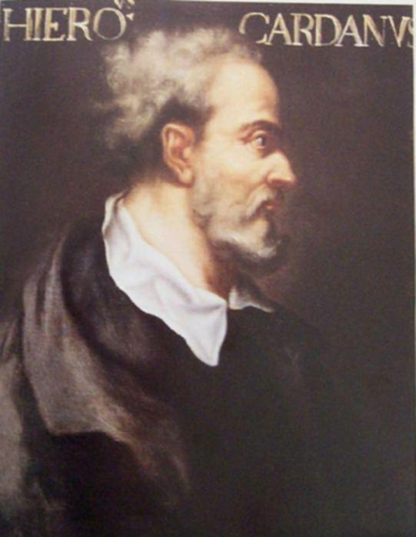
Considering all consequences
This was a big philosophical problem at the beginning of the Enlightenment
Why should things that aren’t actually going to happen affect our decisions?
Probability was the realm of disreputable people, i.e. drunkards, gamblers and bettors
Gerolamo Cardano, father of probability
Inveterate gambler and cheat

Slide 4
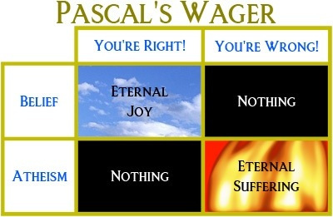
The Enlightenment
God has left some things indeterminate for our amusement - Pascal
Probabilities can be useful for theologians as well as gamblers

Slide 5
Working through Pascal’s wager
Actions = belief, atheism
Outcomes = nothing, eternal joy, eternal suffering
Reward for belief = Eternal joy if God exists, nothing if doesn’t exist
Punishment for disbelief = Eternal suffering if God exists, nothing if doesn’t exist
Pascal’s conclusion: best case scenario for disbelief = worst case scenario for belief
Believe!

Slide 6
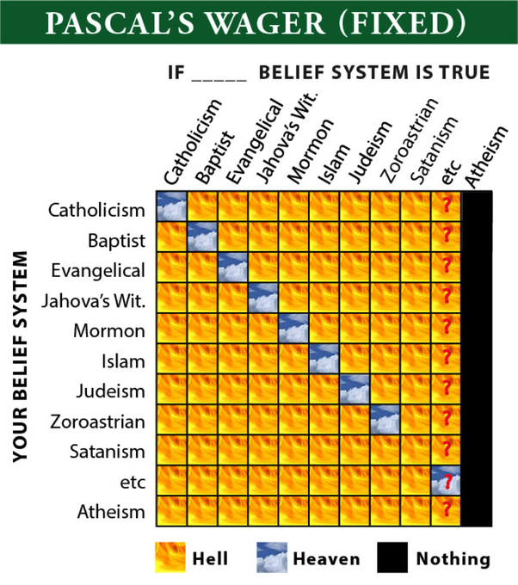

Slide 7

A probabilistic treatment
Bernoulli etc picked up where Pascal left off
Expected reward(belief) = Reward(belief) x p(God) + Reward(atheism) x (1 – p(God))
The idea of expected value was born
Used to this day
What is the expected value of a gamble that will pay out Rs 100 with probability ½?

Slide 8
The St Petersburg paradox
You have to pay me if you want to play this game
Game: toss a coin as long as you keep getting heads
If you get a head on the nth toss, you get Rs 2^{n}
Game continues until the first tail
How much will you pay to play?
Any amount is too small?

Slide 9
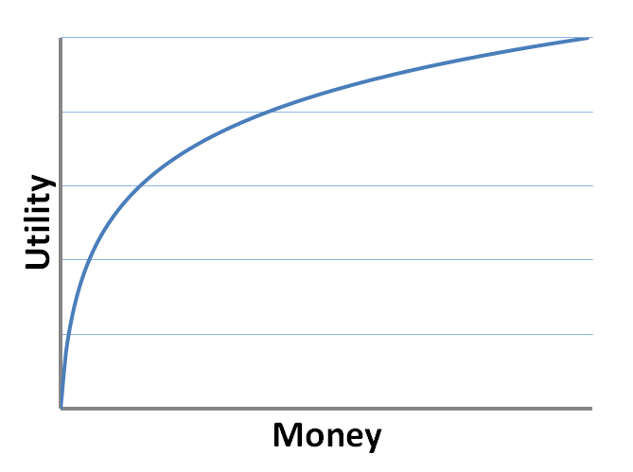

The St Petersburg paradox
Daniel Bernoulli’s explanation: the face value of the gamble is not the same as the utility of the money to someone
Utility is the subjective worth of an outcome to someone
Heresy! People have free will?

Slide 10

How to access subjective utility?
For money amounts it is possible to approximate subjective judgments with a logarithm-like functions
But generally speaking, this is not easy to elicit for non-monetary items
Diamonds have high value and low utility
Water has low value and high utility

Slide 11
The VNM revolution
Economists were forced to use preferences revealed as comparisons in their models
Very hard work, very restrictive when trying to make public policy
Von Neumann and Morgenstern changed that by showing under what assumptions someone’s revealed preference comparisons could emerge from an underlying subjective utility function

Slide 12
The VNM axioms
Completeness
Transitivity
Independence
Continuity
If a decision-maker’s preferences satisfy these criteria
we can represent them by a utility function
and use expected utility calculations to model their decisions

Slide 13



Completeness
A decision-maker must have pair-wise preferences for all possible options
Allows for indifference between options
True for most decision-makers, except for compositional arguments

Slide 14


Completeness
A decision-maker must have pair-wise preferences for all possible options
Allows for indifference between options
True for most decision-makers, except for compositional arguments

Slide 15
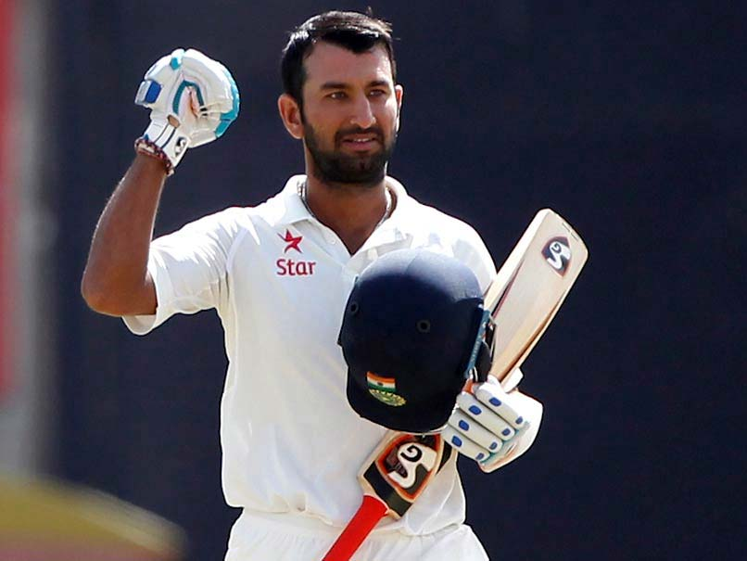
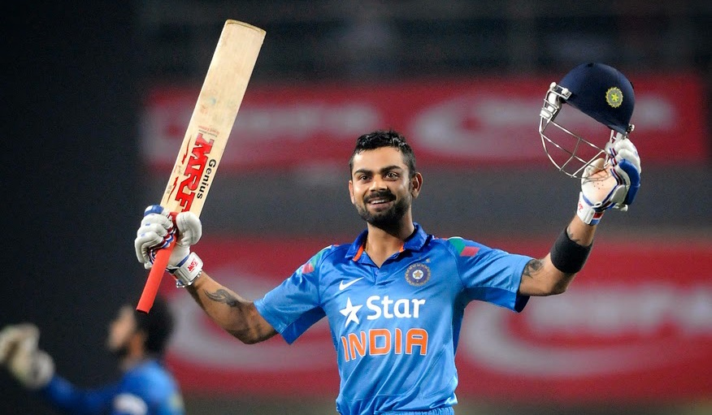

Transitivity
If I prefer A to B and B to C, then I must prefer A to C
True for most decision-makers
But with exceptions due to context effects

Slide 16

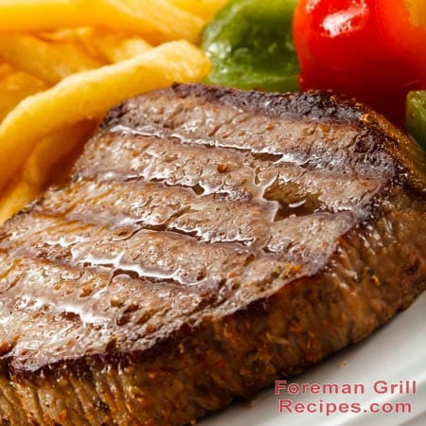

Continuity
If you prefer B to C and A to B, then there will be some probabilistic combination of A and C which you will prefer to B
True, except for deontic preferences
10%
or
90%

Slide 17
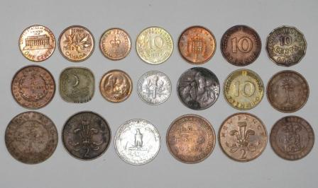

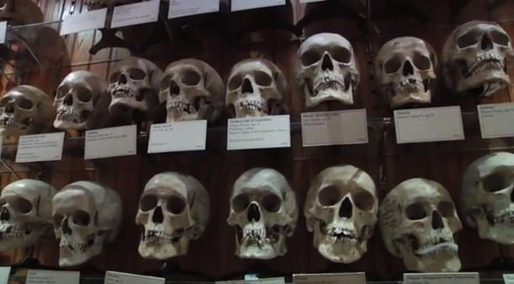
Independence
If I prefer A to B, the addition of C to my set of choices should not make a difference to my preference between A and B
The most controversial of the VNM axioms
Extra choices provide information that guide the context of the decision

Slide 18
What do the axioms imply?
That people can make up their minds about things (completeness)
That people’s preferences are generally context-specific (transitivity)
That people don’t bring too many sacred values into economic transactions (continuity)
That people don’t generally acquire extra information once they are engaged in the decision-making process (independence)

Slide 19
Criticism of homo economicus
The picture of the economic decision-maker represented by the VNM axioms is not a very well-rounded one
The independence assumption is the weakest one w.r.t. real-life economic decision-making
Typically relaxed in generalized utility theories
But it took a lot of convincing
Lots of experiments, real and virtual
Let’s look at some

Slide 20
Allais paradox
Two separate choices between two choices each
Choice 1
Option A: Win Rs 1 lakh for sure
Option B: Win Rs 1 lakh with probability 89%, Rs 5 lakh with probability 10% and nothing with probability 1%
Choice B
Option A: Win Rs 1 lakh with probability 11% and nothing with probability 89%
Option B: Win Rs 5 lakh with probability 10% and nothing with probability 90%

Slide 21
Why is this a paradox?
Preference revealed from choice 1
Preference revealed from choice 2
Rewriting this yields
Can’t be maximizing expected utility in both cases!

Slide 22
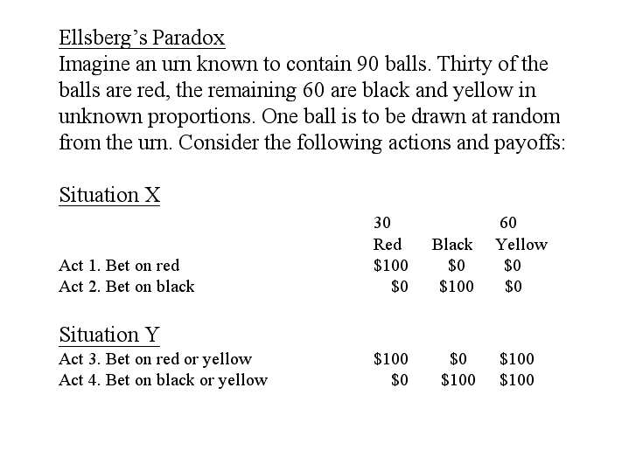
Ellsberg paradox

Slide 23
Why is this a paradox?
Most people prefer Action 1 to 2 and 4 to 3
What does that imply about their utility function?
Assume R,Y and B are your probability estimates for red, yellow and black balls respectively
From gamble 1
From gamble 2
Inconsistent inferences!

Slide 24
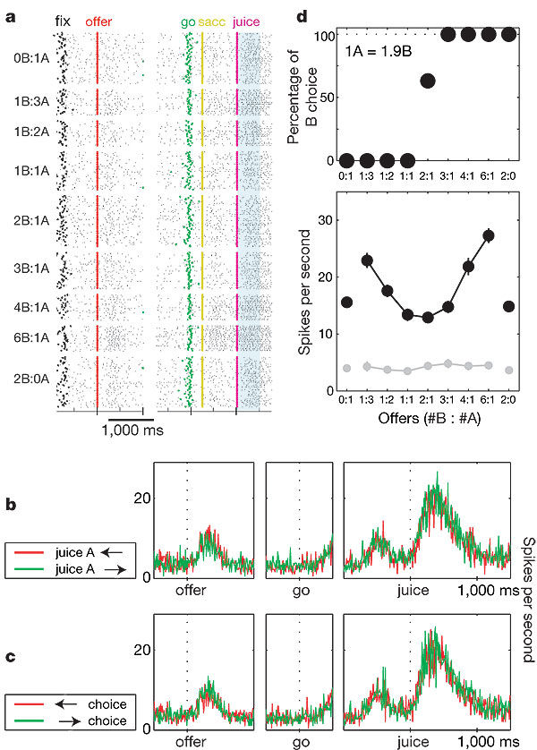
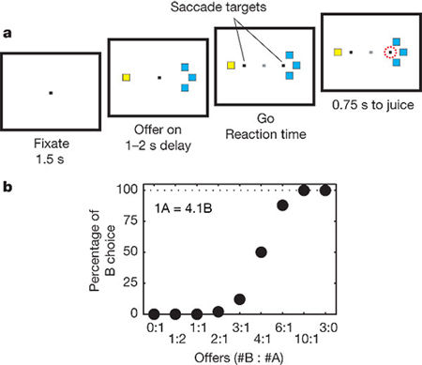
Does the brain actually calculate value?
Some neuroscientists say yes (Padoa-Schioppa & Assad, 2006)

Slide 25
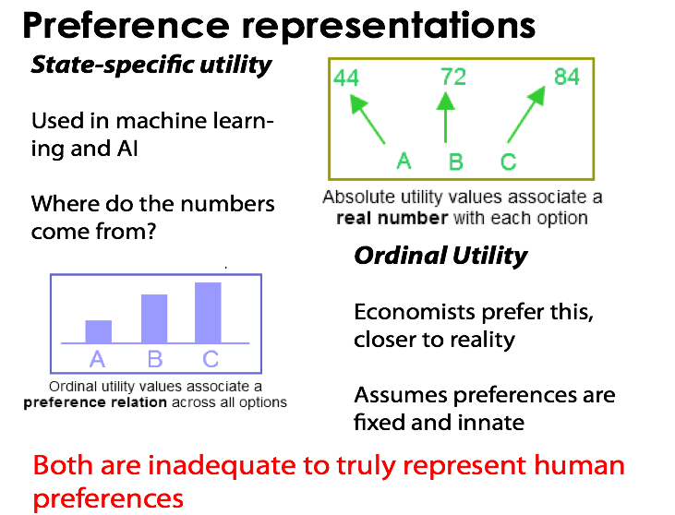
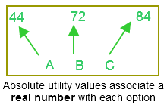
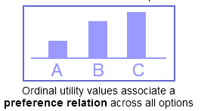
Representing preferences
Most machine learning and artificial intelligence techniques
Assumes knowledge of value of an object independent of the value of other object
Where do the numbers come from?

Slide 26
PROBLEM: Pay for (no) Pain
Vlaev, Ivo, Nick Chater, Neil Stewart, and Gordon DA Brown. "Does the brain calculate value?." Trends in cognitive sciences 15, no. 11 (2011): 546-554.

Slide 27
40p
80p
People double their offers, when they have double the money...
Value of pain changes by x2 within minutes!

Slide 28
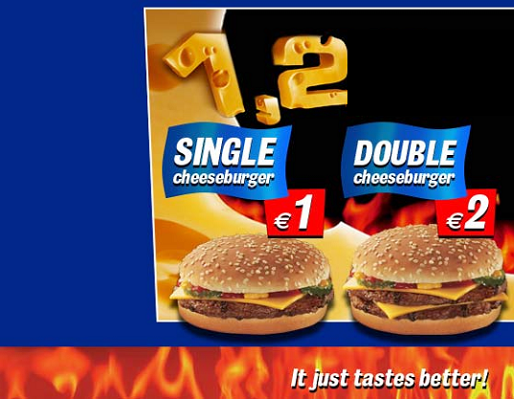
Deep PROBLEM: Cheeseburgers
50%
50%

Slide 29
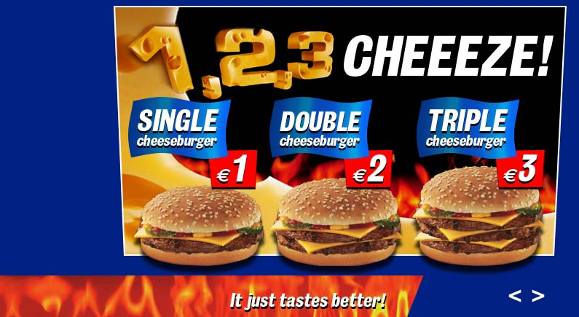
Deeper Problem: Cheeseburgers
30%
60%
10%

Slide 30
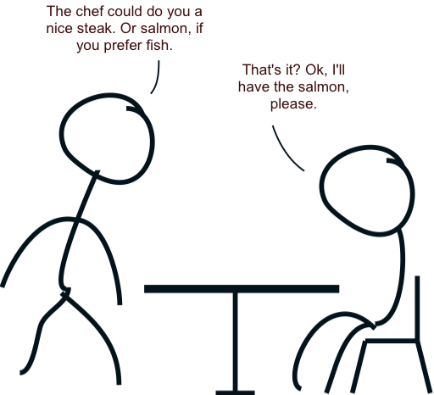
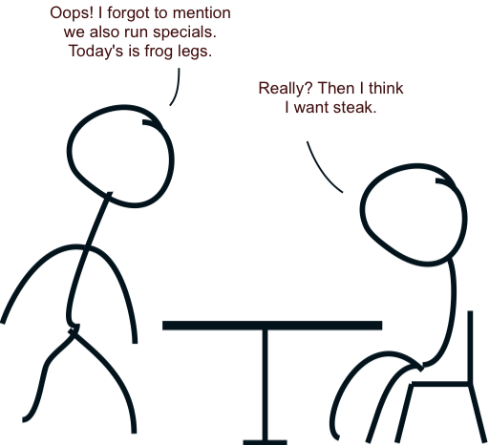
Can preferences really describe human choices?
(Luce and Raiffa, 1957)

Slide 31
Or choices in general?
The deep ‘cheeseburger problem’ also shows up in decision studies with several organisms

Slide 32

Or choices in general?
The deep ‘cheeseburger problem’ also shows up in decision studies with several organisms

Slide 33

Or choices in general?
The deep ‘cheeseburger problem’ also shows up in decision studies with several organisms

Slide 34
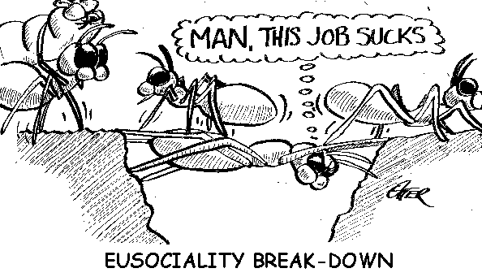
Or choices in general?
The deep ‘cheeseburger problem’ also shows up in decision studies with several organisms

Slide 35

Or choices in general?
The deep ‘cheeseburger problem’ also shows up in decision studies with several organisms

Slide 36
Summary
The homo economicus view of the economic decision-maker has pros and cons
Pros: lets economists make public policy using aggregate utility functions that are in theory measurable from revealed preferences
Cons: theory is not a good fit with human behavior more broadly
Conclusion 1: have to circumscribe the use of the model carefully
Conclusion 2: have to study deviations

