Slide 1
Deviations from EUT
Nisheeth
April 3rd 2018

Slide 2
Expected utility theory says that utilities are…
Not directly observable (internal to an individual)
Not comparable across individuals
Constrained by revealed preferences (i.e. choices between gambles)

Slide 3
Do people’s choices obey the theory of expected utility (i.e., formal rationality)?

Slide 4
Expected Utility Theory – Crucial Features
Utility (“degree of liking”) is defined by (revealed) preferences
i.e. U(A) > U(B) iff A is preferred to (chosen over) B

Slide 5
Utility versus Preference (Lichtenstein and Slovic, 1971; 1973)
Ps given two options:
P bet: 29/36 probability to win $2
$ bet: 7/36 probability to win $9
Two conditions:
Choose one: Most prefer P bet
Value the bets: Most value $ bet higher
Shows utility (based on cash value) is not consistent with revealed preference

Slide 6
Expected Utility Theory – Crucial Features
Utility (“degree of liking”) is defined by (revealed) preferences
i.e. U(A) > U(B) iff A is preferred to (chosen over) B
Contradicted by preference reversal

Slide 7
Expected Utility Theory – Crucial Features
Utility (“degree of liking”) is defined by (revealed) preferences
i.e. U(A) > U(B) iff A is preferred to (chosen over) B
Contradicted by preference reversal
Preferences are well ordered
i.e. transitive: If A ≻ B and B ≻ C, then A ≻ C

Slide 8
Tests of Transitivity (A. Tversky, 1969)
Ps shown ratings of college applicants on three dimensions:
Applicant
Intelligence
Stability
Social
A
69
84
75
B
72
78
65
C
75
72
55
D
78
66
45
E
81
60
35
Ps chose A over B, B over C, C over D, D over E, but……E over A (difference in intelligence outweighed)

Slide 9
Expected Utility Theory – Crucial Features
Utility (“degree of liking”) is defined by (revealed) preferences
i.e. U(A) > U(B) iff A is preferred to (chosen over) B
Contradicted by preference reversal
Preferences are well ordered
i.e. transitive: If A ≻ B and B ≻ C, then A ≻ C
Contradicted by three-option intransitivities (and preference reversals)

Slide 10

Expected Utility Theory – Crucial Features
Utility (“degree of liking”) is defined by (revealed) preferences
i.e. U(A) > U(B) iff A is preferred to (chosen over) B
Contradicted by preference reversals
Preferences are well ordered
i.e. transitive: If A ≻ B and B ≻ C, then A ≻ C
Contradicted by three-option intransitivities (and preference reversals)
Choices under uncertainty are determined by expected utility
Expected utility is a probability-weighted combination of the utilities of all n possible outcomes O_{i}

Slide 11
Testing Expected Utility (Tversky and Kahneman, 1981)
Choose between
A. Sure win of $30
B. 80% chance to win $45

Slide 12
Testing Expected Utility (Tversky and Kahneman, 1981)
Choose between:
A. Sure win of $30
B. 80% chance to win $45
Choose between:
C. 25% chance to win $30
D. 20% chance to win $45

Slide 13
Testing Expected Utility (Tversky and Kahneman, 1981)
Choose between:
A. Sure win of $30 [78 percent]
B. 80% chance to win $45 [22 percent]
Choose between:
C. 25% chance to win $30 [42 percent]
D. 20% chance to win $45 [58 percent]

Slide 14
Testing Expected Utility (Tversky and Kahneman, 1981)
Choose between:
A. Sure win of $30 [78 percent]
B. 80% chance to win $45 [22 percent]
Choose between:
C. 25% chance to win $30 [42 percent]
D. 20% chance to win $45 [58 percent]
But this pattern is inconsistent with EUT:
EU(A)>EU(B) => u($30)>.8u($45)
EU(D)>EU(C) => .25u($30)<.2u($45)
Multiply both sides of bottom inequality by 4: contradicts top inequality

Slide 15
Testing Expected Utility (Tversky and Kahneman, 1981)
Choose between:
A. Sure win of $30 [78 percent]
B. 80% chance to win $45 [22 percent]
Choose between:
C. 25% chance to win $30 [42 percent]
D. 20% chance to win $45 [58 percent]
But this pattern is inconsistent with EUT:
EU(A)>EU(B) => u($30)>.8u($45)
EU(D)>EU(C) => .25u($30)<.2u($45)
Multiply both sides of bottom inequality by 4: contradicts top inequality
This is called a “certainty effect”: certain gains have extra psychological value

Slide 16
Expected Utility Theory – Crucial Features
Utility (“degree of liking”) is defined by (revealed) preferences
i.e. U(A) > U(B) iff A is preferred to (chosen over) B
Contradicted by preference reversals
Preferences are well ordered
i.e. transitive: If A ≻ B and B ≻ C, then A ≻ C
Contradicted by three-option intransitivities (and preference reversals)
Choices under uncertainty are determined by expected utility
Expected utility is a probability-weighted combination of the utilities of all n possible outcomes O_{i}
Contradicted by certainty effect

Slide 17
So, people’s choices do not obey formal rationality. Are their preferences nonetheless stable?

Slide 18
Neoclassical Assumptions About Preferences
The chosen option in a decision problem should remain the same even if the surface description of the problem changes (descriptive invariance)

Slide 19
A Test of Descriptive Invariance (Tversky and Kahneman, 1981)
Consider a two-stage game. In the first stage, there is a 75% chance to end the game without winning anything, and a 25% chance to move into the second stage. If you reach the second stage, you have a choice between
Sure win of $30
80% chance to win $45
Your choice must be made before the game starts, i.e. before the outcome of the first stage is known

Slide 20
A Test of Descriptive Invariance (Tversky and Kahneman, 1981)
Consider a two-stage game. In the first stage, there is a 75% chance to end the game without winning anything, and a 25% chance to move into the second stage. If you reach the second stage, you have a choice between
Sure win of $30 [74 percent]
80% chance to win $45 [26 percent]
Your choice must be made before the game starts, i.e. before the outcome of the first stage is known

Slide 21
A Test of Descriptive Invariance (continued)
But this gamble is formally identical to a problem we saw earlier, namely:
Choose between:
C. 25% chance to win $30 [42 percent]
D. 20% chance to win $45 [58 percent]

Slide 22
A Test of Descriptive Invariance (continued)
But this gamble is formally identical to a problem we saw earlier, namely:
Choose between:
C. 25% chance to win $30 [42 percent]
D. 20% chance to win $45 [58 percent]
Compare:
Consider a two-stage game. In the first stage, there is a 75% chance to end the game without winning anything, and a 25% chance to move into the second stage. If you reach the second stage, you have a choice between
Sure win of $30 [74 percent]
80% chance to win $45 [26 percent]

Slide 23
A Test of Descriptive Invariance (continued)
But this gamble is formally identical to a problem we saw earlier, namely:
Choose between:
C. 25% chance to win $30 [42 percent]
D. 20% chance to win $45 [58 percent]
Compare:
Consider a two-stage game. In the first stage, there is a 75% chance to end the game without winning anything, and a 25% chance to move into the second stage. If you reach the second stage, you have a choice between
Sure win of $30 [74 percent]
80% chance to win $45 [26 percent]
A violation of descriptive invariance
This is known as a “pseudo-certainty” effect: When a stage of the problem is presented as involving a certain gain, it carries extra weight even if getting to that stage is itself uncertain.

Slide 24
Framing Effects (Tversky and Kahneman, 1981)
Problem 1: Imagine that the U.S. is preparing for the outbreak of an unusual Asian disease, which is expected to kill 600 people. Two alternative programs to combat the disease have been proposed. Assume that the exact scientific estimate of the consequences of the programs are as follows:
If Program A is adopted, 200 people will be saved
If Program B is adopted, there is 1/3 probability that 600 people will be saved, and 2/3 probability that no people will be saved.
Which of the two programs do you favor?
Problem 2:
If Program C is adopted 400 people will die
If Program D is adopted there is 1/3 probability that nobody will die, and 2/3 probability that 600 people will die.
Which of the two programs do you favor?

Slide 25
Framing Effects (Tversky and Kahneman, 1981)
Problem 1: Imagine that the U.S. is preparing for the outbreak of an unusual Asian disease, which is expected to kill 600 people. Two alternative programs to combat the disease have been proposed. Assume that the exact scientific estimate of the consequences of the programs are as follows:
If Program A is adopted, 200 people will be saved [72 percent]
If Program B is adopted, there is 1/3 probability that 600 people will be saved, and 2/3 probability that no people will be saved. [28 percent]
Problem 2:
If Program C is adopted 400 people will die [22 percent]
If Program D is adopted there is 1/3 probability that nobody will die, and 2/3 probability that 600 people will die. [78 percent]
But the programs are identical! This example also violates descriptive invariance.
Shows reflection effect: Risk aversion in the domain of gains; risk seeking in the domain of losses

Slide 26
Neoclassical Assumptions About Preferences
The chosen option in a decision problem should remain the same even if the surface description of the problem changes (descriptive invariance)
Contradicted by pseudo-certainty and framing effects

Slide 27
Neoclassical Assumptions About Preferences
The chosen option in a decision problem should remain the same even if the surface description of the problem changes (descriptive invariance)
Contradicted by pseudo-certainty and framing effects
The chosen option should depend only on the outcomes that will obtain after the decision is made, not on differences between those outcomes and
the status quo
what one expects
the overall magnitude of the decision

Slide 28
Status Quo Bias (Kahnemen, Knetsch, and Thaler, 1990)
“Sellers” each given coffee mug, asked how much they would sell if for
“Buyers” not given mug, asked how much they would pay for one
Median values:
Sellers: $7.12
Buyers: $2.87

Slide 29
Status Quo Bias (Kahnemen, Knetsch, and Thaler, 1990)
“Sellers” each given coffee mug, asked how much they would sell if for
“Buyers” not given mug, asked how much they would pay for one
Median values:
Sellers: $7.12
Buyers: $2.87
“Choosers” asked to choose between mug and cash – preferred mug if cash amount was $3.12 or lower, on average
Shows “endowment effect” – we value what we have; and “loss aversion” – we don’t want to lose it

Slide 30
Mental accounts and expectations (Tversky and Kahneman, 1981)
Imagine that you have decided to see a play where admission is $20 per ticket. As you enter the theater you discover that you have lost the ticket. The seat was not marked and the ticket cannot be recovered. Would you pay $20 for another ticket?

Slide 31
Mental accounts and expectations (Tversky and Kahneman, 1981)
Imagine that you have decided to see a play where admission is $20 per ticket. As you enter the theater you discover that you have lost the ticket. The seat was not marked and the ticket cannot be recovered. Would you pay $20 for another ticket?

Slide 32
Mental accounts and expectations (Tversky and Kahneman, 1981)
Imagine that you have decided to see a play where admission is $20 per ticket. As you enter the theater you discover that you have lost a $20 bill. Would you still pay $20 for a ticket to the play?

Slide 33
Mental accounts and expectations (Tversky and Kahneman, 1981)
Imagine that you have decided to see a play where admission is $20 per ticket. As you enter the theater you discover that you have lost the ticket. The seat was not marked and the ticket cannot be recovered. Would you pay $20 for another ticket? [No: 54%]
Imagine that you have decided to see a play where admission is $20 per ticket. As you enter the theater you discover that you have lost a $20 bill. Would you still pay $20 for a ticket to the play? [Yes: 88%]
But in both problems, the final outcome is the same if you buy the ticket: you have the same amount of money and you see the play. Why should these cases differ?

Slide 34
Dependence on Ratios (Tversky and Kahneman, 1981)
Imagine that you are about to purchase a jacket for $250, and a calculator for $30. The calculator salesman informs you that the calculator [jacket] you wish to buy is on sale for $20 [$240] at the other branch of the store, located 20 minutes drive away. Would you make the trip to the other store?
Results:
68% willing to make extra trip for $30 calculator
29% willing to make extra trip for $250 jacket
Note: save same amount in both cases: $10. Why the discrepency?

Slide 35
Neoclassical Assumptions About Preferences
The chosen option in a decision problem should remain the same even if the surface description of the problem changes (descriptive invariance)
Contradicted by pseudo-certainty and framing effects
The chosen option should depend only on the outcomes that will obtain after the decision is made, not on differences between those outcomes and
the status quo: Contradicted by endowment effect
what one expects: Contradicted by mental accounts
the overall magnitude of the decision: Contradicted by ratio effect

Slide 36
More Neoclassical Assumptions About Preferences
Preferences over future options should not depend on the transient emotional state of the decision maker at the time of the choice (state independence)
Contradicted by projection bias
Preferences between future outcomes should not vary systematically as a function of the time until the outcomes (delay independence)
Contradicted by impulsiveness
Experienced utility should not differ systematically from
decision utility: Contradicted by failures of decision to predict experiences
predicted utility: Contradicted by failure to predict adaptation
retrospective utility: Contradicted by duration neglect and failure to integrate moment utilities

Slide 37
Prospect Theory (Kahneman and Tversky, 1979; 1992)
Prospects are evaluated according to a value function that exhibits
reference dependence (subjectively oriented around a zero point, defining gains and losses)
diminishing sensitivity to differences as one moves away from the reference point
loss aversion: steeper for losses than for gains

Slide 38
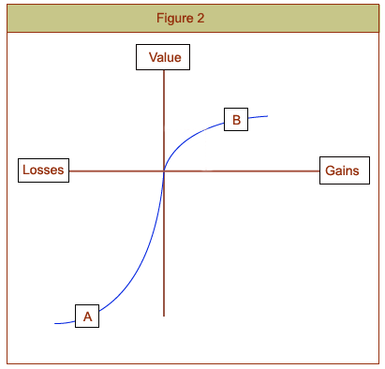
The Value Function

Slide 39
Prospect Theory (Kahneman and Tversky, 1979; 1992)
Prospects are evaluated according to a value function that exhibits
reference dependence (subjectively oriented around a zero point, defining gains and losses)
diminishing sensitivity to differences as one moves away from the reference point
loss aversion: steeper for losses than for gains
Probabilities are transformed by a weighting function that exhibits diminished sensitivity to probability differences as one moves from either certainty (1.0) or impossibility (0.0) toward the middle of the probability scale (0.5)
Refinement of reflection effect: risk aversion for medium-to-high probability gains and low probability losses; risk seeking for medium to high probability losses and low probability gains

Slide 40
Some everyday, observed consequences of prospect theory (Camerer, 2000)
Loss aversion:
Equity premium in stock market: stock returns too high relative to bond returns
Cab drivers quit around daily income target instead of “making hay while sun shines”
Most employees do not switch out of default health/benefit plans
People at quarter-based schools prefer quarters, at semester-based schools prefer semesters
Reflection effect:
Horse racing: favorites underbet, longshots overbet (overweight low probability loss); switch to longshots at end of the day
People hold losing stocks too long, sell winners too early
Customers buy overpriced “phone wire” insurance (overweight low probability loss)
Lottery ticket sales go up as top prize rises (overweight low probability win)

Slide 41
More serious consequences
Loss aversion makes individuals/societies unwilling to switch to healthier living (fear loss of income, unsustainable luxuries)
Risk seeking for likely losses can cause prolonged pursuit of doomed policies, e.g. wars that are not likely to be won, choosing court trial instead of bargaining
Risk seeking for unlikely gains can lead to excessive gambling in individuals, quixotic policies when leaders get too powerful

Slide 42
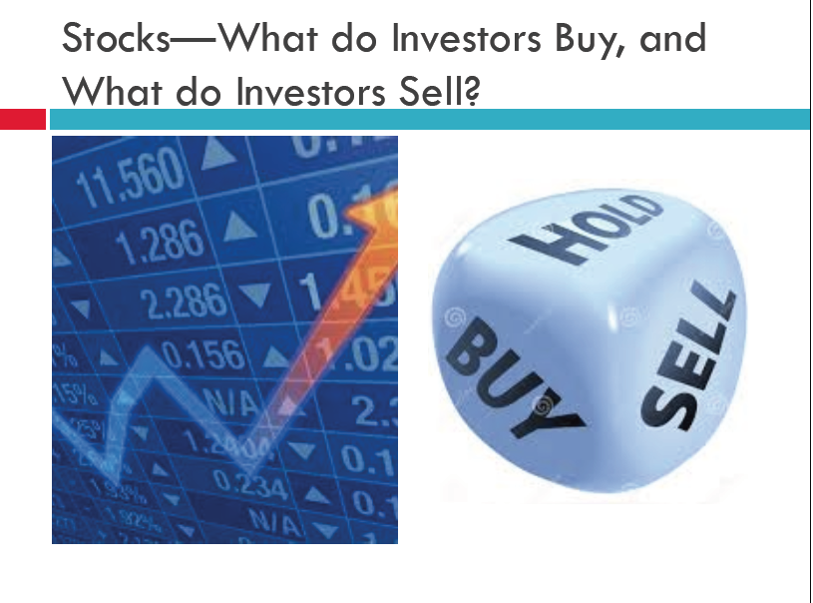

Slide 43
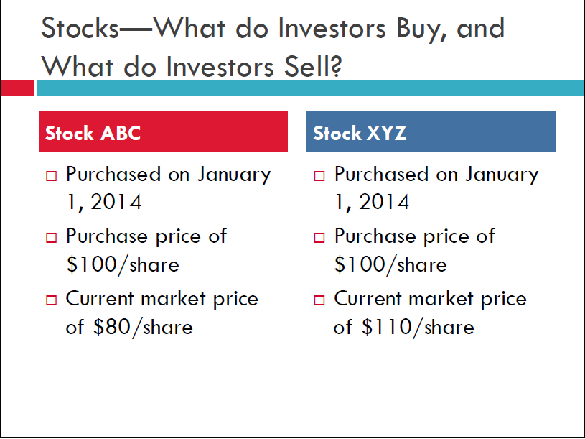

Slide 44
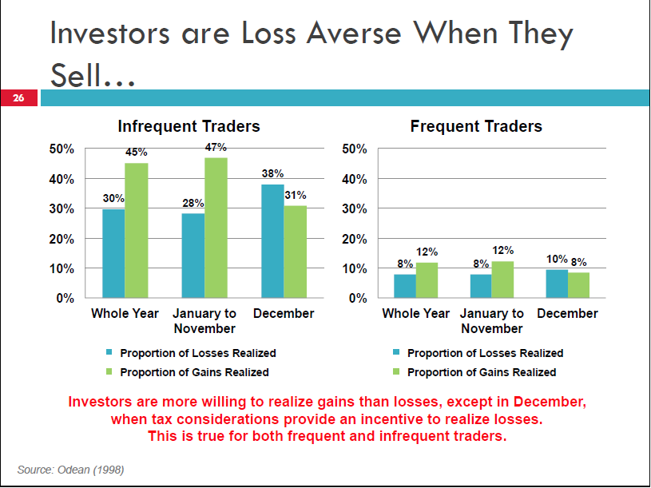

Slide 45
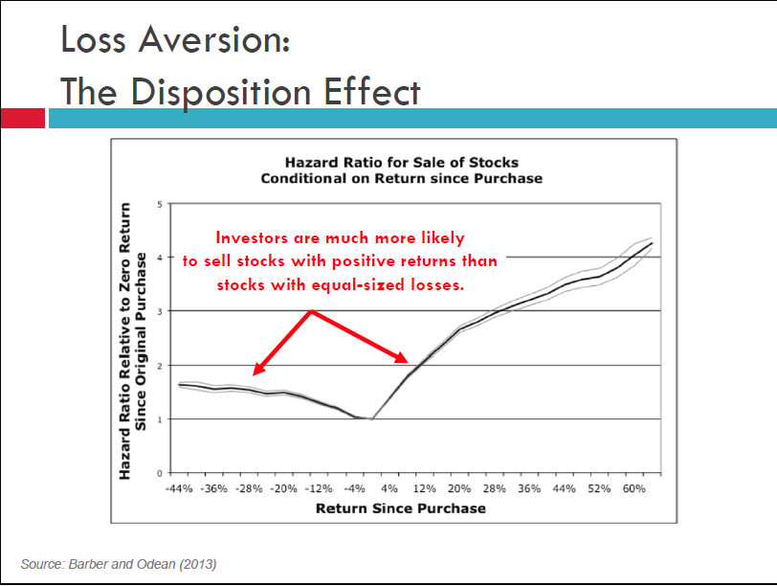

Slide 46
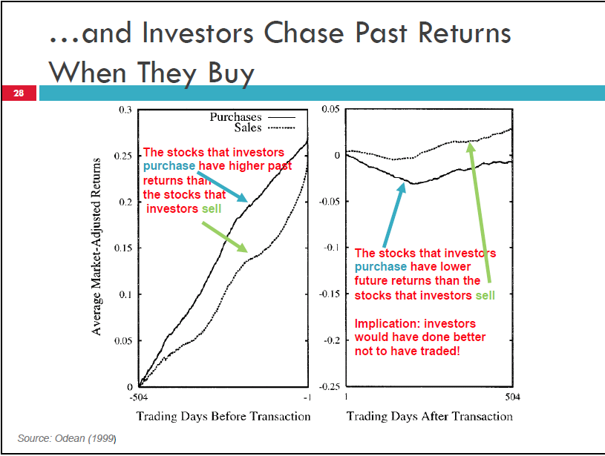

Slide 47
Implication
Best to have someone else who doesn’t care for you trade for you!
Best returns in US stock portfolios over 40 years seen for retirees
Who had forgotten their trading account passwords
Hedge fund and mutual fund managers lose money on average
Low hanging research fruit
Replicate this analysis for the Indian stock market

Slide 48
Okay, people are not generally rational and don’t have stable preferences, but aren’t they at least basically selfish?

Slide 49
Self-Interest Assumption in Game Theory
Choices in games should always reflect what is best for the decision maker, i.e. what will maximize the decision maker’s payoff

Slide 50
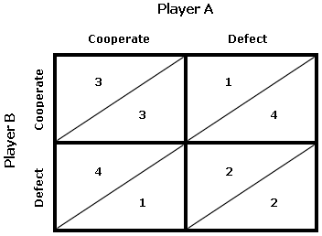
Prisoner’s Dilemma (Tucker, 1955)

Slide 51
Prisoner’s Dilemma Labeling Experiment (Ross and Samuels, 1993)
When PD is labeled the “Wall Street Game”, only 1/3 cooperate
When it is labeled the “Community Game”, 2/3 cooperate
Shows presence of both tendencies – defection and cooperation – which can be evoked by social signals

Slide 52
The Ultimatum Game (Guth et al., 1982)
$100 in one dollar bills available to be divided between two players
“Proposer” chooses a division
“Receiver” can either
accept: both receive proposed amounts
reject: both receive nothing
How much should the Proposer offer?

Slide 53
The Ultimatum Game (Guth et al., 1982)
$10 in one dollar bills available to be divided between two players
“Proposer” chooses a division
“Receiver” can either
accept: both receive proposed amounts
reject: both receive nothing
How much should the Proposer offer?

Slide 54
Ultimatum game experiment (Thaler, 1988)
Most proposers offer $5 (even split), or a little less, to the receiver
altruism
Low offers ($1) usually rejected
“altruistic punishment”

Slide 55
Dictator Game (Kahneman et al., 1986)
One P (student in class) asked to divide $20 between self and other P. Other P has no choice to accept/reject.
Two possibilities:
Even split ($10 each)
Uneven split ($18 for self, $2 for other)
Game theory predicts uneven split
76% chose an even split

Slide 56
Ultimatum and Dictator Games in Traditional Societies (Henrich et al., 2001)
Ps tested 15 small-scale societies
Ultimatum game:
Mean offer varied from 0.26 to 0.58 (0.44 in industrial societies)
Rejection rate also quite varied: low offers rarely rejected in some groups, in others high offers are often rejected
Great variation in behavior even among nearby groups; depends on deep aspects of culture, experience:
e.g. meat-sharing Ache (Paraguay) and village-minded Orma (Kenya) made generous offers, family-focused Machiguenga (Peru) showed low cooperation

Slide 57
Ultimatum and Dictator Games in Traditional Societies (Henrich et al., 2001)
Ps tested 15 small-scale societies
Ultimatum game:
Mean offer varied from 0.26 to 0.58 (0.44 in industrial societies)
Rejection rate also quite varied: low offers rarely rejected in some groups, in others high offers are often rejected
Great variation in behavior even among nearby groups; depends on deep aspects of culture, experience:
e.g. meat-sharing Ache (Paraguay) and village-minded Orma (Kenya) made generous offers, family-focused Machiguenga (Peru) showed low cooperation
General conclusion: there is no such thing as homo economicus; cooperation behavior is highly variable, heavily determined by cultural norms

Slide 58
Are people generally rational?
People evolved to cope with problems the brain has faced for most of humanity's existence (i.e. pre-civilizational) – for these problems, the brain could be considered well-adapted, but it can still be fooled
The modern world of commerce, technology, and politics presents challenges to which the brain is not well adapted
Behavior is not well described by formal theories of rationality: probability, decision and game theory

