Slide 1
Preference reversals and their consequences
Nisheeth
5th April 2018

Slide 2
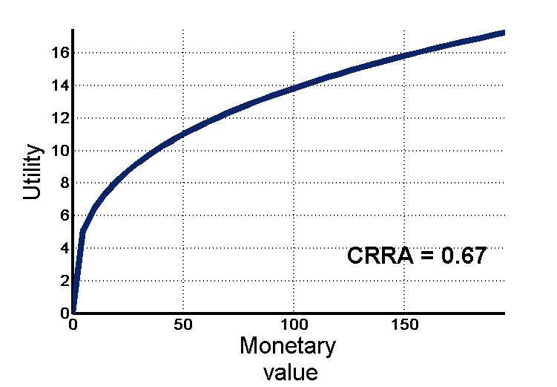
Replacing value by utility
Scientists realized that numbers in the world aren’t the same as numbers in the head
People generally prefer bigger numbers to smaller ones, but not in naive proportions
So we transform V(x) into U(V(x)) using clever math
Is all well now?

Slide 3
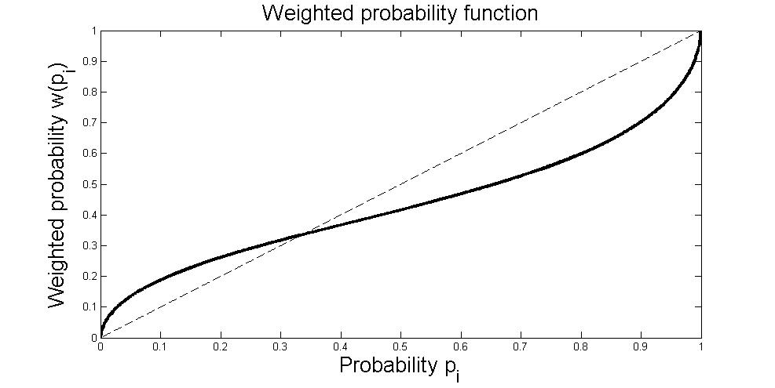
Probability judgments are also systematically biased
It turned out that people understood frequencies of events in the world in non-linear ways also
So we had to map P(x) to a subjective probability judgment W(P(x))
Now we do a generalized expected utility computation U(x)*W(x)
Neither U, nor W are observable

Slide 4
Prospect Theory (Kahneman and Tversky, 1979; 1992)
Prospects are evaluated according to a value function that exhibits
reference dependence (subjectively oriented around a zero point, defining gains and losses)
diminishing sensitivity to differences as one moves away from the reference point
loss aversion: steeper for losses than for gains
Probabilities are transformed by a weighting function that exhibits diminished sensitivity to probability differences as one moves from either certainty (1.0) or impossibility (0.0) toward the middle of the probability scale (0.5)
Refinement of reflection effect: risk aversion for medium-to-high probability gains and low probability losses; risk seeking for medium to high probability losses and low probability gains

Slide 5
A weekend’s story
Gamble! Gamble! Gamble!
Hit Rs 5000 jackpot with 0.0001% probability
Get nothing, out Rs 5 with 99.9999% probability
Where do we go to eat?
Blow Rs 900 on chicken sizzler overpriced with 90% probability
Sizzler actually is worth Rs 900 in retrospect with 10% probability
What do I order?
Kingfisher will taste as good as anything else with 95% probability
Kingfisher is much worse than anything else you could have ordered with 5% probability
Why is she doing this???
Girlfriend will elope with stranger who is chatting her up with 0.0001% probability
Girlfriend will never see stranger again with 99.9999% probability

Slide 6
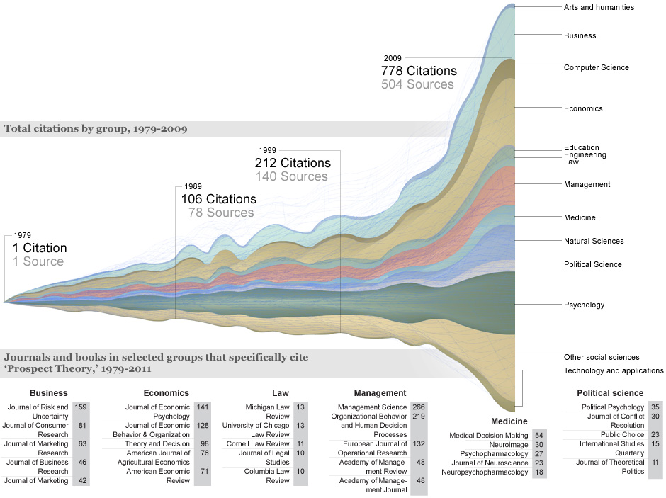
Has been very influential across fields

Slide 7
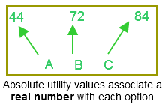
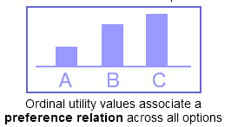
Prospect theory is a generalized utility theory
Most machine learning and artificial intelligence techniques
Assumes knowledge of value of an object independent of the value of other object
Where do the numbers come from?
Economists prefer this, because it lets value depend on the value of other options
More realistic, but still assumes there is a fixed vector of numbers that encodes preferences
Can’t generalize

Slide 8
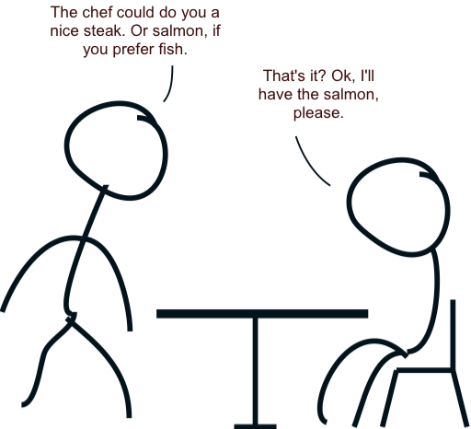
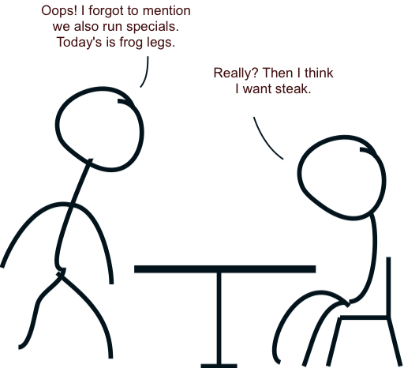
But there are problems even it can’t solve
(Luce and Raiffa, 1957)

Slide 9
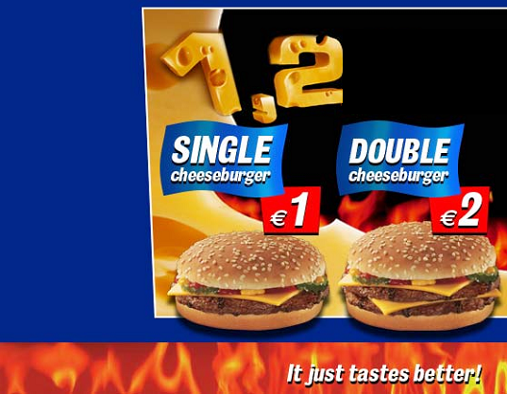
Deep PROBLEM: Cheeseburgers
50%
50%

Slide 10
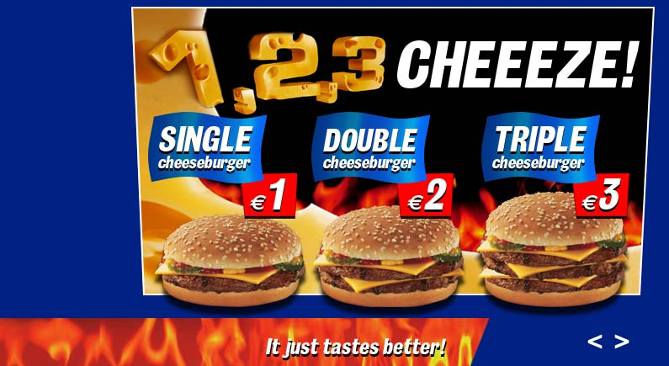
Deeper Problem: Cheeseburgers
30%
60%
10%

Slide 11
How does one choose?
People make choices
How?
No reason (irrationalism)
They pick what they prefer (rationalism)
Rational choice requires assuming an underlying preference relation (>)
Q T l
Q T l
v
v
Q
>
T
Q
>
l

Slide 12
The problem with context effects
A new choice was added to the subject’s choice set
That caused his original preference to change
How is that possible?
Preference relations forbid A>B if B>A
This is a fatal problem for the preference relation worldview
If preferences can be reversed by adding another option to the set of choices, then you can’t describe peoples’ choices with preference relations

Slide 13
Context effects
A new choice was added to the subject’s choice set
That caused his original preference to change
How is that possible?
Preference relations forbid A>B if B>A
This is fatal for the preference relation worldview
If preferences can be reversed by adding another option to the set of choices, then you can’t describe peoples’ choices with preference relations

Slide 14
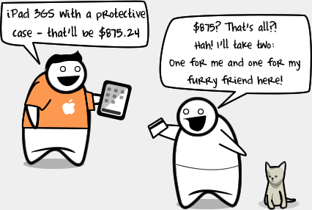
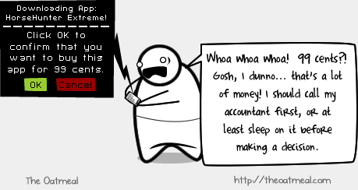
iStupid

Slide 15
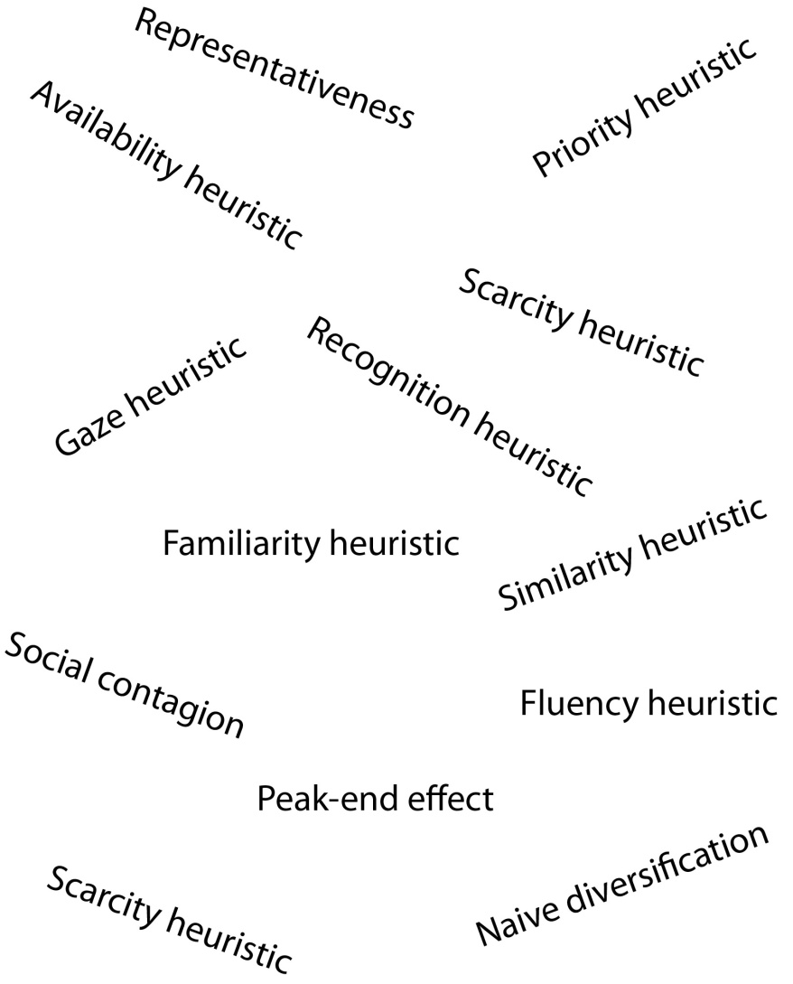
Biases and heuristics
People who still wanted to know how people decide what to do had to let go of the utility framework
Focus shifted to characterizing biases and heuristics
(Todd & Gigerenzer, 2004) is a great introduction to this line of research

Slide 16
PROBLEM: Pay for (no) Pain

Slide 17
40p
80p
People double their offers, when they have double the money...
Value of pain changes by x2 within minutes!

Slide 18
Can preferences really describe human choices?
(Luce and Raiffa, 1957)

Slide 19
Or choices in general?
The deep ‘cheeseburger problem’ also shows up in decision studies with several organisms

Slide 20

Or choices in general?
The deep ‘cheeseburger problem’ also shows up in decision studies with several organisms

Slide 21
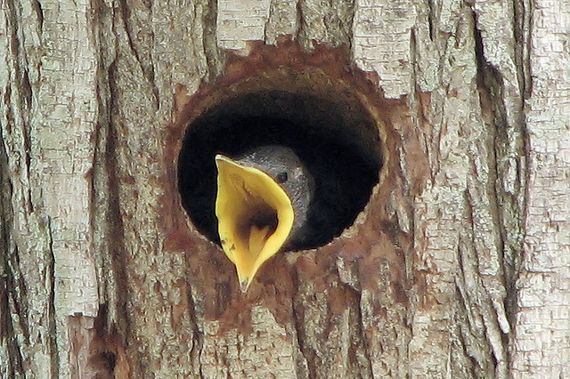
Or choices in general?
The deep ‘cheeseburger problem’ also shows up in decision studies with several organisms

Slide 22
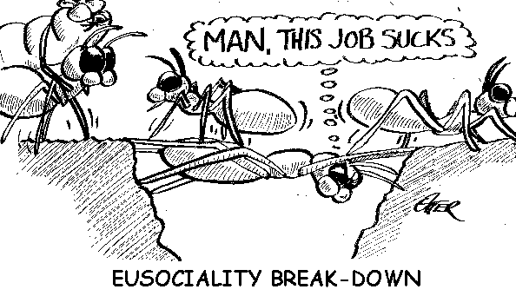
Or choices in general?
The deep ‘cheeseburger problem’ also shows up in decision studies with several organisms

Slide 23
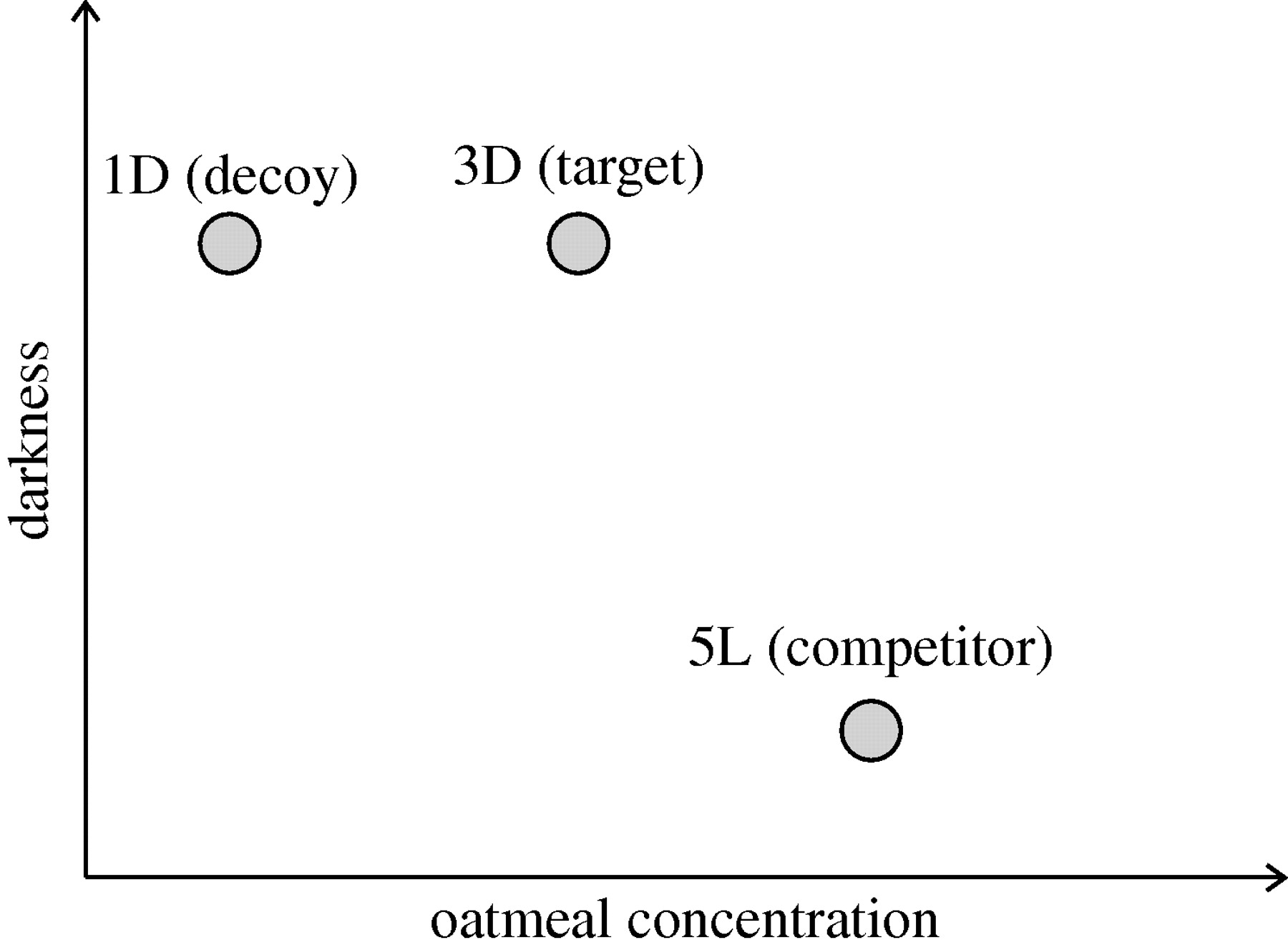

Testing for the asymmetrically dominated decoy effect.
Tanya Latty, and Madeleine Beekman Proc. R. Soc. B 2011;278:307-312
This Journal is © 2010 The Royal Society
Notes:
Testing for the asymmetrically dominated decoy effect. An option is said to be dominated if it is lower in one attribute than an alternative. A decoy is asymmetrically dominated if it is inferior to one option in all attributes, but is only inferior to the other option along one attribute. In our experiment, the decoy (1D) is dominated on both attributes by the target (3D), but is only dominated by the competitor along one attribute (oatmeal concentration).

Slide 24
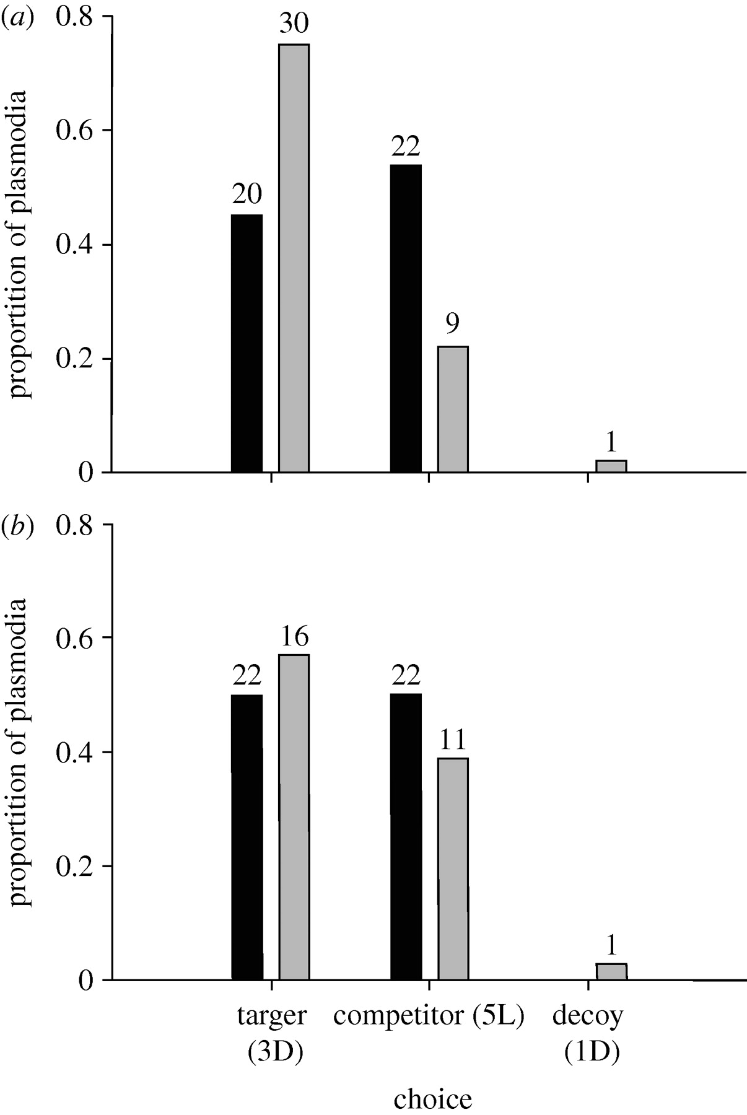
The proportion of plasmodia selecting the target, competitor or the decoy.
Tanya Latty, and Madeleine Beekman Proc. R. Soc. B 2011;278:307-312
This Journal is © 2010 The Royal Society
Notes:
The proportion of plasmodia selecting the target, competitor or the decoy. (a) Non-starved plasmodia. (b) Starved plasmodia. The numbers above the bars indicate the number of plasmodia in each group. (a,b) Grey bars, binary; black bars, ternary.

Slide 25
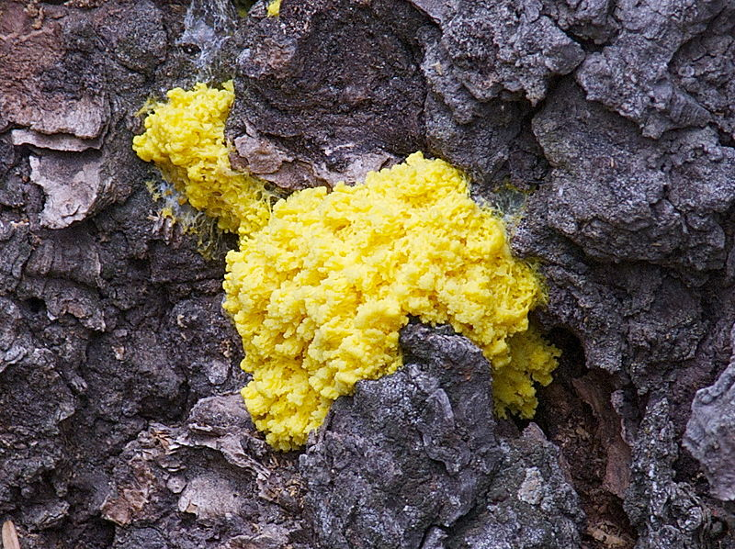
Context effects seen in slime mold
Unicellular, brainless organism
Can also solve TSP better than most algorithms

Slide 26
Solution: preference construction as a dynamic process
Sequential sampling is the most common category of choice process models
Noisy internal representations of evidence favoring each alternative accumulate
Whichever alternative reaches a critical internal threshold first is emitted as the correct choice

Slide 27
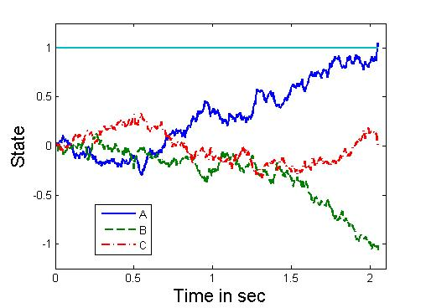
Basic intuition

Slide 28
Many examples
Drift diffusion (Ratcliff & McKoon, 2008)
Leaky competing accumulation (Usher & McClelland, 2001)
Decision field theory (Busemeyer, 1993)
Bayes-optimal preference construction (Srivastava & Schrater, 2015)

Slide 29


Decision field theory
Preference modeled as dynamically constructed
Preference for action i at time t
j is action index here
Valence at time t is
Utility computed in real-time as an attention-weighted version of economic utility
k is outcome index here
W varies as a stochastic process across all outcomes and items

Slide 30
DFT’s explanations
Similarity effect is explained by attention dissipation
Attraction effect is explained by lateral inhibition of option valence

