Slide 1
Sequential sampling models of the choice process
Nisheeth
7th April 2018

Slide 2


Decision field theory
Preference modeled as dynamically constructed
Preference for action i at time t
j is action index here
Valence at time t is
Utility computed in real-time as an attention-weighted version of economic utility
k is outcome index here
W varies as a stochastic process across all outcomes and items

Slide 3
DFT Example: College choice
w_{Fac} | w_{Rep} | w_{SAT} | w_{Act}
0.40 | 0.30 | 0.20 | 0.10
 | Ratio | Reputation | SAT score | Activities
Adams | 1.00 | 1.00 | .80 | .63
Buchanan | .80 | .78 | .90 | 1.00
Coolidge | .60 | .89 | 1.00 | .25
 | Ratio | Reputation | SAT score | Activities
Adams | .05 | 90 | 800 | 50
Buchanan | .04 | 70 | 900 | 80
Coolidge | .03 | 80 | 1000 | 20
.923
.834
.732
Attention shifting
Evaluation of relative values
Preference updating
Decision threshold

Slide 4
DFT: Illustration
P(t)
A
θ
B
A
B
t
C
C

Slide 5
Multialternative choice
Alternative space
Dimension interpretations
Binary choices
Additional alternatives
Choice pair relations
{X,Y} vs. {X,Y,Z}
Y
Z
X

Slide 6
Choice phenomena
Similarity
Pr (X|X,Y,S) <
Pr (Y|X,Y,S)
Attraction (decoy)
Pr (X|X,Y,D) >
Pr (Y|X,Y,D)
Compromise
Pr (C|X,Y,C) >
Pr (X|X,Y,C) =
Pr (Y|X,Y,C)
Y
C
S
D
X
Pr (X|X,Y) = Pr (Y|X,Y) = 0.5
= Pr (X|X,C) = Pr (Y|Y,C)

Slide 7
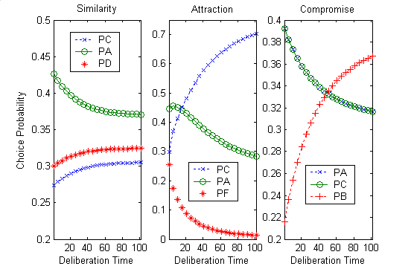
DFT: Account for phenomena
x
Pr (X)
Pr (Y)
Pr (S)
x
Pr (X)
Pr (Y)
Pr (D)
x
Pr (X)
Pr (Y)
Pr (C)
Y
+
+
+
C
S
D
X

Slide 8
Free parameters in DFT
Attention weights
Interaction matrix
Lots of flexibility
Low data observability

Slide 9
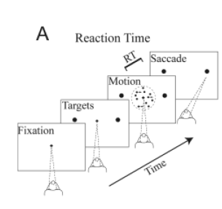
Perceptual decision-making increases observability
RT task paradigm of R&T.
Motion coherence and direction is varied from trial to trial.

Slide 10
A Classical Model of Decision Making: The Drift Diffusion Model of Choice Between Two Alternative Decisions
At each time step a small sample of noisy information is obtained; each sample adds to a cumulative relative evidence variable.
Mean of the noisy samples is +μ for one alternative, –μ for the other, with standard deviation σ.
When a bound is reached, the corresponding choice is made.
Alternatively, in ‘time controlled’ or ‘interrogation’ tasks, respond when signal is given, based on value of the relative evidence variable.

Slide 11
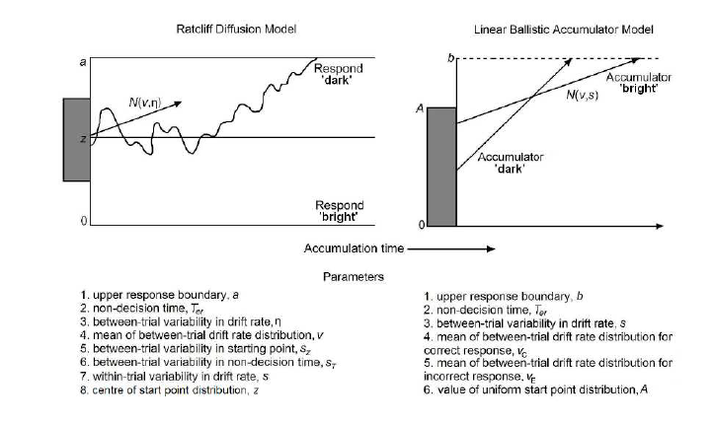
DDM and derivative models

Slide 12
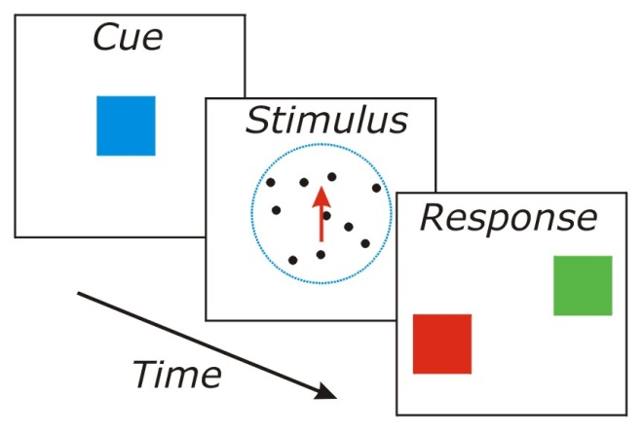
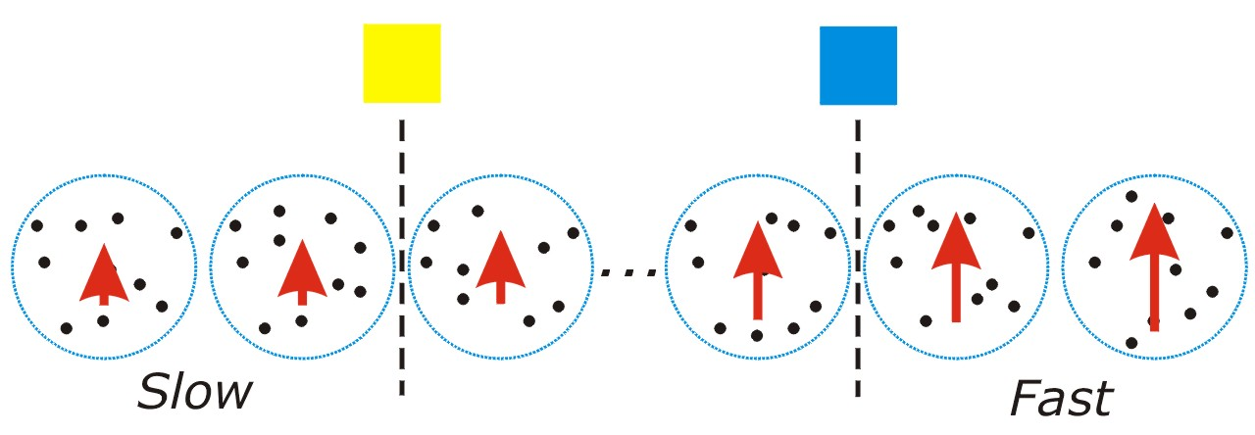
A DDM case study
Humans and monkeys performed a binary speed discrimination task
Criterion for fast and slow speed varied across trials to make both responses equiprobable

Slide 13
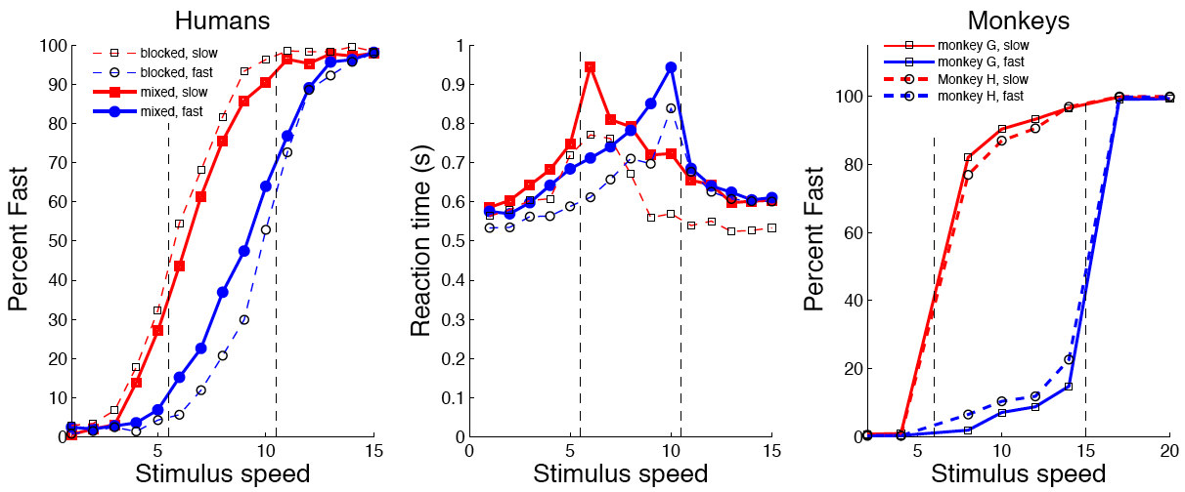
Basic psychophysical analysis
There is a bias by condition, but what is causing the bias?

Slide 14
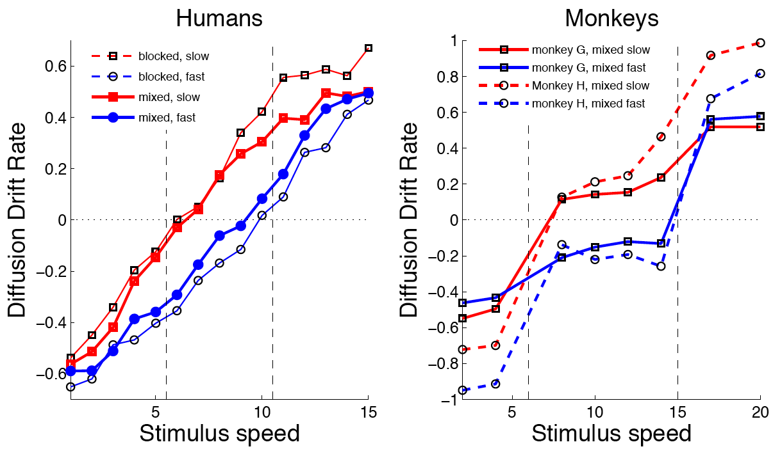
DDM fit: drift rate

Slide 15
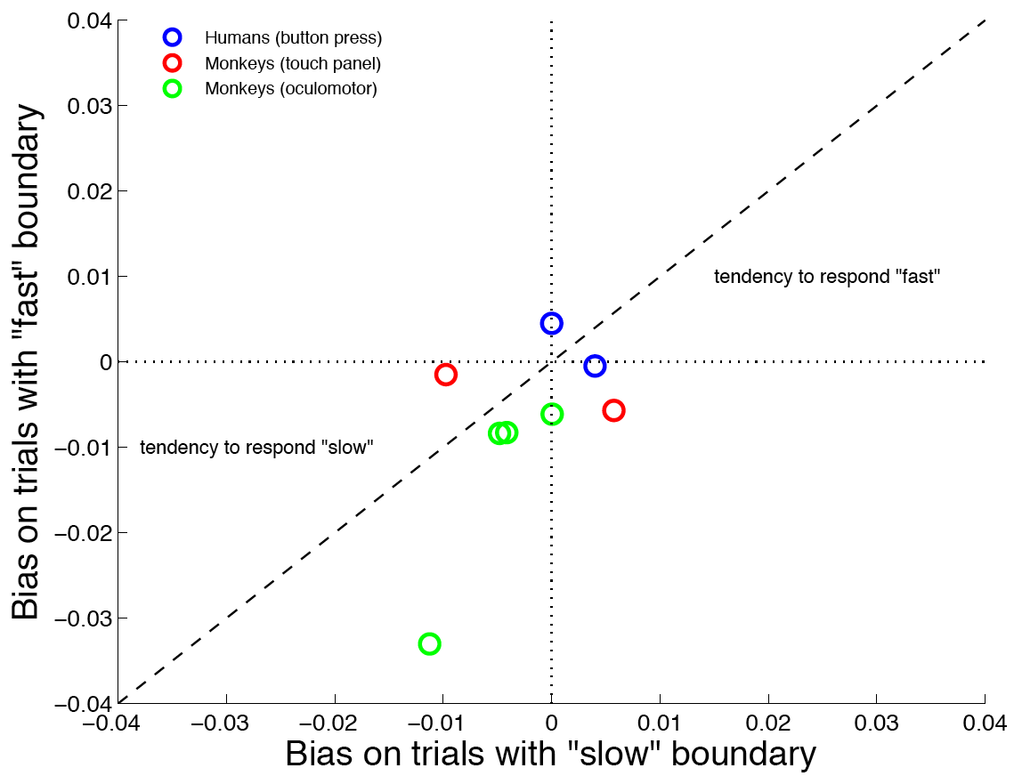
DDM fit: start point mean

Slide 16
Interpretation
Bias in the variable criterion speed judgment task is a function of sensory evidence encoding, not category-wise response bias
Perceptual categorization is based on a representation that encodes the relationship of the stimulus to the category boundary
(Ferrera, Grinband, Xiao, Hirsch & Ratcliff, 2006)
Highly recommend Ratcliff’s 2016 Trends in Cognitive Science review paper for more examples

Slide 17
Fitting DDM to data
Hard to fit all parameters given just accuracy and RT data
Very hard, in general
Alternative: fit an EZ-version of the DDM (Wagenmakers et al, 2007)
Fit three parameters
Drift rate
Boundary separation
Non-decision time
Given three summary statistics
Probability correct
Mean RT
Variance of RT

Slide 18
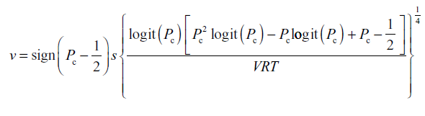


EZ-DDM
Calculate drift rate
Calculate separation
Calculate non-decision time

Slide 19
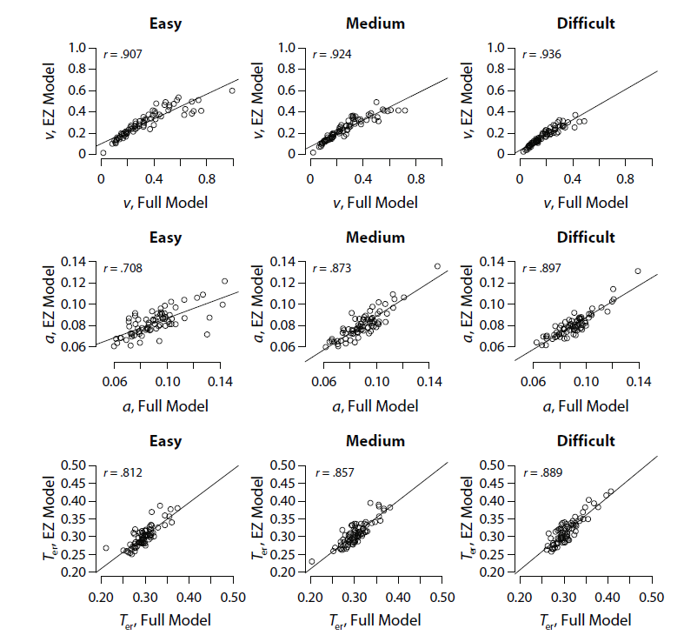
Close approximation of full model

Slide 20
The DDM is an optimal model, and it is consistent with neurophysiology
It achieves the fastest possible decision on average for a given level of accuracy
It can be tuned to optimize performance under different kinds of task conditions
Different prior probabilities
Different costs and payoffs
Variation in the time between trials…
The activity of neurons in a brain area associated with decision making seems to reflect the DD process

Slide 21
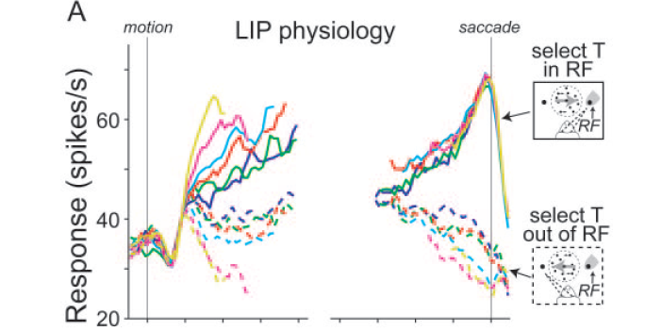
Neural Basis of Decision Making in Monkeys: Results
Data are averaged over many different neurons that are associated with intended eye movements to the location of target.

Slide 22
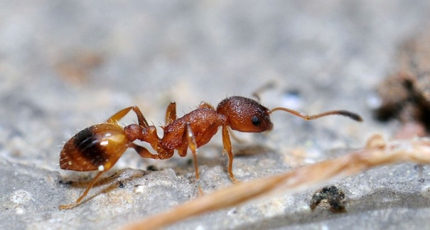
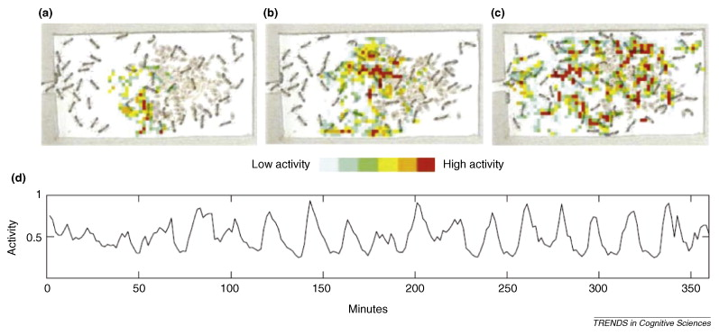
Other biological bases of the DDM
Temnothorax albipennis lives in shallow cracks in rocks, and so the ant colony has to move to new sites very frequently
These ants walk around very much like individually spiking neurons (Couzin, 2009)

Slide 23
Other biological bases of DDM
Multiple ants scout different sites as a possible future home
A scout that identifies a particular site as suitable comes back home and takes a follower back to the site
If the follower also finds the site suitable, they both come back to take away more followers
Once a quorum is reached, the ants run back and carry other ants to the site
Carrying is three times faster than leading a follower back
Under conditions of urgency
More ants go out scouting (drift rate)
Quorum size is reduced (threshold)

Slide 24
A Problem with the DDM
Accuracy should gradually improve toward ceiling levels as more time is allowed, even for very hard discriminations, but this is not what is observed in human data.
Two possible fixes:
Trial-to-trial variance in the direction of drift
Evidence accumulation may reach a bound and stop, even if more time is available
Easy
Prob. Correct
Hard

Slide 25
Usher and McClelland (2001) Leaky Competing Accumulator Model
Addresses the process of deciding between two alternatives based on external input, with leakage, mutual inhibition, and noise:
dy₁/dt = I₁-γy₁–βf(y₂)+ξ₁
dy₂/dt = I₂-γy₂–βf(y₁)+ξ₂
f(y) = [y]⁺
Participant chooses the most active accumulator when the go cue occurs
This is equivalent to choosing response 1 iff y₁-y₂ > 0
Let y = (y₁-y₂). While y₁ and y₂ are positive, the model reduces to: dy/dt = I-λy+ξ [I=I₁-I₂; λ = γ-β; ξ=ξ₁-ξ₂]
y₁
y₂
Ι₁
Ι₂

Slide 26
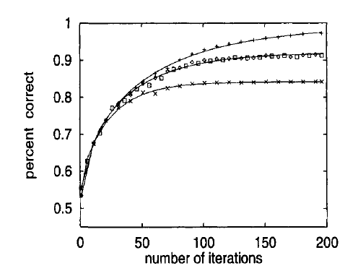
Time-accuracy curves for different |k-β| or |λ|
|k-β| = 0
|k-β| = .2
|k-β| = .4

Slide 27
Prob. Correct

Slide 28
Kiani, Hanks and Shadlen 2008
Random motion stimuli of different coherences.
Stimulus duration follows an exponential distribution.
‘go’ cue can occur at stimulus offset; response must occur within 500 msec to earn reward.

Slide 29
The earlier the pulse, the more it matters (Kiani et al, 2008)

Slide 30
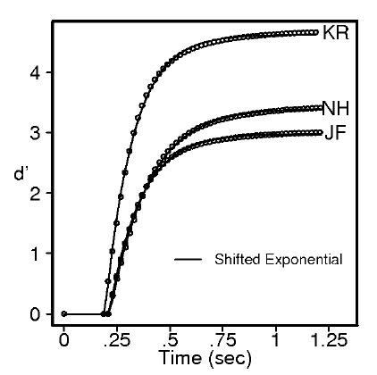
Why Model Decisions?
Evidence Accumulation
Model (EAM)
Speed-Accuracy Tradeoff
MANIFEST = Response & Distribution of Response Times (RT)
LATENT = e.g.,
quality of evidence,
rate evidence arrives,
caution (evidence threshold),
non-decision time,
…
EAM

Slide 31
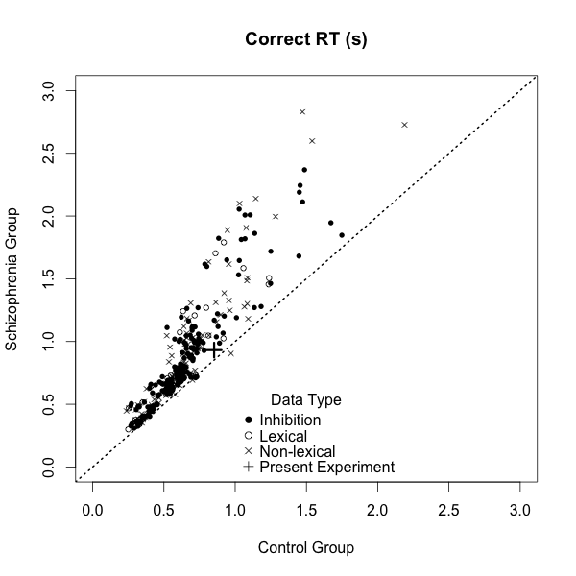
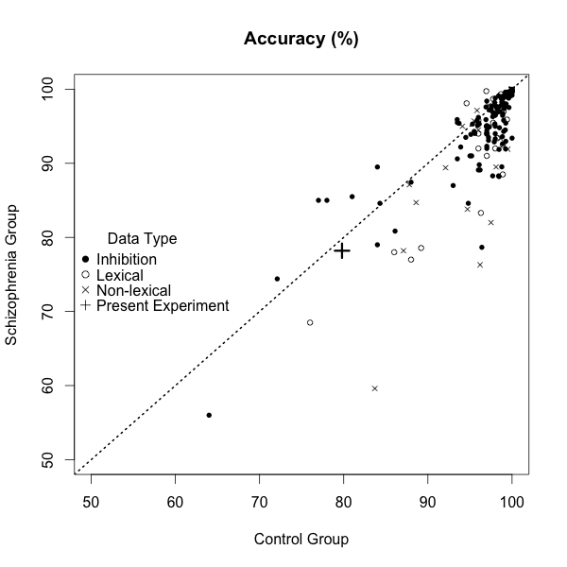
Why does it matter?
What causes slowing in people with Schizophrenia?
Slowing pervasive in Sz
Errors less studied/more equivocal
We found a tradeoff with rate effects masked by greater caution.
Heathcote, A., Suraev, A., Curley, S., Love, J. & Michie, P. (invited resubmission). Decision processes and the slowing of simple choices in schizophrenia, Journal of Abnormal Psychology
Does aging slow your clock?
Diffusion-model analysis (many papers by Ratcliff and co):
slowed fingers (non-decision time),
more cautious (higher threshold),
the rate & quality of evidence preserved (except for fine perceptual discriminations).
Speculation: might pre-dementia have a different signature?

Slide 32
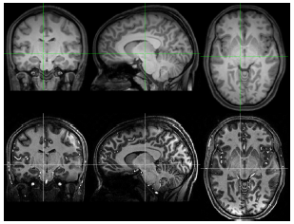
Caution or Inflexibility?
Sub-thalamic nuclus (STN) controls caution: BOLD correlates with LBA.
Forstmann, B. U., Dutilh, G., Brown, S., Neumann, J., Cramon, Von, D. Y., Ridderinkhof, K. R., & Wagenmakers, E.-J. (2008). Striatum and pre-SMA facilitate decision-making under time pressure. PNAS, 105(45), 17538–17542.
Ability to change threshold depends on tract strength from pre-SMA.
Forstmann, B. U., Anwander, A., Schäfer, A., Neumann, J., Brown, S., et al. (2010). Cortico-striatal connections predict control over speed and accuracy in perceptual decision making. PNAS, 107(36), 15916–15920.
Tract strength weakened by age (less able to be “fast-but-careless”)
Forstmann, B. U., Tittgemeyer, M., Wagenmakers, E. J., Derrfuss, J., Imperati, D., & Brown, S. (2011). The Speed-Accuracy Tradeoff in the Elderly Brain. Journal of Neuroscience, 31(47), 17242–17249.
Joining the party: STN BOLD - DDM threshold correlated in task-switching.
Mansfield, E. L., Karayanidis, F., Jamadar, S., Heathcote, A., & Forstmann, B. U. (2011). Adjustments of Response Threshold during Task Switching. Journal of Neuroscience, 31(41), 14688–14692.

Slide 33
Task Switching
<5 or ODD = left >5 or even = right
1
3
7
2
6
4
9
8
First application of EAM to task-switching: caution, rate and delay effects
Karayanidis, F., Mansfield, E. L., Galloway, K. L., Smith, J. L., Provost, A., & Heathcote, A.
(2009). Anticipatory reconfiguration elicited by fully and partially informative cues that validly
predict a switch in task. Cognitive, Affective, & Behavioral Neuroscience, 9(2), 202–215.
Reduced switch costs in the aged (slower repeats as inflexible thresholds)
Karayanidis, F., Whitson, L. R., Heathcote, A., & Michie, P. T. (2011). Variability in proactive and
reactive cognitive control processes across the adult lifespan. Frontiers in Psychology, 2 (318).

Slide 34
Cognitive Control
Task Switching
Parallel Model

Slide 35
Summary
Choice process models shift emphasis away from static representations of preference
Prominent models reviewed
Some interpretations of these models are of independent research and translational interest
Discussed how to fit an EZ-DDM

