Slide 1
Choice rules
Nisheeth
April 10th 2018

Slide 2
A random utility model of binary choice
Underlying Preference Scale, U*(choices)
Revelation of Preferences:
U*(choices) < 0 Choice “0”
U*(choices) > 0 Choice “1”

Slide 3
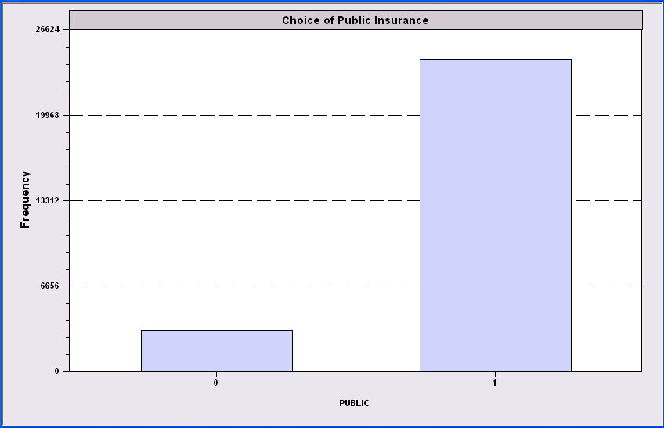
Simple Binary Choice: Insurance

Slide 4
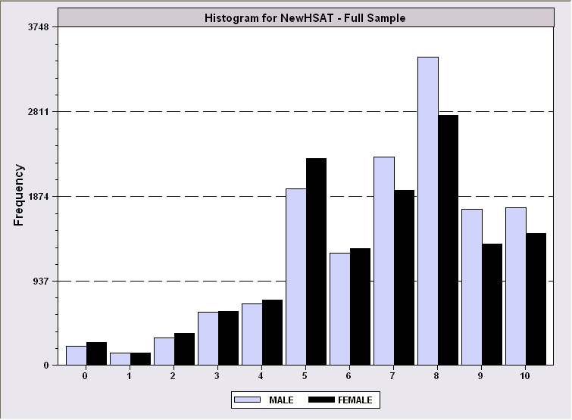
Censored Health Satisfaction Scale
0 = Not Healthy
1 = Healthy

Slide 5
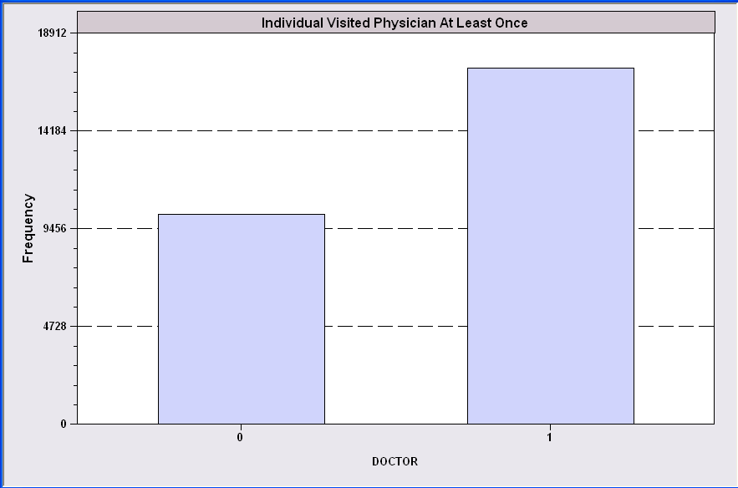
Count Transformed to Indicator

Slide 6
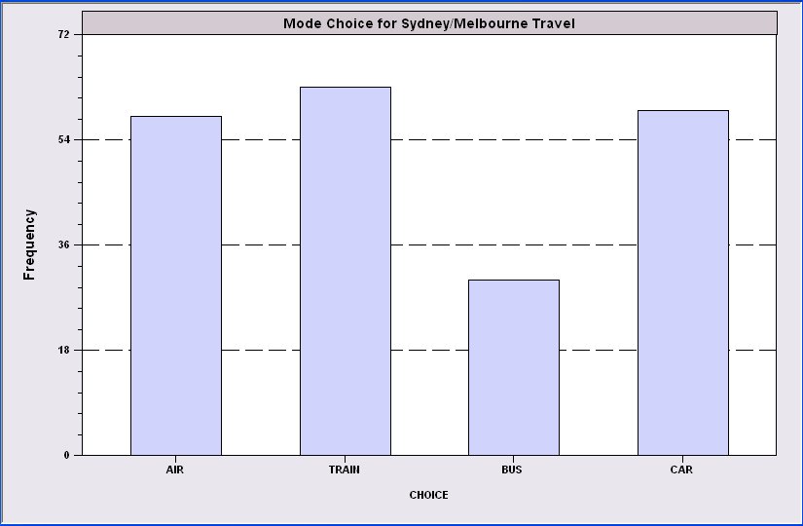
Redefined Multinomial Choice
Fly
Ground

Slide 7
Random utility models of choice
Let U_{n} be the utility of doing something for person n
Utility has both a deterministic and a random component
Treat the stochastic component as a logistic distribution
Learn parameters via logistic regression

Slide 8

Choice rule
Relates data to choice in a principled way
For the binary RUM with a logistic error term this is
This is particularized for the model
Assumes the choice has no attributes of its own
Only persons’ attributes are known
Example?

Slide 9
A Model for Binary Choice
Yes or No decision (Buy/NotBuy, Do/NotDo)
Example, choose to visit physician or not
Model: Net utility of visit at least once
U_{visit} = α+β₁Age + β₂Income + γSex + ε
Choose to visit if net utility is positive
Net utility = U_{visit} – U_{not visit}
Data: X = [1,age,income,sex]
y = 1 if choose visit, ⬄ U_{visit} > 0, 0 if not.
Random Utility

Slide 10
Choosing Between the Two Alternatives
Modeling the Binary Choice
U_{visit} = α + β₁ Age + β₂ Income + β₃ Sex + ε
Chooses to visit: U_{visit} > 0
α + β₁ Age + β₂ Income + β₃ Sex + ε > 0
ε > -[α + β₁ Age + β₂ Income + β₃ Sex ]

Slide 11
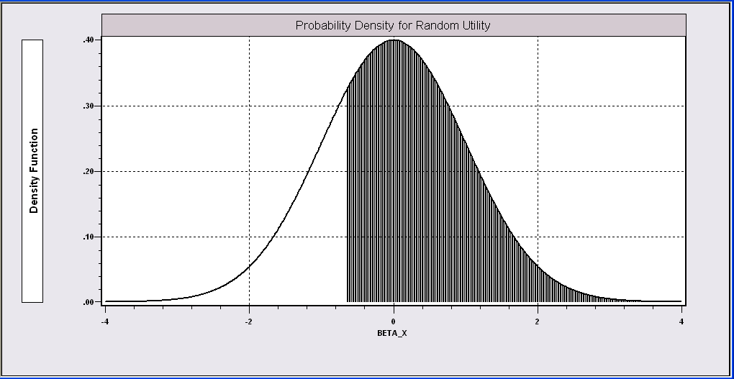
Probability Model for Choice Between Two Alternatives
Probability is governed by ε, the random part of the utility function.
ε > -[α + β₁Age + β₂Income + β₃Sex ]

Slide 12
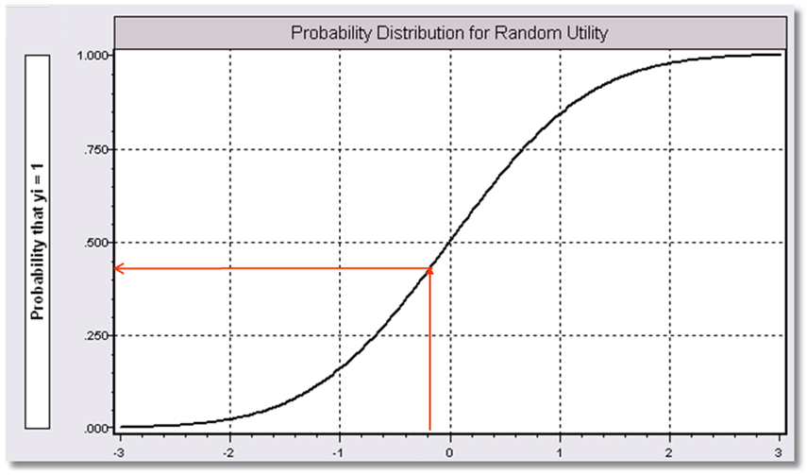
α+β₁Age + β₂ Income + β3 Sex

Slide 13
What Can Be Learned from the Data? (A Sample of Consumers, i = 1,…,N)
Are the characteristics “relevant?”
Predicting behavior
Individual – E.g., will a person visit the physician? Will a person purchase the insurance?
Aggregate – E.g., what proportion of the population will visit the physician? Buy the insurance?
Analyze changes in behavior when attributes change – E.g., how will changes in education change the proportion who buy the insurance?

Slide 14
Application: Health Care Usage
German Health Care Usage Data (GSOEP), 7,293 Individuals, Varying Numbers of Periods Data downloaded from Journal of Applied Econometrics Archive. This is an unbalanced panel with 7,293 individuals. They can be used for regression, count models, binary choice, ordered choice, and bivariate binary choice. This is a large data set. There are altogether 27,326 observations. The number of observations ranges from 1 to 7. (Frequencies are: 1=1525, 2=2158, 3=825, 4=926, 5=1051, 6=1000, 7=987). Variables in the file are
DOCTOR = 1(Number of doctor visits > 0) HOSPITAL = 1(Number of hospital visits > 0)
HSAT = health satisfaction, coded 0 (low) - 10 (high)
DOCVIS = number of doctor visits in last three months HOSPVIS = number of hospital visits in last calendar year PUBLIC = insured in public health insurance = 1; otherwise = 0 ADDON = insured by add-on insurance = 1; otherwise = 0
HHNINC = household nominal monthly net income in German marks / 10000.
(4 observations with income=0 were dropped) HHKIDS = children under age 16 in the household = 1; otherwise = 0 EDUC = years of schooling
AGE = age in years
FEMALE = 1 for female headed household, 0 for male
Notes:
14

Slide 15
Application
27,326 Observations
1 to 7 years, panel
7,293 households observed
We use the 1994 year, 3,337 household observations
Descriptive Statistics
=========================================================
Variable Mean Std.Dev. Minimum Maximum
--------+------------------------------------------------
DOCTOR| .657980 .474456 .000000 1.00000
AGE| 42.6266 11.5860 25.0000 64.0000
HHNINC| .444764 .216586 .340000E-01 3.00000
FEMALE| .463429 .498735 .000000 1.00000

Slide 16
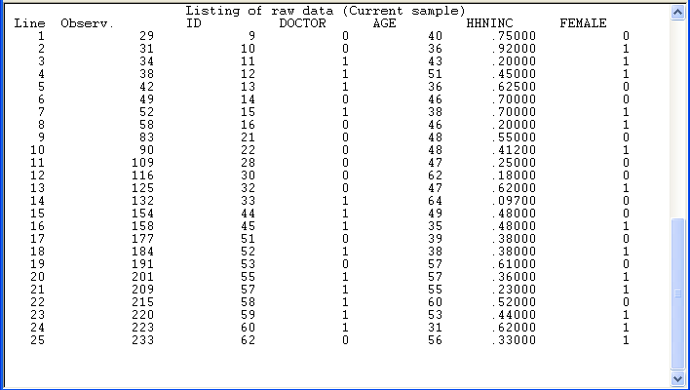
Binary Choice Data

Slide 17
An Econometric Model
Choose to visit iff Uvisit > 0
Uvisit = β₀ + β₁ Age + β₂ Income + β₃ Sex + ε
Uvisit > 0 ⇔ ε > -(β₀ + β₁ Age + β₂ Income + β₃ Sex) ε < β₀ + β₁ Age + β₂ Income + β₃ Sex
Probability model: For any person observed by the analyst,
Prob(visit) = Prob[ε < β₀ + β₁ Age + β₂ Income + β₃ Sex]
Fitting is straightforward in statistical computing packages
In MATLAB, the function regress will do it for you
In python, import statsmodels.api and use fit()
https://towardsdatascience.com/building-a-logistic-regression-in-python-step-by-step-becd4d56c9c8

Slide 18
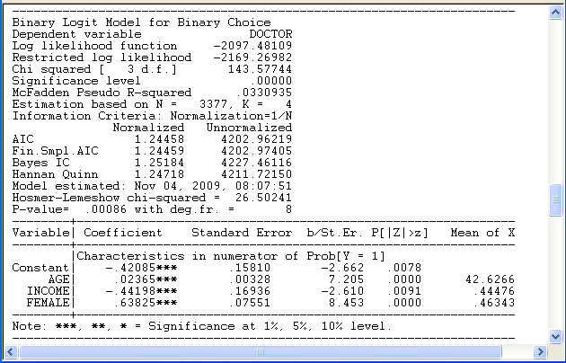
Logit model output
What do these mean?

Slide 19
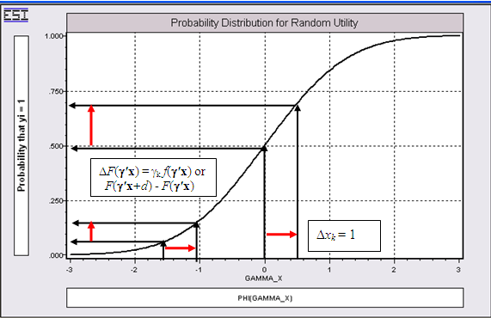
Effect on Predicted Probability of an Increase in Age
α + β₁ (Age+1) + β₂ (Income) + β₃ Sex
(β₁ is positive)

Slide 20

Extension to other choice settings
No person attributes, only choice attributes
Choice rule
Example
Choice between two brands of toothpaste

Slide 21


Multiple attribute settings
Several attributes, both personal and choice-related
Choice rule

Slide 22

Multinomial choice settings
Multinomial logit models
Very popular in economic analyses
Choice rule

Slide 23
Further extensions
Probit function can replace logit in all these applications with no consequential difference
Mixed logit models allow random variation in personal characteristics
Exploded logit models can emit probabilities of rankings
Ordered logit models can emit probabilities of ratings
https://en.wikipedia.org/wiki/Discrete_choice

Slide 24
Cognitive connection
Assume an implicit utility maximization criterion for subjects
Assume the existence of static preference traits
Yield population level fits for large sample data
Valuable for large sample preference analyses
Conclusions for individuals restricted by limitations of EUM framework as guide to peoples’ behavior

