Slide 1
The faculty of language
Nisheeth
April 13th 2018

Slide 2
Faculty of language
Mapping between sound and meaning
In a broad sense
A sensory-motor apparatus
A conceptual-intentional controller
A computational interface between them
Permits production (‘colorless green ideas sleep furiously’)
Permits displacement (‘I don’t think he has changed his mind since I saw him last year’)
In a narrow sense
Just the computational interface

Slide 3
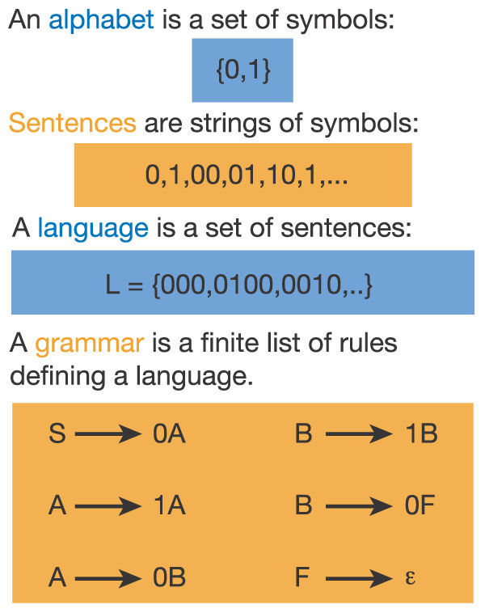
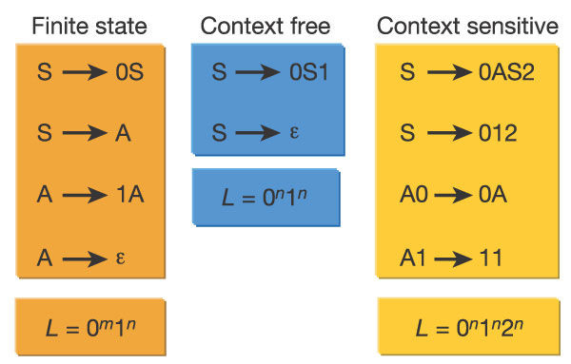
The computational problem
Natural language has expressivity greater than CSG

Slide 4
The computational problem
Poverty of stimulus
No negative examples
Degenerate input
Does not describe full scope of what is possible within grammatical rules
What do you think, when he came to your room yesterday, he was doing?
What did you make, when he came to your room yesterday, he was doing?
Inputs frequently contain errors
Large differences in frequency

Slide 5
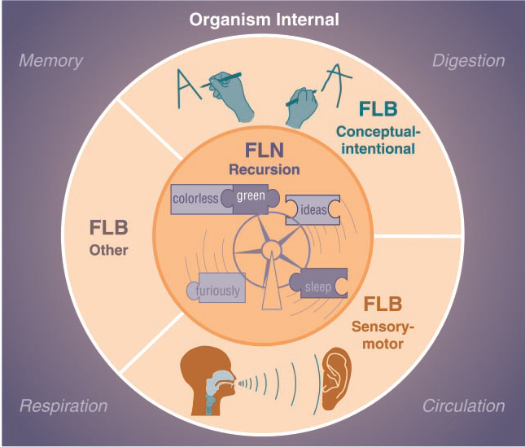
(Hauser, Chomsky & Fitch, 2002)

Slide 6
Prominent hypotheses
Category 1 – FLB is homologous to animal communication. Aspects of FLB exist in nonhuman animals
Category 2 – FLB is a uniquely human adaptation.
Category 3 – FLN is a uniquely human adaptation, FLB aspects are present in both humans and nonhumans
Chomsky’s Universal Grammar hypothesis

Slide 7
What constitutes FLN?
Basic elements
Productivity
Displacement
Both possible via recursion
Claim: all human languages contain recursion
Claim: animal languages don’t contain recursion

Slide 8
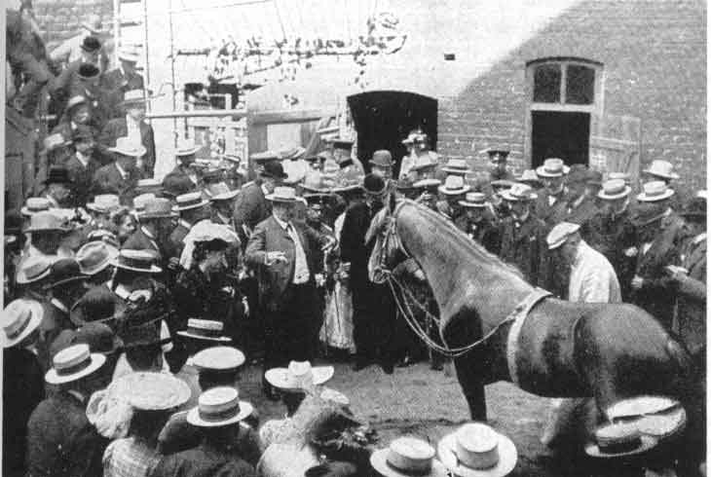
Animal language research
Animals can be trained to respond to complex questions
Experimental settings very susceptible to the Clever Hans effect
Are they genuinely learning language, or stimulus-response mappings adequate for a simple hypothesis space? (Terrace, 1973)

Slide 9
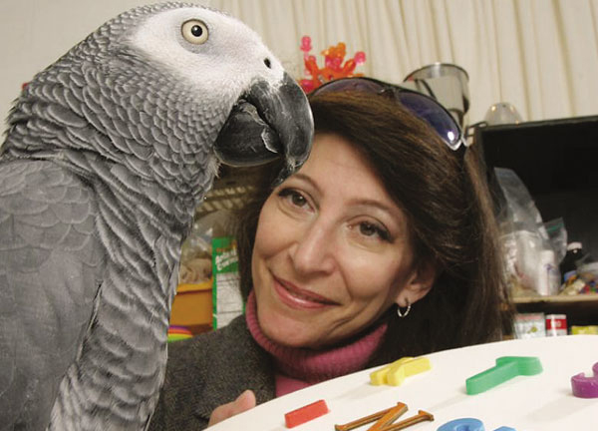
Alex the parrot
Irene Pepperberg developed a new way of teaching parrots language
Model/rival method
Over 30 years, Alex learned to distinguish
7 colors
5 shapes
Bigger/smaller, same/different
Also learned to ask questions, answer questions with clarifications and combine words to describe a new object
https://www.youtube.com/watch?v=ldYkFdu5FJk
For a similar project with bonobos, watch Sue Savage-Rumbaugh’s TED talk

Slide 10
Animal language
We talked about the nature of representations
We agreed that you can’t really have complex memories without verbal representations
Animals, spectacularly elephants, have long memories
Cornell’s elephant listening project has been putting together a vocabulary of elephant vocalizations for the past 20 years
Vocalizations vary across elephant families, newborns pick up variants specific to their own mothers and allomothers
Orca hunt in packs with very sophisticated hunting strategies, coordinated with calls
Many other observations, but hard to separate truth from sentiment

Slide 11
Animal language summary
Except for interesting outliers that have been extensively trained
Recursion doesn’t yet show up in animal language
Other components of language, i.e. intent communication, sensory-motor coordination do show up in animal language
Category 3 seems to be the most promising direction of research at this point

Slide 12
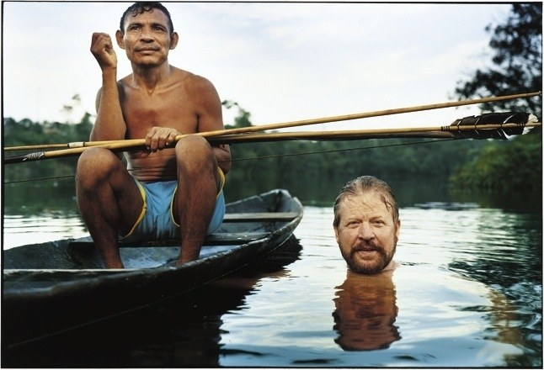
Counterpoint: the piraha
Piraha have among the simplest languages in the world
Between 10-12 phonemes
No number words
No color words
No way of talking about the past
No recursion!!?
https://www.newyorker.com/magazine/2007/04/16/the-interpreter-2

Slide 13

Linguistic relativity gold mine
Piraha have no way of talking about things that are not seen
No notion of coercion
No political organization
Very active area of research
Some claims likely overblown

