Slide 1
Poverty of stimulus: argument & explanations
Nisheeth
17th April 2018

Slide 2
Learning theory
Studies formal limits of abstract learnability under assumptions
Assumptions define the learning process and input data representations
Learning theory results tell us what types of data-symbol maps observers can and can’t learn

Slide 3
Purpose of language learning
Weak view – learning the string set of the language
Strong view – learning the grammar that allows generation of all possible strings of the language
Difference – generative capacity

Slide 4
The Gold paradigm
Language consists of a set of strings
Learner is presented with a sequence of strings s₁, s₂, …
Every string in the language appears at least once in the sequence
At every step in the sequence, the learner reappraises his hypothesis about the language

Slide 5
Identification in the Limit
For language L and input sequence s₁, s₂, …, the learner identifies in the limit the language L if there is some N such that for all n>N, G_{n} = G_{N}, and G_{N} is a correct representation of L
A class of languages L is identified in the limit if all L in L are identified

Slide 6
Input variations
Positive examples only
Both positive and negative examples

Slide 7
Finite languages are identifiable from only positive evidence
Proof: construct hypotheses as union of all strings presented up to a point
Once all strings have occurred at least once, the hypothesis will be correct
Won’t change thereafter
What about the class of all finite languages?
Homework for you

Slide 8
Finite classes of languages are learnable from positive evidence
Finite classes contain a finite number of languages
The class could contain infinite languages
Infinite languages have an infinite number of strings
Proof
Let the learning sequence be presented such that if L_{i} is a subset of L_{j}, then L_{i} is presented before L_{j}
Hypothesis generation is eliminative
Learner starts with all possible languages
Iteratively removes languages inconsistent with observed sequence
Eventually, all languages except the correct one (and its supersets) are removed
The learner ends up retaining the most compact representation of the language because of the input ordering

Slide 9
Supra-finite languages
A supra-finite class of languages contains all finite languages and at least one infinite language
This class is not identifiable from positive evidence only
Suppose L_{inf} is the infinite language in this class
Can construct a presentation sequence such that the learner can’t learn this language

Slide 10
The Gold sequence
Start with a string s₁ that in itself represents one of the languages L₁ in L
Stick with this presentation until the learner starts predicting L₁
Then switch to sequences that predict a different language L₂ consisting of {s₁,s₂ }
And so on
Algorithm will only ever predict L_{i}, never L_{inf}

Slide 11
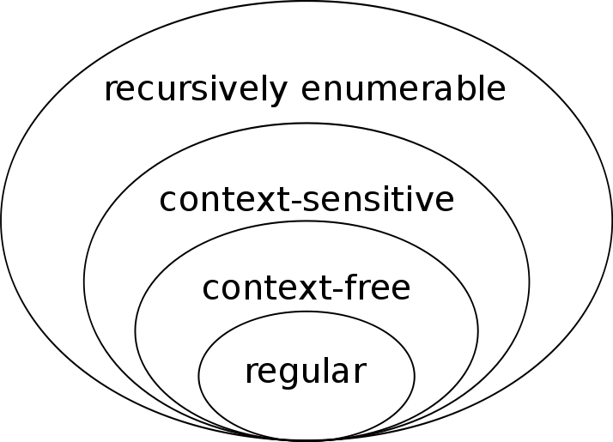
Recursive languages
A recursive language has a recursive function that enumerates its string set
All languages with formal grammars are recursive
Live at the top of the Chomsky hierarchy
By J. Finkelstein - Own work, CC BY-SA 3.0, https://commons.wikimedia.org/w/index.php?curid=9405226

Slide 12
Formal grammars
What are formal grammars?
Grammars recursively define string sets of the corresponding languages
Specified using non-terminal symbols (capital letters), terminal symbols (small letters) and a start symbol (S)
Production rules are applied recursively until no non-terminal symbols remain
For example
S → aSb
S → ba
Yields infinite language {a^{n}bab^{n} | n>=0}

Slide 13
Chomsky hierarchy
A hierarchy of grammars influential in both computer science and linguistics
Defined by restrictions on production rules
Grammar | Production rule
Unrestricted | No restrictions
Context-sensitive | Production rules sandwiched by contextual symbols
Context-free | LHS can have only single non-terminals
Regular | LHS single non-terminal, RHS single terminal possibly followed by a non-terminal
Programming languages are mostly context-free, natural languages are weakly context-sensitive

Slide 14
Gold’s recursive language result
Recursive languages are identifiable in the limit if the learner has access to both positive and negative evidence for each string in the sequence
Proof sketch
Sequence now presented with membership labels
Learning algorithm maintains list of all possible representations of language L
Returns first representation compatible with data
At some point, one of the data samples will rule out all representations that precede representation G, and all samples that follow this one will be compatible with G
Thus, the learner will make a finite number of errors

Slide 15
Cognitive implications of the IIL genre of results
Natural languages are at least as complex as languages generated from context-free grammars
Given only positive examples, class of learnable natural languages is restricted or,
Children have access to negative evidence during language learning, or
Set of possible data presentations is limited to facilitate learning, or
Humans possess innate priors on language syntax that permits learning of richer languages than data permit (UG hypothesis)

Slide 16
IIL → poverty of stimulus
How compelling one finds the poverty of stimulus argument depends on how compelling one finds IIL as a model of learning
Learning in the infinite limit is not a solid model for human learning
Learning results are proved under heavily adversarial conditions
Humans learn in nurturing conditions, with teachers trying to maximize rate of language growth

Slide 17
PoS implications on language learning
Humans do learn how to use language displaced from empirical content
Therefore, this learning has to be grammatical structure learning, not string set learning
Environment, biology, and culture likely impose constraints on data presentation during language learning
The relative role of these elements in facilitating language learning is still not resolved
The Chomsky FLN UG hypothesis is consistent with limited animal ability to learn recursive language
In the next class, we will see some models of cultural evolution that inform our sense of how languages are learned

Slide 18
Language learning is influenced by constraints
Biology
Constraints
Environment
Culture
What are they?

Slide 19
Principles and parameters
The UG hypothesis argues that people are born with most language syntax built in as generative principles
Syntactic transformations must preserve structure
A noun can only be replaced by a designated replacement, not an arbitrary noun, for the meaning of the sentence to remain fixed
Many others …
Role of experience limited to tuning parameters
Is language head-initial or head-final?
Is language polysynthetic?
Does subject precede or succeed the head?
Phrases without explicit subjects possible?
Many others …

Slide 20
Criticisms
No consensus on parameters and principles
Lack of imagination about the source of language similarities
Real-world languages are very diverse
Hard to find linguistic principles constant across English and piraha
Recursion and grammatical complexity much rarer in spoken languages than written languages

Slide 21
Alternative – cultural evolution
Language acquisition studies how children acquire language
Language evolution studies how a language ends up acquiring the properties it does in the first place
Evolutionary model of language
There are finite number of grammars in the world
Newcomers learn grammar from the population
More successful grammars have a higher probability of being learned

Slide 22
Classic language evolution results
Nowak et al formalized these assumptions to show that
For a majority of individuals in a population to acquire the same grammar, there has to be a lower bound on the probability of a learner acquiring its parent’s grammar correctly
This lower bound is proportional to the number of sample sentences a child needs to achieve learning success
If we assume that all languages are equally expressive and equally distinct
Lower bound on sentence count is proportional to total number of possible grammars
Conclusion: reasonable lower bound only achievable given a small total number of possible grammars → UG!

Slide 23
Recent challenge: iterated learning
Critical insight: language learning is a special form of learning
Output of one stage of learning is input to the next stage of learning
In iterated learning, the target to be learned itself changes over time
Claim: languages simplify their structure over generations to improve the chances of new generations learning their grammar

Slide 24
Zuidema’s formal demonstration
Investigate grammar induction under the restriction that grammars are CFG
Three step algorithm
Incorporation: add production rules to grammar until all input strings are represented
Compression: substitute frequent and long substrings with non-terminals
For each valid substring on the RHS of all rules
Calculate the compression effect v(z) of substituting the substring z with a non-terminal A
Replace all occurrences of substring z’ = argmax_{z} v(z) if v(z’)>0
Add a rule A → z’ to the grammar
Repeat until no more compression (change in number of symbols)
Generalization: equate non-terminals, such that the grammar becomes smaller
for every combination of two non-terminals A and B,
Calculate compression effect of equating A and B
Equate the maximally compressing combination
Replace one of the non-terminals with the other in the grammar
Repeat until the grammar does not change any more

Slide 25
Iterated grammar induction
First agent induces grammar from E randomly generated strings
No structure in language
Grammar looks like the one after step 1 of the induction process
Subsequent agents induces grammar from T strings emitted by the parent (T out of E) and random new strings
Random occurrences of structure in the parent’s strings are captured by grammatical induction steps 2 and 3
These persist in the child’s generated strings that will teach its own child
Key points
Grammatical structure arises spontaneously across generations
Communication success increases across generations
No need to postulate innate restricted grammars
CFGs become identifiable in the limit (contra Gold’s result)
Zuidema, W. H. (2003). How the poverty of the stimulus solves the poverty of the stimulus. In Advances in neural information processing systems (pp. 51-58).

Slide 26
Summary
The poverty of stimulus argument
Language learning involves primarily positive evidence
Learning theory restricts the classes of grammars that can be learned from data using only positive evidence
Classic interpretation
There are constraints on the sorts of grammars that can be learned
Chomsky tradition – these constraints are biological in nature
Recent counter-narratives – cultural evolution of language could just as easily have constrained the language learning problem

