Slide 1
Language in action
Nisheeth
20th April 2018

Slide 2
What is the link between language and meaning?
What does the sentence ‘Mary had a little lamb’ convey to you?
Empiricist approach → It references a poem I heard a long time ago
Truth-conditional approach → It describes a person’s possession of a lamb, which happens to be small
Speech acts approach → It is an example the professor is using to demonstrate different philosophical views about language
Pragmatist approach → It is a phrase everyone is expected to know

Slide 3
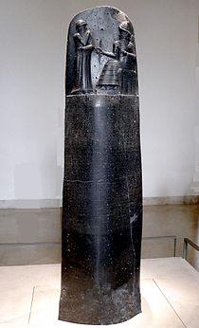
Language was historically a container for laws
"If a man destroy the eye of another man, they shall destroy his eye. If one break a man's bone, they shall break his bone. If one destroy the eye of a freeman or break the bone of a freeman he shall pay one gold mina. If one destroy the eye of a man's slave or break a bone of a man's slave he shall pay one-half his price."
Justified a truth-conditional view of language
Hammurabi’s Code, 3772 BP

Slide 4
What is the link between language and meaning?
What does the sentence ‘Mary had a little lamb’ convey to you?
Empiricist approach → It references a poem I heard a long time ago
Truth-conditional approach → It describes a person’s possession of a lamb, which happens to be small
Speech acts approach → It is an example the professor is using to demonstrate different philosophical views about language
Pragmatist approach → It is a phrase everyone is expected to know

Slide 5
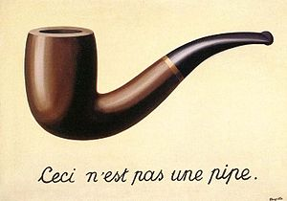
Sense and reference

Slide 6

Semiotics
Communication without words

Slide 7
The meaning of words
The meaning of the figure is undecidable, and yet we must attempt to dis-figure it, read the logic of the metaphor. We know that the figure can and will be literalized in yet other ways. All around us is the clamour for the rational destruction of the figure, the demand for not clarity but immediate comprehensibility by the ideological average. This destroys the force of literature as a cultural good. Anyone who believes that a literary education should still be sponsored by universities must allow that one must learn to read. And to learn to read is to learn to dis-figure the undecidable figure into a responsible literality, again and again. — Gayatri Chakravorty Spivak, Death of a Discipline

Slide 8
The meaning of words
For sale: baby shoes. Never worn. – Ernest Hemingway(?)

Slide 9
What is the link between language and meaning?
What does the sentence ‘Mary had a little lamb’ convey to you?
Empiricist approach → It references a poem I heard a long time ago
Truth-conditional approach → It describes a person’s possession of a lamb, which happens to be small
Speech acts approach → It is an example the professor is using to demonstrate different philosophical views about language
Pragmatist approach → It is a phrase everyone is expected to know

Slide 10
Language games
The relationship between words and the meaning they convey is governed by the context of language use
Wittgenstein proposed that usage of language is heavily formalized in everyday interactions in the form of language games
People identify referents of words based on environmental properties

Slide 11
Application to HCI
(Winograd & Flores, 1987)
Argued that understanding natural language is not necessary for computers to interact with users
Just need to infer illocutionary purpose from text and respond accordingly
Transactional view of language use simplifies computational task

Slide 12
Implications of ‘language as use’
The word-referent mapping is dependent on the environment
Words used detached from environmental experience are meaningless
This is what the piraha also say
Private languages are impossible
Discussion of internal mental states with no behavioral correlates is impossible
Wittgenstein’s beetle
Even talking to oneself about one’s mental states is impossible
Jaynes’ hypothesis: this was true until language became a dominant factor in peoples’ experience ~ 3000 years ago
https://en.wikipedia.org/wiki/Bicameralism_(psychology)

Slide 13
What is the link between language and meaning?
What does the sentence ‘Mary had a little lamb’ convey to you?
Empiricist approach → It references a poem I heard a long time ago
Truth-conditional approach → It describes a person’s possession of a lamb, which happens to be small
Speech acts approach → It is an example the professor is using to demonstrate different philosophical views about language
Pragmatist approach → It is a phrase everyone is expected to know

Slide 14
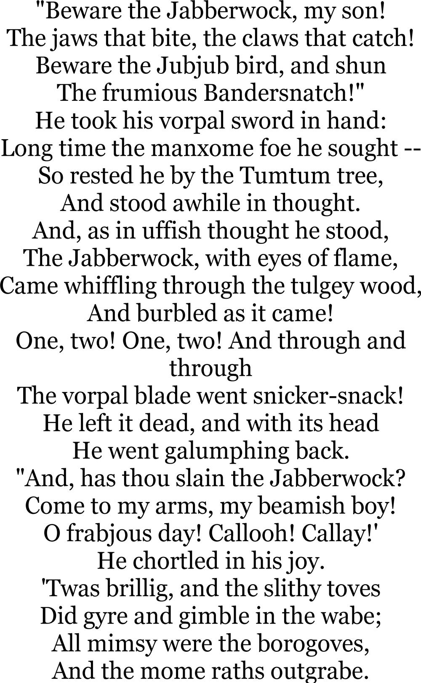
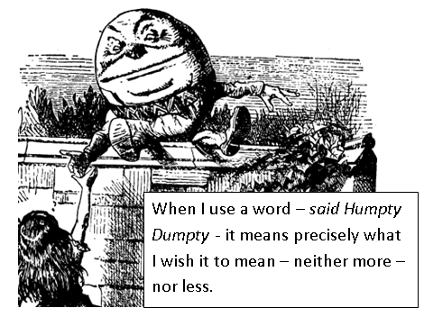
What do words mean?
Communication with made up words

Slide 15

Rational speech acts model
Formalizes these intuitions
Behavior is modeled by assuming listeners use Bayesian inference to recover a speaker’s intended referent r in context C, given that the speaker used the word w
Likelihood model assumes rational speech acts
Speakers choose words that will be informative in context
Model informativeness as surprisal, i.e. uncertainty reduction

Slide 16

Rational speech acts
Surprisal for use of a word is –log (1/|w|), where |w| is the number of objects to which the word w could apply
Assuming W is the set of all words that could apply to the speaker’s intended referent, and assuming a Luce choice rule
Prior p(r) measured empirically

Slide 17
Experimental test
Speaker: What word would a speaker use to describe a particular object?
Salience: A speaker used an unknown word to talk about one of the objects. Which object were they talking about?
Listener: A speaker used the word ‘blue’ to talk about an object. Which object was the speaker talking about?

Slide 18
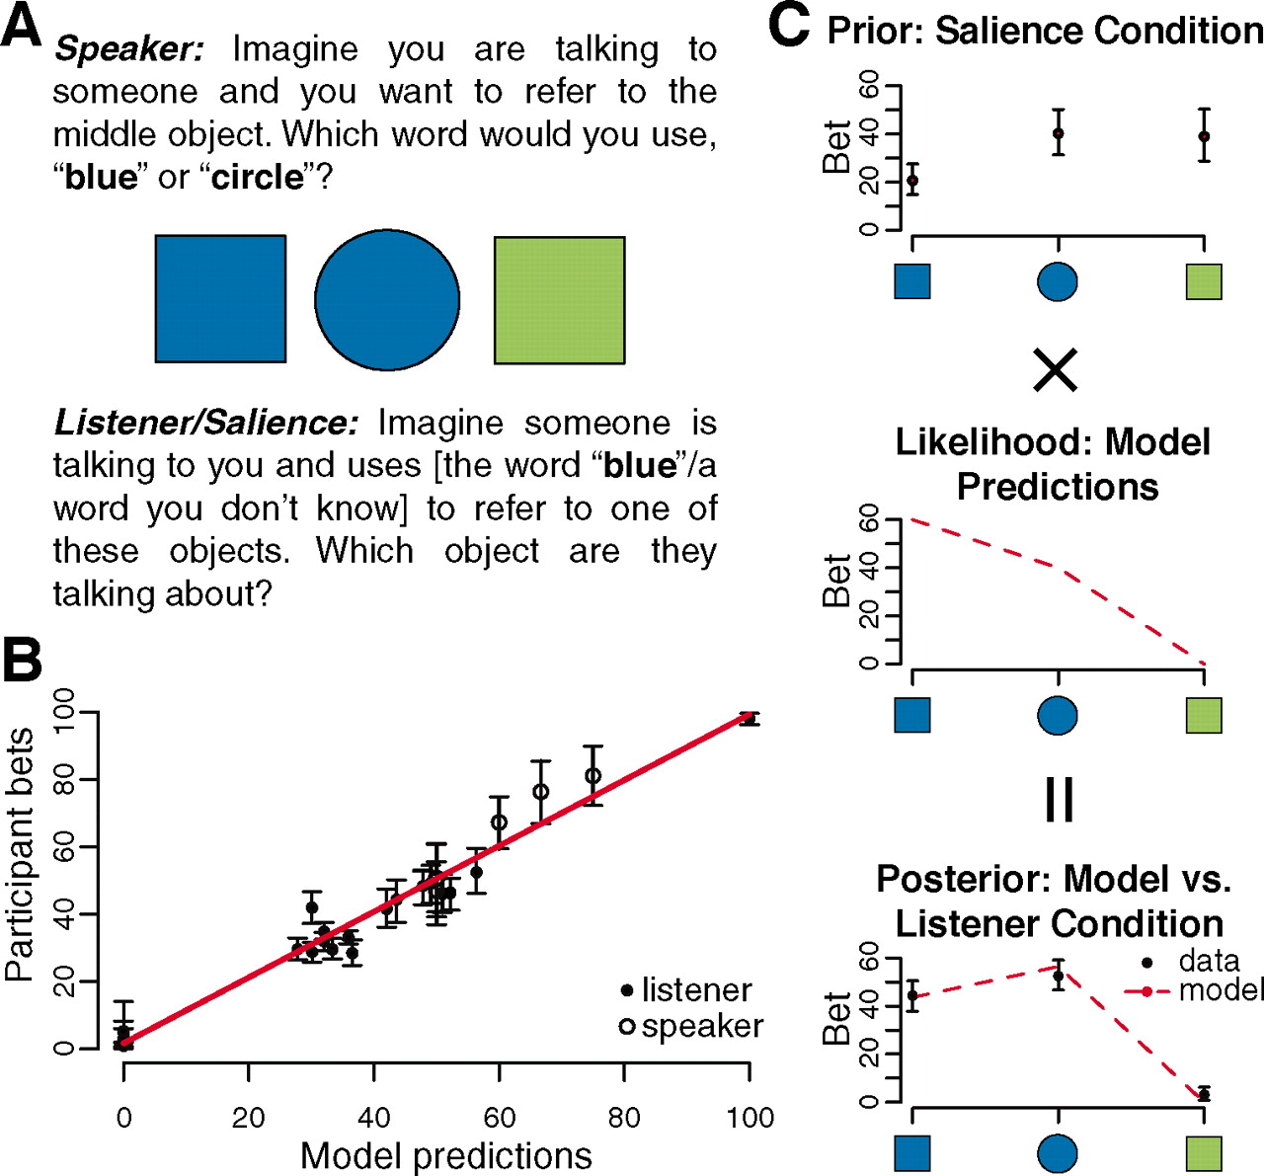

Fig. 1 (A) An example stimulus from our experiment, with instructions for speaker, listener, and salience conditions.
Michael C. Frank, and Noah D. Goodman Science 2012;336:998
Published by AAAS
Notes:
(A) An example stimulus from our experiment, with instructions for speaker, listener, and salience conditions. (B) Human bets on the probability of a choosing a term (speaker condition, N = 206) or referring to an object (listener condition, N = 263), plotted by model predictions. Points represent mean bets for particular terms and objects for each context type. The red line shows the best linear fit to all data. (C) An example calculation in our model for the context type shown in (A). Empirical data from the salience condition constitute the prior term, N = 20 (top); this is multiplied by the model-derived likelihood term (middle). The resulting posterior model predictions (normalization step not shown) are plotted alongside human data from the listener condition, N = 24 (bottom). All error bars show 95% confidence intervals.

Slide 19
Implications
Simple model with large implications
For question-answering systems
For intent inference in HCI
For grounding language use in real world scenarios in general
Still in early stages of experimental research
Lots of low-hanging fruit

