Slide 1


BASICS OF ENTREPRENUERSHIP Unit – I: Introduction
Dr. S. VIJAYA BHASKAR
M.Tech (Mech)., Ph.D (Mech)., Ph.D (Management)
Professor in mechanical engineering
Sreenidhi Institute of Science and Technology
Yamnampet, Ghatkesar, Hyderabad, Telangana-501301

Slide 2
Unit – I: Introduction to Entrepreneurship & Self Discovery
Define Entrepreneurship,
Entrepreneurship as a Career option,
Find your Flow, Stock of Your Means,
Characteristics,
Qualities and Skills of Entrepreneurship,
Effectuation (act of implementing),
Principles of Effectuation,
Life as an Entrepreneur,
Stories of Successful Entrepreneurs.

Slide 3
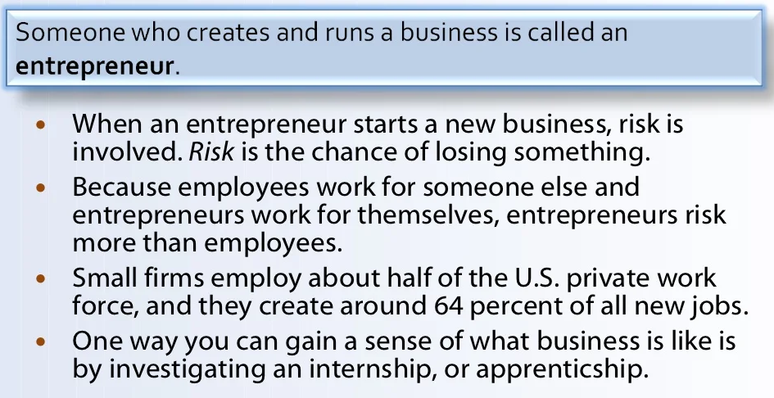
What is Entrepreneurship?

Slide 4
Defining Entrepreneurship
2
Meaning of Entrepreneur
 The word “Entrepreneur” has been taken from the French Language Enterprendre which means “ to undertake" and meant to organize musical or other entertainment programs.
 Oxford Dictionary (1897) also defined entrepreneur as the director or manager of a public musical institution.
 Entrepreneurship is the Process of creating something new and assuming the risks and rewards. Robert D.Hisrich, M.P.Peters & D.A.Shepherd
Entrepreneur
Person
Entrepreneurship
Process
Innovation
Object

Slide 5
Defining Entrepreneurship
4
Entrepreneurship is defined as the professional application of knowledge, skills and competencies of generating a new business idea, by an individual or a set of people by launching an enterprise or business organization to pursue growth while generating wealth, employment and social good.
Entrepreneur
Entrepreneur is defined as an agent who buys factors of production at certain prices in order to combine them into product with a view to selling it at uncertain prices in future.
Entrepreneur is defined as one who combines the land of one, the labor of another and the capital of yet another and thus produces the product.

Slide 6
Defining Entrepreneurship
3
 It was Schumpeter however, who really launched the field of entrepreneurship by associating it clearly with innovation. Peter Drucker defined Entrepreneurship as ‘a systematic innovation, which consists in the purposeful and organized search for changes, and it is the systematic analysis of the opportunities such changes might offer for economic and social innovation.
 Entrepreneur is a person who starts an enterprise. The process of creation is called entrepreneurship.
 The entrepreneur is the actor and entrepreneurship is the act. The outcome of the actor and the act is called the enterprise.
 An enterprise is the business organization that is formed and which provides goods and services, creates jobs, contributes to national income, exports and over all economic development.

Slide 7

Entrepreneur

Slide 8
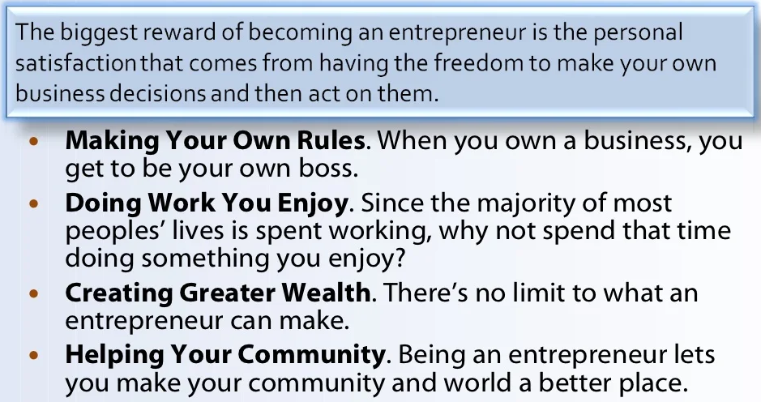
Why be Entrepreneur?

Slide 9
Difference b/w Entrepreneurship and
Entrepreneur
5
Entrepreneurship can be described as a process of setting up an enterprise.
Entrepreneurship is a creative activity.
Entrepreneurship is the attitude of mind to seek opportunities, take calculated risks and derive benefits by setting up a venture.
Entrepreneur is a person who starts an enterprise.
The process of creation is called entrepreneurship.
The entrepreneur is the actor and entrepreneurship is the act.
The outcome of the actor and the act is called the enterprise.

Slide 10
Entrepreneurship as a Career option
6
 Freedom to work and be your own boss and also boss to others.
 Freedom to make money for oneself rather than for someone else.
 Participation in every aspect of running of a business, learning new things and gaining experience.
 Work directly for the customers and gain first-hand experience about their needs.
 Personal satisfaction of owning and running a business venture.
 Build a retirement value and gain respect for family and friends.
 Satisfaction of being the creator of jobs for many people.

Slide 11
Finding your Flow
 Finding your flow is about losing yourself in tasks that you are passionate about. It allows you to experience enjoyment in the progress of doing something challenging, yet rewarding.
 Flow is a blissful state of balance, where you are fully immersed in a task, completely free from distracting thoughts.
 Flow states enable you to enjoy your work and perform at the peak of your potential. Research shows people working in a state of flow are five times more productive than they'd otherwise be.
 Flow states makes you achieve positive thinking, happiness, productivity and chances of an early success. Now combining all these amazing factors guarantees that the entrepreneur will achieve their potential very quickly and very effectively.

Slide 12
Finding your Flow
Benefits of Finding your Flow
 Focuses one’s attention on what’s important
 Peak Performance & Thriving in the New Economy
 Accelerated Learning and Skill Development
 Maximised Productivity and Output in a given time frame
 Increased Creativity
 Happiness & Fulfillment

Slide 13
Finding your Flow
Steps to Find your Flow
 Step 1: Choose an important task belonging to the work you love.
Make sure it’s challenging, but not too hard.
 Step 2: Set clear goals, and develop the skills required to meet the demands of the task.
 Step 3: Find your quiet, peak time.
 Step 4: Clear away distractions and learn to focus on that task for as long as possible.
 Step 5: Immerse yourself in the present moment, enjoy yourself.
 Step 6: Keep practicing.
 Step 7 : Reap the rewards.

Slide 14
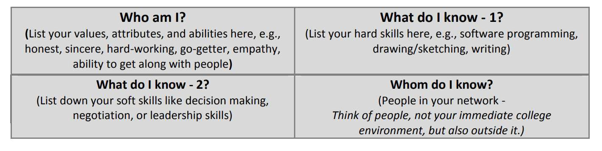
Taking Stock of Your Means
 Taking Stock of Your Means refers to the act of carefully thinking about or examining the “means” you resort to and/or require, in order to start off well to become a successful entrepreneur, and the “means” mentioned here include finance, skills, people, etc.
 Taking stock of your means is crucial towards the application of the first principle of effectuation, “Bird-In-Hand”. (discussed later in this Unit ) which states that an entrepreneur starts with what he has in hand, i.e. after duly taking stock of his means.

 Source : An Activity on WF Learnwise

Slide 15
Characteristics of Entrepreneurs
According to John Hornaday, the characteristics of entrepreneurs are:
11
Self Confidence, Energy, Diligence
 Ability to take calculated risk
 Creativity , Flexibility
 Positive response to challenges
 Dynamism, leadership
 Ability to get along with people
 Responsiveness to suggestions
 Responsiveness to Criticism
 Knowledge of market ,product and technology
 Perseverance, determination
 Resourcefulness, Need to achieve
 Initiative, Independence
 Foresight, Profit orientation
 Perceptiveness, Optimism, Versatility

Slide 16
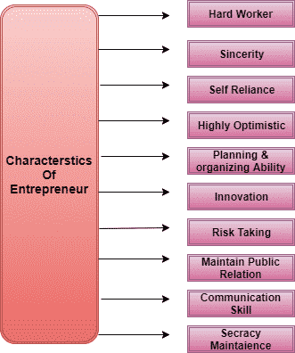
Characteristics of Entrepreneurs

Slide 17
Functions of Entrepreneurs
12
The main functions of entrepreneurs are
Planning
Risk and Uncertainty bearing
Organization building
Managing
Decision making
Innovation vii.Leading
viii.Managing growth

Slide 18

Qualities of Entrepreneurship
13
Qualities of Entrepreneurship
Ability to Innovate
Business oriented tendency
Organizing function
Managerial and leadership function
Knowledge based function
Based on principles, not on intuition essential in every activity.

Slide 19
Skills of Entrepreneurship
14
 Communication skills (possessing the ability to read, write and speaking in an understandable, accurate and professional manner)
 Human relations skills (the ability to build and maintain positive relationships, working well with others)
 Math skills (knowledge of basic arithmetic and business math skills such as calculating profit)
 Problem-solving and Decision-making skills (the ability to assess situation and make good decisions)
 Technical skills (knowledge of computers and how to use them productively)
 Business skills (knowledge and understanding of the economy and business functions such as marketing and management)

Slide 20
Meaning of Effectuation
“Saras
Sarasvathy’s theory of Effectuation
(2001)
describes an approach to making decisions and performing actions in entrepreneurship processes, where you identify the next, best step by assessing the resources available in order to achieve your goals, while continuously balancing these goals with your resources and actions.”

Slide 21
Features of Effectuation
Face Challenges with Common Sense
Focus on what is Doable
Framework to make Decisions
Mindset and Practical Approach
It is not a Formula
It not means that Entrepreneurs don’t Plan

Slide 22
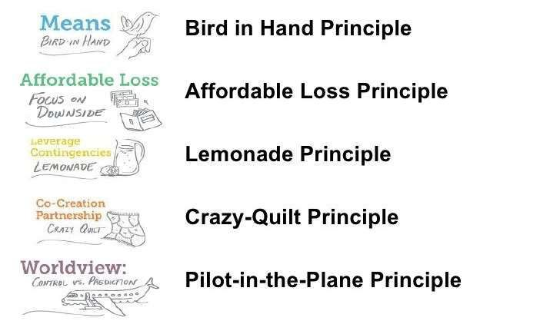
Principles of Effectuation:

Slide 23
Principles of Effectuation:
The Bird in Hand Principle: Entrepreneurs start with what they have.
The Affordable Loss Principle: How they can minimize those losses.
The Crazy Quilt Principle: Entrepreneurs cooperate with parties they can trust.
The Lemonade Principle: Entrepreneurs will look at how to leverage contingencies/possibilities.
The Pilot-in-the-plane: Entrepreneurs can control some of the factors which determine the future.

Slide 24
Life as an Entrepreneur
 For an individual, the role and type of career he or she chooses is of great importance because, it lays down his or her pattern of living, determines social status and controls one’s present and future life.
Any individual has three options.
19
To work for someone else
To be self – employed in a profession
To be an entrepreneur.
Of the three Entrepreneurship has gained lot of popularity.
It provides numerous opportunities for self expression and realization of one’s passion for doing something new and different.
There are numerous opportunities for growth and self development
Monetary rewards are greater
Entrepreneurs enjoys the power of decision making
Reward of working on one’s own leads to immense satisfaction.

Slide 25
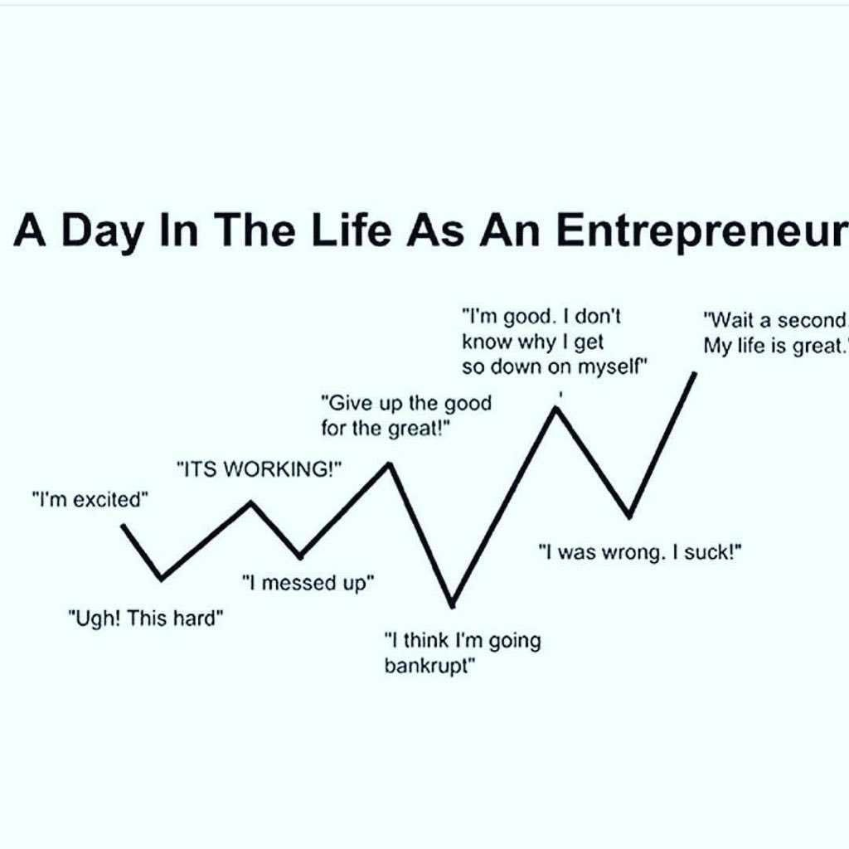
20

Slide 26
Successful Entrepreneurs
21
 AJAY PIRAMAL - PIRAMAL ENTERPRISES LIMITED
 AMAR BOSE - BOSE CORPORATION
 S. ANANTHARAMAKRISHNAN – AMALGAMATION GROUP
 ANIL AGARWAL – VEDANTA GROUP
 AZIM PREMJI – WIPRO
 BHAI MOHAN SINGH - RANBAXY LABORATORIES LTD
 BRIJMOHAN LAL MUNJAL - THE HERO GROUP
 CHETAN MAINI - REVA ELECTRIC CAR
 DEEPAK PAREKH – HDFC
 DHIRUBHAI AMBANI – RELIANCE GROUP
 EKTA KAPOOR - BALAJI TELEFILMS
 GALLA RAMACHANDRA NAIDU – AMARARAJA BATTERIES
 GAUTAM ADANI - ADANI GROUP
 RAMOJI RAO – RAMOJI CITY

Slide 27
 GHANSHYAM DAS BIRLA – BIRLA GROUP
 GOENKA. R.P. – RPG GROUP
 JEYSINGH THOMAS - AVT GROUP
 JINDAL, O.P. - JINDAL GROUP
 JOHN YESUDHAS, V.F. – WAVETEL
 KALLAM ANJI REDDY - DR REDDY'S LABS
 KARSANBHAI PATEL – NIRMA
 KIRAN MAZUMDAR-SHAW - BIOCON LTD
 KISHORE BIYANI – PANTALOON
 KOCHOUSEPH CHITTILAPPILLY -V GUARD
 MOHAN SINGH OBEROI - OBEROI GROUP
 NARAYANA MURTHY, N. R. – INFOSYS
 NARESH GOYAL - JET AIRWAYS
 DR. PRATAP C REDDY - APOLLO HOSPITAL GROUP
 RAMNATH GOENKA - INDIAN EXPRESS GROUP
22

Slide 28


Entrepreneurial Process
23
Six Stage Entrepreneurial Process
Identifying an Opportunity
Identifies opportunities where others do not
Establishing a Vision
Has a clear understanding of the concept
Persuade other’s
Communicates the Concept clearly
Gather Resources
Money, People and Things
Create new Venture / Product / Market
Organizes resources to create new venture
Change / Adapt with Time
Meets the changing demands of the market

Slide 29
Benefits and Myths of Entrepreneurship
24
Benefits of Entrepreneurship
 Opportunity to create your own destiny: Owning a business provides an entrepreneurs the independence and the opportunity to achieve what is important to them.
 Opportunity to make a Difference : More and more entrepreneurs are starting businesses because they see this as an opportunity to make a difference in a route or way that is personally important to them.
 Opportunity to reap extraordinary profits: The profit earned by an entrepreneur are an important motivation and indication factor for further increased performance. Thus these could spur them to greater achievement and success.

Slide 30
25
 Societal Responsibility and Recognition:
Small business owners are among the most admired, respected and trusted individuals of society.
 Opportunity to engage in work of their choice : Small business owners tend to engage in business that gives them personal satisfaction.
 Entrepreneurs see their business as a vehicle of self expression of personal desire and eventual self actualization of their personal goals – the pinnacle of their career success.

Slide 31
Myths of Entrepreneurship
26
 Myth 1: Entrepreneurs Are Doers, Not Thinkers
 Myth 2: Entrepreneurs Are Born, Not Made
 Myth 3: Entrepreneurs Are Always Inventors
 Myth 4: Entrepreneurs Are Academic and Social Misfits
 Myth 5: Entrepreneurs Must Fit the “Profile”
 Myth 6: All Entrepreneurs Need Is Money
 Myth 7: All Entrepreneurs Need Is Luck
 Myth 8: Ignorance Is Bliss For Entrepreneurs
 Myth 9: Entrepreneurs Seek Success But Experience High Failure Rates
 Myth 10: Entrepreneurs Are Extreme Risk Takers (Gamblers)

Slide 32
Types Of Entrepreneurs
27
 Pure Entrepreneur : He is motivated by psychological and economic rewards. He starts activities for his personal satisfaction is work, ago or status.
 Induced Entrepreneur : Such entrepreneur is induced to take up an entrepreneurial task due to the policy measures of the government.
 Motivated Entrepreneur : Such an entrepreneur is motivated by the desire for self-fulfilment. He is also motivated by the desire for innovations and profit.
 Growth Entrepreneur : These entrepreneurs choose an industry which has high growth prospects.
 Women Entrepreneurs: An enterprise owned and controlled by a women having a minimum financial interest of 51% of the capital and giving at least 51% of employment generated in the enterprise to women.

Slide 33
shown enormous growth performance in has venture.
 Super-Growth Entrepreneur : He is an individual who has
28
 First-Growth Entrepreneur : He is one who starts an industrial unit by means of an innovative skill.
 Modern Entrepreneur : He is one who undertakes those ventures which go well along with the changing demand in the market. He cares for the current marketing needs.
 Copreneurs : It is related to the married couples working together in a business. When a married couple shares ownership, commitment and responsibility for a business, they are called ‘copreneurs’.
 Young Entrepreneurs and Part-Time Entrepreneurs : Starting a part-time business is a popular gateway to entrepreneurship. Part-time entrepreneurs can easily enter into business without sacrificing their service benefits.

Slide 34
Entrepreneurship on the Basis of Stages of Economic Development
29
Clarence Danhof classifies entrepreneur into four types
Innovative: An Innovating entrepreneur is one who introduces new products, new methods of production and new technology. Example: Hennery Ford wanted to replace the petrol fuel or the diesel engine with the Kerosene fuel system.
Imitative or Adoptive: Imitative entrepreneur is characterized by readiness to adopt successful innovation initiated by innovating entrepreneurs. China is a growing economy that provides large opportunity to its citizens. Among them the cellular market is growing through adaptation and modification of the innovative product by the Innovative Companies.

Slide 35
3. Fabian: Fabian entrepreneurs are lazy and shy. They lack the will to adopt new methods of production. Fabian are more applicable in the Indian rural agriculture environment.
30
4. Drone: Drone entrepreneur is one who follows the traditional methods of production. There is a “Beeree” (Old fashion tobacco making process) producer Co-operative that uses employee to make the tobacco by hand. Even though it is a dying industry but it does not stop them.

Slide 36

Pitfalls of Being an Entrepreneur
31
 Constraints of lenders, laborers, customers, suppliers, and debtors curtail freedom of thought and work.
 Frustration due to availability of limited capital and other resources.
 Work-life balance under stress due to busy life and long hours of work.
 Frustration due to non-achievement of full objectives.
 Risk of failure and bankruptcy.

Slide 37
Impact of Entrepreneurship on Economy and Society
32
Impact of Entrepreneurship on Economy:
Improvement in living standards
Employment generation
Managing resources
Balanced regional development and economy growth
Import export promotion and capital formation
Technological advancement
Market place change
Contribution to large business
Provides international opportunities
Social and ethical awakening.

Slide 38
Impact of Entrepreneurship on Society:
1. Entrepreneurship creates employment: The existence of business activities influences employment. Business establishments need people to work for them.
Entrepreneurship improves the quality of life: People need to work in order to survive, attend to their needs, and satisfy their wants.
Entrepreneurship contributes to a more equitable distribution of income: With more entrepreneurial activities provided to the people in the country sides, natives have more work opportunities thus, discouraging them from resettling in other places.
Entrepreneurship utilizes resources: We may use our own natural resources, and process and convert them to more useful things.
Entrepreneurship brings social benefits through the government: The resources collected by the government are given back to the people in the form of services, infrastructure projects, school buildings, and maintenance of peace and order.
33

Slide 39

OPPORTUNITIES FOR ENTREPRENEURS IN INDIA & ABROAD
34
 | Tourism
 | Automobile
 | Textiles
 | Social ventures
 | Software
 | Engineering goods
 | Franchising
 | Education and Training
 | Gems and Jeweler
Food Processing
Corporate demands
Ayurveda and traditional medicine
Organic farming
Media
Floriculture
Healthcare sector
Biotechnology
Recycling business

