Slide 1

Depression Prediction
A Project on Mental Health Awareness with Machine Learning By Nayana D

Slide 2
Introduction
Depression is a serious mental health issue affecting millions worldwide.
Early prediction can help in better diagnosis and treatment.
This project uses machine learning to predict depression based on dataset features.

Slide 3
Dataset Overview
The dataset contains various features related to lifestyle, mental health history, and habits.
The target variable indicates whether a person is experiencing depression.
There are 27905 rows and 18 columns

Slide 4
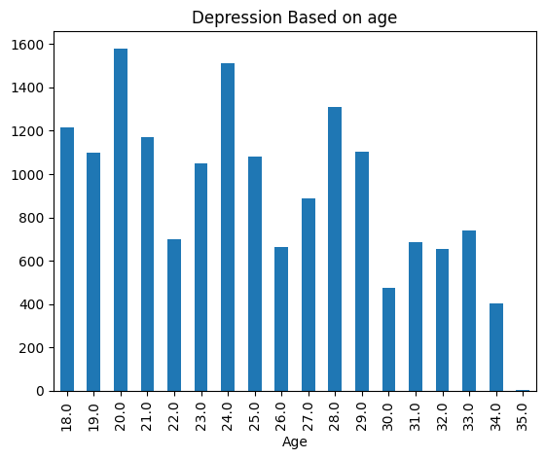
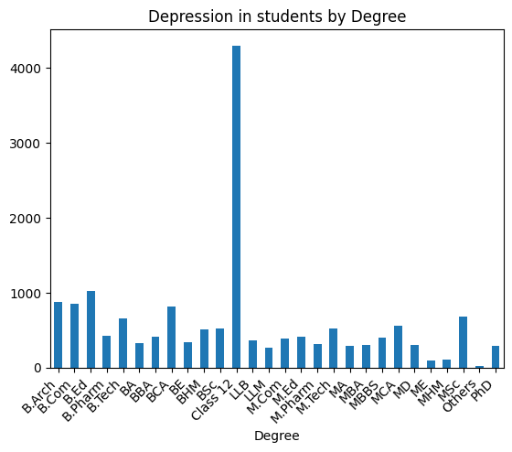
Here is some visualisation

Slide 5
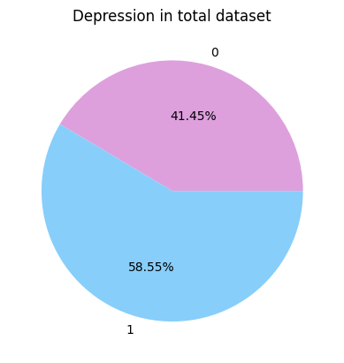
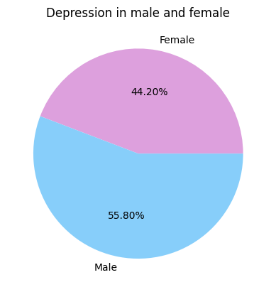
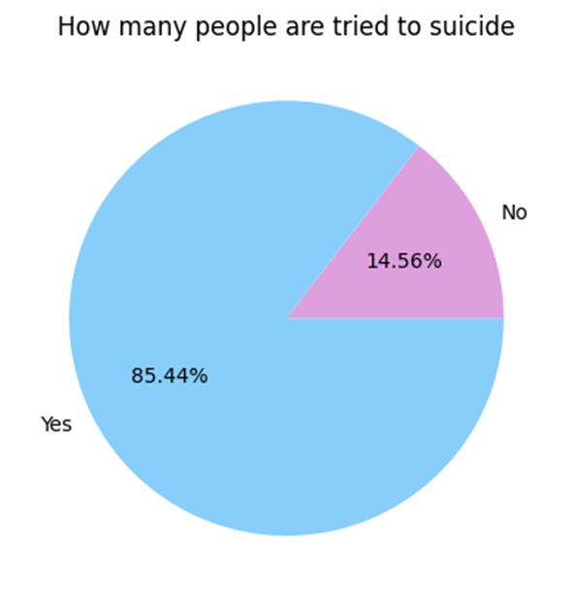
Base on this visualization 58.55% of people facing depression
Men facing depression more than women
Visualization shows that 85.44% of people are tried to suicide by the side-effect of depression.

Slide 6
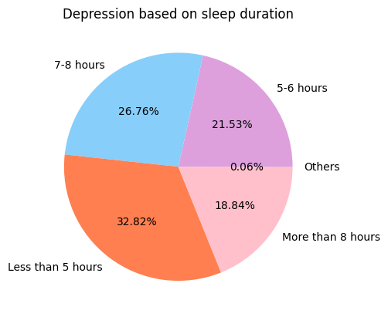
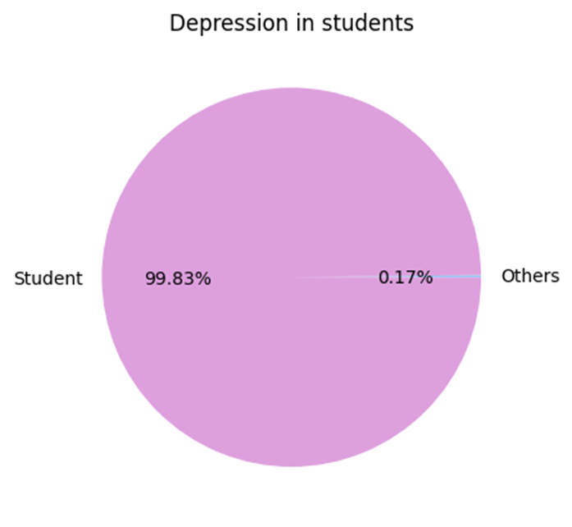
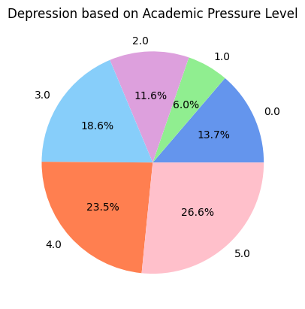
This data set focused mainly on students
12th class students are horribly facing depression.

Slide 7
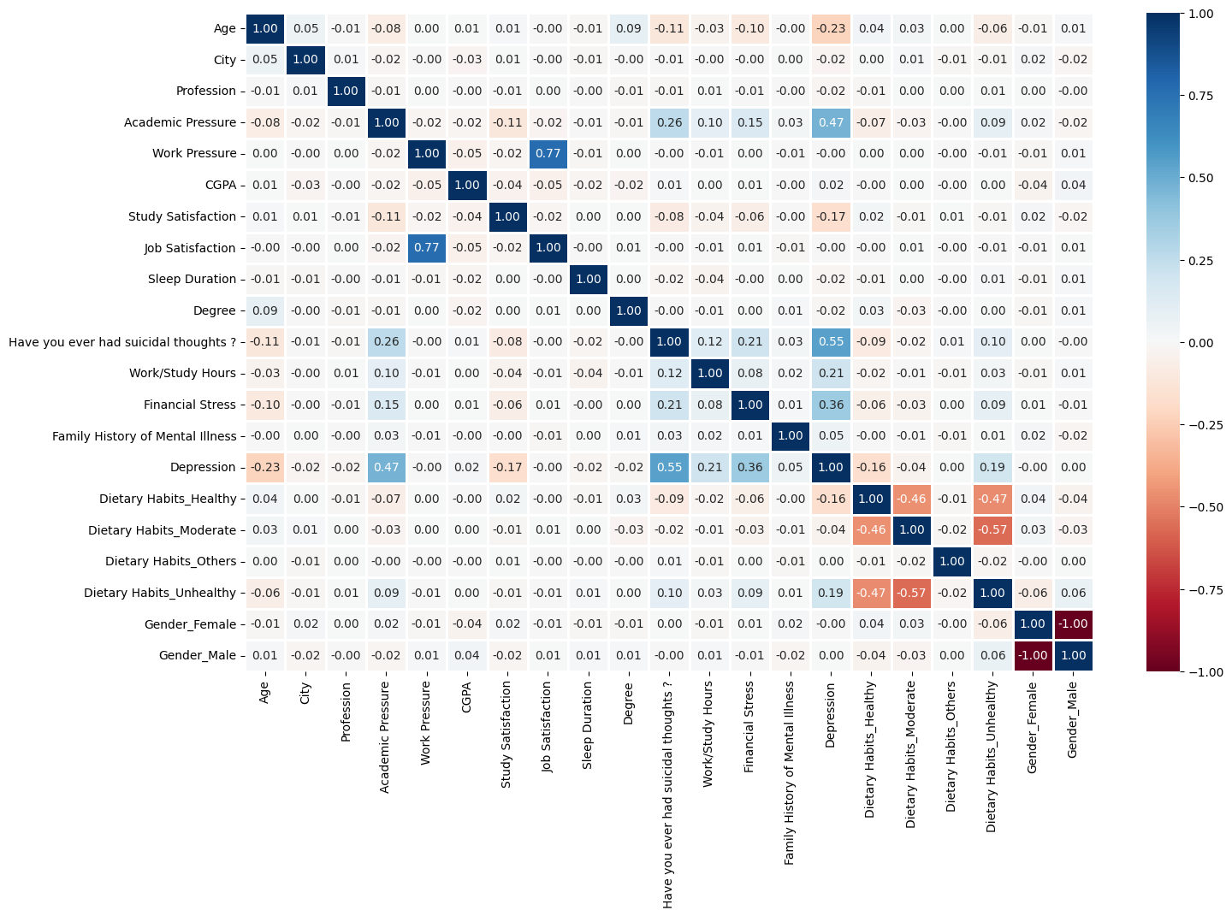

Slide 8
Data Pre-processing
Handling missing values and outliers.
Encoding categorical variables (Label Encoding & One-Hot Encoding).
Feature scaling and selection to improve model performance.
Applying SMOTE
Checking correlation

Slide 9
Machine Learning Models Used
K-Nearest Neighbours
Naïve Bayes
Decision Tree
Random Forest
Logistic Regression
Adaboost
Support Vector Machine (SVM)
Chooses Logistic Regression as the best model, Based on the above model training and testing(accuracy, precision, good fit).

Slide 10
Key Findings & Insights
Academic pressure and financial have a strong correlation with depression.
The model achieved high accuracy in predicting depression.
Early intervention based on predictions can help prevent severe mental health issues.

Slide 11
Real-world Applications & Awareness
Early detection tools for therapists and psychologists.
Integration with wearable health devices for real-time monitoring.

Slide 12
Conclusion
Project can help predict depression early for better support.
The project highlights the need to spread mental health awareness.
Encourages people to seek help when needed.

