Slide 1
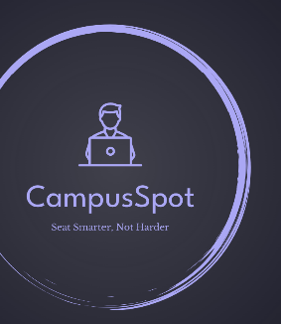

CampusSpot Seat Smarter, Not Harder
Team 9
Anagha Vasista
Nayana Magadi Nagaraj
Bhakti Paithankar
Utkarsh Gupta

Slide 2


Vision
Students at Northeastern University struggle to find suitable study spaces.
Peak times make finding quiet areas with necessary resources difficult.
The result: time wasted, increased stress, and reduced productivity.

Slide 3
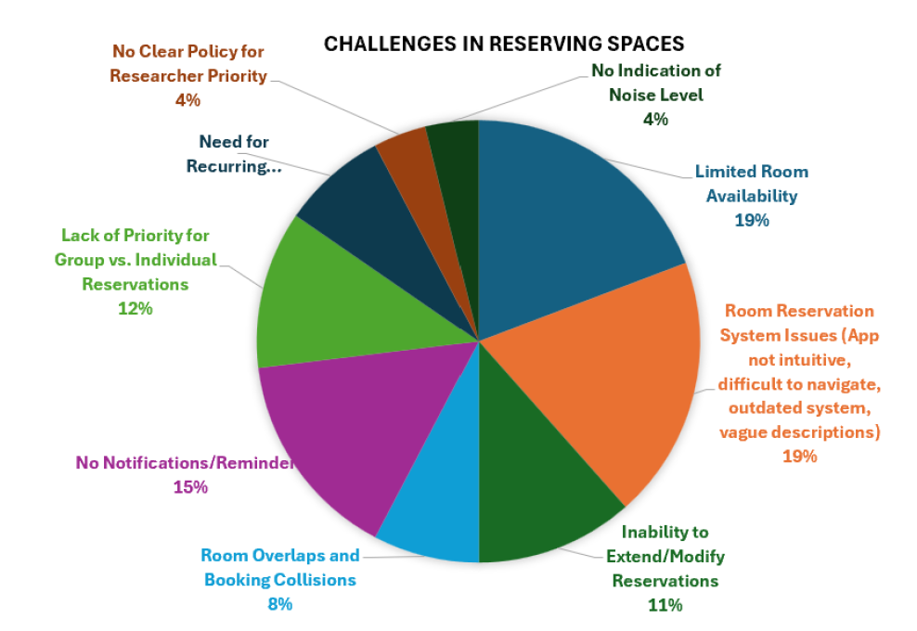
Unmet Needs
Primary Needs:
Time lost searching for seats, lack of noise control, and limited access to equipment.
Cannot contact staff or admin in case of emergency or slight alteration in plans.
CampusSpot alleviates these frustrations, helping students focus on their studies.

Slide 4

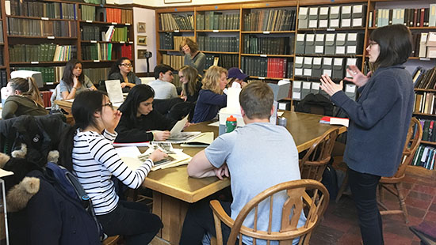

Customer Segments
Students- Seeking quiet, equipped spaces to maximize productivity
Faculty and Researchers- Spots for collaboration and meetings and presentations
Staff and Administrators-Focused on optimizing spaces to reduce student complaints and improve experience
Key Insights- Interviews reveal recurring challenges: limited seating, noise, and lack of resources

Slide 5
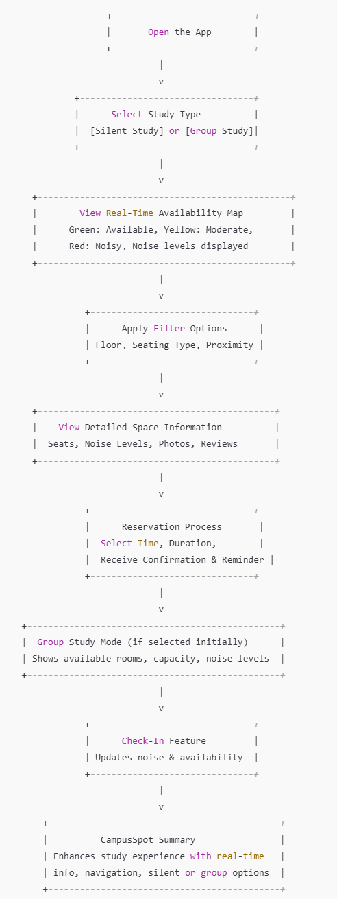
Use Cases
Scenario A: Individual Study – Students need quiet study spaces without constant searching.
Scenario B: Group Study – Reserving collaborative spaces for team meetings is complex and inefficient.
Scenario C: Advanced Booking – Demand for advance booking options and cleanliness information during peak times.

Slide 6
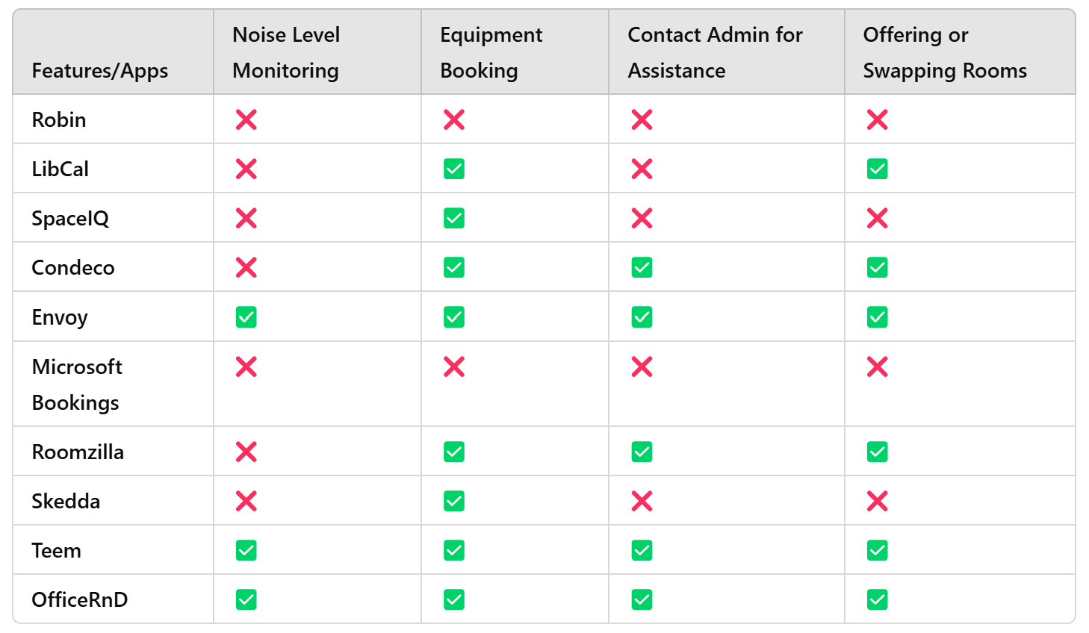
Competitive Analysis
Existing Solutions:
Apps like Robin, LibCal, and SpaceIQ offer basic booking features but lack key functions for university needs.
Most focus on corporate environments, not the unique demands of student study spaces.
Gaps:
Limited noise monitoring feature.
Few options for equipment tracking and in-session adjustments.
Cumbersome cancellation and modification processes.

Slide 7

Market Size
Projected to grow from $100.65 M in 2023 to $200 M by 2030, with education as the leading industry
North America is expected to dominate this market
Expected CAGR is 9.6% from 2024 to 2030

Slide 8
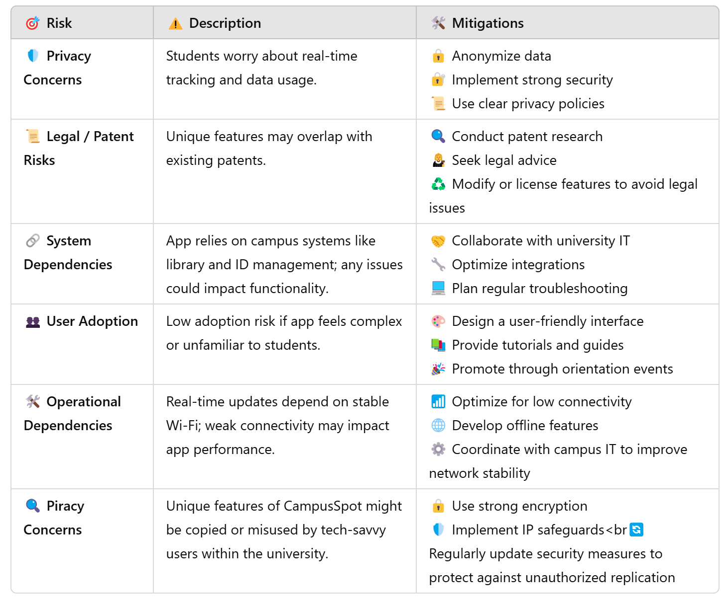
Risk/Dependencies and Mitigations

