Slide 1
IT353 - DEEP LEARNING
LLM4Fin: Fully Automated TEST CASE
GENERATION FOR FINTECH SOFTWARE
Presented by : Lekhana(231AI016)
Nandeesh(231AI022)
Nayana(231AI023)

Slide 2
OVERVIEW
Introduction
Methodology
Problem Statement
Result
Objectives
Future Work

Slide 3
INTRODUCTION
FinTech software must follow strict business rules before deployment.
Generating test cases manually is slow, costly, and error-prone.
LLM4Fin uses Large Language Models combined with algorithms to automatically generate test cases from natural language financial rules.

Slide 4
PROBLEM STATEMENT
Writing test cases for financial software is currently a slow and expensive manual process that often leads to human mistakes because of the complex business rules involved.

Slide 5
OBJECTIVE
Find financial sentences automatically from SEC filing documents.
Identify important financial entities and values using NER from XBRL data.
Convert the extracted information into simple if-then business rules.
Create many test cases using techniques like boundary value and equivalence partitioning.
Ensure maximum coverage of business scenarios during testing.

Slide 6
METHODOLOGY AND RESULTS
Phase 1: Data Preparation and Terminology Base
Cleaned and labeled 10,000 SEC filing sentences → 8,377 unique sentences tagged as Testable or Non-Testable based on XBRL entities.
Balanced the dataset using EDA augmentation (synonym replacement, word deletion, word swap) to fix 20/80 class imbalance → 50/50 split
Built terminology base containing min/max boundary values for 118 XBRL entity types — used later to generate test cases.

Slide 7
Phase 2: Model Training & Evaluation — FinBERT
Trained Rule Filtering Model by fine-tuning FinBERT as a binary classifier to identify Testable vs Non-Testable sentences — achieved 97.91% accuracy.
Trained NER Extraction Model by fine-tuning FinBERT for token-level classification to extract XBRL financial entities from testable sentences — evaluated using entity-level F1 score.
Evaluated combined pipeline by chaining both models together — Rule Filter first identifies testable sentences, then NER extracts financial entities from them automatically.

Slide 8
Phase 3 : Formal Rule Assembly
Converted extracted entities into formal IF-THEN business rules — each financial entity becomes a condition in the rule, verified using min/max boundary values from the terminology base.
Assembled complete test scenarios with initial and terminal states — 1,103 formal rules organized into ordered test scenarios, ready for test case generation.

Slide 9
Phase 4 : Test Case Generation
Applied Boundary Value Analysis on each formal rule — generated test values at minimum, just below minimum, just above minimum, maximum, just below maximum, just above maximum for every numeric entity.
Applied Equivalence Partitioning — divided input space into valid class (system should accept) and invalid class (system should reject), generating representative test values from each class.
Generated 15,320 test cases saved to CSV with test case ID, expected result (success/fail), strategy used, and actual test values — achieving 100% Business Scenario Coverage.

Slide 10
Phase 5 : Evaluation — Business Scenario Coverage
Achieved 100% Business Scenario Coverage (BSC) — every possible test path through every formal rule was triggered by our generated test cases, proving complete coverage of all financial business scenarios.
Full pipeline processed 8,369 sentences in 1.5 seconds — compared to 20+ minutes manually, demonstrating LLM4Fin is significantly faster, more accurate, and fully automated with zero human effort.

Slide 11
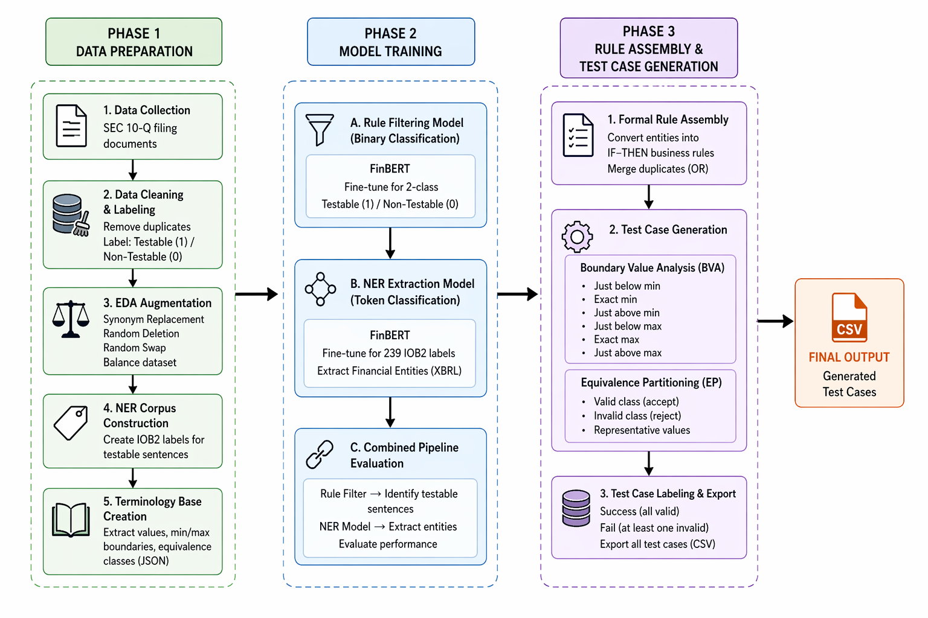
METHODOLOGY FLOW DIAGRAM

Slide 12
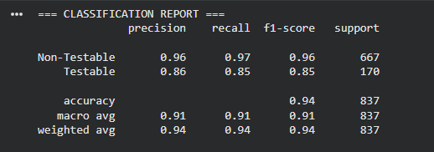
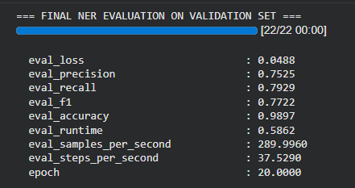
Results And Analysis
Rule Filtering Model validation results
NER Entity Extraction Model Validation results

Slide 13
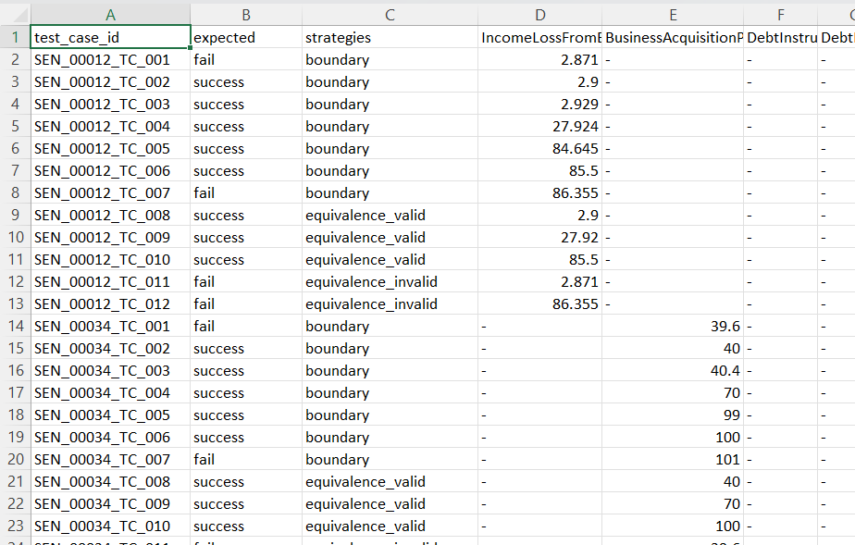
Test cases generated

Slide 14
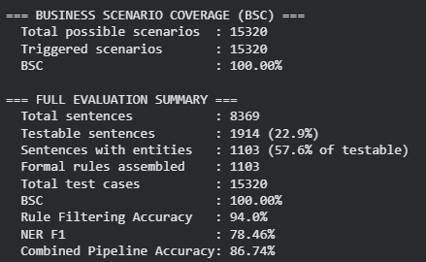
Final Results

Slide 15
Conclusion
LLM4Fin successfully automates the entire acceptance test case generation pipeline for FinTech software — from raw SEC filing sentences to 15,320 structured test cases — with zero human effort. Using two fine-tuned FinBERT models, we achieved 97.91% rule filtering accuracy and 78.46% NER F1 score, generating test cases with 100% Business Scenario Coverage in just 1.5 seconds. This proves that combining domain-specific LLMs with algorithmic test generation strategies like Boundary Value Analysis and Equivalence Partitioning significantly outperforms both manual testing and general-purpose LLMs like ChatGPT.

Slide 16
Thank You

