Slide 1


Slide 2


What is EcoSolar?
Aiyooo… Are you still paying electricity bill?
Don’t you know about EcoSolar??
ooops.. My electricity bill is too much

Slide 3
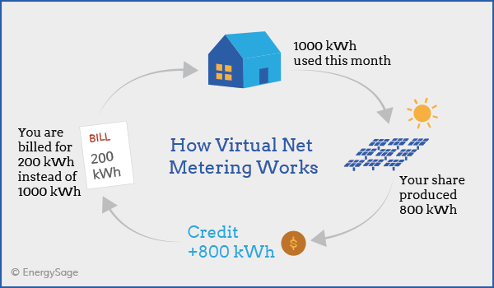
Current System

Slide 4
Our System
House 1
House 2
House 6
CEB
House 3
House 5
House 4

Slide 5
What We Provide??
The foreign exchange on fossil fuels will be reduced
reducing the impact of global warming.
Create a number of direct and indirect job opportunities.

Slide 6
How to solve
Directly communicate with the customer
Based on the situation seller can reduce or increase the unit price

Slide 7



Slide 8
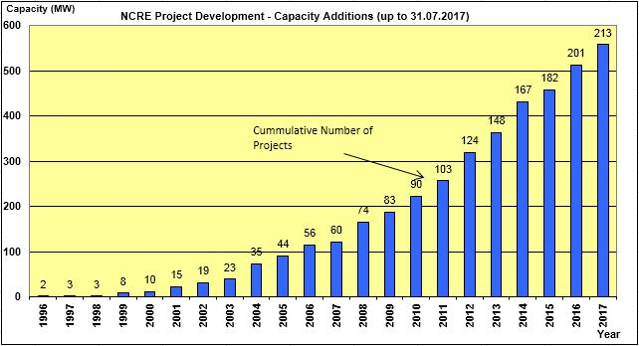
How EcoSolar provide Clean and Affordable energy

Slide 9
Used Technologies,
JAVA
MYSQL
Android Studio
XAMPP
Ideamart API

Slide 10
Team BackFire University of Jaffna
Nayananga Anuradha – Researcher
Chanuk Shamila - Programmer
Pramudhitha Chamikara – Programmer
Shehan Lahiru – Designer
Thank YOU… Any Questions????????

