Slide 1

SANCHAYA
NAYANA U
MES24MCA-2041
Department of Computer Applications
MES College of Engineering, Kuttippuram
20-7-2025

Slide 2
PRODUCT OWNER Mr.NOWSHAD CV Assistant Professor DEPARTMENT OF COMPUTER APPLICATIONS MES COLLEGE OF ENGINEERING, KUTTIPPURAM

Slide 3
TABLE OF CONTENTS
Introduction
Objective
Existing System
Proposed System
Motivation
Functionalities
Module Description
Developing Environment
Sprint Backlog
Product Backlog
User Story
Project Plans
Data Flow Diagrams
ER Diagram

Slide 4
SANCHAYA
Sanchaya is a flutter based mobile app for food donation and redistribution.
Aims to bridge the gap between surplus food sources and people in need.
Enables donors (restaurants, event organizers, households) to post available food.
Registered volunteers and NGOs can view and claim food in real-time.
Supports geolocation tagging, food expiry alerts, and photo uploads.
Promotes a sustainable, zero-waste food culture in Kerala.
Multilingual support: Malayalam and English for wider usability.

Slide 5
OBJECTIVES
Minimize food wastage by collecting surplus food.
Redistribute food to underprivileged communities.
Provide a real-time digital platform for donations.
Ensure food safety with expiry countdown & alerts.
Promote transparency through geolocation & photos.
Support disaster relief and local governance efforts

Slide 6
EXISTING SYSTEM
Food donation is mostly informal and unstructured.
Coordination happens manually (calls, messages).
No real-time tracking of surplus food availability.
Lack of transparency and accountability.
Difficult to ensure food safety and timely delivery.
Limited scalability beyond local communities

Slide 7
PROPOSED SYSTEM
Flutter-based mobile app for cross-platform support.
OTP-secured login for donors and volunteers
Real-time posting and claiming of food donations
Google Maps integration for location tracking.
Expiry countdown and quality tagging for safety.
Push notifications for timely coordination.
Admin panel for monitoring and user verification

Slide 8
MOTIVATIONS
Large-scale food wastage in Kerala.
Many people still suffer from hunger and malnutrition.
Lack of structured food redistribution systems.
Need for transparency and accountability in donations.
Desire to promote sustainability and social responsibility

Slide 9
FUNCTIONALITIES
Secure Login – OTP-based authentication for donors & volunteers
Food Posting – Donors upload details, quantity, expiry & photos
Food Claiming – Volunteers/NGOs can view & claim available food
Geolocation – Google Maps integration for locating donation points
Notifications – Real-time alerts for posting, claiming, and expiry
Admin Control – Verify users, monitor activities, ensure safety

Slide 10
MODULE DESCRIPTION
Donor Module – Register/login, post surplus food with details & photos
Volunteer/NGO Module – View available food and claim donations
Admin Module – Verify users, monitor activities, ensure safe delivery
Notification Module – Send alerts for posting, claiming, and expiry
Database Module – Store and manage user, food, and claim records

Slide 11
DEVELOPING ENVIRONMENT
Operating System – Windows
Frontend – Flutter (Dart)
Backend – Firebase Services
IDE – Android Studio / VS Code

Slide 12
SPRINT BACKLOG
Backlog tem | Status And Completion Date | Original Estimation in Hours | Day 1 hrs | Day 2 hrs | Day 3 hrs | Day 4 hrs | Day 5 hrs | Day 6 hrs | Day 7 hrs | Day 8 hrs | Day 9 hrs | Day 10 hrs
SPRINT1
Table designing | 16/8/2022 | 2 | 1 | 1 | 0 | 0 | 0 | 0 | 0 | 0 | 0 | 0
Form designing | 22/8/2022 | 3 | 1 | 1 | 1 | 0 | 0 | 0 | 0 | 0 | 0 | 0
Coding | 27/8/2022 | 3 | 1 | 1 | 1 | 0 | 0 | 0 | 0 | 0 | 0 | 0
SPRINT 2
Data collection | 13/9/2022 | 7 | 1 | 1 | 1 | 1 | 1 | 1 | 1 | 0 | 0 | 0
Data processing | 29/9/2022 | 7 | 1 | 1 | 1 | 1 | 1 | 1 | 1 | 0 | 0 | 0
The table given above is for reference only. Update/create a table with your data.

Slide 13
SPRINT BACKLOG
Backlog tem | Status And Completion Date | Original Estimation in Hours | Day 1 hrs | Day 2 hrs | Day 3 hrs | Day 4 hrs | Day 5 hrs | Day 6 hrs | Day 7 hrs | Day 8 hrs | Day 9 hrs | Day 10 hrs
SPRINT3
Course contents | 3/10/2022 | 7 | 1 | 1 | 1 | 1 | 1 | 1 | 1 | 0 | 0 | 0
Assassement | 20/10/2022 | 7 | 1 | 1 | 1 | 1 | 1 | 1 | 1 | 0 | 0 | 0
SPRINT 4
Certificate | 8/11/2022 | 7 | 1 | 1 | 1 | 1 | 1 | 1 | 1 | 0 | 0 | 0
Testing | 15/11/2022 | 7 | 1 | 1 | 1 | 1 | 1 | 1 | 1 | 0 | 0 | 0
TOTAL |  | 50 | 9 | 9 | 8 | 6 | 6 | 6 | 6
The table given above is for reference only. Update/create a table with your data.

Slide 14
PRODUCT BACKLOG
ID | NAME | PRIORITY <high/medium/low> | ESTIMATE (Hours) | STATUS <Planned/In progress/Completed>
1 | REGISTRATION | High | 5 | COMPLETED
2 | LOGIN | High | 5 | COMPLETED
3 | CRUD(Course,Student,University) OPERATIONS | High | 20 | COMPLETED
4 | STUDENT ENROLLMENT | High | 10 | COMPLETED
5 | CERTIFICATE GENERATION | MEDIUM | 10 | COMPLETED
The table given above is for reference only. Update/create a table with your data.

Slide 15
USER STORY
User Story ID | As a type of User | I want to <Perform some task> | So that i can <Achieve Some Goal>
1 | ADMIN | Login | login successful with correct username and password
2 | ADMIN | View and Manage | Can view and Manage registered users,Faculties and Universities
3 | ADMIN | Verification | Verify Courses
4 | USER | Register | Can users register
5 | USER | Login | login successful with correct username and password
6 | USER | Enrollment | Can enroll in any Courses
7 | USER | View Profile | View users profile in application
The table given above is for reference only. Update/create a table with your data.

Slide 16
PROJECT PLAN
User StoryID | Task Name | Start Date | End Date | Days | Status
1 | Sprint 1 | 16/08/2022 | 17/08/2022 | 10 | Completed
4 |  | 18/08/2022 | 19/08/2022 |  | Completed
5 |  | 20/08/2022 | 22/08/2022 |  | Completed
10 |  | 23/08/2022 | 24/08/2022 |  | Completed
11 |  | 25/08/2022 | 27/08/2022 |  | Completed
2 | Sprint 2 | 13/09/2022 | 23/09/2022 | 16 | Completed
7 |  | 23/09/2022 | 24/09/2022 |  | Completed
12 |  | 24/09/2022 | 29/09/2022 |  | Completed
The table given above is for reference only. Update/create a table with your data.

Slide 17
PROJECT PLAN
User StoryID | Task Name | Start Date | End Date | Days | Status
3 | SPRINT 3 | 03/10/2022 | 06/10/2022 | 14 | Completed
6 |  | 07/10/2022 | 10/10/2022 |  | Completed
13 |  | 13/10/2022 | 20/10/2022 |  | Completed
14 | SPRINT 4 | 28/10/2022 | 5/11/2022 | 10 | Completed
8 |  | 7/11/2022 | 11/11/2022 |  | Completed
9 |  | 13/11/2022 | 15/11/2022 |  | Completed
The table given above is for reference only. Update/create a table with your data.

Slide 18
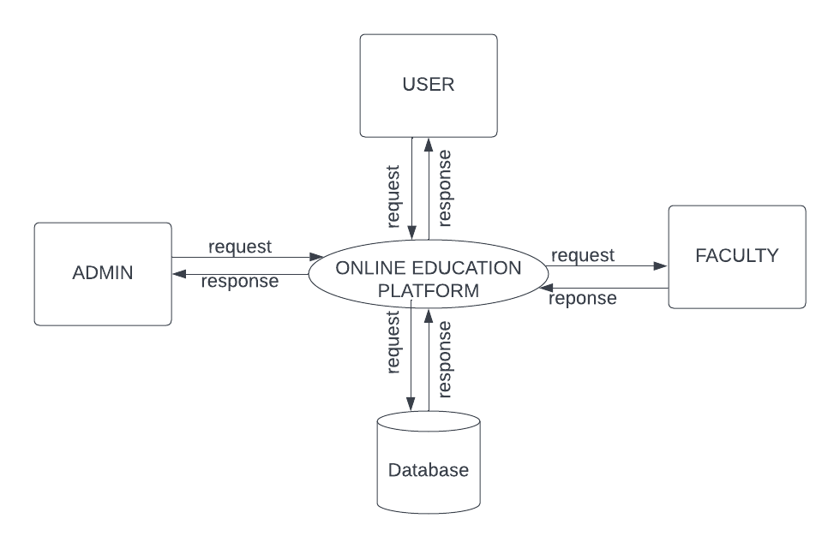
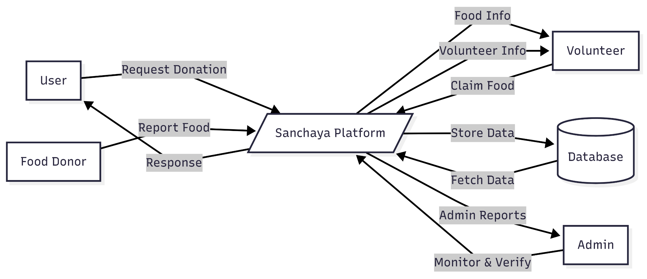
DATA FLOW DIAGRAM
LEVEL 1

Slide 19
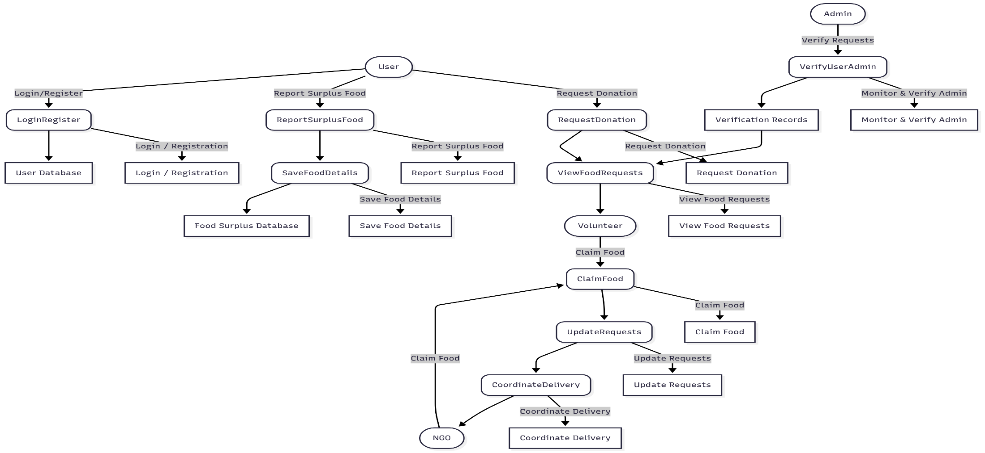
DATA FLOW DIAGRAM
Level 1.1

Slide 20
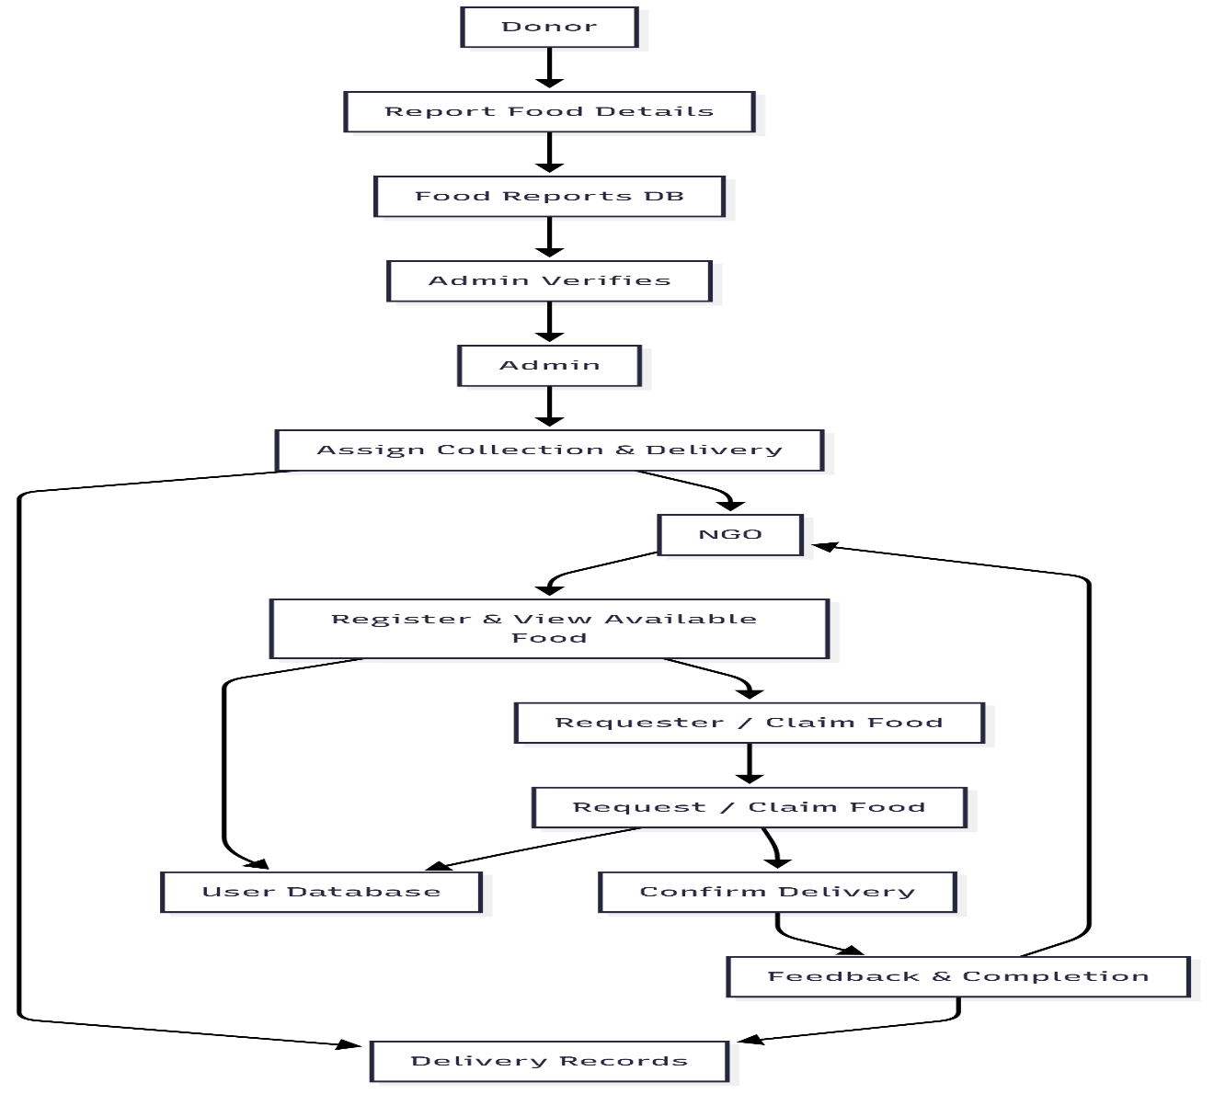
DATA FLOW DIAGRAM
Level 1.2

Slide 21
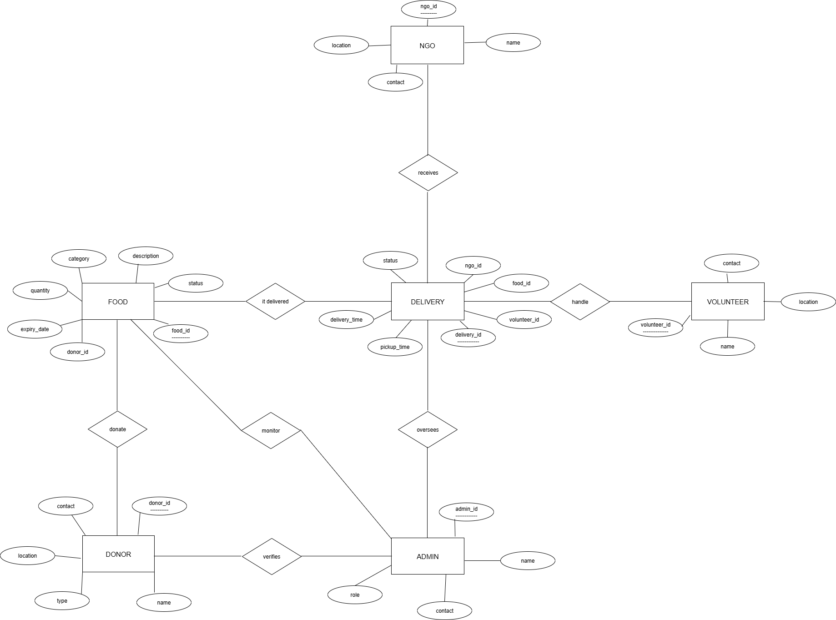
ER DIAGRAM

Slide 22
THANK YOU

