Slide 1
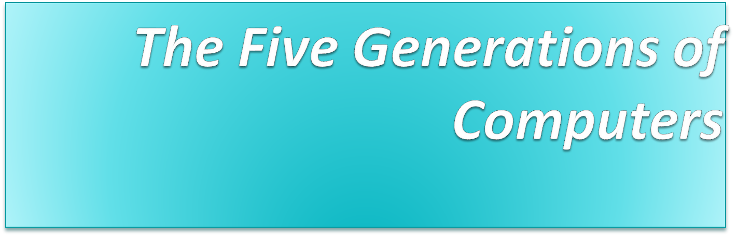
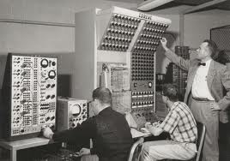
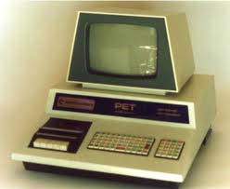
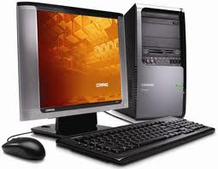
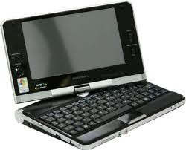
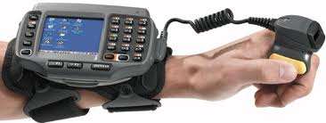

Slide 2
Generations of Computer
The computer has evolved from a large-sized simple calculating machine to a smaller but much more powerful machine.
The evolution of computer to the current state is defined in terms of the generations of computer.
Each generation of computer is designed based on a new technological development, resulting in better, cheaper and smaller computers that are more powerful, faster and efficient than their predecessors.

Slide 3
Generations of Computer
Currently, there are five generations of computer. In the following subsections, we will discuss the generations of computer in terms of the technology used by them (hardware and software), computing characteristics (speed, i.e., number of instructions executed per second), physical appearance, and their applications.

Slide 4
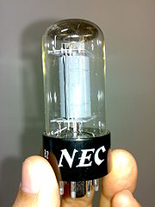
First Generation Computers
(1940-1956)
The first computers used vacuum tubes(a sealed glass tube containing a near-vacuum which allows the free passage of electric current.) for
circuitry and magnetic drums for memory.
They were often enormous and taking up entire room.
First generation computers relied on machine language.
They were very expensive to operate and in addition to using a great deal of electricity, generated a lot of heat, which was often the cause of malfunctions(defect or breakdown).
The UNIVAC and ENIAC computers are examples of first-generation computing devices.

Slide 5
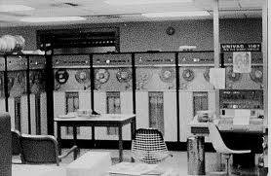
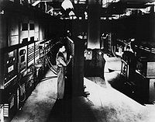
First Generation Computers
Advantages :
It was only electronic device
First device to hold memory
Disadvantages :
Too bulky i.e large in size
Vacuum tubes burn frequently
They were producing heat
Maintenance problems

Slide 6
Second Generation Computers
(1956-1963)
Transistors replaced vacuum tubes in the second generation of computers.
Second-generation computers moved from cryptic binary machine language to symbolic.
High-level programming languages were also being developed at this time, such as early versions of COBOL and FORTRAN.
These were also the first computers that stored their instructions in their memory.

Slide 7
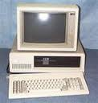
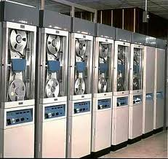
Second Generation Computers
Advantages :
Size reduced considerably
The very fast
Very much reliable
Disadvantages :
They over heated quickly
Maintenance problems

Slide 8
Third Generation Computers
(1964-1971)
The development of the integrated circuit was the hallmark of the third generation of computers.
Transistors were miniaturized and placed on siliconchips, called semiconductors.
Instead of punched cards and printouts, users interacted with third generation computers through keyboards and monitors and interfaced with an operating system.
Allowed the device to run many different applications at one time.

Slide 9
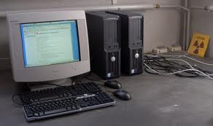
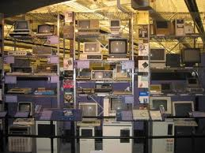
Third generation computers
Advantages :
ICs are very small in size
Improved performance
Production cost cheap
Disadvantages :
ICs are sophisticated

Slide 10
Fourth Generation Computers
(1971-present)
The microprocessor brought the fourth generation of computers, as thousands of integrated circuits were built onto a single silicon chip.
The Intel 4004 chip, developed in 1971, located all the components of the computer. (VLSI- Very Large Scale Integration)
From the central processing unit and memory to input/output controls—on a single chip.
. Fourth generation computers also saw the development of GUIs, the mouse and handheld devices.

Slide 11
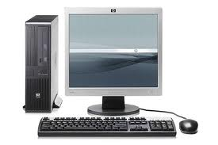
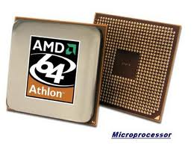
Fourth Generation Computers

Slide 12
Fifth Generation Computers
(present and beyond)
Fifth generation computing devices, based on artificial intelligence and technology is ULSI
Are still in development, though there are some applications, such as voice recognition.
The use of parallel processing and superconductors is helping to make artificial intelligence a reality.
The goal of fifth-generation computing is to develop devices that respond to natural language input and are capable of learning and self-organization.

Slide 13
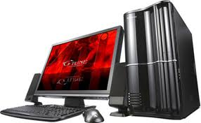
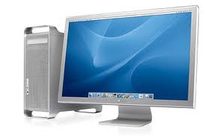
Fifth Generation Computers

Slide 14
Answer the MCQs
1. A term in computer terminology is a change in technology a computer is/was being used.
a) development
b) generation
c) advancement
d) growth
3. The generation based on VLSI microprocessor.
a) 1st
b) 2nd
c) 3rd
d) 4th
Answer: b
Answer: d
2. The fourth generation was based on integrated circuits.
a) True
b) False
4. ______ generation of computer started with using vacuum tubes as the basic components.
a) 1st
b) 2nd
c) 3rd
d) 4th
Answer: b
Answer: a

Slide 15
6. ___________ is an emerging branch in computer science, which interprets means and method of making computers think like human beings.
a) Block chain
b) VR
c) AI
d) Cloud computing
8. In this generation Time sharing, Real time, Networks, Distributed Operating System was used.
a) 1st
b) 2nd
c) 5th
d) 4th
Answer: c
Answer: d
7. ULSI stands for?
a) Ultra Large Scale Integration
b) Under Lower Scale Integration
c) Ultra Lower Scale Integration
d) Under Large Scale Integration
10. The period of ________ generation was 1952-1964.
a) 1st
b) 2nd
c) 5th
d) 4th
Answer: a
Answer: b

Slide 16
Interesting Fullforms(some famous companies)
BSNL - Bharat Sanchar Nigam Limited
HTC - High Tech Computer Corporation
MRF - Madras Rubber Factory
OYO - On Your Own (Originally "OYO Rooms")
AMUL - Anand Milk Union Limited
PVR - Priya Village Roadshow
NDTV - New Delhi Television
PAYTM - Pay Through Mobile
SYSKA – Shri Yogi Sant Kripa Anant
VODAFONE - Voice, Data, Fone (Phone)
LG - Lucky Goldstar (formerly) / Now just "LG"
HCL - Hindustan Computers Limited
WIPRO - Western India Products Limited
TVS - Thirukkurungudi Vengaram Sundram
ITC - Indian Tobacco Company (now just ITC Limited)
HDFC - Housing Development Finance Corporation

Slide 17
THANK YOU

